Slide 1
Information Society
Guibone & Hermoso

Slide 2
Information
A Word is a Combination of Sound that represents something.
Now What does this mean.

Slide 3


A sound can only have meaning when it can be understood or be interpreted by another entity.
We can exchange information and ideas through verbal means only if we can understand the meaning of the word.
Thus, not knowing the meaning or Significance of the word only leads to misunderstanding or outright not being able to converse with someone.

Slide 4
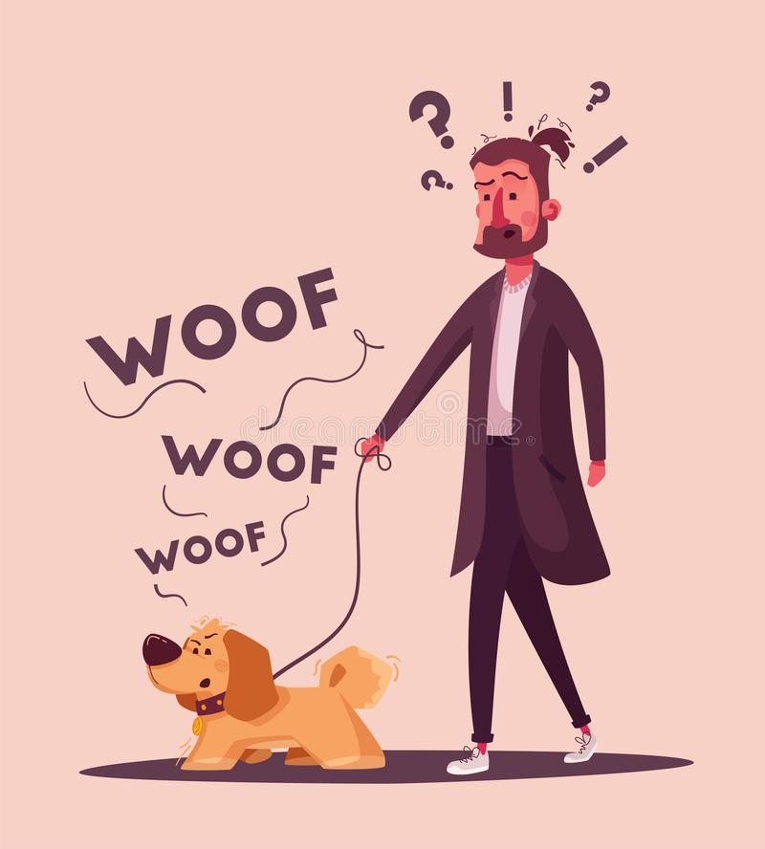
It is this significance which makes words distinct from just any kind of vocal utterance.
Sounds are just noises, unless we can infer meaning behind the sound.

Slide 5

Words Transmit a message. The words are “informed” because they carry “information”
(Chaisson, 2006; Ben-Naim, 2015).
So, the Speaker needs to use well informed words with regards to the listener for the words to be considered informed.
Simply put it must communicate meaning.

Slide 6
Thank you
Johanes Guibone
Alheinxer Hermoso

