Slide 1

(/ɛʤ/)

Slide 2

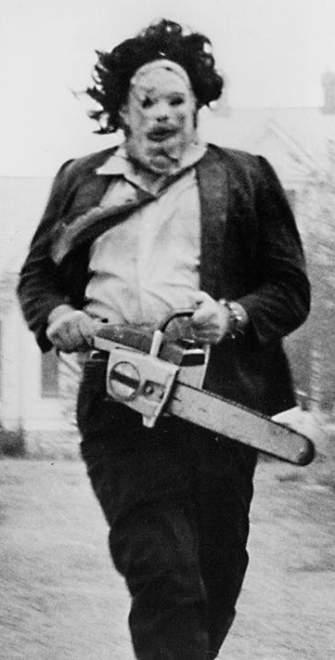


(Team members)
Eileen Chang
“Terrible…. ”
Jonathan Guzman
“It's Halloween, everyone's entitled to one good treat or trick”
Jonathan Ong
“Wait there’s two of them?”

Slide 3
What we accomplished
Optimization algorithm for the exercise
Web application
“a fresh look” of mission planning

Slide 4
Optimization algorithm summary
Of the 49 lines of restraints and constraints:
11 not met (77.55% met)
Key notes:
Every target is killed
Jets and helos have no limit on time, and do not fail after landing
No resources (jets, helos, pilots, or weapons) are transferred between carriers
https://github.com/Jonathan805/RestrictedPlanning/blob/main/Matlab/AutoScheduling.m

Slide 5
Targets:
Target 1 - Enemy Carrier A, no defenses, Collocated with Destroyer A, and protected by both Cruiser A and B
Target 2 - Enemy Carrier B, no defenses, Collocated with Destroyer B, and protected both Cruiser A and B
Target 3 - Enemy Destroyer A, collocated with Target 1, 25% chance to kill 50% of the aircraft that attack Target 1, and 30% chance to kill 50% of the aircraft that attack Target 3
Target 4 - Enemy Destroyer B, collocated with Target 2, 30% chance to kill 50% of the aircraft that attack it, and 30% chance to kill 50% of the aircraft that attack Target 3
Target 5 - Enemy Cruiser A, Collocated with Target 1, 15% chance to Kill 50% of the aircraft that attack Target 1 or Target 2, and 40% chance to kill 50% of the aircraft that attack Target 5
Target 6- Enemy Cruiser B, Collocated with Target 2, 15% chance to Kill 50% of the aircraft that attack Target 1 or Target 2, and 40% chance to kill 50% of the aircraft that attack Target 6
Each missile launched against an enemy vessel has a 60% Chance of hitting that ship.
Each hit has an 50% chance of Killing or Disabling that ship. Disabled ships cannot defend themselves or other vessels.
Pilot 1 cannot fly with Pilot 2
Pilot 11 cannot Fly with Pilot 12
Pilot 20 cannot fly with Pilot 21
Pilot 3 can only fly with Pilot 4 or Pilot 9
Pilot 18 can only fly with Pilot 21 or Pilot 19
Pilot 5 cannot fly Jet 8
Pilot 17 cannot fly Jet 12
Jet 10 and Jet 11 cannot be in the same sortie
Pilot 15 can only fly twice during the offensive
Pilot 20 can only fly three times during the offensive
Pilot 4 cannot fly any missions on Day 5
Pilot 13 cannot fly any missions on Day 6 and Day 7
Jet 5 will need 48 hours of maintenance after it's first 10 hours of flight
Jet 7 is not available after day 5
Jet 1 is not available until 1400z on day 3
Jet 4, 8, 9 , and 17 can only carry one missile
Each Helo has a 30% chance of needing 16 hours of down-time after landing at it's home carrier for that day
Each Jet has a 20% chance of needing 24 hours of downtime after each landing at it's home carrier for that day

Slide 6
Sorties against Target 1 or 3 must be no less than 2 hours, but may not be more than 4 hours long and can attack one or both of Targets 1 and 3, and are at risk of getting shot by Target 3, 5, and 6
Sorties against Target 2 or 4 must be no less than 3 hours, but may not be more than 5 hours long and can attack one or both of Targets 2 and 4, and are at risk of getting shot by Target 4, 5, and 6
Sorties against Targets 5 or 6 must be no less than 4 hours, but may not more than 6 hours long and can attack one or both of Targets 5 or 6, and are at Risk of being shot by targets 5 and 6
Killed friendly Jets causes the loss of that Jet and its pilot.
It takes 24 hours and occupies 1 helo and helo crew to shuffle people (up to 2 jet pilots or 1 whole helo crew) between Carriers (two-way trip, the helo returns to it's home carrier and may bring passengers back on the second leg).
It takes six hours occupies 1 helo and 1 helo crew to reposition that helo between carriers
It takes 12 Hours and occupies 1 Jet and 1 Jet Pilot to move missiles between Carriers (two-way trip, may swap pilots and/or bring missile(s) back on its return leg)
It takes 4 Hours and occupies 1 Jet and 1 Pilot to reposition a jet and that pilot (one way trip, that Jet may bring missile(s))
All Jets are single seat and take 1 pilot to fly.
Jets can carry up to 2 weapons per sortie, unless some restraint says otherwise.
All sorties must have a minimum of 2 jets and 2 pilots, except reposition flights between carriers.
Each jet requires 1 pilot to fly.
Each sortie requires a Helo and crew for that carrier to be airborne during the period 1 hour before to 1 hour after launch and 1 hour before and 1 hour after recovery for man-overboard and rescue requirements (helos may cover multiple launches and lands during their period of flight)
Helos may not be airborne for more than 8 hours
Each helo requires 12 hours after land to reset for the next flight, except when doing a hotseat
Each helo crew requires 12 hours after land
Crews may hot-seat aircraft (that is, a jet or helo can land and a new pilot can take that jet for another sortie)
Each jet may fly 3 sorties per day, but may not be airborne for more than 16 hours in a day
Each jet needs 8 hours after it lands at it's home carrier for that day, unless hotseating
Each Hot Seat takes 30 minutes
Each carrier can accommodate 2x hotseats at a time in any combination of jet or helo
Each jet Pilot requires 16 hours to rest and replan before flying again
Each Jet Pilot may only fly for 16 hours in a day, but may fly more than one Jet in a day (hotseat time counts against their max duty time for the day)

Slide 7
Mission Planning
Importing an ATO
With JMPS:
Import ATO and ACO with Task View (7 + clicks)
Port over the targets and geozones from Task View into JMPS
Now:
Drag and drop tasking into page. Get summary and visualization of targets immediately. (1 click)

Slide 8


Slide 9
Lessons Learned
Impacts
Learned how to send group texts
Watching youtube videos at 3x speed is the normal now

