Slide 1
HL-HGAT Demo
Jinghan Huang
National University of Singapore
Google colab
Notes:
Hello everyone. This morning, we presented the theory behind the HL-HGAT model. In this session, we will show how to implement the proposed model using PyTorch.

Slide 2
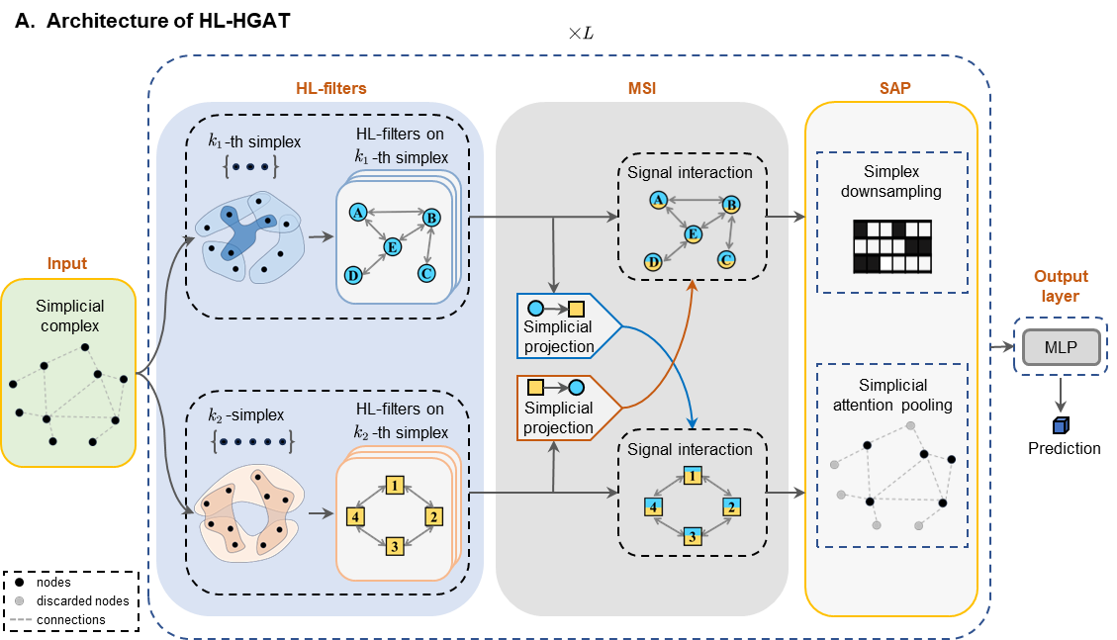
Demonstrate HL-HGAT to predict sex

Slide 3

Code in Google Colab
https://colab.research.google.com/drive/14SYI5de5xODUhDajUERKumEdqyJe_Mog?usp=sharing

Slide 4
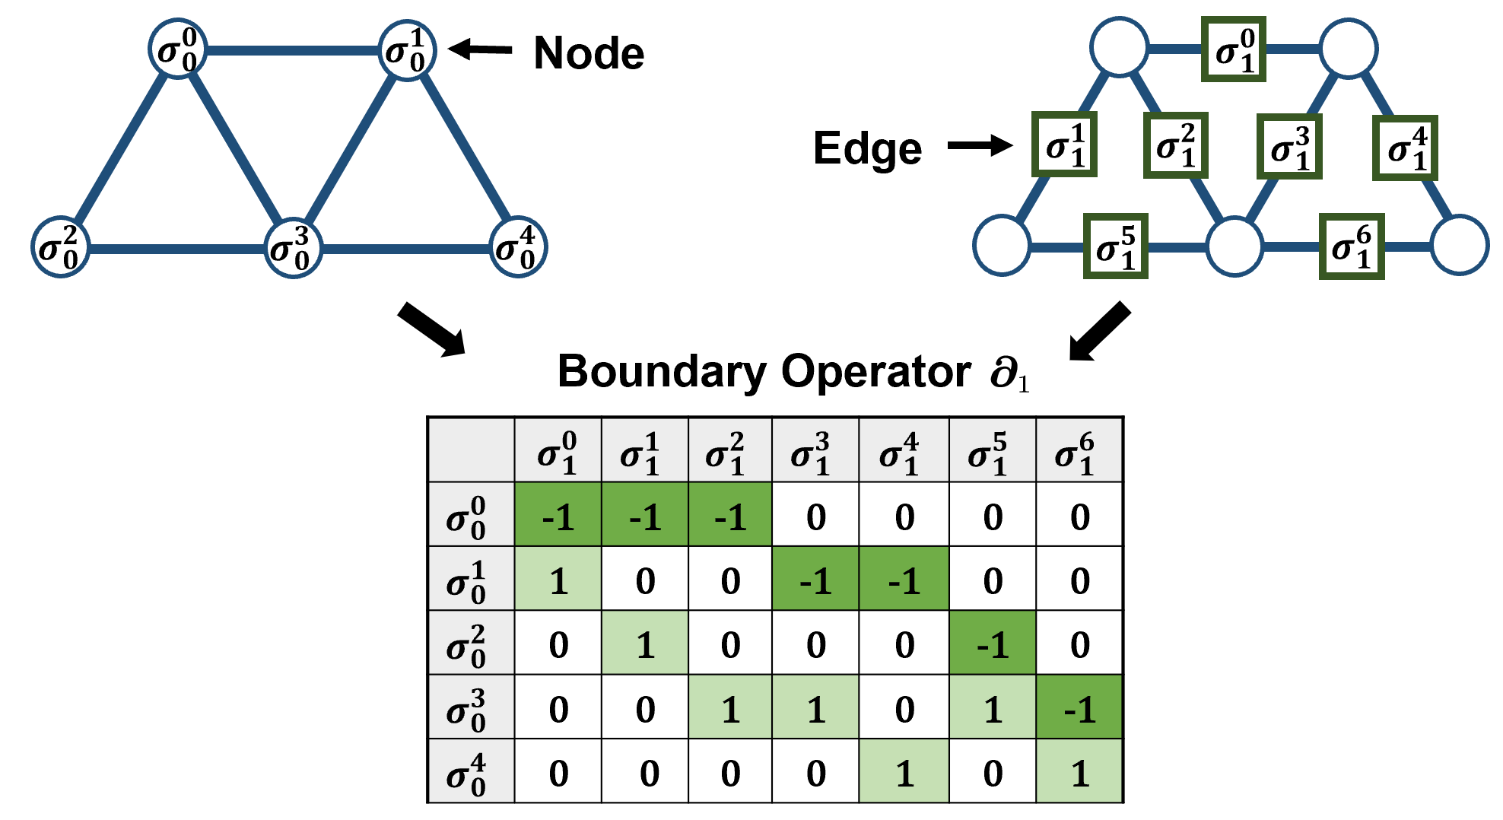
Input data
Node Features:
Functional time series (fMRI)
Cortical morphometry (T1)
Node degree
Edge Features:
Functional connectivity (fMRI)
Structural connectivity (DTI)
Anatomical distance (T1)
Notes:
As introduced this morning, we model the brain network with a heterogeneous graph instead of a traditional graph because we have diverse features defined on both nodes and edges. For example, ...

Slide 5
Input data
Node Features:
Functional time series (fMRI)
Cortical morphometry (T1)
Node degree
Edge Features:
Functional connectivity (fMRI)
Structural connectivity (DTI)
Anatomical distance (T1)
Notes:
As introduced this morning, we model the brain network with a heterogeneous graph instead of a traditional graph because we have diverse features defined on both nodes and edges. For example, ...

Slide 6
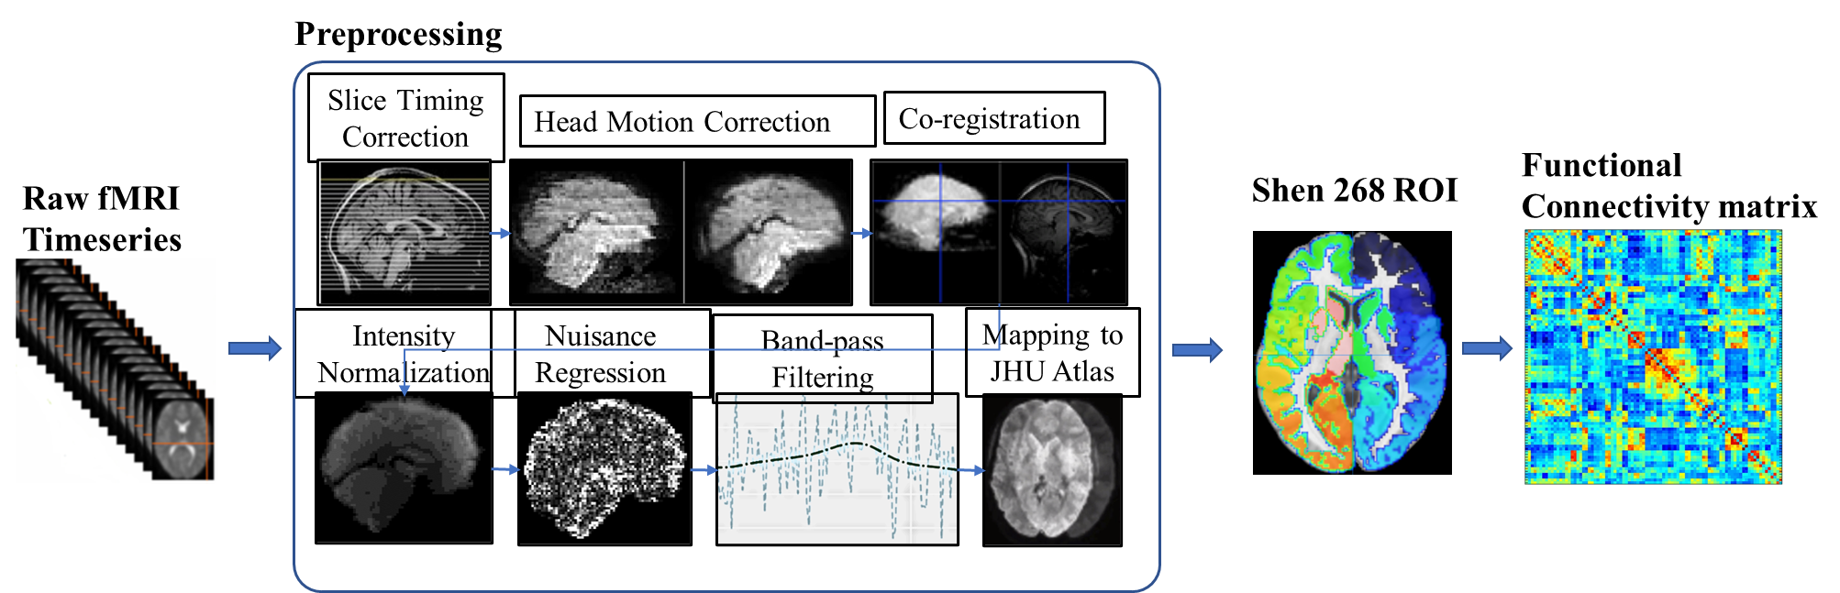
Dataset: Adolescent Brain Cognitive Development (ABCD) study
Number of samples: 7693
Task: sex classification

Slide 7
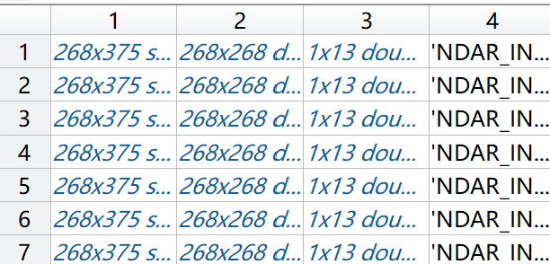
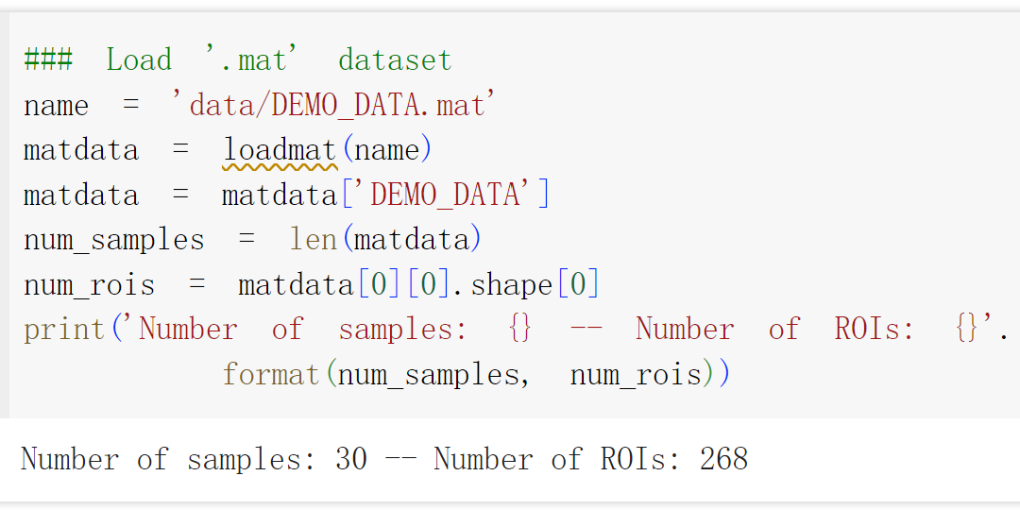
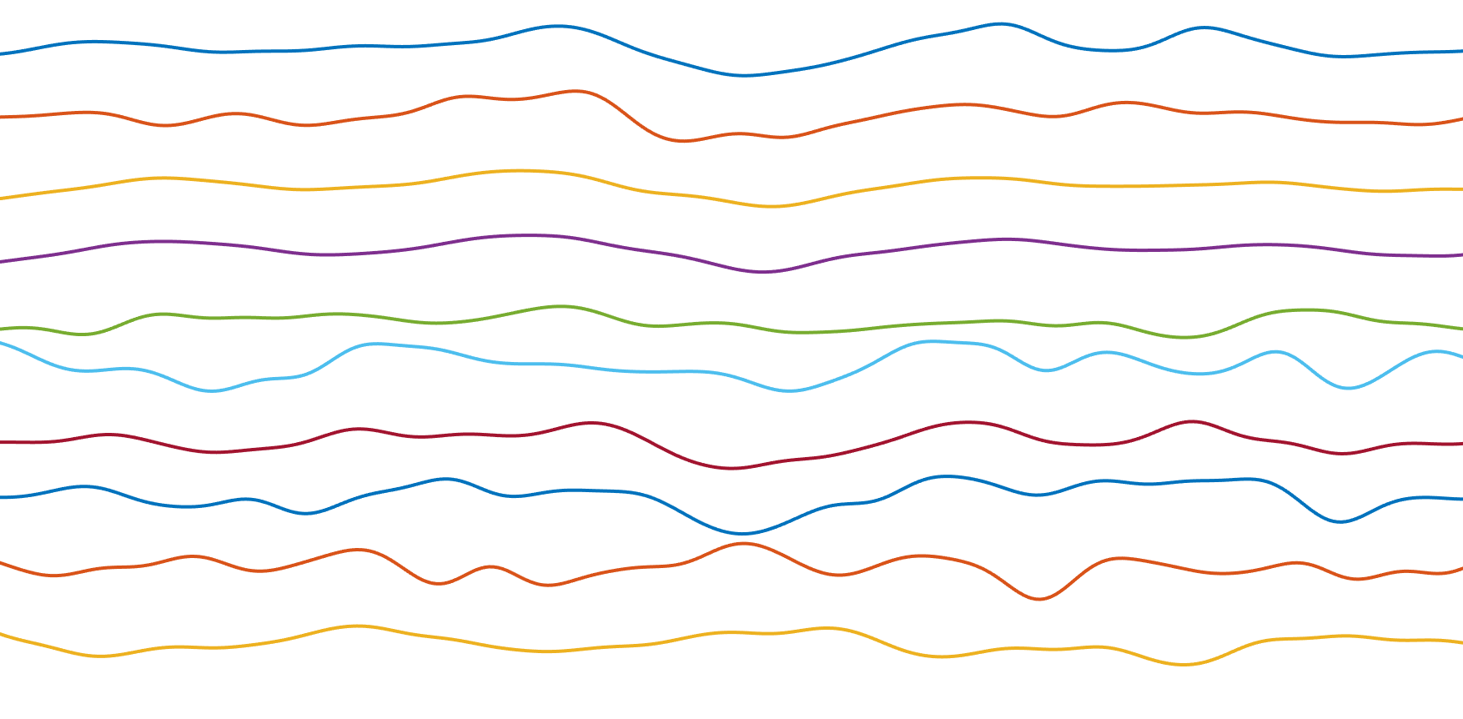
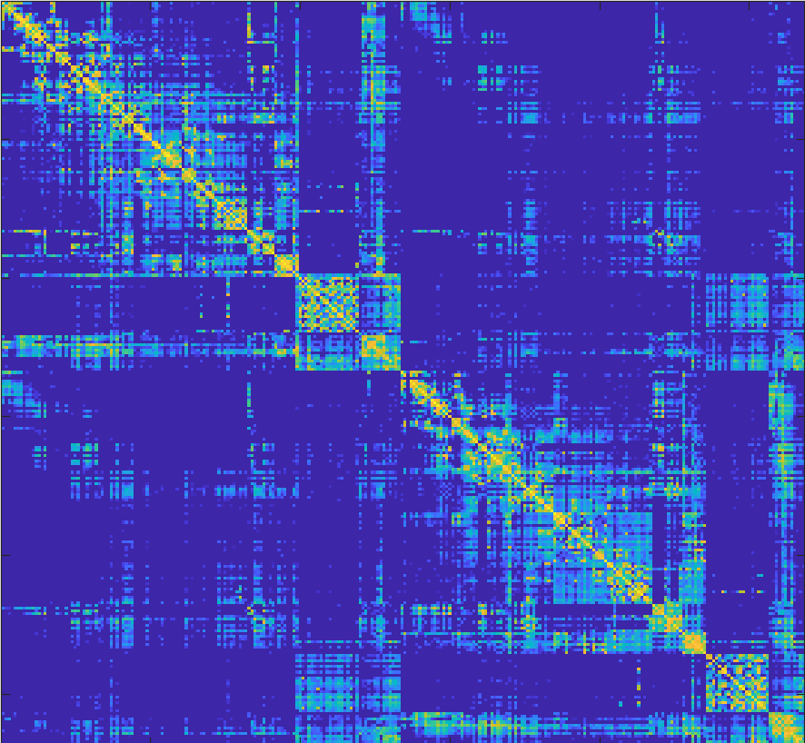

Data Structure
$N×4$ MATLAB cell matrix
Build heterogeneous graph with brain fMRI
Subject ID
[age, sex, general intelligence, …]
Subject Information
fMRI time series
Functional connectivity

Slide 8
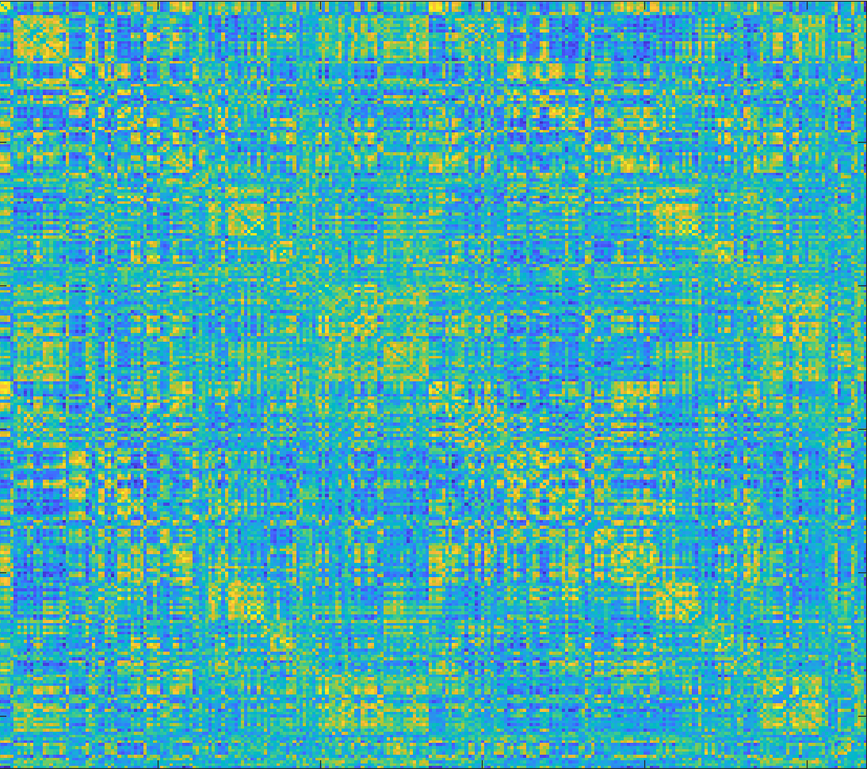
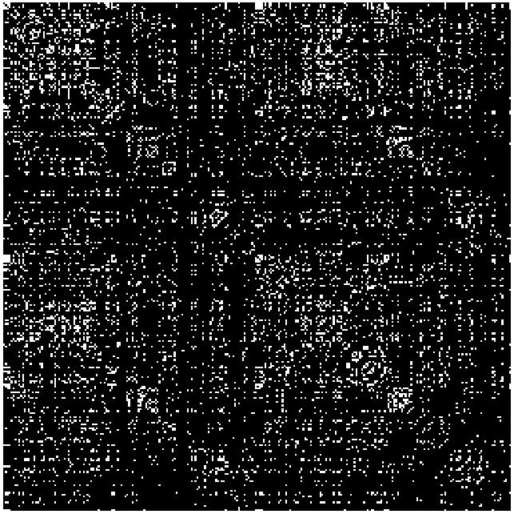
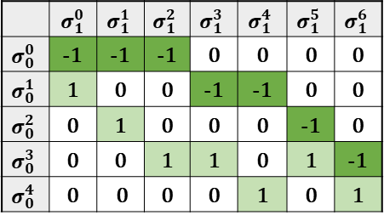
Build filters for node and edge features
fMRI time series on ROIs
Functional connectivity computed by Pearson correlation
Binary mask
Boundary operator
Node Feature
Edge Feature
Hodge-Laplacian operators
Filters for node and edge features

Slide 9
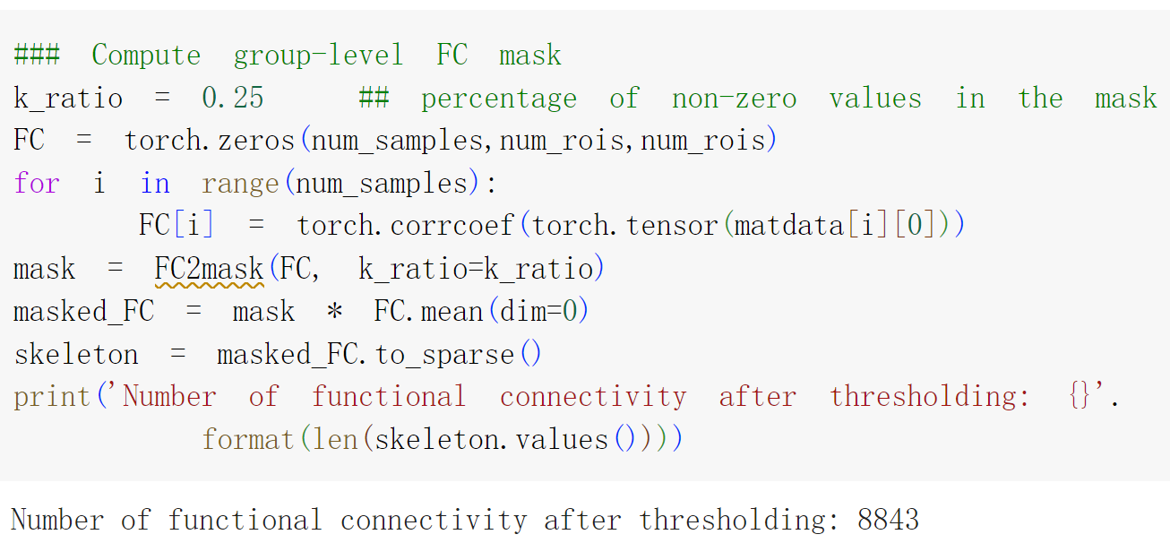
fMRI time series on ROIs
Functional connectivity computed by Pearson correlation
Binary mask computed by thresholding

Slide 10
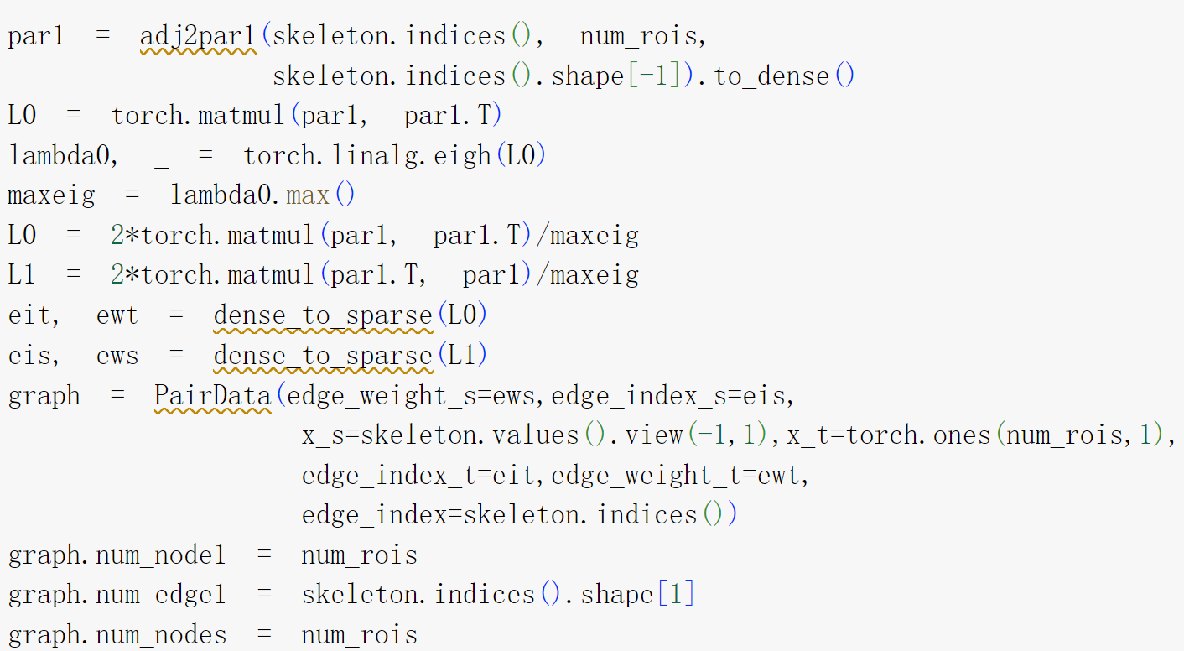
Hodge-Laplacian operators
Binary mask computed by thresholding
Boundary operator
1-st Hodge-Laplacian operator
Edge and node feature
0-th Hodge-Laplacian operator
Boundary operator

Slide 11
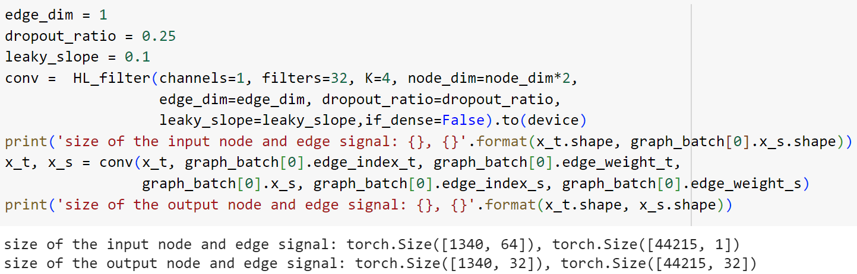
HL-HGAT modules
HL-filters: Convolutional layer on node and edge signals

Slide 12
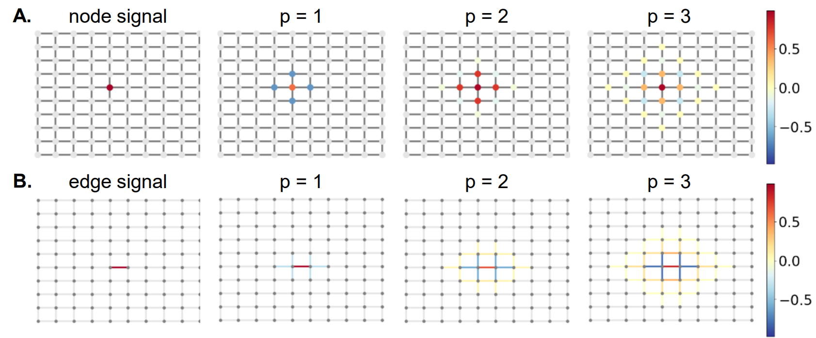
HL-HGAT modules
HL-filters: Convolutional layer on node and edge feature
p = K - 1

Slide 13
HL-HGAT modules
MSI: multi-simplicial interaction layer. (Enable modeling feature interactions between node and edge)

Slide 14
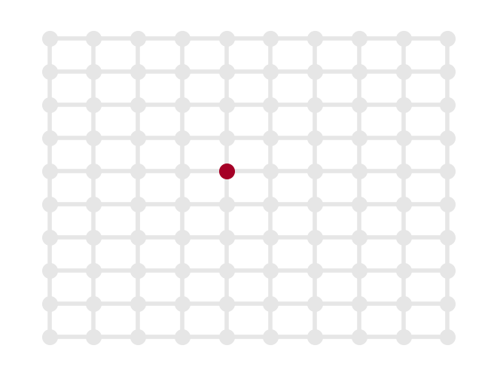
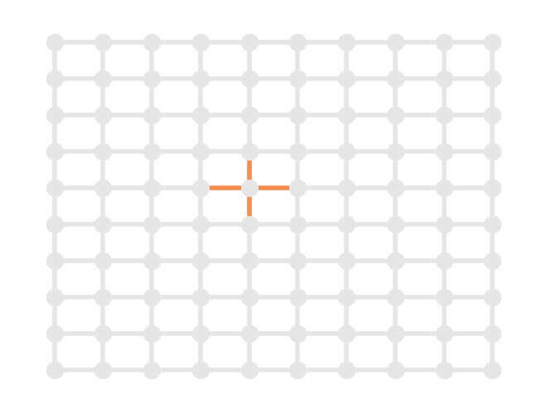
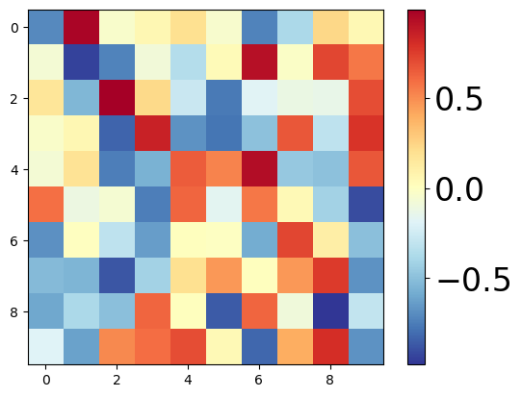
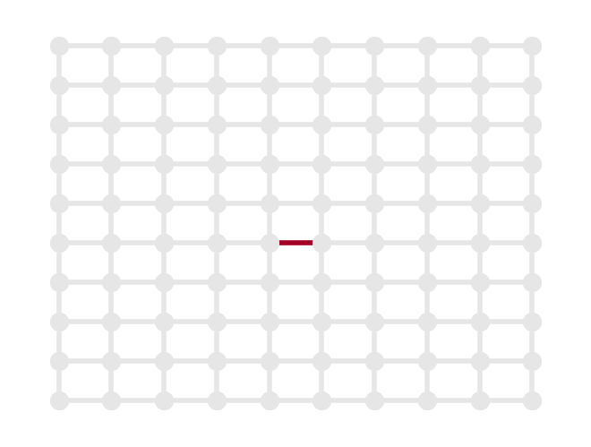
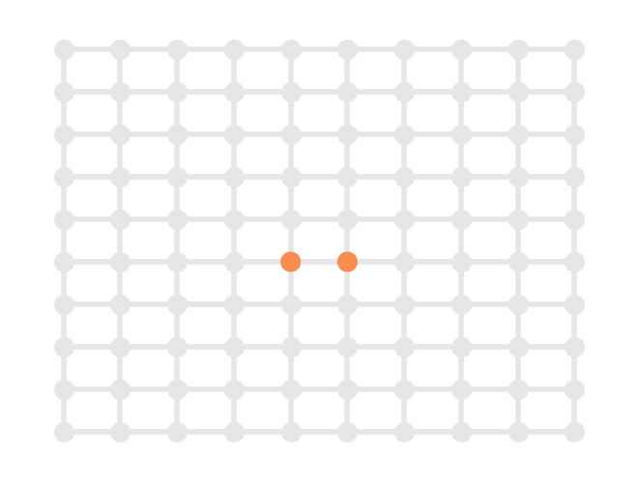
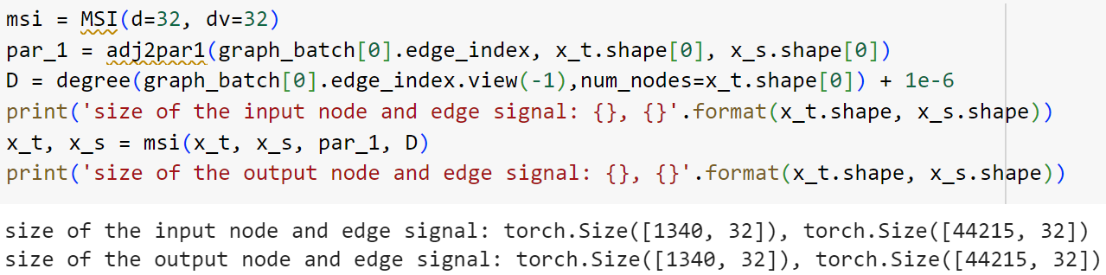
HL-HGAT modules
node signal
node-to-edge signal
MSI: multi-simplicial interaction layer. (Enable modeling feature interactions between node and edge)
MSI
edge signal
edge-to-node signal

Slide 15
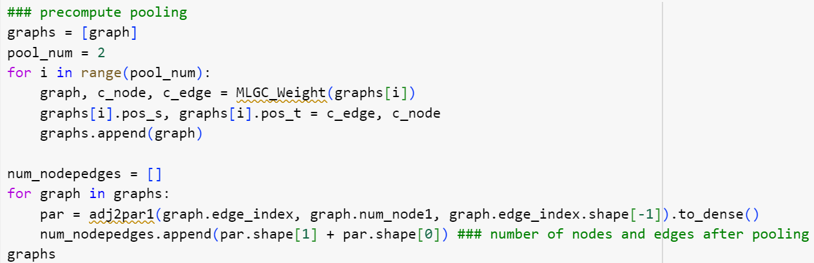
Simplex downsampling
Number of nodes roughly divided by 2 after one pooling layer
Number of edges roughly divided by 4 after one pooling layer

Slide 16
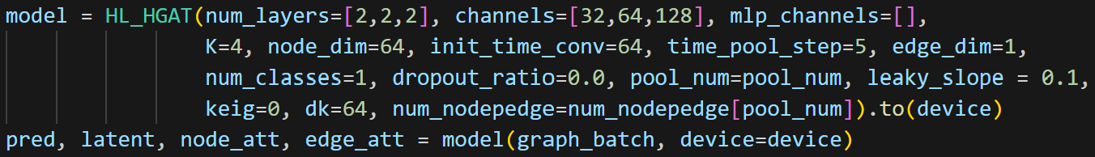
Construct HL-HGAT
HL-HGAT model consists of multiple blocks. The number of these blocks is determined by the num_layers variable.
HL-HGAT with three blocks. Each block contains two convolutional layers
Notes:
For example, to construct an HL-HGAT with two blocks — where the first block has one convolutional layer and the second block has three — we simply set num_layers = [1,3]. Similarly, the code shown in the right figure constructs an HL-HGAT with three blocks, each containing two convolutional layers.

Slide 17
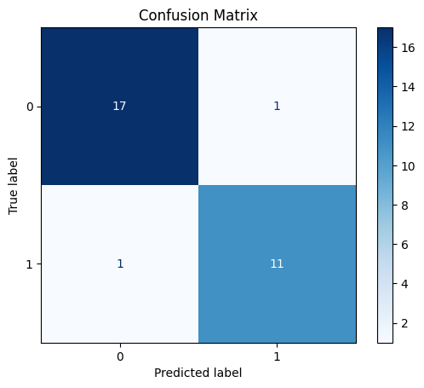
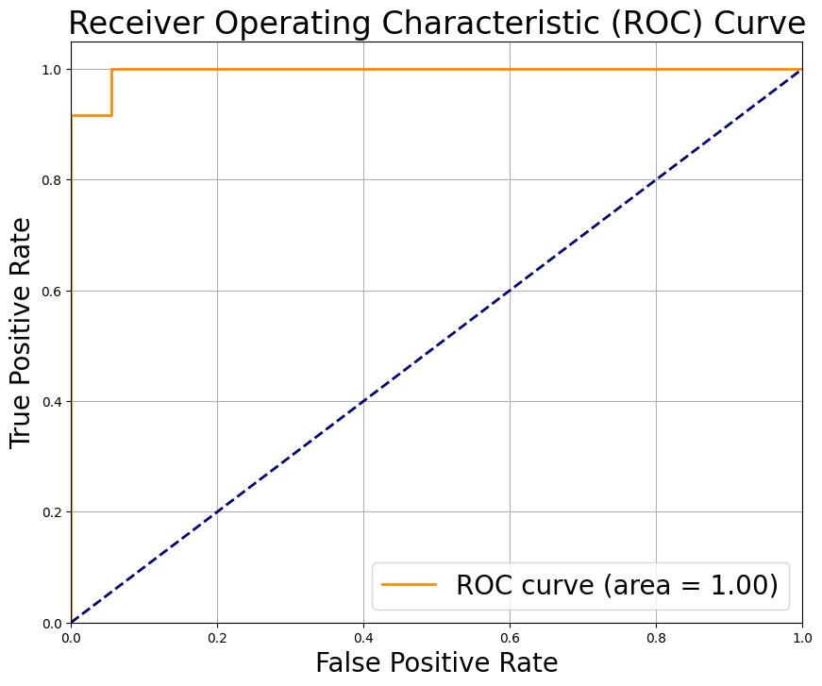
Visualization
Prediction Result: Used for both training and testing phases.

Slide 18
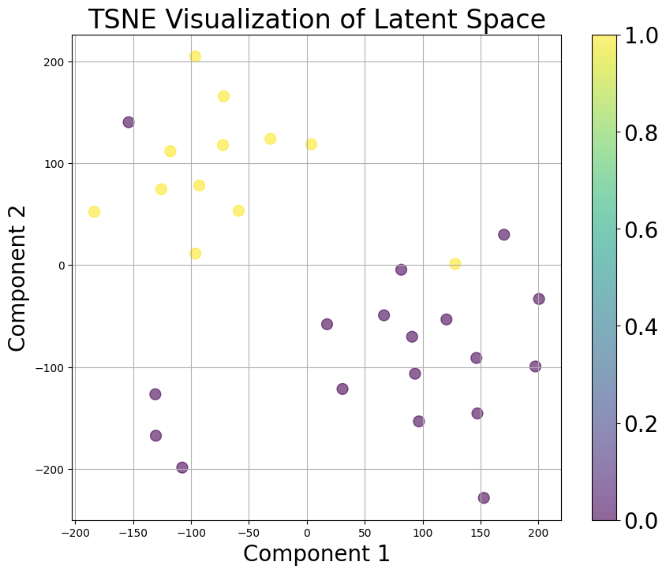
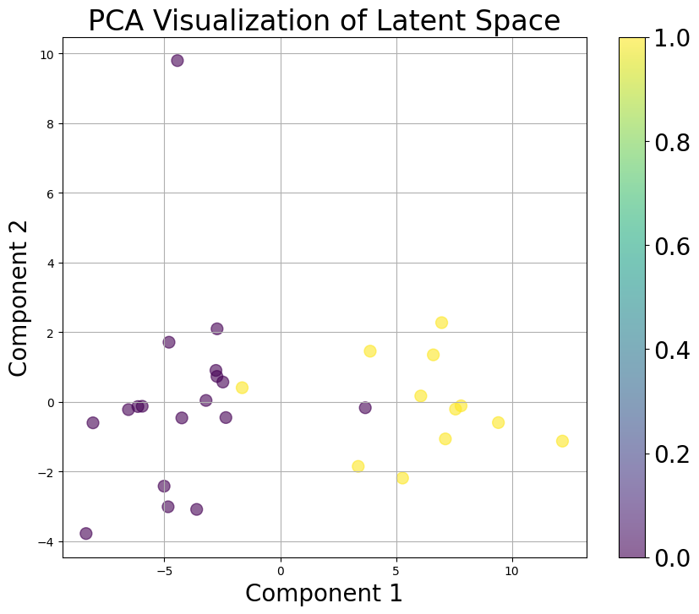
Visualization
Latent Representation: A low-dimensional representation from the final layer, suitable for t-SNE visualization, as depicted in the figure.

Slide 19
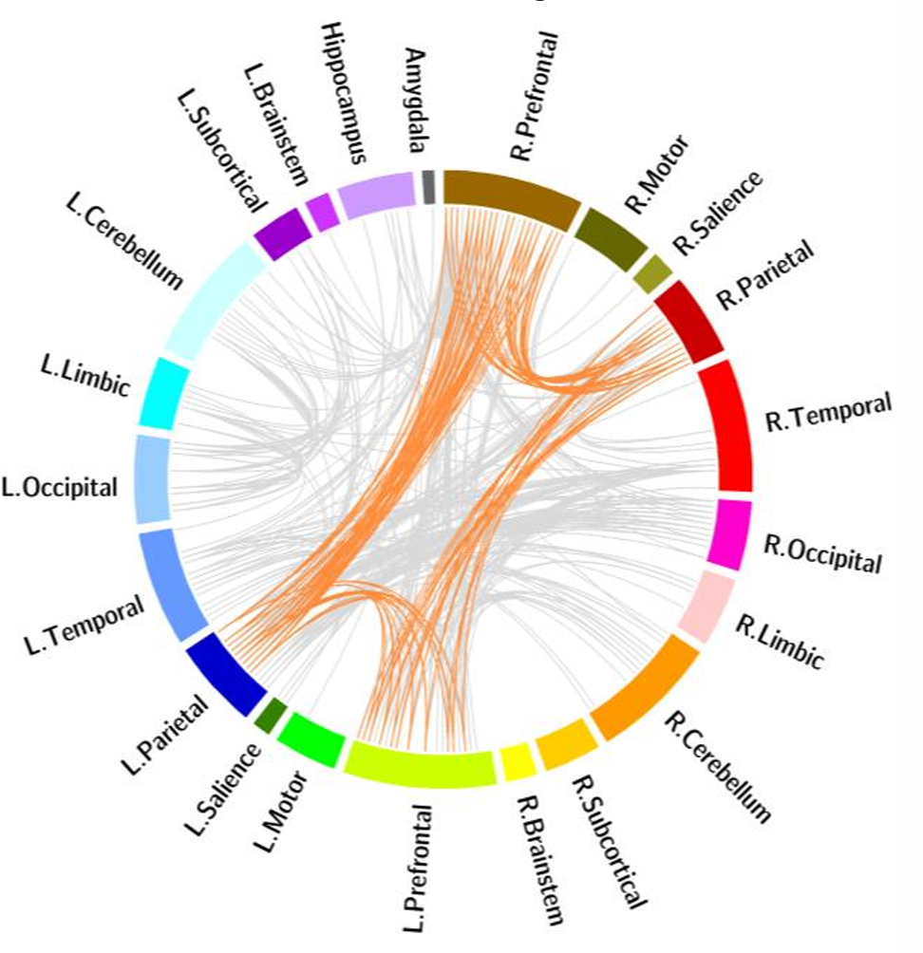
Visualization
Attention Visualizations: node and edge attention computed from the simplicial attention pooling layer (SAP)

Slide 20
Code in Google Colab
https://colab.research.google.com/drive/14SYI5de5xODUhDajUERKumEdqyJe_Mog?usp=sharing

