Slide 1
Progress Report
최지호
EECS, GIST College

Slide 2
Prompt Architecture 1
To prevent overfitting, Reduce learnable parameters
E^2VPT: An Effective and Efficient Approach for Visual Prompt Tuning(ICCV 2023)
Light weight architecture than before(i.e., EXPRES(CVPR 2023))
Prompt length Pruning

Slide 3
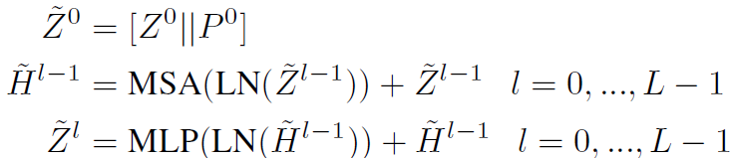

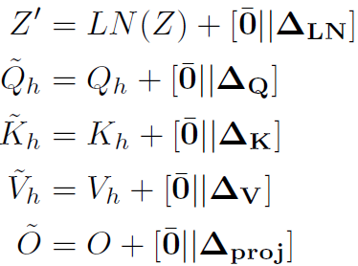
Prompt Architecture 1
Light weight architecture than before(i.e., EXPRES(CVPR 2023))
EXPRES(61U, 0.2M)
  shallow prompt(U)
  layer-wise prompt(12X5U)
E^2VPT(13.2U)
  deep prompt(12U)
  layer-wise prompt(12/10U)
    V, K share parameters

Slide 4
Prompt Architecture 1
E^2VPT(14U, 0.05M)
  shallow prompt(4/5U)
  layer-wise prompt(12*2/5U)
    V, K share parameters
Paper: 11.43 mErr(Surface normal)
Bias: 10.62 mErr
E^2VPT(14U): 11.49 mErr
Previous(61U): 10.14 mErr
Length 고정, 추가 parameter의 도입 필요.
E^2VPT(14U, 0.05M)
  shallow prompt(4/5U)
    Layer를 거치면서 prompt가 abstract한 information을 담도록 하기 위해서 필요
  layer-wise prompt(12*2/5U)
    각 layer별로 필요한 representation을 추가하기 위해서 필요
    앞선 결과에 따라서, 특히 이 부분의 parameter를 추가 필요

Slide 5
Prompt Architecture 1
channel | 3 | 3 | 3 | 3 | 1 | 1 | 1 | 1
Shallow | 4 | 3 | 2 | 1 | 4 | 3 | 2 | 1
Layer | 2 | 3 | 4 | 5 | 2 | 3 | 4 | 5
Params(M) | 0.06 | 0.09 | 0.11 | 0.14 | 0.02 | 0.03 | 0.04 | 0.05
Result(mErr) | 11.79 | 11.74 | 11.97 | 11.65 | 11.49 | 11.61 | 11.55 | 11.50

Slide 6
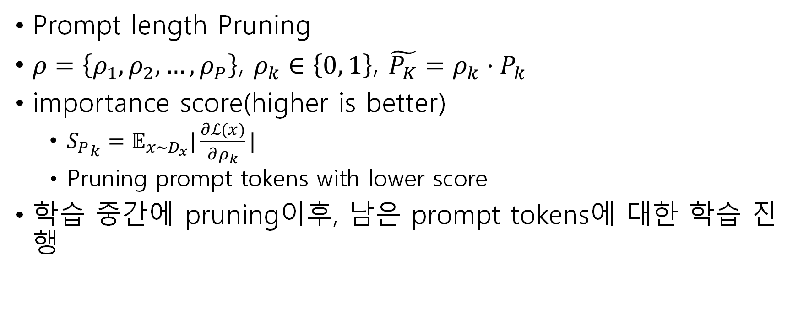
Prompt Architecture 1
Prompt length Pruning
$ρ=\left\{ρ_{1}, ρ_{2},…,ρ_{P}\right\}$, $ρ_{k}∈\left\{0, 1\right\}$, $\tilde{P_{K}}=ρ_{k}⋅P_{k}$
importance score(higher is better)
  ${S_{P}}_{k}=𝔼_{x\sim D_{x}}|\frac{∂ℒ(x)}{∂ρ_{k}}|$
  Pruning prompt tokens with lower score
학습 중간에 pruning이후, 남은 prompt tokens에 대한 학습 진행

Slide 7
Prompt Architecture 2
Vision Transformer Adapters for Generalizable Multitask Learning(ICCV 2023)
  Weighted Training for Cross-Task Learning(ICLR 2022)
Channel(sub-task) affinity aware weighted sum prompt
VTM에서 task의 정의는 다음과 같음
기존의 VTM은 task를 해결함에 있어서 multi-channel information을 고려하지 않고 sub-task를 독립적으로 생각하였음
“Although multi-channel information is beneficial in general, we observe that its impact is negligible in practice.” from VTM(ICLR 2023)

Slide 8

Prompt Architecture 2
Channel(sub-task) affinity aware weighted sum prompt
weighted sum of deep prompt
$P_{t, m}^{i}←\sum_{j=1}^{T}{\frac{P_{j, m}^{i}ω_{t, j}}{\sum_{k=1}^{T}{ω_{t,k}}}}$
  i-th layer prompt
  task t(e.g., surface normal |T| = 3)
  m prompt length
Bias: 10.62 mErr(Surface Normal)
E^2VPT(14U), 1channel: 11.49 mErr
E^2VPT(42U), 3channel: 12.52 mErr
E^2VPT(42U), 3channel, parameter ensemble: 11.15 mErr
As a toy example,
directly optimize weight paramters
self.weighted_sum = nn.Parameter(torch.eye(self.n_tasks), requires_grad=True)
_prompt_embedding = (self.weighted_sum[t_idx] / self.weighted_sum[t_idx].sum(dim=1)[:, None])[:, :, None, None, None] * prompt.expand(B, -1, -1, -1, -1)
_prompt_embedding = _prompt_embedding.sum(dim=1)

Slide 9
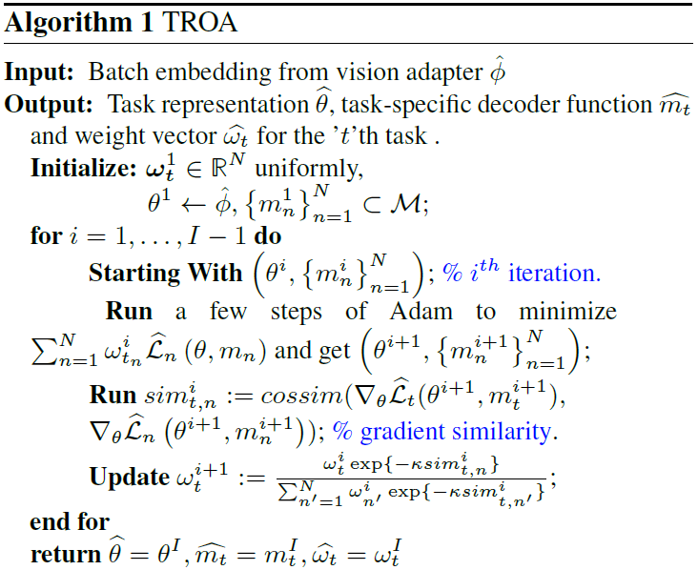
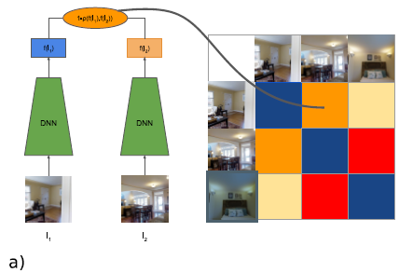
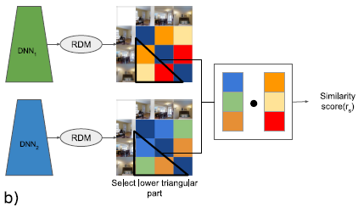
Prompt Architecture 2
Task Affinity from Multi-task Learning perspective.
Task Representation Optimization Algorithm(TROA); gradient based; ICCV 2023
Representation Similarity Analysis; CVPR 2019

Slide 10
Prompt Architecture 2
Channel(sub-task) affinity aware weighted sum prompt
  Weight algorithm의 선정
  Prompt에 대해서만 weighted sum을 할 것인가?
  Bias에 대해서도 weighted sum을 할 것인가?

Slide 11
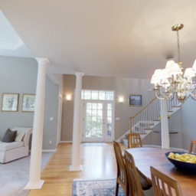
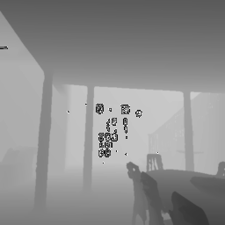
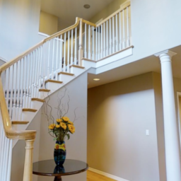
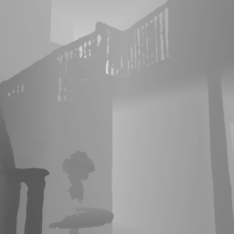
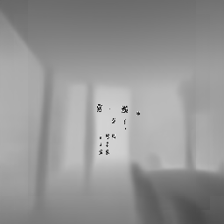
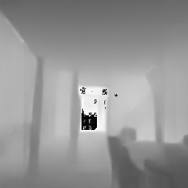
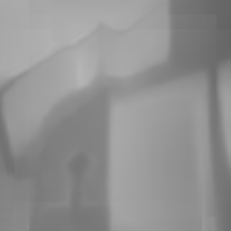
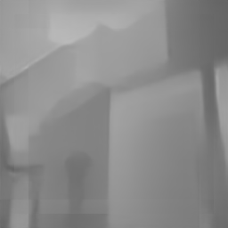
Visualizations: z-buffer
MSE
  Bias: 0.0322(reproduced)
  Previous(61U): 0.0314
img
GT
Bias
Prompt

Slide 12
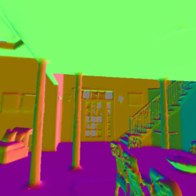
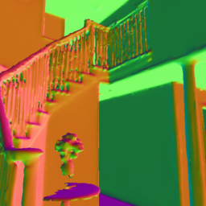
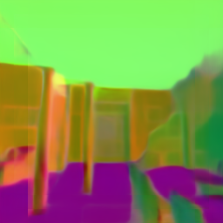
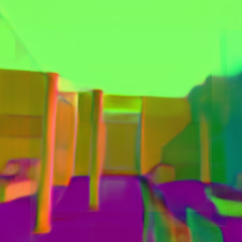
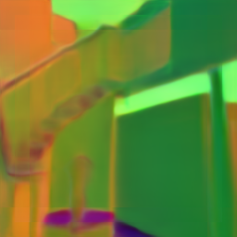
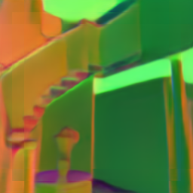
Visualizations: normal
mErr
  Bias: 10.59
  Previous(61U): 10.14

Slide 13
Adapter
fine grained details의 표현에 문제가 있음
  Adapter를 통해서 local spatial vision prior를 vanilla ViT에 부여하는 것 고려
Patch 크기의 visual artifact
  VTM module에서 기인하는 특성으로 생각됨

Slide 14
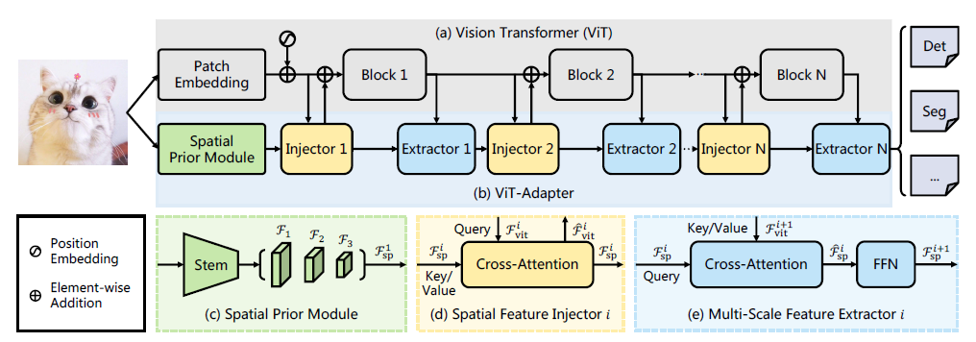
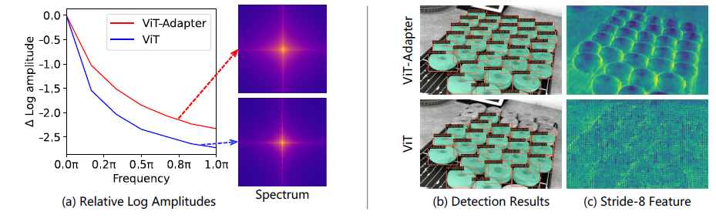
Adapter
Vision Transformer Adapter for Dense Predictions(ICLR 2023 spotlight)
Spatial Prior Module(SPM). It is designed to model the local spatial contexts of images parallel with the path embedding layer.
  Borrowed from ResNet

