Slide 1
REPRODUCIBILITY STUDY
Reproducing SAGA
Defazio, Bach & Lacoste-Julien (NeurIPS 2014)
Does SAGA really beat SGD and SVRG in optimization and on a held-out validation set?
Jihyun Kim & William Zhang

Slide 2
MOTIVATION & SETUP
Can SAGA's theoretical advantages be confirmed empirically?
Defazio et al. claim SAGA…
We verify this by…
Converges faster than SGD (lower final loss)
Uses fewer grad evals than SVRG
Unbiased gradient estimator - O(nd) memory
Adaptive to strong convexity
Implementing SGD, SVRG, SAGA from scratch
LR sweep + locked comparison across 30 epochs
Gradient correctness check (finite-diff error < 10⁻¹⁰)
Novel: validation loss on held-out set
Dataset note: Original paper used MNIST, COVTYPE, IJCNN1, MILLIONSONG. We use sklearn Breast Cancer (n=569, d=30), a different benchmark.
Q1: Does variance reduction beat SGD? Q2: Is there a compute–accuracy tradeoff? Q3: Does better training → better generalization?

Slide 3
TAKE-HOME 1
SVRG achieves the best training loss, but all three tie on the validation set
Method | LR | Train Loss | Val Loss | Grad Evals
SGD | 0.03 | 0.05865 | 0.08512 | 13,650
SVRG | 0.10 | 0.05580 | 0.08650 | 40,950
SAGA | 0.03 | 0.05665 | 0.08771 | 14,105
Results on train split (n=455, 80/20 stratified split). F* ≈ 0.05576 estimated via L-BFGS-B.
SVRG: lowest train loss (0.05580) but 3× grad evals - confirmed
SAGA: nearly matches SVRG train loss at same cost as SGD - confirmed
Val loss: all three cluster at 0.085-0.088 - optimizer precision doesn't improve generalization

Slide 4
TAKE-HOME 2
All methods are LR-sensitive - SVRG is most stable across seeds
Seed Stability (seeds 0–2)
Method | Std Loss
SGD | 0.00134
SVRG | 0.000009
SAGA | 0.0001
SAGA steepest drop → most sensitive to LR choice
SVRG std 150× lower than SGD → variance reduction works

Slide 5
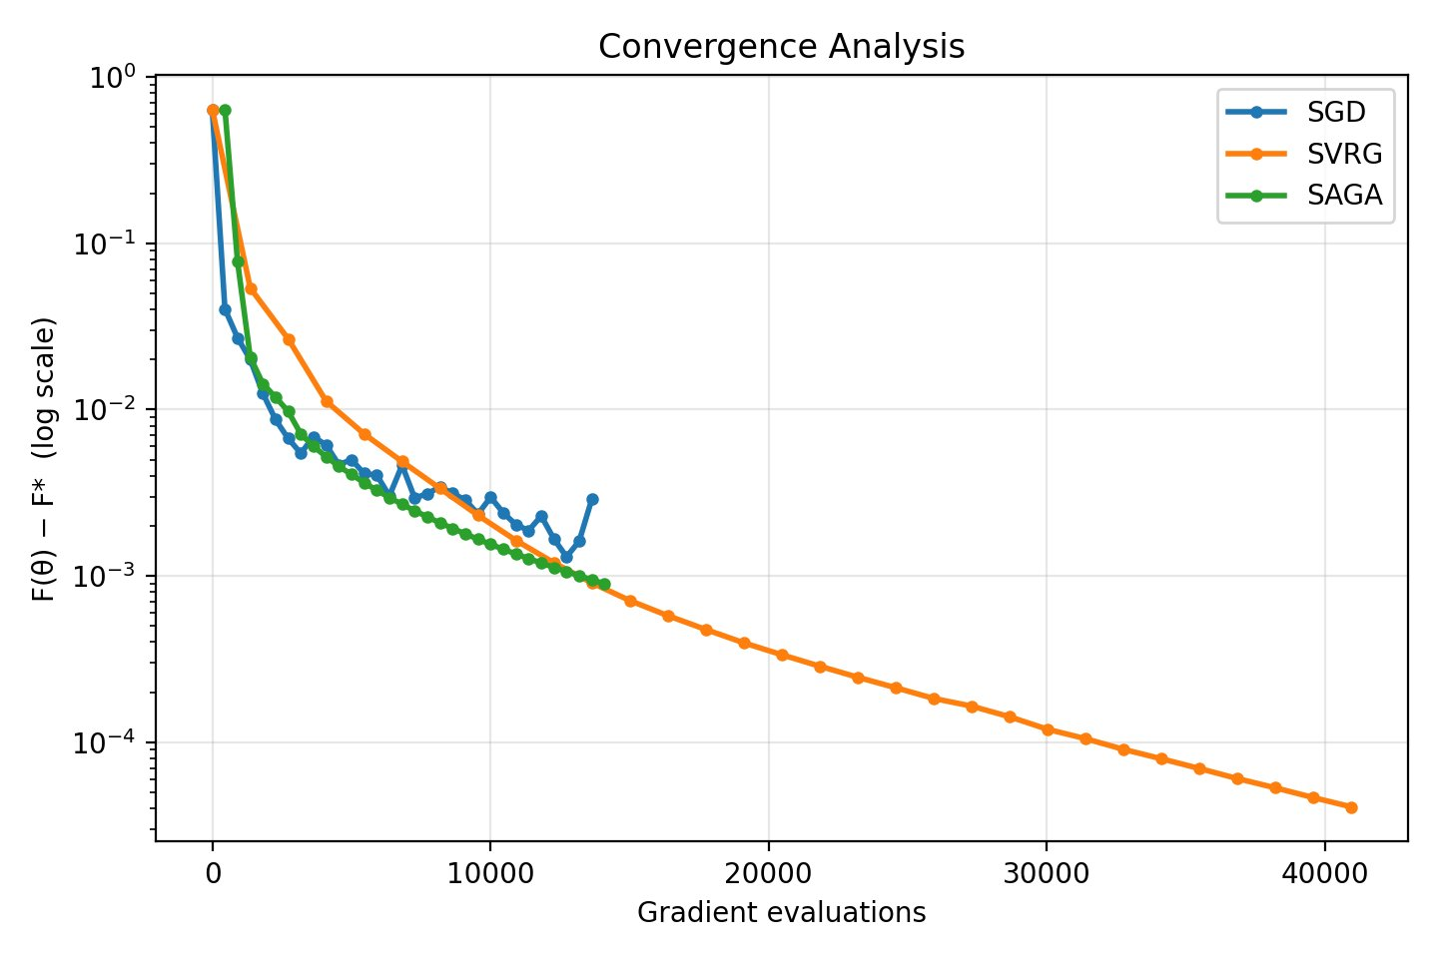
TAKE-HOME 3
SVRG converges linearly - SGD and SAGA plateau within budget
SVRG: linear convergence
Descends to ~4×10⁻⁵
still improving at 41K evals. Matches theory.
SGD: noisy plateau
Oscillates at ~10⁻³. Variance reduction is visibly needed.
SAGA: leads early, then stops
Descends steeper than SVRG in first ~5K evals.
SVRG overtakes at ~8K.

Slide 6
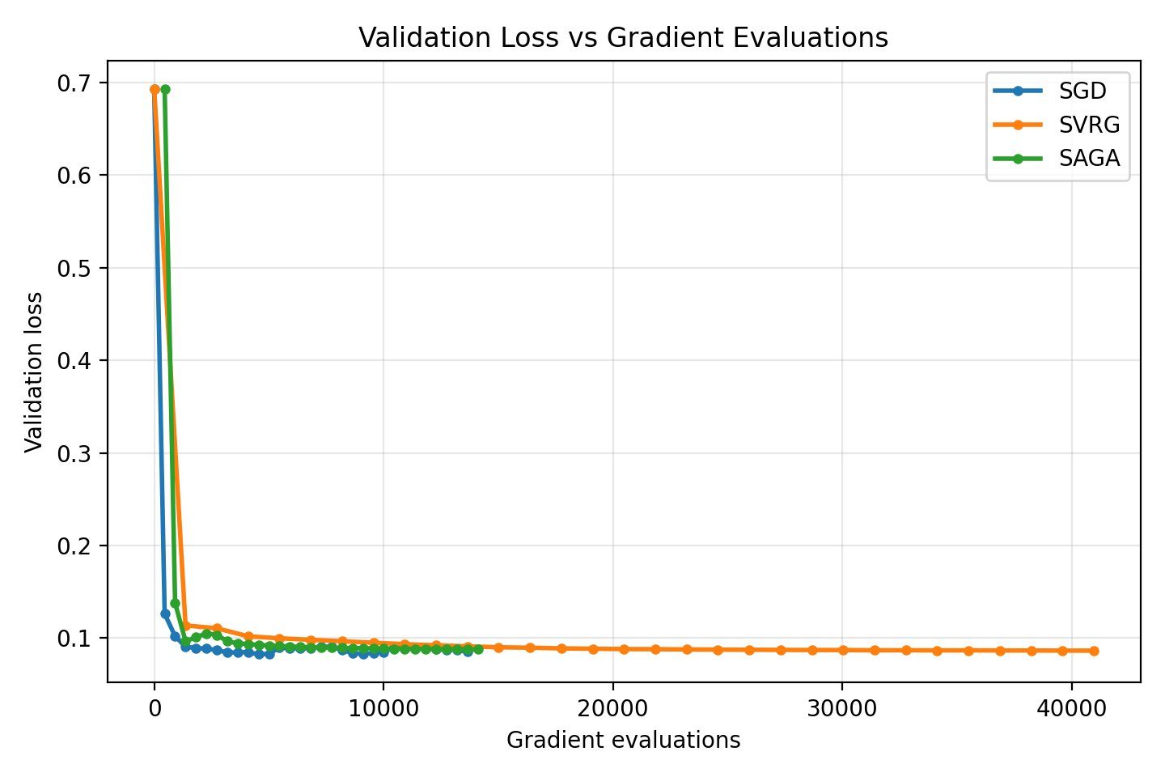
NOVEL
VALIDATION LOSS ANALYSIS
All three methods generalize equally well, SVRG's extra compute doesn't help
All converge to ~0.085–0.09 val loss
Despite large training loss differences, all three reach the same validation performance.
SVRG's 3× compute yields no val gain
51K grad evals → val loss ~0.088. No better than SGD or SAGA at 17K evals.
Novel vs original paper
Defazio et al. never evaluate on held-out data. Optimizer choice affects training efficiency, not generalization on this dataset.

Slide 7
Summary
Reproducibility verdict: SAGA's core claims hold
SVRG wins training accuracy
Limitations
1
Lowest train loss (0.05580), most stable across seeds. Costs 3× grad evals (40,950).
Single small dataset (n=569), different benchmark from original paper
Seed check excludes SAGA
Future: test on COVTYPE (581K) and sparse datasets
SAGA is the efficiency sweet spot
2
At lr=0.03: matches SVRG quality at ⅓ the cost. Confirmed, but only when tuned.
Training ≠ Generalization
3
Novel finding: all methods reach the same val loss (~0.088). SVRG's extra compute buys nothing on this dataset.
SGD: speed · SVRG: reliability · SAGA: efficiency (with tuning)

