Slide 1
User
TalentConnect
Employer

Slide 2
TalentConnect
(rep. User)
TalentConnect
(rep. Employer)

Slide 3
User’s skills:
Current skillset
New skills to learn
pre-processing
word2vec
TF-IDF
Job descriptions
Our models
Recommendations
pre-processing
Cosine similarity
word2vec
TF-IDF
KNN

Slide 4
User’s skills:
Current skillset
New skills to learn
pre-processing
Job descriptions
Our models
Recommendations
pre-processing

Slide 5
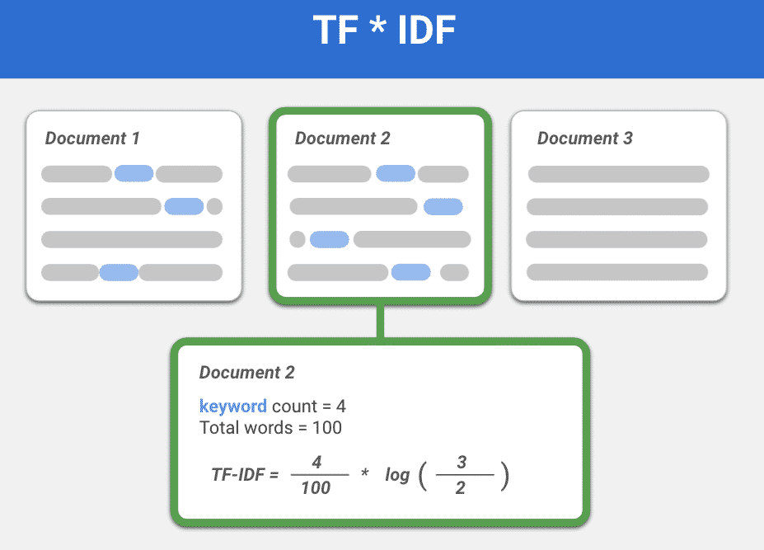

Slide 6
