Slide 1
Beyond the Horizon
The Age of Exploration, 1487–1522: why Europeans sailed, how they found their way, and how the map changed
Notes:
HOW TO USE THIS DECK
This presentation teaches the content that the game and the practice deck reinforce. Run it in five short segments (one per class period, or two segments per period). Each segment ends with retrieval, and students then play the matching voyage in the game and do the matching practice-deck slides.
DESIGN NOTES (Mayer, multimedia learning): slides carry pictures, maps and a few key words; the explanation lives here in the notes for you to SAY aloud (modality and redundancy principles). Labels sit on the maps next to what they name (spatial contiguity). Each slide makes one point (segmenting). Key terms come first (pre-training). Red callouts and numbered markers point to what matters (signaling). There is no decoration that does not teach (coherence).
DESIGN NOTES (Bjork, desirable difficulties): students PREDICT before they are told (generation and pretesting), RECALL without notes at spaced points (retrieval practice and spacing), and answer MIXED questions that switch between explorers (interleaving). Expect some wrong answers: struggling a little to retrieve is what makes memory stick. Keep these moments low-stakes and never graded.
ACTIVITY BADGES: green Turn & Talk, blue Check (hinge question: students show 1–4 fingers or write a letter on a whiteboard), gold Predict, purple Recall (notes closed), red Write.

Slide 2

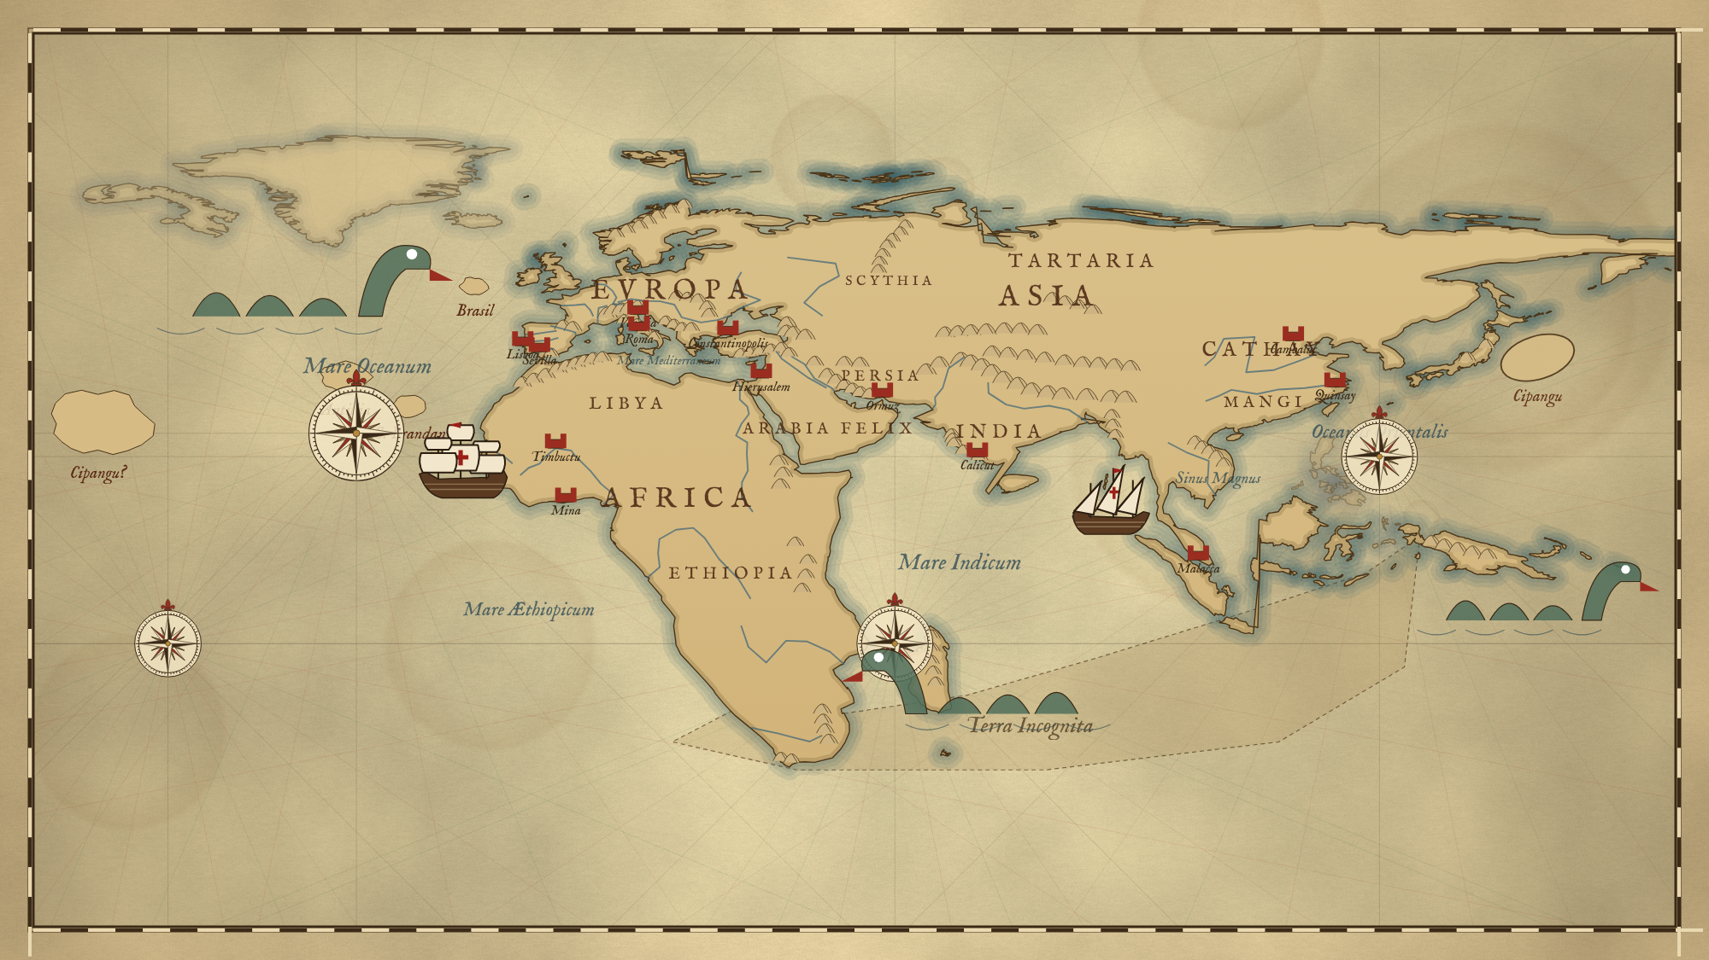
What is wrong with this map?
PREDICT
This is how Europeans pictured the world around 1490.
Find two things that are missing or wrong.
Notes:
TIME: 4 minutes (1 minute alone, 2 minutes with a partner, 1 minute share).
SAY: "This is how educated Europeans pictured the world around 1490. You know what the world really looks like. On your own, find two things that are missing or wrong. Then compare with your partner."
LISTEN FOR: no North or South America; Africa is the wrong shape and stretches too far; a made-up southern land (Terra Incognita) closes off the Indian Ocean; Asia stretches too far east; imaginary islands in the Atlantic; no Pacific Ocean; no Australia.
DO NOT correct everything now. Say: "By the end of this unit you will know which explorer fixed each of these mistakes."
WHY THIS DESIGN: pretesting (Bjork). Trying to answer before instruction, even wrongly, makes later learning stronger. The map also gives the unit its question: how did the map change?

Slide 3





Our route through the unit
1. Why sail?
2. How?
3. Around Africa
4. Across the Atlantic
5. Around the world
Spices, motives
Ships, stars, winds
Dias, da Gama
Columbus
Tordesillas, Magellan
Notes:
TIME: 1 minute.
SAY: "We will follow the same path as history: first why Europeans wanted to sail, then how they did it, then the voyages around Africa, across the Atlantic and finally around the whole world. After each part you will sail that voyage in the game."
WHY THIS DESIGN: segmenting and signaling (Mayer). Showing the five chunks up front helps students organize what follows. The same colors return on each section slide.

Slide 4
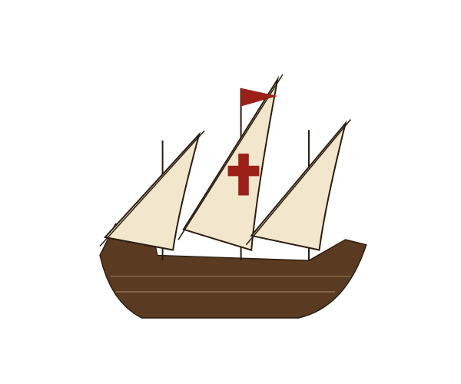
Four words you need first
Caravel
Astrolabe
Trade winds
Spice trade
A small, fast ship with triangular sails
Measures the sun or stars to find latitude
Steady winds that blow toward the west
Buying pepper, cloves and cinnamon from Asia
Notes:
TIME: 3 minutes.
SAY: "Four words will come up again and again. A CARAVEL is the small, fast Portuguese ship you sail in the game; its triangular lateen sails let it sail at an angle toward the wind. An ASTROLABE is a brass instrument that measures how high the sun or a star is, which tells you your LATITUDE, how far north or south you are. TRADE WINDS are steady winds near the tropics that blow from the east toward the west. The SPICE TRADE is the trade in Asian spices that Europeans would pay almost anything for."
DO: have students say each word aloud with you once.
WHY THIS DESIGN: pre-training (Mayer). Learning the key terms before the explanation frees working memory for the ideas. These four terms are also the first Codex cards in the game.

Slide 5
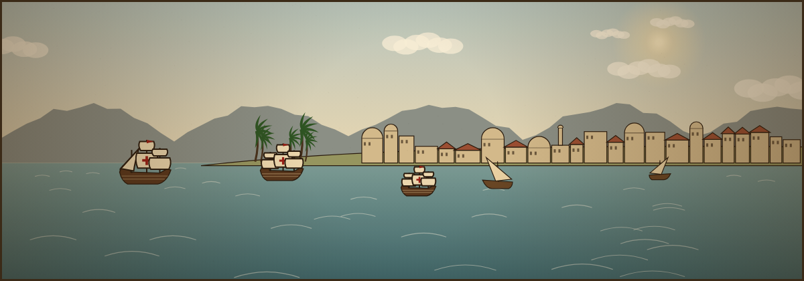
Why Sail?
Spices, middlemen and three big motives
Notes:
TIME: 15–20 minutes for this segment.
Segment goal: students can explain why Portugal and Spain wanted a sea route to Asia and name the three motives (God, Gold, Glory) with an example of each.

Slide 6
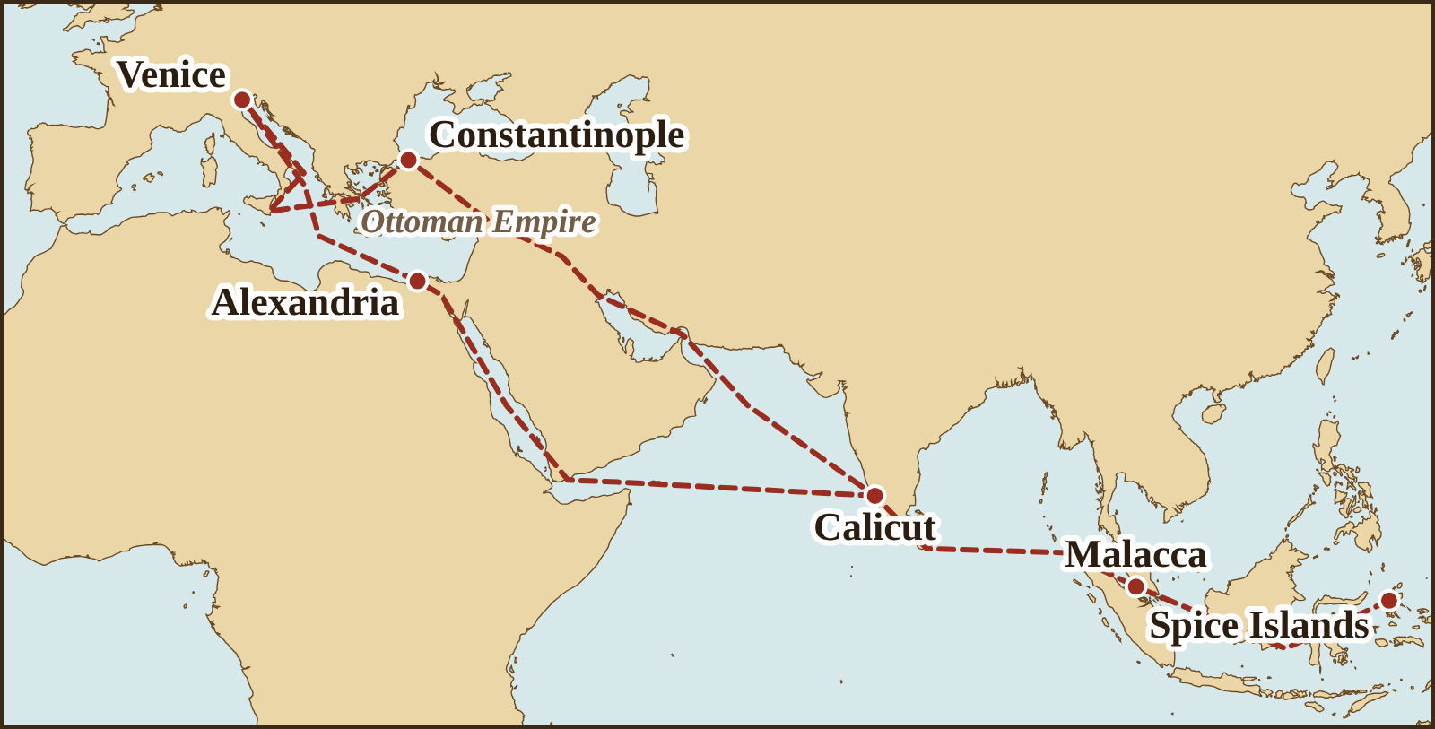
The spice routes ran through many hands
Spices changed hands many times; each trader added to the price.
1453: the Ottoman Empire takes Constantinople and controls key routes.
Goal: reach Asia by sea and cut out the middlemen.
Notes:
TIME: 4 minutes.
SAY: "Follow the red dashed lines. Pepper and cloves grew in India and the Spice Islands. Before reaching Europe they passed through Indian, Arab, Persian, Ottoman and finally Venetian merchants, and each one took a profit. By the time pepper reached Lisbon it was extremely expensive. After the Ottoman Turks captured Constantinople in 1453, they controlled several of these routes. So Portugal asked: what if we could sail all the way to Asia ourselves?"
POINT to Constantinople and Venice on the map while you say their names (temporal contiguity: say it while they look at it).
CHECK MISCONCEPTION: the land routes did not "close" in 1453; trade continued, but it was costly and controlled by others.
WHY THIS DESIGN: one map, labels on the map, three short callouts. The explanation is spoken, not printed (redundancy principle).

Slide 7


If you were the King of Portugal…
TURN & TALK
What problem would you want to solve? How might you solve it?
Sentence starter: “Portugal should… because…”
90 seconds each partner
Notes:
TIME: 3 minutes.
DO: Partner A speaks for 90 seconds while B listens, then switch. Cold-call two pairs to share.
LISTEN FOR: "find a sea route to Asia," "trade directly," "get spices cheaper," "go around Africa." Portugal sits on the Atlantic edge of Europe, so a sea route made sense.
WHY THIS DESIGN: generation (Bjork). Students reason toward the solution before they hear it. The map is repeated small so they can refer to it without searching back.

Slide 8


God, Gold and Glory
God
Gold
Glory
Spread Christianity to new lands
Get rich from spices, gold and trade
Win fame and power for rulers and nations
Notes:
TIME: 3 minutes.
SAY: "Historians often sum up the reasons for exploration in three words. GOD: spreading Christianity. GOLD: wealth from spices, gold and trade. GLORY: fame and power for explorers and their kings and queens. Most voyages had all three mixed together."
ASK: "Which of these would matter most to a sailor? To a king? To a priest?" (Quick answers, no need to write.)
WHY THIS DESIGN: three parallel columns with one icon and one line each, so the structure is visible at a glance (signaling, coherence).

Slide 9
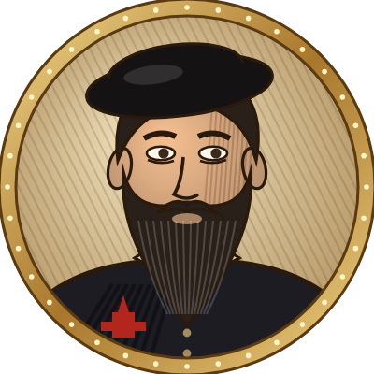
In their own words: Calicut, 1498
TURN & TALK
“
They asked what he sought so far away from home, and he told them that we came in search of Christians and of spices.
Which motives do you hear?
A Journal of the First Voyage of Vasco da Gama (the “Roteiro”), author unknown; trans. E. G. Ravenstein (Hakluyt Society, 1898).
Who wrote this, and were they there?
Notes:
TIME: 3 minutes.
CONTEXT: in May 1498, da Gama's first man ashore at Calicut, India, was met by two merchants from Tunis who spoke Spanish. This is his answer to "what brought you here?"
ASK: "Which motives do you hear?" (God: Christians; Gold: spices.) "Who wrote this?" (An unknown sailor on the voyage, an eyewitness.)
WHY THIS DESIGN: a short, authentic primary source tied to the idea just taught; sourcing questions build the habit used in practice-deck Level 4.

Slide 10

Which was NOT a reason Europeans explored?
CHECK
To spread Christianity
To buy spices without middlemen
A
B
To escape the cold European winters
To win fame for their rulers
C
D
Show 1–4 fingers on the count of three.
Notes:
TIME: 1 minute.
ANSWER: C (3 fingers). A = God, B = Gold, D = Glory.
IF MORE THAN A QUARTER MISS: return to the God, Gold, Glory slide and give one more example of each before moving on.
WHY THIS DESIGN: a hinge question shows instantly whether to move on. Retrieval right after learning starts the memory; we will retrieve again later (spacing).

Slide 11
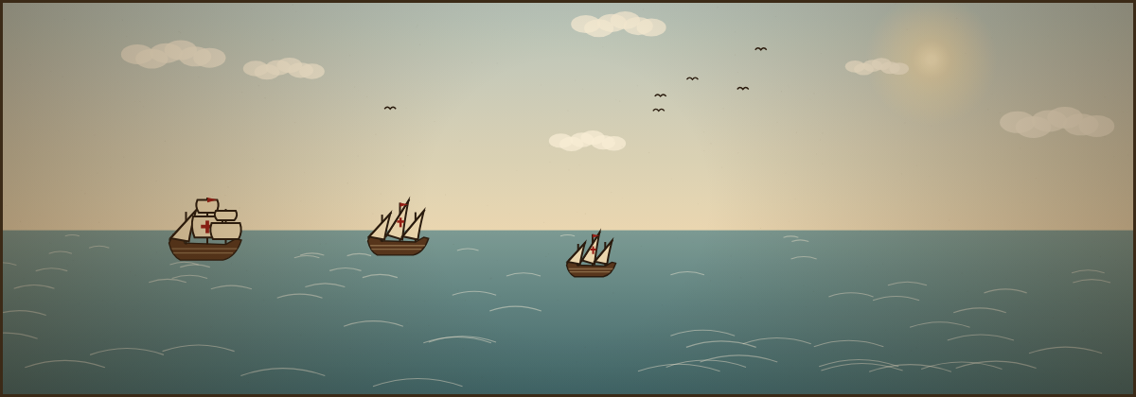
Ships, Stars and Winds
How did sailors find their way across open ocean?
Notes:
TIME: 20 minutes.
Segment goal: students can explain what a caravel could do, why latitude was measurable but longitude was not, and how wind belts shaped routes.

Slide 12
The caravel
Triangular lateen sails: sail at an angle toward the wind
Small and fast: about 20 meters long
Shallow hull: explore coasts and river mouths
Notes:
TIME: 2 minutes.
SAY: "The caravel was Portugal's secret weapon. Its triangular LATEEN sails, borrowed from Arab and Mediterranean sailors, let it sail at an angle into the wind and zig-zag home. Its shallow hull let it explore coastlines and river mouths. It was small, about 20 meters, the length of two school buses."
POINT to each part as you name it. Connect: "In the game, if you sail straight into the wind you barely move. Sailing at an angle is called tacking."
WHY THIS DESIGN: labels sit beside the parts they name, joined by arrows (spatial contiguity and signaling).

Slide 13
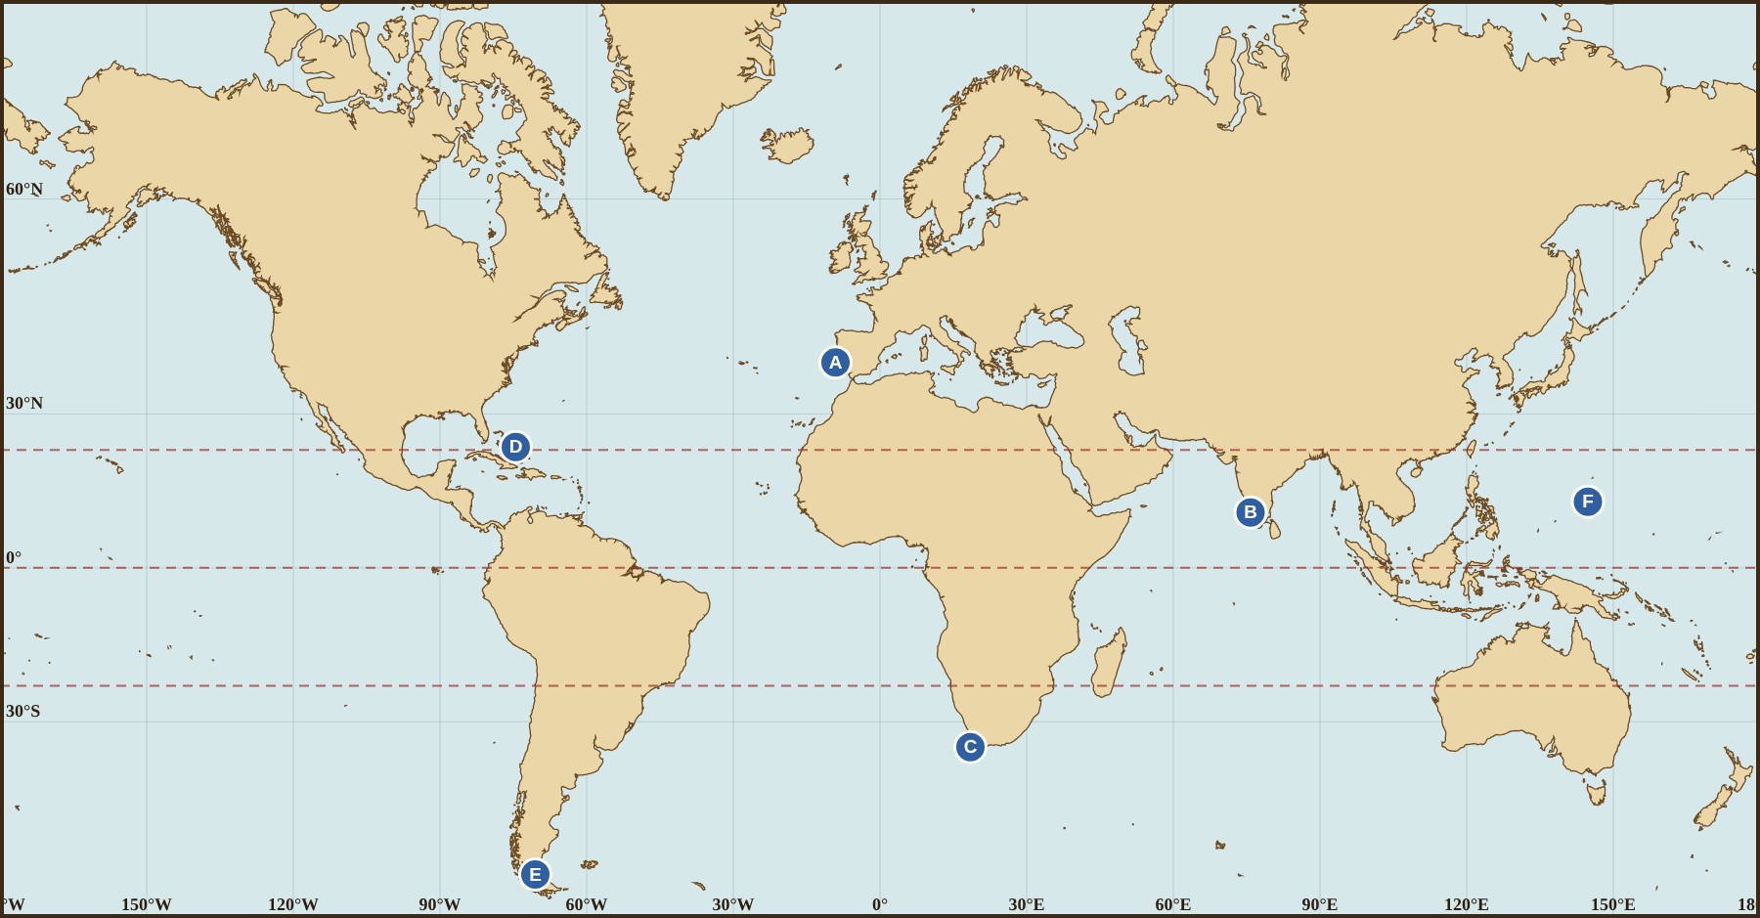
Latitude: measured. Longitude: guessed.
✓ Latitude
North–south. Measured from the sun or North Star with an astrolabe.
✗ Longitude
East–west. Only guessed by dead reckoning: speed × time × direction.
Notes:
TIME: 3 minutes.
SAY: "Lines of LATITUDE run east–west and tell you how far north or south you are. Sailors could measure it: the higher the North Star above the horizon, the farther north you are. Lines of LONGITUDE run pole to pole and tell you how far east or west you are. Nobody could measure longitude at sea until accurate clocks were invented in the 1700s, so sailors used DEAD RECKONING: if I sailed west at 5 knots for 10 hours, I am about 50 nautical miles west."
CONNECT: "In the game, look at the top right: latitude is a number; longitude has an ≈ sign because it is a guess."
WHY THIS DESIGN: a direct two-way comparison, with the map for reference, instead of a paragraph of text.

Slide 14
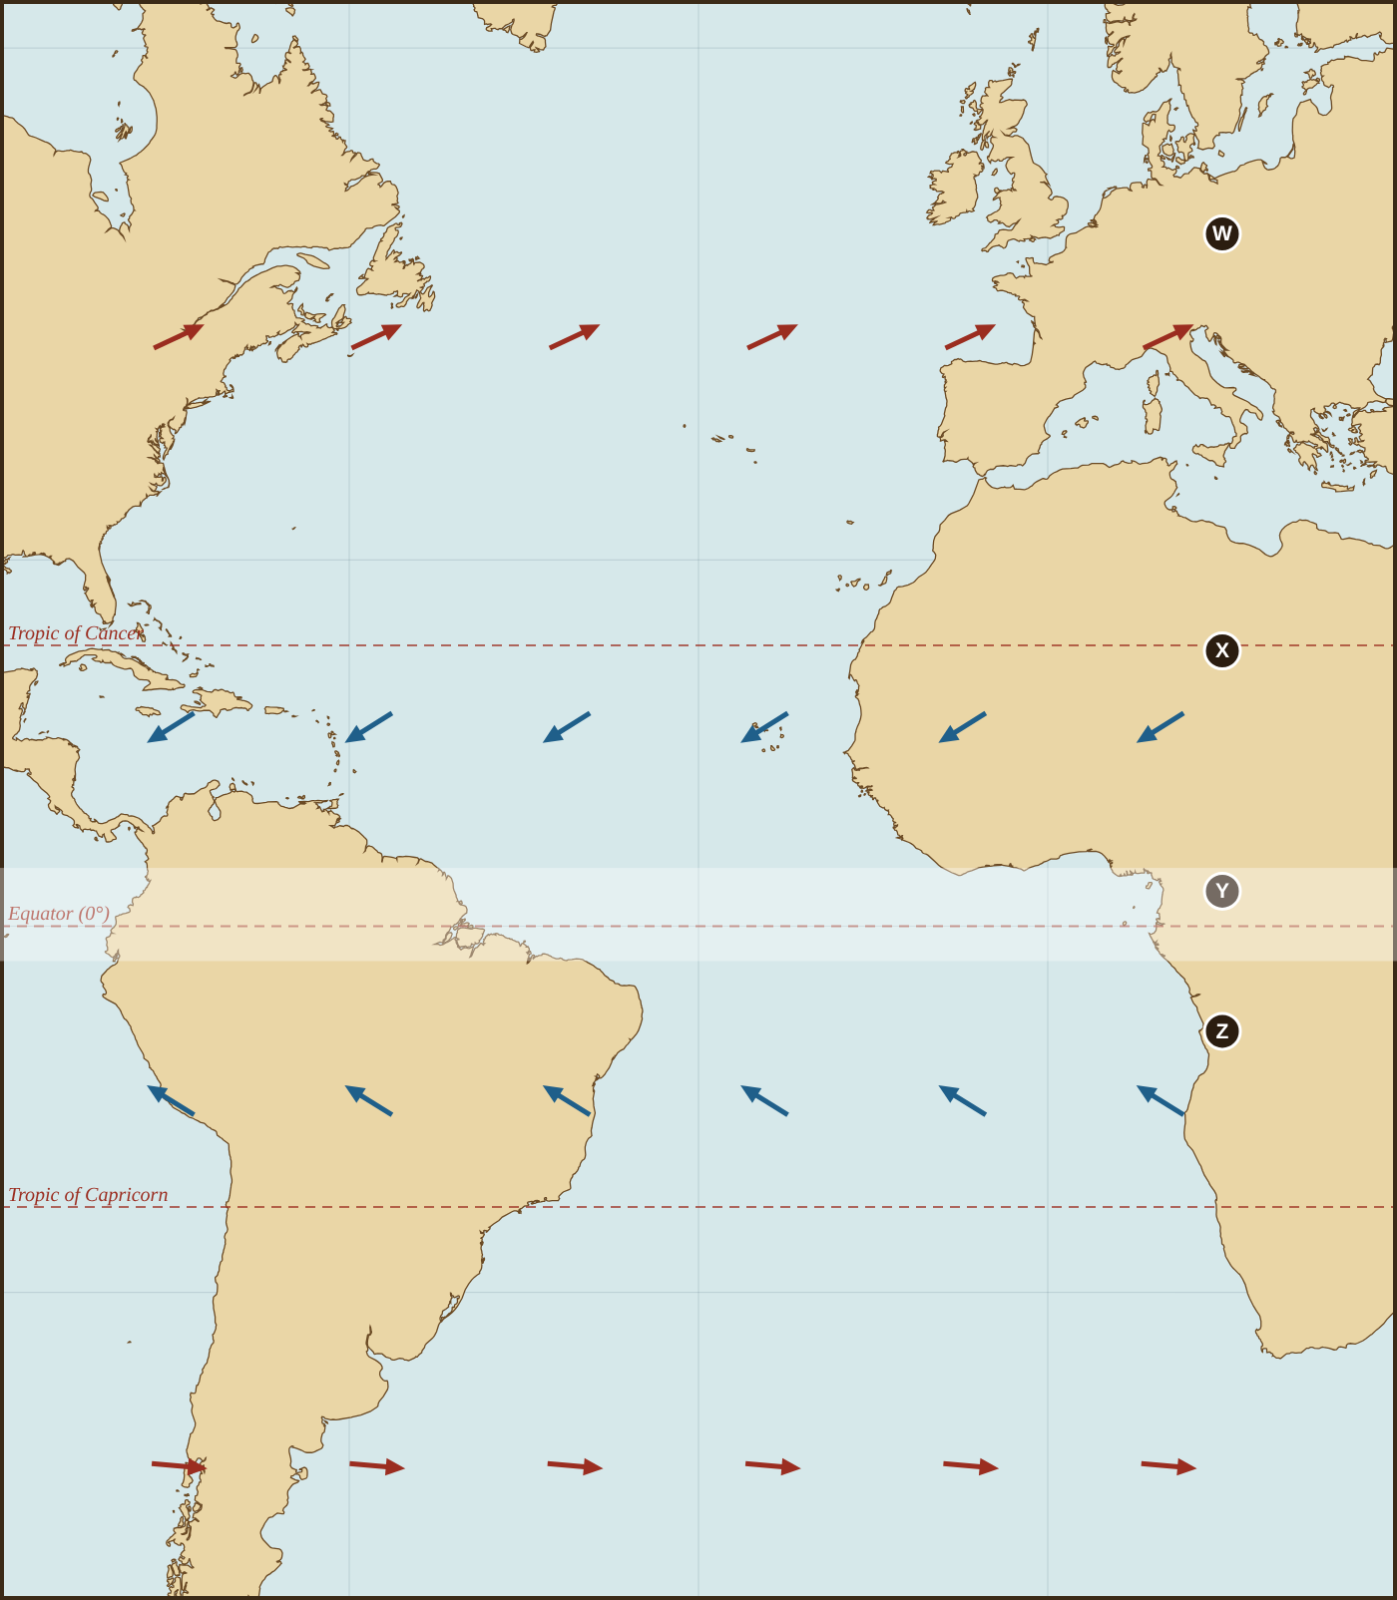
Wind belts decided the routes
W
Westerlies
blow toward the east
X
Northeast trade winds
blow toward the west
Y
Doldrums
calm: ships get stuck
Z
Southeast trade winds
blow toward the northwest
Notes:
TIME: 4 minutes.
SAY (pointing at each letter): "Sailing ships went where the wind let them. Near Europe, the WESTERLIES blow toward the east, which is great for coming home. Farther south, around the Canary Islands, the NORTHEAST TRADE WINDS blow steadily toward the west. Near the Equator are the DOLDRUMS, where the wind can die for days. South of the Equator, the SOUTHEAST TRADE WINDS blow toward the northwest."
DO: have students trace the arrows with a finger in the air: "Which way would you go at X?" (west)
WHY THIS DESIGN: the labels line up with the letters on the map (spatial contiguity); the narration explains while students look (temporal contiguity). This is the key idea behind the next prediction.

Slide 15
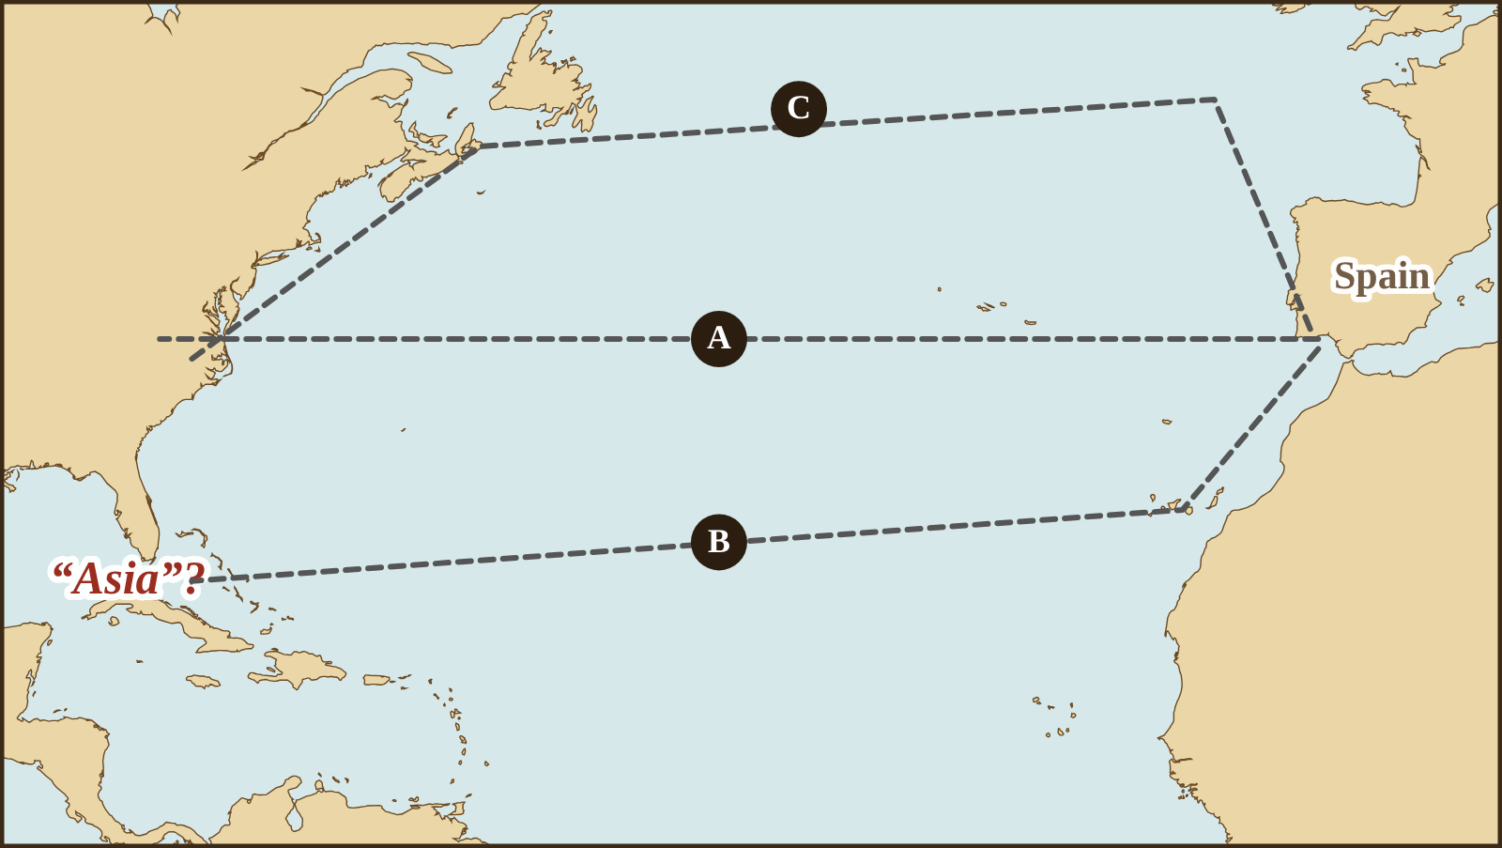
Sailing west to “Asia”: which route?
PREDICT
Use the wind belts to decide: A, B or C?
Write your letter and one reason before we reveal.
Notes:
TIME: 2 minutes.
DO: everyone commits to a letter and a reason on a whiteboard or paper BEFORE you advance. Ask a few students to defend different letters.
ANSWER (do not reveal yet): B. A sails straight into the westerlies; C goes far north into cold, stormy westerlies; B drops south to the Canaries to catch the northeast trade winds blowing west.
WHY THIS DESIGN: generation effect (Bjork). Committing to a prediction, then checking it, produces stronger memory than being told. Wrong predictions are useful here.

Slide 16
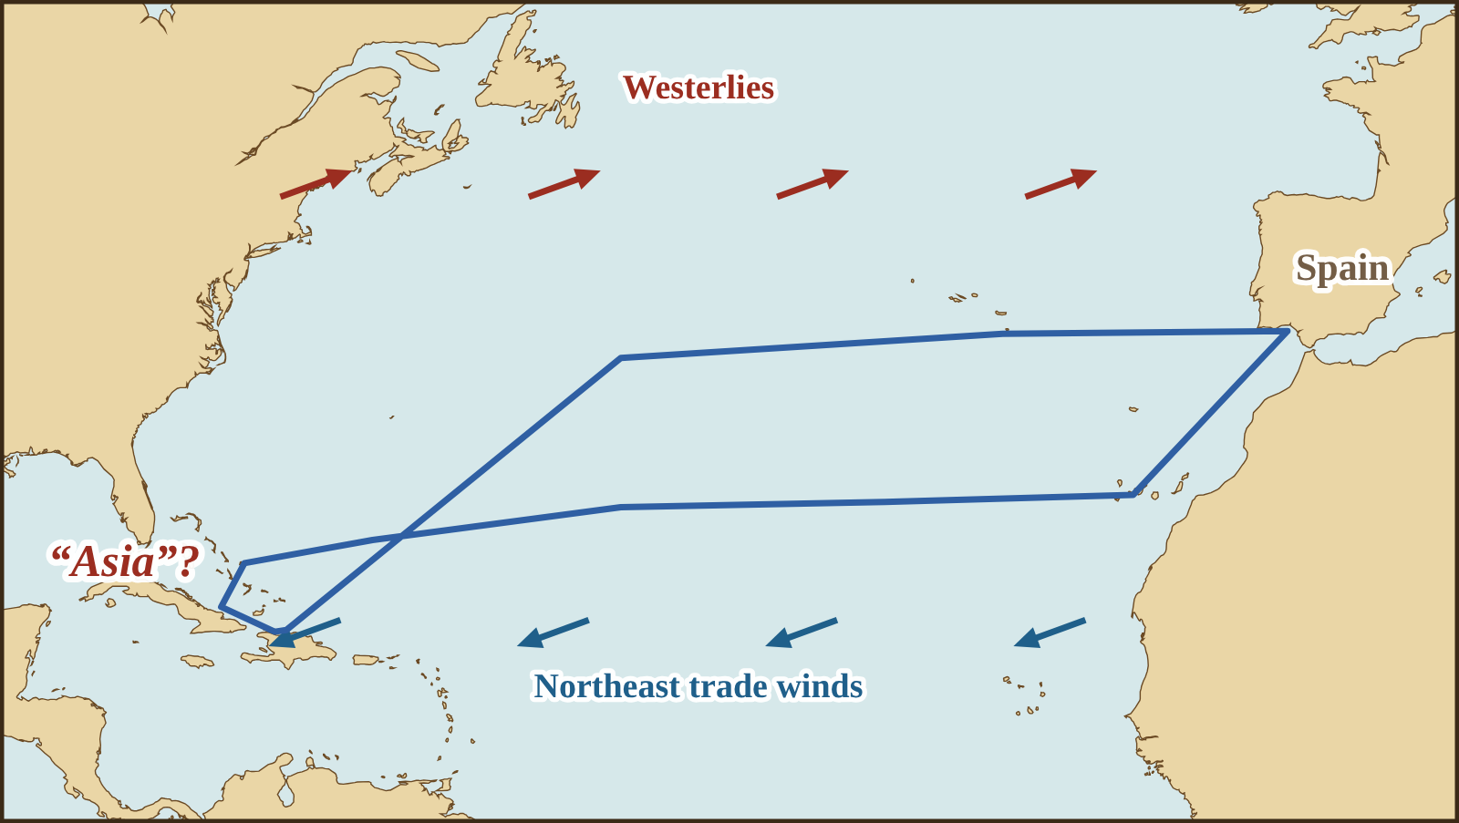
Route B: south, then west on the trade winds
Out: south to the Canary Islands, then west with the northeast trade winds
Home: north to the westerlies, then east to Spain
Notes:
TIME: 2 minutes.
SAY: "Columbus went south to the Canary Islands first, exactly where the northeast trade winds begin, and they pushed him west for 33 days. To come home he sailed north until he found the westerlies. This loop, west in the south and east in the north, became the main sailing route across the Atlantic for centuries."
ASK: "Who predicted B? What clue did you use?"
WHY THIS DESIGN: immediate feedback after a prediction; the reveal uses the same map so only the new information changes.

Slide 17

Close your notes
RECALL
1
What does an astrolabe measure?
2
Which winds blow west near the Canary Islands?
3
Name one motive for exploring and give an example.
Notes:
TIME: 3 minutes.
DO: notes closed. Students write answers alone for 90 seconds, then check with a partner, then you give answers.
ANSWERS: 1) The height of the sun or a star, which gives latitude. 2) The northeast trade winds. 3) God (spread Christianity), Gold (spices, wealth) or Glory (fame, power), with an example.
WHY THIS DESIGN: retrieval practice with spacing (Bjork). Question 3 comes from the previous segment on purpose. Effortful recall without notes is a desirable difficulty.

Slide 18
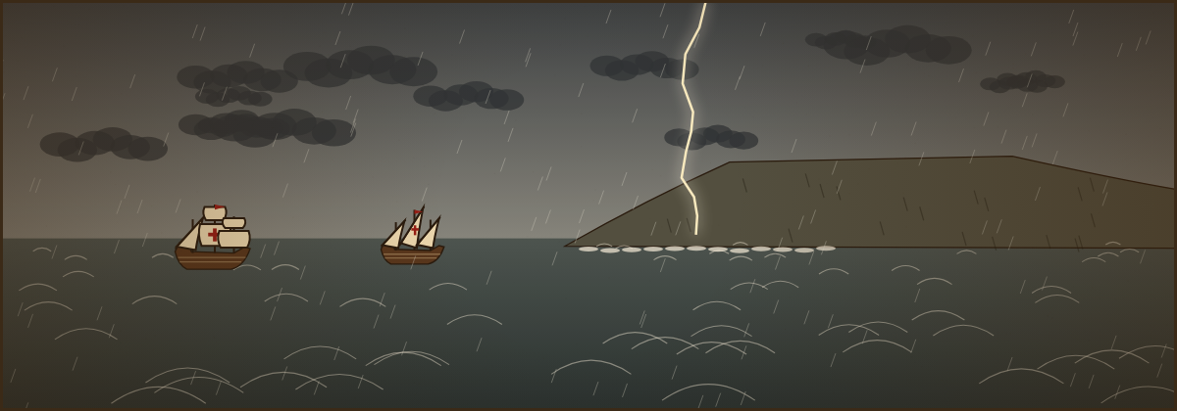
Portugal: Around Africa
Bartolomeu Dias and Vasco da Gama
Notes:
TIME: 20 minutes, then students play the Dias or da Gama voyage.
Segment goal: students can trace both routes, explain the volta do mar, and say why reaching India mattered.

Slide 19
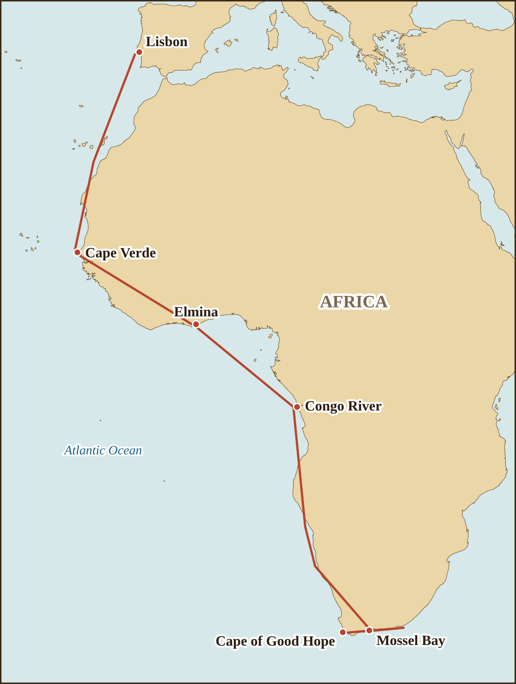
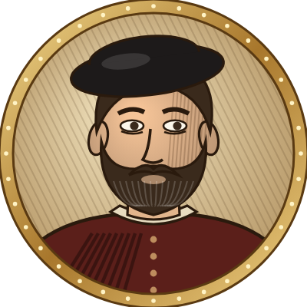
Bartolomeu Dias, 1487–1488
Sailing for Portugal
1
First European to sail around the southern tip of Africa (1488)
2
His tired crew forced him to turn back
3
Named it the “Cape of Storms”
Notes:
TIME: 3 minutes.
SAY: "In 1487 King John II sent Bartolomeu Dias south along Africa. A storm blew his ships far south, out of sight of land for nearly two weeks. When he turned north again, the coast was running EAST: he had gone around the tip of Africa without seeing it. His exhausted crew demanded to go home, and on the way back he saw the great cape and called it the Cape of Storms."
TRACE the route on the map with the pointer as you tell it.
WHY THIS DESIGN: map left, three numbered facts right, labels on the map. The story is told aloud.

Slide 20
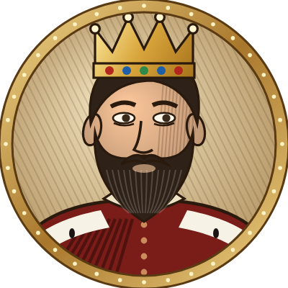
Why rename it “Cape of Good Hope”?
TURN & TALK
King John II changed the name from Cape of Storms to Cape of Good Hope. What was he hoping for?
King John II of Portugal
Notes:
TIME: 2 minutes.
LISTEN FOR: hope of reaching India and the spice trade by sea; good publicity to encourage more sailors and investors.
WHY THIS DESIGN: a short inference question that connects a fact (the renaming) to the big motive (the spice route).

Slide 21
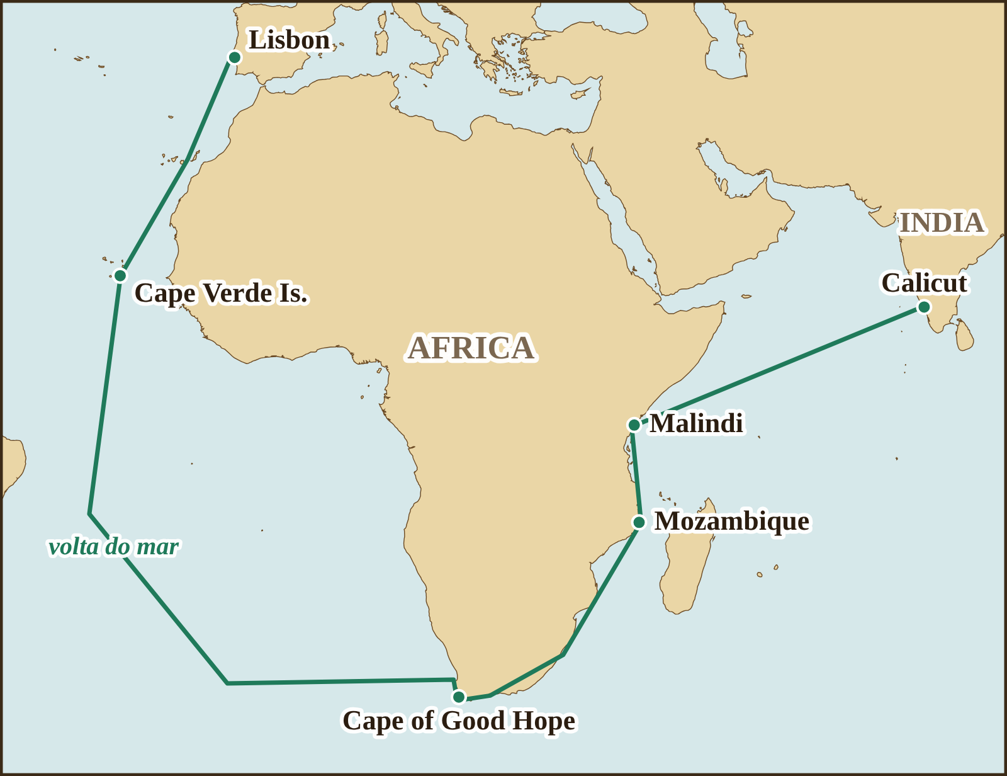
Vasco da Gama, 1497–1499
Sailing for Portugal
1
Volta do mar: a huge loop into the open ocean to find better winds
2
A pilot from Malindi guided him across the Arabian Sea
3
Reached Calicut, India, in 1498
Notes:
TIME: 4 minutes.
SAY: "Ten years later, Vasco da Gama followed Dias's path, but with a bold change. Instead of hugging the coast, where winds blew against him, he swung far out into the Atlantic, the VOLTA DO MAR, and was out of sight of land for about three months. He rounded the Cape, sailed up the East African coast, and at Malindi hired an experienced local pilot who knew the monsoon winds. In May 1498 he reached Calicut, India."
POINT to the words "volta do mar" on the map loop.
KEY POINT: the Indian Ocean already had a rich trade network; the Portuguese were newcomers relying on local knowledge.
WHY THIS DESIGN: same map style as Dias so students can compare the routes.

Slide 22
Why did da Gama swing far out into the Atlantic?
CHECK
To find stronger winds that would carry him south and east
To look for Brazil
A
B
To avoid pirates near Africa
Because his maps were wrong
C
D
Write the letter on your whiteboard.
Notes:
TIME: 1 minute.
ANSWER: A. The volta do mar used the trade winds and then the westerlies of the South Atlantic to reach southern Africa faster than fighting headwinds along the coast.
COMMON WRONG ANSWER: B. Brazil was not known yet (Cabral reached it in 1500, partly by swinging even wider).
WHY THIS DESIGN: hinge check on the hardest new idea in the segment.

Slide 23
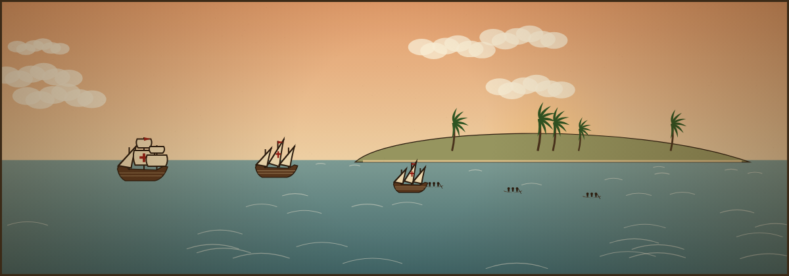
Spain: Across the Ocean Sea
Christopher Columbus and the encounter
Notes:
TIME: 20–25 minutes, then students play the Columbus voyage.
Segment goal: students can explain Columbus's mistaken plan, describe his route, analyze a primary source with sourcing, and describe the Columbian Exchange.

Slide 24
Columbus thought Asia was close
He thought the Earth was smaller and Asia much wider than they are.
The Americas lay right where he expected Asia.
Notes:
TIME: 3 minutes.
SAY: "Educated Europeans knew the Earth was round. The argument was about its SIZE. Columbus calculated that Japan was only about 2,400 nautical miles west of the Canary Islands. The real distance is about 10,600. Experts in Portugal and Spain told him he was wrong, and they were right. No ship of the time could carry food and water for 10,600 miles. Columbus survived only because two continents nobody in Europe knew about were in the way."
MISCONCEPTION ALERT: students often believe people thought the Earth was flat. They did not.
WHY THIS DESIGN: a native bar chart makes the size of the mistake visible instantly; two short callouts carry the meaning.

Slide 25
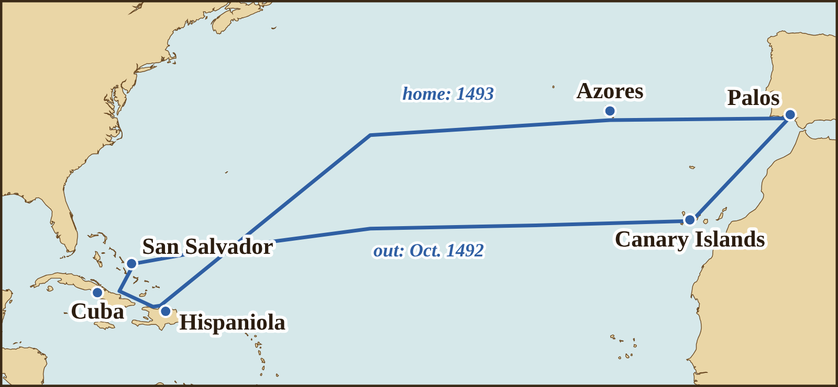
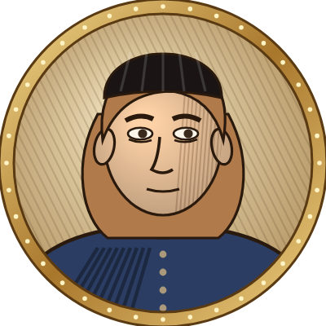
Christopher Columbus, 1492–1493
Sailing for Spain
1
Sponsored by Ferdinand and Isabella
2
Landed on San Salvador, Oct. 12, 1492
The Taíno people already lived on these islands.
3
Believed he had reached the “Indies” of Asia
Notes:
TIME: 4 minutes.
SAY: "After years of asking, Columbus convinced Ferdinand and Isabella of Spain to fund him. With three ships he sailed from Palos to the Canaries and then west. On October 12, 1492, he landed on an island in the Bahamas that the Taíno people called Guanahani; he named it San Salvador. He explored Cuba and Hispaniola, sure that he was near China and Japan, and called the people 'Indians.' He died still believing he had reached Asia."
EMPHASIZE: these lands were already home to millions of people. "Discovery" describes a European point of view.
WHY THIS DESIGN: route map plus three facts; the scene and callout keep the Taíno in view.

Slide 26
Source: Columbus meets the Taíno
TURN & TALK
“
1. What does Columbus plan for the Taíno?
They should be good servants and intelligent, for I observed that they quickly took in what was said to them, and I believe that they would easily be made Christians, as it appeared to me that they had no religion.
2. What does he assume? Could he know that after one day?
3. Why does it matter that we only have a summary?
Columbus, Journal, entry for Oct. 11–12, 1492; surviving only in Bartolomé de las Casas’s summary. Trans. in Olson and Bourne, eds., The Northmen, Columbus and Cabot (1906).
Notes:
TIME: 5 minutes.
DO: read the quotation aloud once while students follow. Pairs discuss the three questions; cold-call one pair per question.
ANSWERS: 1) To make them servants and convert them. 2) That they had no religion; after one day and no shared language he could not know this, and in fact the Taíno had their own beliefs. 3) The original log is lost; the text was copied and summarized decades later by Las Casas, so some words may not be Columbus's.
This source is Source B in the practice deck.
WHY THIS DESIGN: the source is large and readable; the questions sit beside it, not on another slide (spatial contiguity).

Slide 27








The Columbian Exchange
Americas → Europe, Africa, Asia
Europe, Africa, Asia → Americas
Corn
Potatoes
Horses
Wheat
Tomatoes
Cacao
Cattle
Smallpox
Notes:
TIME: 4 minutes.
SAY: "After 1492, plants, animals, people and diseases crossed the Atlantic in both directions. Historians call this the Columbian Exchange. From the Americas came corn, potatoes, tomatoes and cacao, which changed diets around the world. From Europe came horses, wheat and cattle, and diseases like smallpox. Indigenous peoples had never been exposed to smallpox, and epidemics killed a huge share of the population. The exchange also included the forced movement of millions of enslaved Africans."
ASK: "What food you ate this week would not exist without the Columbian Exchange?" (pizza sauce, fries, chocolate)
WHY THIS DESIGN: icons with one-word labels in two signaled columns; the narration supplies the causes and consequences.

Slide 28
Which explorer? Mixed review
CHECK
1. Reached India by sea
A Dias
B Columbus
C da Gama
2. First to sail around the tip of Africa
3. Landed in the Bahamas
4. Hired a pilot at Malindi
5. Sponsored by Ferdinand and Isabella
Notes:
TIME: 2 minutes.
ANSWERS: 1 C, 2 A, 3 B, 4 C, 5 B.
WHY THIS DESIGN: interleaving (Bjork). Mixing explorers forces students to tell them apart instead of answering from whichever lesson was most recent. It feels harder, and that is the point.

Slide 29
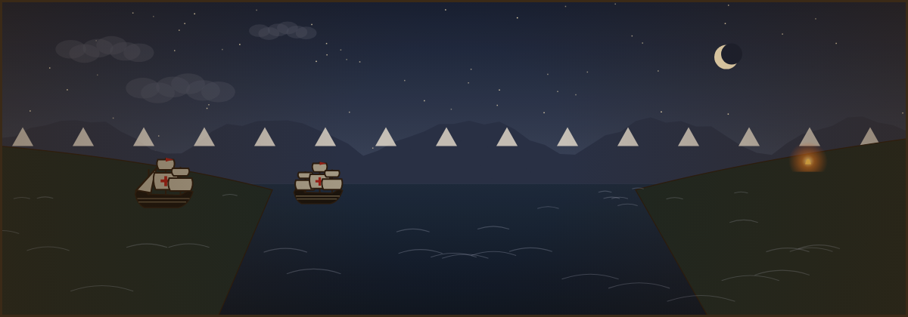
Dividing and Circling the World
The Treaty of Tordesillas and Magellan’s voyage
Notes:
TIME: 20–25 minutes, then students play the Magellan voyage.
Segment goal: students can explain the Treaty of Tordesillas and its effects, trace Magellan's route, and weigh the cost of the first circumnavigation.

Slide 30
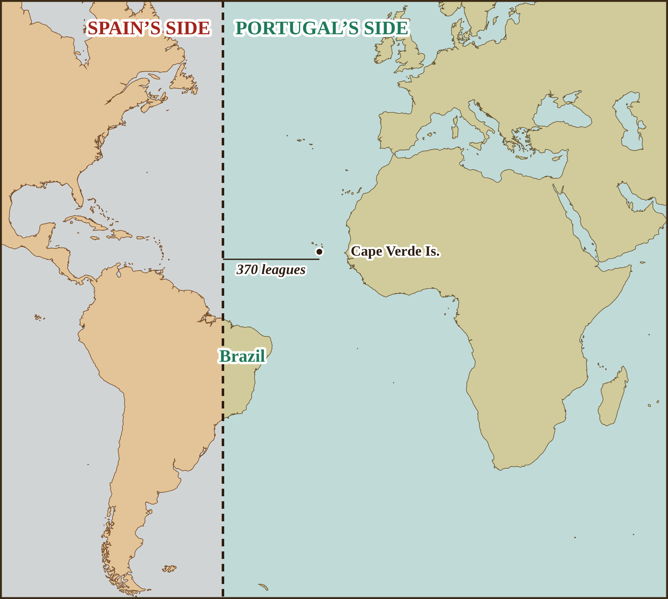
1494: Spain and Portugal divide the world
“
…a boundary or straight line be determined and drawn north and south, from pole to pole… at a distance of three hundred and seventy leagues west of the Cape Verde Islands…
Treaty of Tordesillas, 1494; trans. F. G. Davenport (1917).
This is why Brazil speaks Portuguese today.
Notes:
TIME: 3 minutes.
SAY: "After Columbus returned, Spain and Portugal nearly went to war over who owned the new lands. In 1494, in the Treaty of Tordesillas, they drew a line down the Atlantic, 370 leagues west of the Cape Verde Islands. New lands west of the line went to Spain; lands east went to Portugal. The eastern bulge of South America fell on Portugal's side, which is why Brazilians speak Portuguese."
WHY THIS DESIGN: the map shows the line; the quote shows the actual language; one callout gives the lasting effect.

Slide 31
Who was not asked?
TURN & TALK
Two kingdoms divided lands where millions of people already lived.
Who was left out of this decision? What might they have said?
Notes:
TIME: 3 minutes.
LISTEN FOR: the Indigenous peoples of the Americas, Africa and Asia; other European kingdoms such as England and France (who ignored the treaty).
WHY THIS DESIGN: perspective-taking after a fact, preparing for the Level 4 sources and Level 5 claims in the practice deck.

Slide 32
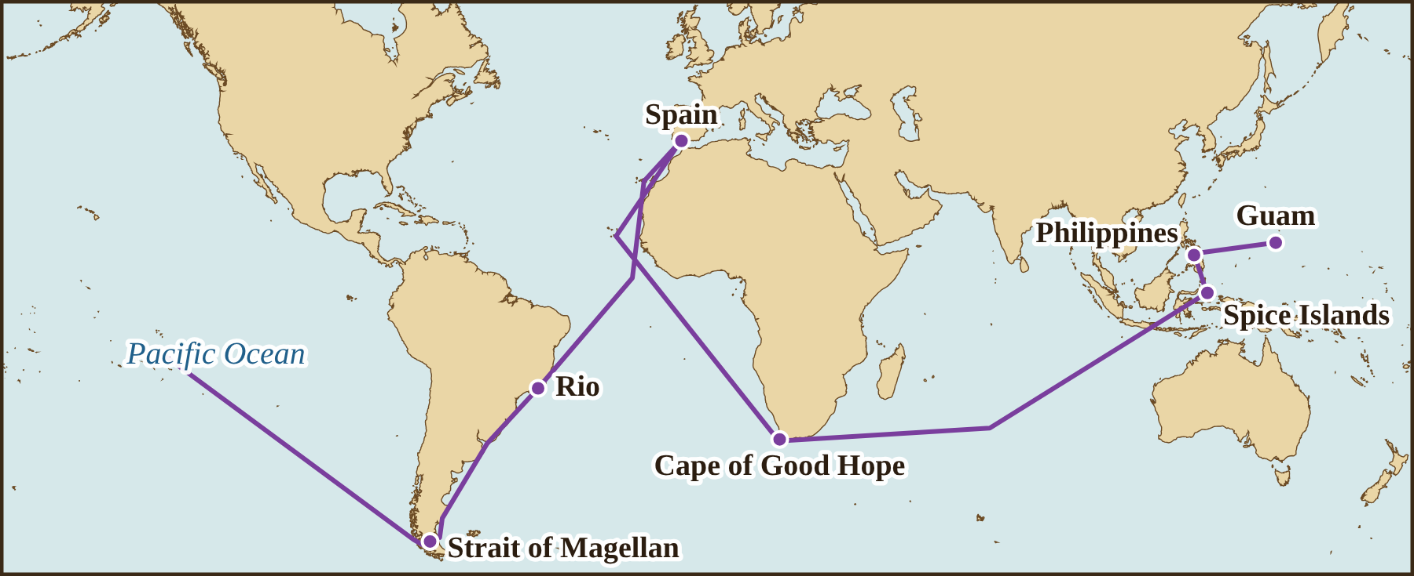
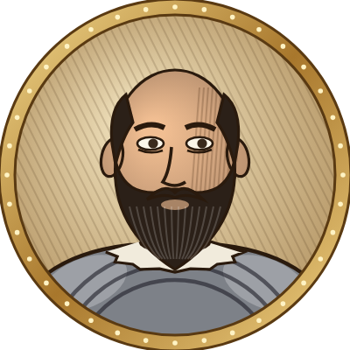
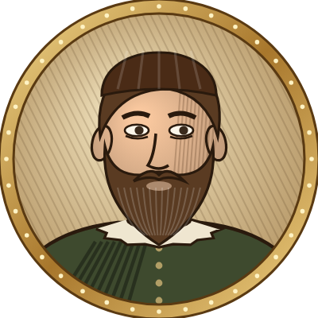
Magellan and Elcano, 1519–1522
1
Found a strait through South America
2
Magellan was killed in the Philippines by Lapu-Lapu’s warriors (1521)
3
Elcano brought 18 men home: the first trip around the world
Notes:
TIME: 4 minutes.
SAY: "Magellan was Portuguese but sailed for Spain, hoping to reach the Spice Islands by going west. He found a narrow, dangerous strait at the tip of South America, now the Strait of Magellan, and crossed the Pacific, which was far larger than anyone imagined. In the Philippines, he tried to force the chief Lapu-Lapu of Mactan to submit to Spain and was killed in battle in 1521. Juan Sebastián Elcano took command and brought one ship, the Victoria, home in 1522 with only 18 of about 270 men."
TRACE the route. Point out that the line leaves the right edge and comes back on the left: the world is round.
WHY THIS DESIGN: same map style and fact layout as the other explorers, which makes comparison easy.

Slide 33
Source: crossing the Pacific
“
Scurvy
We were three months and twenty days without getting any kind of fresh food. We ate biscuit, which was no longer biscuit, but powder of biscuits swarming with worms… Rats were sold for one-half ducado apiece, and even then we could not get them.
A disease from lack of vitamin C. It killed more sailors than storms.
Pigafetta was one of the 18 survivors. Why is his account valuable?
Antonio Pigafetta, who sailed with Magellan; trans. J. A. Robertson (1906).
Notes:
TIME: 3 minutes.
SAY: read the quotation aloud. "This is Antonio Pigafetta, an Italian scholar who kept a journal every day. Without fresh fruit and vegetables, the crew got scurvy: gums swelled, teeth fell out, and many died."
ANSWER: he was an eyewitness who wrote things down at the time; but he is one person, writing for powerful patrons after he survived.
This is Source F in the practice deck.
WHY THIS DESIGN: a vivid authentic source anchors an abstract cost (scurvy) in a concrete experience.

Slide 34
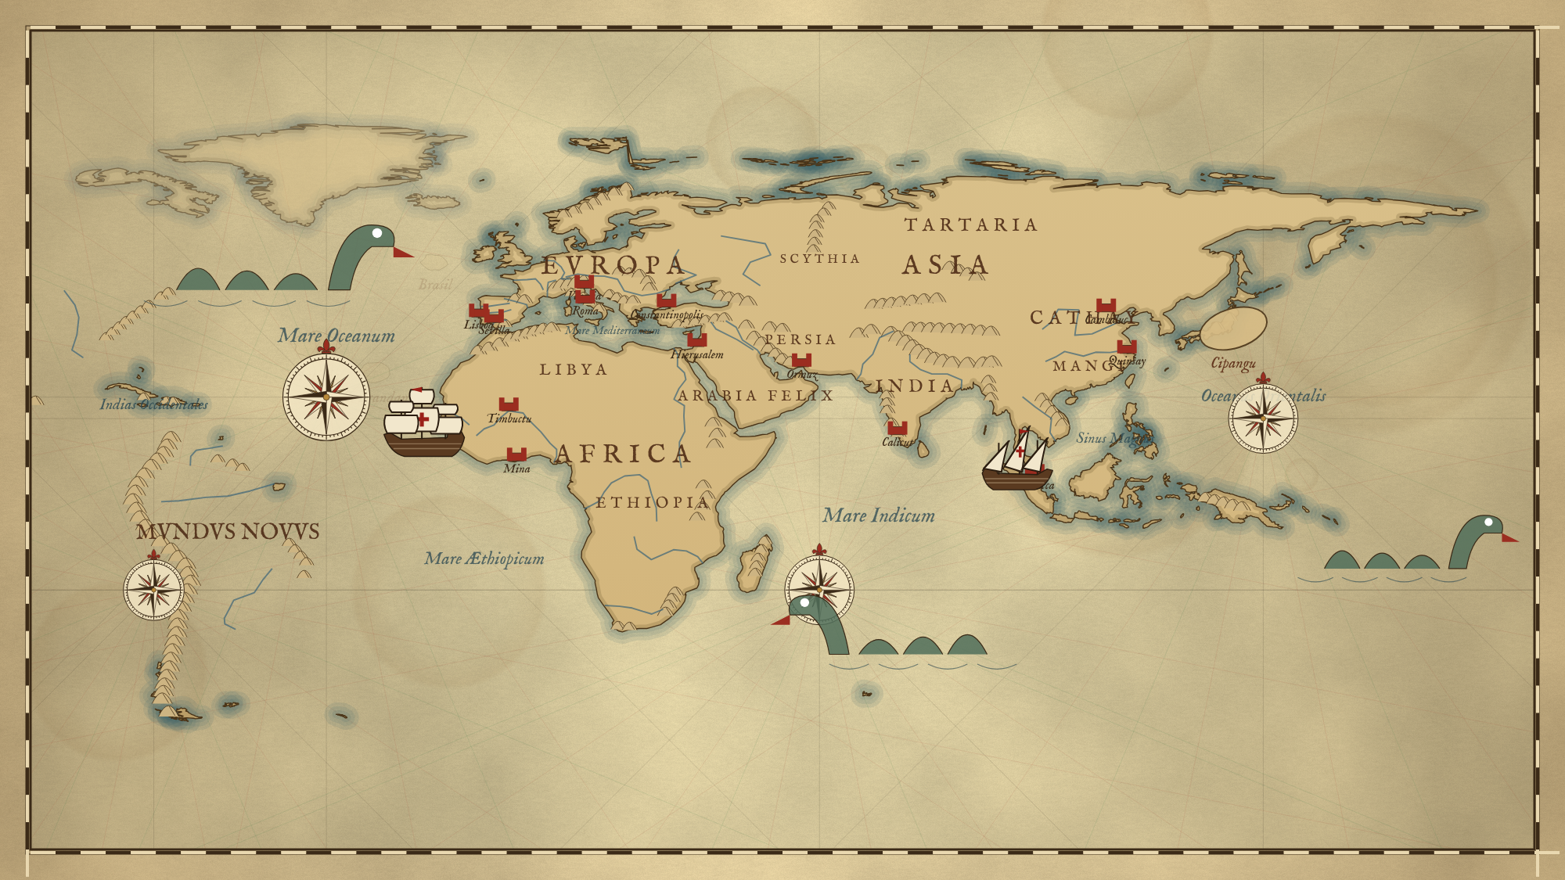
How did the map change?
RECALL
Before: c. 1490
After: 1522
Name three changes. Which explorer caused each one?
Notes:
TIME: 4 minutes.
DO: notes closed; 2 minutes alone, then share. Return to the opening slide question: "Which of your mistakes from day one did these explorers fix?"
ANSWERS: southern Africa redrawn and Terra Incognita removed (Dias, da Gama); India corrected (da Gama); Caribbean added (Columbus); South America and the Pacific added (Magellan).
WHY THIS DESIGN: spaced retrieval that loops back to the pretest; varied context (the same facts recalled from a map instead of a list) is another desirable difficulty.

Slide 35
Mixed review: no notes
RECALL
1
Why did Europeans want a sea route to Asia?
2
Why could sailors measure latitude but not longitude?
3
What was the volta do mar?
4
What did the Treaty of Tordesillas do?
5
Name one plant and one disease in the Columbian Exchange.
Notes:
TIME: 6 minutes.
DO: notes closed, answer alone, then partners compare and correct in a different color.
ANSWERS: 1) To buy spices directly, without costly middlemen and Ottoman-controlled routes. 2) Latitude comes from the height of the sun or stars; longitude needs an accurate clock. 3) A wide loop into the Atlantic to catch better winds. 4) Divided new lands between Spain (west of the line) and Portugal (east). 5) For example corn, potatoes, tomatoes or cacao; smallpox.
WHY THIS DESIGN: cumulative, interleaved retrieval across all five segments, the strongest form of review (Bjork).

Slide 36




Make a claim
WRITE
The most significant voyage was ______ because ______.
Think
Write
Pair
Share
1 min
3 min: claim + 2 pieces of evidence
2 min: read to a partner
a few volunteers
Notes:
TIME: 8 minutes.
DO: think, write, pair, share. Any explorer can be defended. Push students to use specific evidence from the maps and sources (dates, places, a quotation) and to say who was affected, not only Europe.
EXTENSION: add a counterclaim ("Some might argue… however…"). This is the bridge to practice-deck Level 5.
WHY THIS DESIGN: generating an argument is effortful and durable; the four steps are signaled visually so students know the routine.

Slide 37
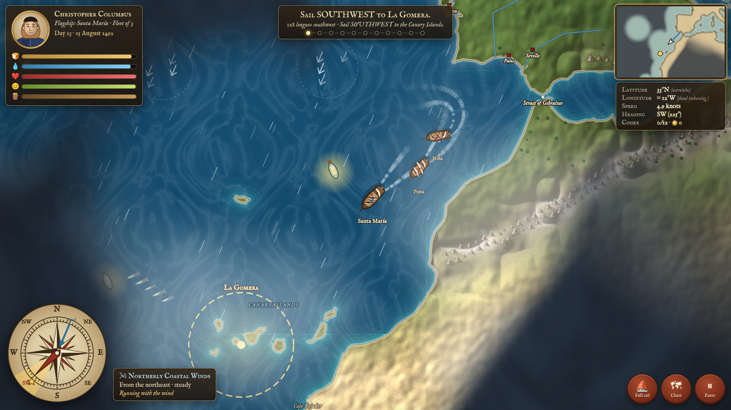
Exit ticket and next steps
Exit ticket
Name one explorer and the country that sponsored him.
Describe his route using two compass directions.
One question you still have.
Next: sail the voyage in the game, then do the matching practice-deck slides.
Notes:
TIME: 4 minutes.
DO: collect exit tickets and sort into "got it / partly / not yet" to plan the next segment's review.
PAIRINGS: Segment 1–2 → practice deck Levels 1–2 and the Geography Lab (compass, winds). Segment 3 → Dias and da Gama voyages; Geography Lab da Gama route. Segment 4 → Columbus voyage; Sources B and C. Segment 5 → Magellan voyage; Sources E and F; Level 5 claims. The Class Race works as a whole-class review after any segment.
WHY THIS DESIGN: spacing. Practice in the game and deck on later days revisits the same ideas after a delay, which strengthens long-term memory more than one long session.

