Slide 1
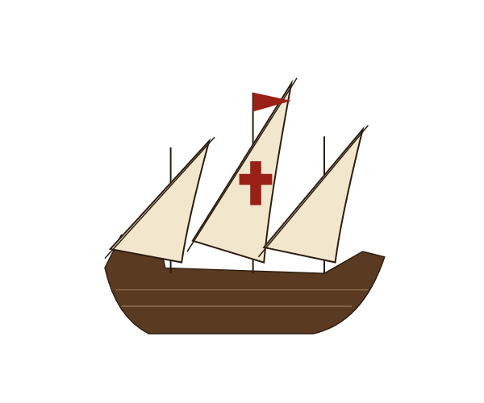
Beyond the Horizon
Age of Exploration Unit Practice · Key terms, people, places, events, primary sources and claim writing
Notes:
This deck is the practice home for the whole unit. Activities climb from recall (Level 1) to claim writing (Level 5), with a geography lab in the middle. Answers for every activity are in the speaker notes of that slide and collected in the answer key at the end. The background is the game's reconstruction of how Europeans pictured the world around 1490.

Slide 2
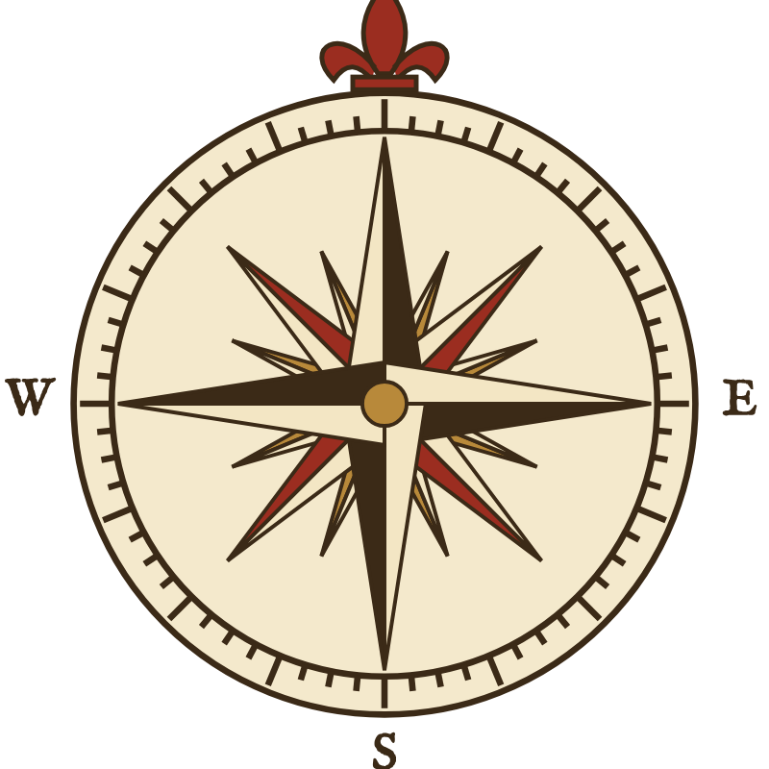






How This Practice Deck Works
Climb the ladder: each level builds on the one before it
Play the voyage in the game first, then practice here. Type your answers into the dashed boxes.
Make a Claim
Primary Sources
Claim, evidence and reasoning writing
Events & Time
Sourcing, close reading, corroboration
Geography Lab
Timelines and cause-and-effect chains
Sort & Classify
Directions, maps, latitude, winds, routes
Recall & Match
Motives, Portugal vs. Spain, tools, causes
Key terms, key people, explorer facts
Notes:
Suggested pacing: Level 1–2 after the first voyage; the Geography Lab across the unit; Levels 3–5 after students have played at least two voyages. Every activity slide has its answers in these notes.

Slide 3
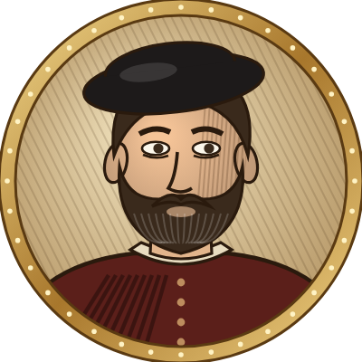
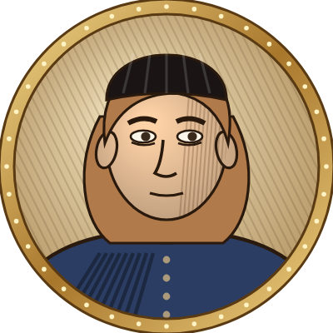
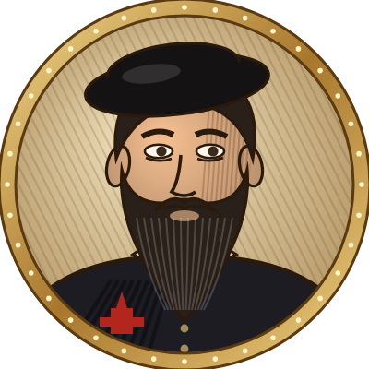
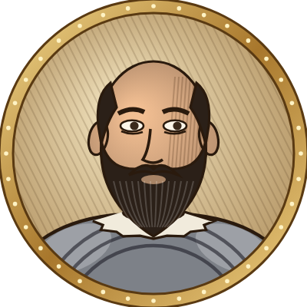
Meet the Four Explorers
The captains you sail with in Beyond the Horizon
Bartolomeu Dias
Christopher Columbus
Vasco da Gama
Ferdinand Magellan
1487–1488 · Portugal
1492–1493 · Spain
1497–1499 · Portugal
1519–1522 · Spain
First European to sail around the southern tip of Africa
Sailed west across the Atlantic and reached the Caribbean
First to sail from Europe around Africa to India
His expedition, finished by Elcano, sailed around the world
Notes:
Portraits are the stylized game portraits, not historical likenesses. Ask students: which two explorers sailed for Portugal and which two for Spain?

Slide 4
Word Bank: Ships & Navigation
1
Study these terms. You will need them for every level.
RECALL
Caravel
Lateen sail
A small, fast Portuguese ship that could explore coasts and sail close to the wind.
A triangular sail that lets a ship sail at an angle toward the wind.
Astrolabe
Magnetic compass
Instrument that measures the height of the sun or a star to find latitude.
A magnetized needle that points north so sailors can hold a course.
Dead reckoning
Latitude
Estimating position from speed, direction and time traveled.
Distance north or south of the Equator, measured in degrees.
Longitude
League
Distance east or west, in degrees; sailors could not measure it well at sea.
A sailor's unit of distance, about 3 nautical miles (5.5 km).
Notes:
Reference slide. Quick check: Which two terms help a navigator know where the ship is without seeing land? (dead reckoning, latitude/astrolabe). Why was longitude so hard? (no accurate clocks at sea until the 1700s).

Slide 5
Word Bank: Winds, Trade & Big Ideas
1
Study these terms. You will need them for every level.
RECALL
Trade winds
Westerlies
Steady winds that blow toward the Equator from the northeast or southeast.
Winds between about 30° and 60° latitude that blow from west to east.
Doldrums
Monsoon
A calm belt near the Equator where the wind often dies.
Seasonal Indian Ocean winds that change direction in summer and winter.
Spice trade
Scurvy
Trade in Asian pepper, cloves, cinnamon and nutmeg, worth a fortune in Europe.
A disease caused by lack of vitamin C that killed many sailors.
Circumnavigation
Columbian Exchange
Sailing all the way around the world.
The movement of plants, animals, people and diseases between hemispheres after 1492.
Notes:
Reference slide. Quick check: Which winds did Columbus use going west? (northeast trade winds). Going home? (westerlies).

Slide 6
Match the Term to Its Meaning
1
Write the letter of the correct term in each box
RECALL
1
A stone pillar topped with a cross, used to claim land for Portugal
Terms
2
Sailing all the way around the world
A. Astrolabe
B. Strait
3
A narrow waterway that connects two larger bodies of water
C. Scurvy
4
A disease caused by a lack of vitamin C
D. Volta do mar
5
A calm belt near the Equator where the winds die
E. Padrão
6
An instrument used to find latitude from the sun or stars
F. Circumnavigation
7
The 1494 agreement dividing new lands between Spain and Portugal
G. Doldrums
H. Treaty of Tordesillas
8
A wide loop into the open ocean to catch better winds
Notes:
Answers: 1-E (padrão), 2-F (circumnavigation), 3-B (strait), 4-C (scurvy), 5-G (doldrums), 6-A (astrolabe), 7-H (Treaty of Tordesillas), 8-D (volta do mar).

Slide 7
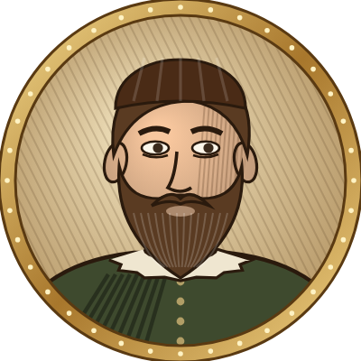
Who Am I?
1
Read each clue and name the person. Use the portrait gallery and the hints.
RECALL
Also in this unit: Prince Henry · Lapu-Lapu · Ferdinand & Isabella
Dias
Columbus
da Gama
Elcano
I hardly ever went to sea, but I paid for Portuguese voyages down the coast of Africa.
Who am I?
I named the great cape at Africa's tip the "Cape of Storms."
Who am I?
1
2
I sailed west to reach Asia, and landed on San Salvador in 1492.
Who am I?
My warriors defeated Magellan's men at Mactan in 1521.
Who am I?
3
4
I anchored at Calicut, India, in May 1498.
Who am I?
I took command after Magellan died and brought the Victoria home.
Who am I?
5
6
Notes:
Answers: 1 Prince Henry the Navigator; 2 Bartolomeu Dias; 3 Christopher Columbus; 4 Lapu-Lapu; 5 Vasco da Gama; 6 Juan Sebastián Elcano.

Slide 8
Explorer Fact Table
1
Fill in the empty cells. Some are done for you.
RECALL
Explorer | Sailed for | Years | Main goal | Greatest achievement
Bartolomeu Dias |  | 1487–1488 |  | First European to round the southern tip of Africa
Christopher Columbus | Spain |  | Reach Asia by sailing west
Vasco da Gama |  | 1497–1499
Ferdinand Magellan | Spain |  |  | His expedition was the first to sail around the world
Notes:
Answers — Dias: Portugal; goal: find the southern end of Africa / a route toward India. Columbus: 1492–1493; achievement: crossed the Atlantic and reached the Americas (began lasting contact). da Gama: Portugal; goal: reach India by sea for spices; achievement: first to sail from Europe to India (Calicut, 1498). Magellan: 1519–1522; goal: reach the Spice Islands by sailing west.

Slide 9
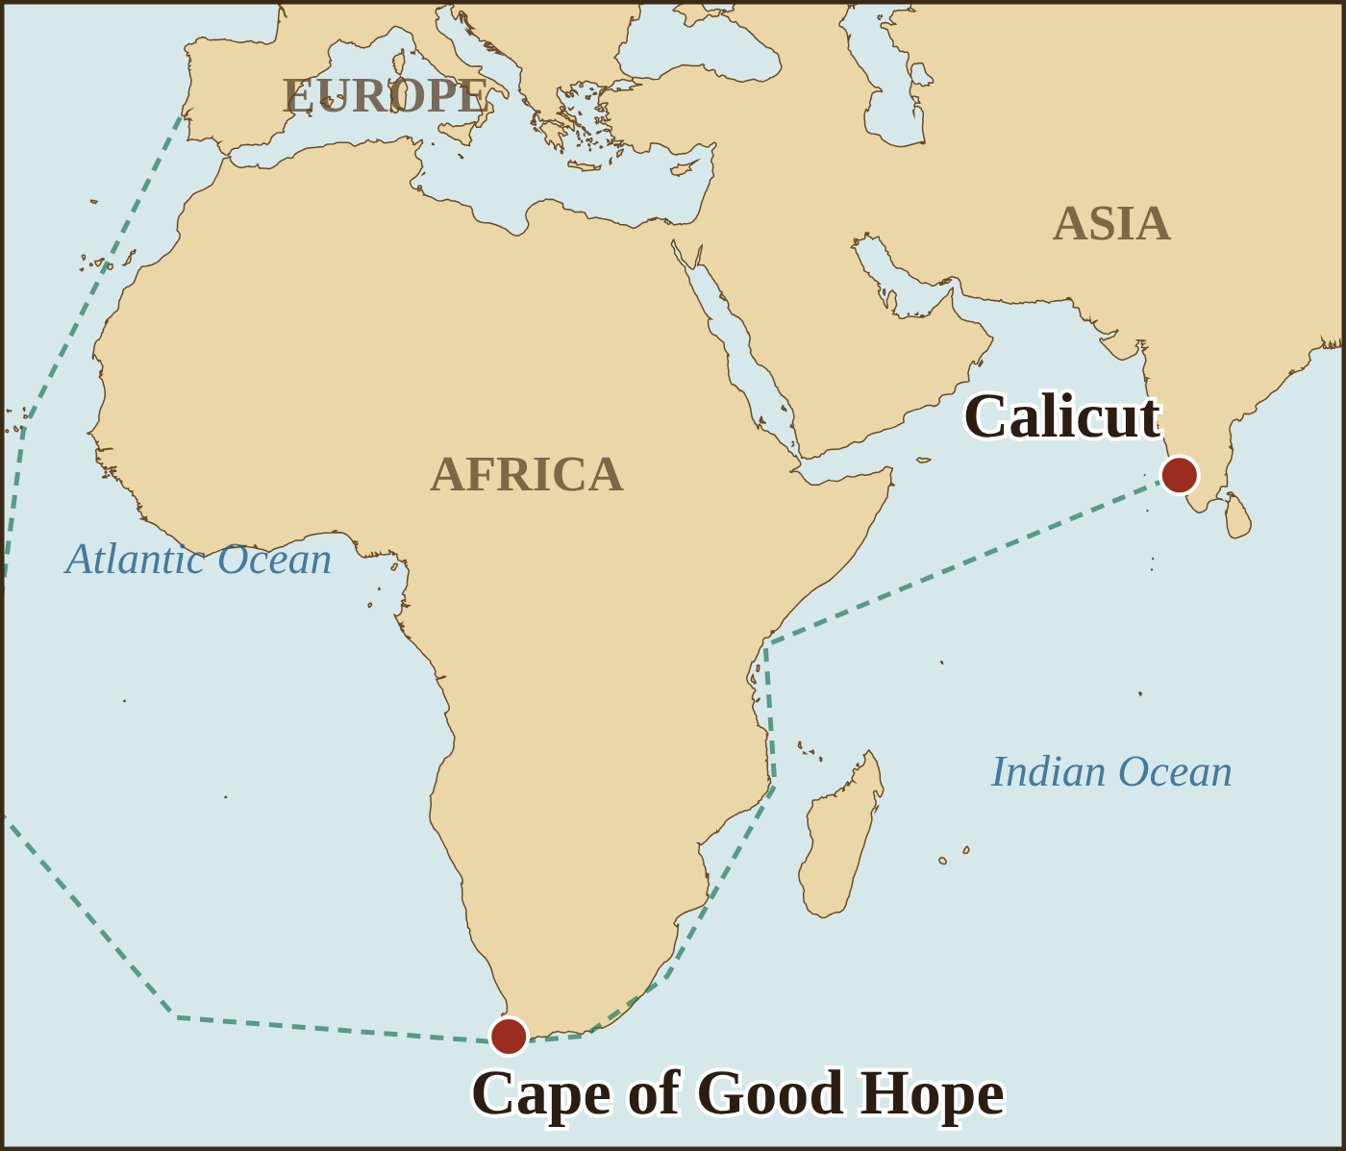
Fill in the Story
1
Use the word bank to complete each numbered blank. Use the map to help with blanks 6 and 7.
RECALL
After the Ottoman Turks captured (1) ________ in 1453, trade with Asia over land became harder and more expensive. Europeans especially wanted (2) ________ such as pepper and cloves. In Portugal, (3) ________ was a (4) ________ of sailors: he paid for voyages down the coast of Africa and supported mapmakers and shipbuilders. His sailors used a fast new ship called the (5) ________. In 1488 Dias sailed around the (6) ________, and in 1498 da Gama reached (7) ________ in India. Sailing for Spain, Columbus believed he had reached the (8) ________, and he met the (9) ________ people.
Word bank
Calicut
caravel
Cape of Good Hope
Word to know: a patron is a person who pays for and supports the work of others, such as artists, scholars or explorers.
Constantinople
Indies
patron
Prince Henry
spices
Taíno
Notes:
Answers: 1 Constantinople; 2 spices; 3 Prince Henry; 4 patron; 5 caravel; 6 Cape of Good Hope; 7 Calicut; 8 Indies; 9 Taíno. Prince Henry "the Navigator" rarely sailed himself; he was a patron who funded voyages and supported mapmakers, navigators and shipbuilders.

Slide 10



God, Gold or Glory?
2
Sort each card into the motive it shows best. Write the card letters in the columns.
SORT
A
Buying pepper and cloves at their source in Asia
B
Planting stone padrões to claim land for the king
C
Spreading Christianity to new lands
D
Trading for gold at São Jorge da Mina
E
Columbus demanding the title "Admiral of the Ocean Sea"
F
Da Gama's crew: "We came in search of Christians and spices"
G
Columbus searching Cuba for gold
H
Priests sailing with the fleets to win converts
I
Spain racing Portugal to reach the Spice Islands first
God
Gold
Glory
Notes:
Suggested answers — God: C, H (and F shows both God and Gold). Gold: A, D, G (F also). Glory: B, E, I. Accept well-reasoned alternatives (e.g., padrões also served God because of the cross). Discussion: which motive do you think mattered most to the monarchs who paid?

Slide 11
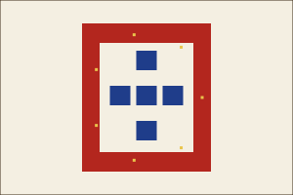
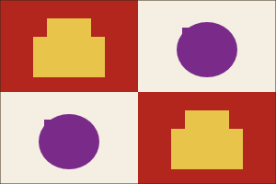
Portugal or Spain?
2
Sort each item onto the correct side of the T-chart. Some may fit both!
SORT
Portugal
Spain
▸ Bartolomeu Dias
▸ Christopher Columbus
▸ Vasco da Gama
▸ Magellan's expedition
▸ King John II
▸ Ferdinand & Isabella
▸ Route around Africa
▸ Route west across the Atlantic
▸ Brazil (east of the Tordesillas line)
▸ Caribbean islands
▸ Calicut trade
▸ Spice Islands goal
Notes:
Portugal: Dias, da Gama, King John II, route around Africa, Brazil, Calicut trade. Spain: Columbus, Magellan's expedition (Magellan was Portuguese but sailed for Spain), Ferdinand & Isabella, route west across the Atlantic, Caribbean islands. Spice Islands goal: both (Portugal reached them first by the eastern route; Spain sought them by sailing west).

Slide 12



Tools of the Navigator
2
Match each tool to the question it helped a sailor answer
SORT
A. Magnetic compass
B. Astrolabe or quadrant
C. Ship's hourglass
D. Portolan chart
"Which direction is my ship heading?"
Think deeper
"How far north or south of the Equator am I?"
Which of these questions could sailors NOT answer with their tools: "How far east or west am I?" Why?
"How much time has passed since I last checked my speed?"
"Where are the harbors, capes and coastlines?"
Notes:
Answers: heading = A (compass); north/south = B (astrolabe/quadrant, which measure latitude); time = C (hourglass, used for dead reckoning); harbors and coasts = D (portolan chart). Think deeper: longitude (east–west position) could not be measured accurately because it requires an accurate clock at sea—not invented until the 1700s; sailors estimated it with dead reckoning.

Slide 13
Cause or Effect?
2
Was each item a CAUSE of European exploration or an EFFECT of it? Write C or E.
SORT
The Ottomans captured Constantinople and taxed trade routes to Asia
C / E
Portuguese shipbuilders developed the caravel
C / E
Corn, potatoes and tomatoes spread to Europe
C / E
The Taíno population collapsed from disease and forced labor
C / E
Europeans wanted spices at lower prices
C / E
Spain and Portugal signed the Treaty of Tordesillas
C / E
Printed copies of Ptolemy's Geography spread across Europe
C / E
Mapmakers drew a new continent called "America"
C / E
Notes:
Answers: 1 C; 2 C; 3 E; 4 E; 5 C; 6 E (the treaty responded to Columbus's voyage); 7 C (Ptolemy's maps were printed from the 1470s and shaped what Europeans expected); 8 E (Waldseemüller map, 1507).

Slide 14
Compass Rose Practice
G
Cardinal directions: N, E, S, W · Intermediate directions: NE, SE, SW, NW
GEOGRAPHY
1
The direction exactly halfway between north and east is ______.
2
The opposite of southwest is ______.
3
From Lisbon to the Canary Islands, a ship sails ______.
4
From Malindi (East Africa) to Calicut (India), a ship sails ______.
5
From the Strait of Magellan to Guam, a ship sails ______.
6
From the Azores home to Spain, a ship sails ______.
7
In the game, you press ↓ and ← together. Which way do you steer?
Notes:
Answers: 1 northeast; 2 northeast; 3 southwest; 4 northeast; 5 northwest; 6 east; 7 southwest.

Slide 15
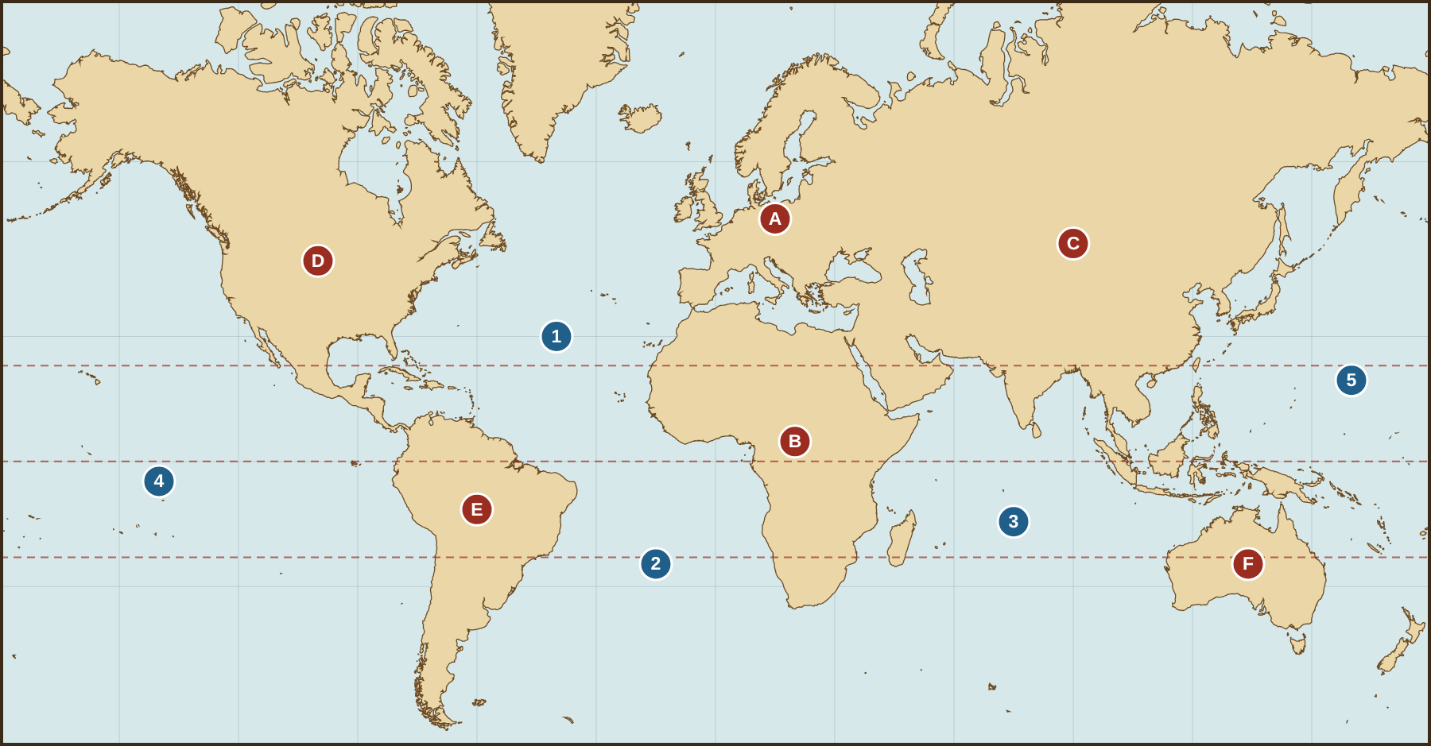
Continents & Oceans
G
Label each letter with a continent and each number with an ocean (one ocean appears more than once)
GEOGRAPHY
A
1
B
2
C
3
D
4
E
5
F
Which lettered continents did Europeans NOT know about in 1490?
Notes:
Answers: A Europe, B Africa, C Asia, D North America, E South America, F Australia. 1 Atlantic (North), 2 Atlantic (South), 3 Indian, 4 Pacific, 5 Pacific. Unknown to Europeans in 1490: D, E and F (the Americas and Australia).

Slide 16
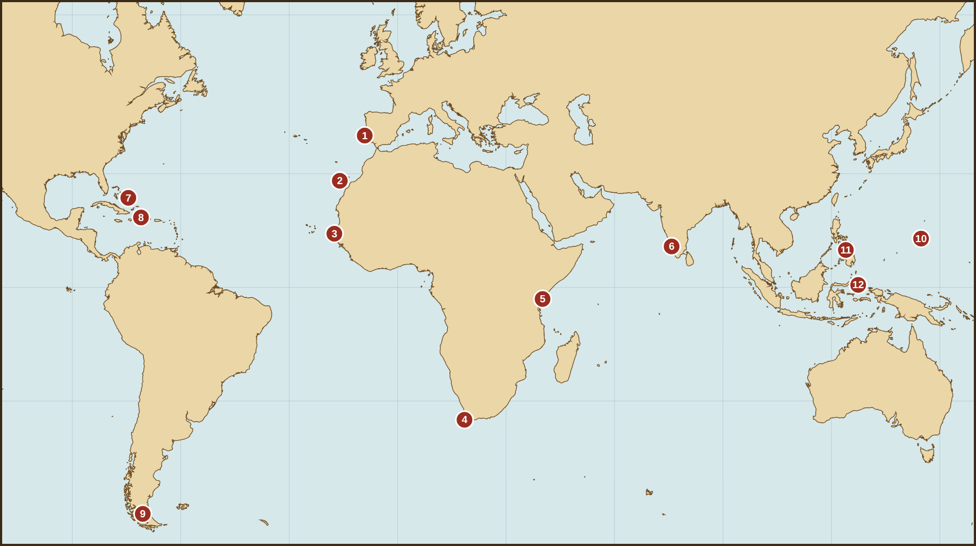
Key Places of the Voyages
G
Match each number on the map to a place from the word bank
GEOGRAPHY
1
2
3
4
5
6
7
8
9
10
11
12
Calicut · Canary Islands · Cape of Good Hope · Cape Verde · Guam · Hispaniola · Lisbon · Malindi · Moluccas (Spice Islands) · Philippines · San Salvador · Strait of Magellan
Notes:
Answers: 1 Lisbon; 2 Canary Islands; 3 Cape Verde; 4 Cape of Good Hope; 5 Malindi; 6 Calicut; 7 San Salvador; 8 Hispaniola; 9 Strait of Magellan; 10 Guam; 11 Philippines (Cebu/Mactan); 12 Moluccas (Spice Islands).

Slide 17
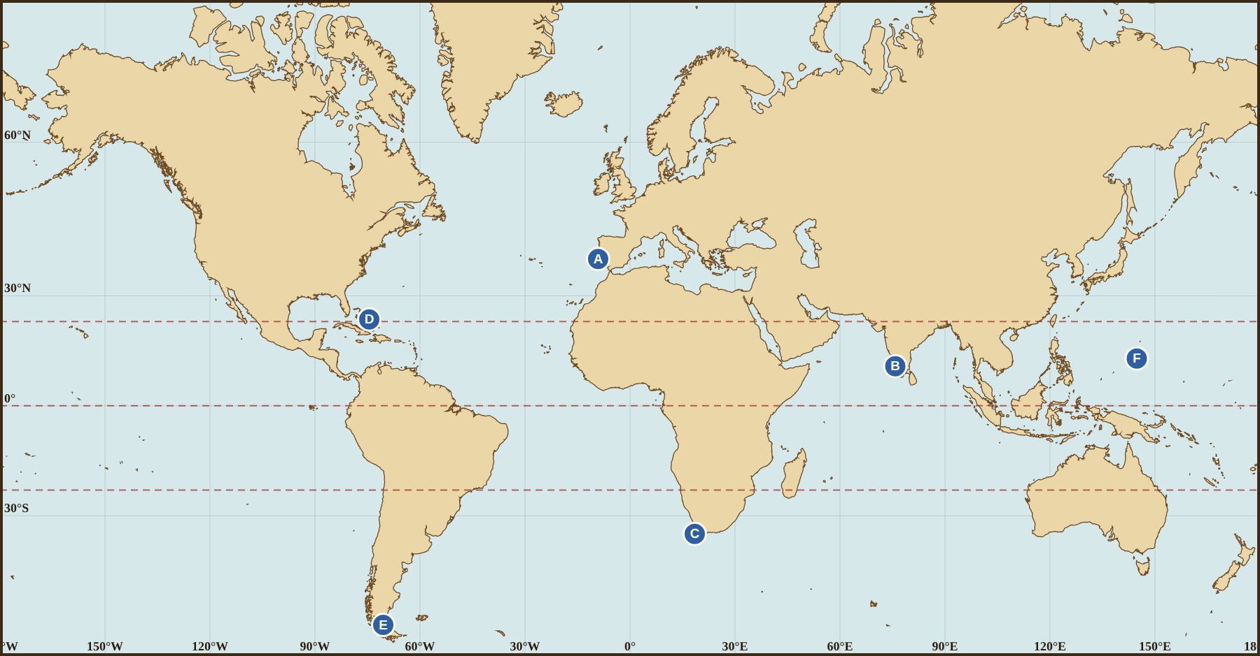
Latitude & Longitude
G
Estimate each place's coordinates from the grid lines (every 30°), then name it
GEOGRAPHY
 | Latitude | Longitude | N or S? | Place
A
B
C
D
E
F
Answers to questions 1–3
1
Which two lettered places are south of the Equator?
2
Which places lie between the Tropic of Cancer and the Tropic of Capricorn?
3
Why could sailors measure latitude but only guess at longitude?
Notes:
Answers (approximate): A Lisbon 39°N, 9°W; B Calicut 11°N, 76°E; C Cape of Good Hope 34°S, 18°E; D San Salvador 24°N, 74°W; E Strait of Magellan 53°S, 70°W; F Guam 13°N, 145°E. Q1: C and E. Q2: B and F (D at 24°N sits just north of the Tropic of Cancer). Q3: latitude can be measured from the height of the sun or North Star; longitude needs an accurate clock, so sailors used dead reckoning.

Slide 18
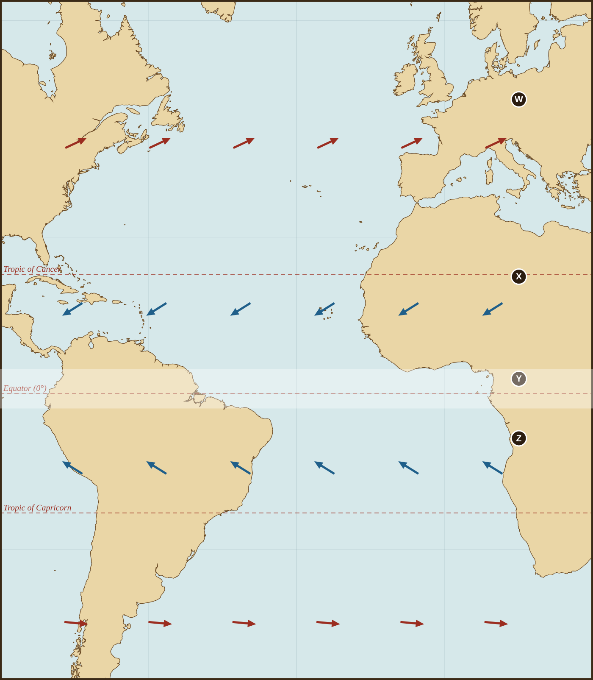
Riding the Wind Belts
G
The arrows show which way the winds blow over the Atlantic
GEOGRAPHY
1
Name wind belt W, X, Y and Z (word bank: doldrums, northeast trade winds, southeast trade winds, westerlies).
2
Columbus sailed SOUTH to the Canary Islands before turning west. Which wind belt was he looking for, and why?
3
To get home, Columbus sailed NORTH before turning east. Explain why using the map.
4
Why would sailors fear getting stuck at Y?
Notes:
Answers: W westerlies; X northeast trade winds; Y doldrums; Z southeast trade winds. Q2: the northeast trade winds, which blow steadily toward the west/southwest at the latitude of the Canaries. Q3: the westerlies north of about 30°N blow toward Europe. Q4: in the doldrums the wind often dies, leaving ships becalmed for days or weeks.

Slide 19
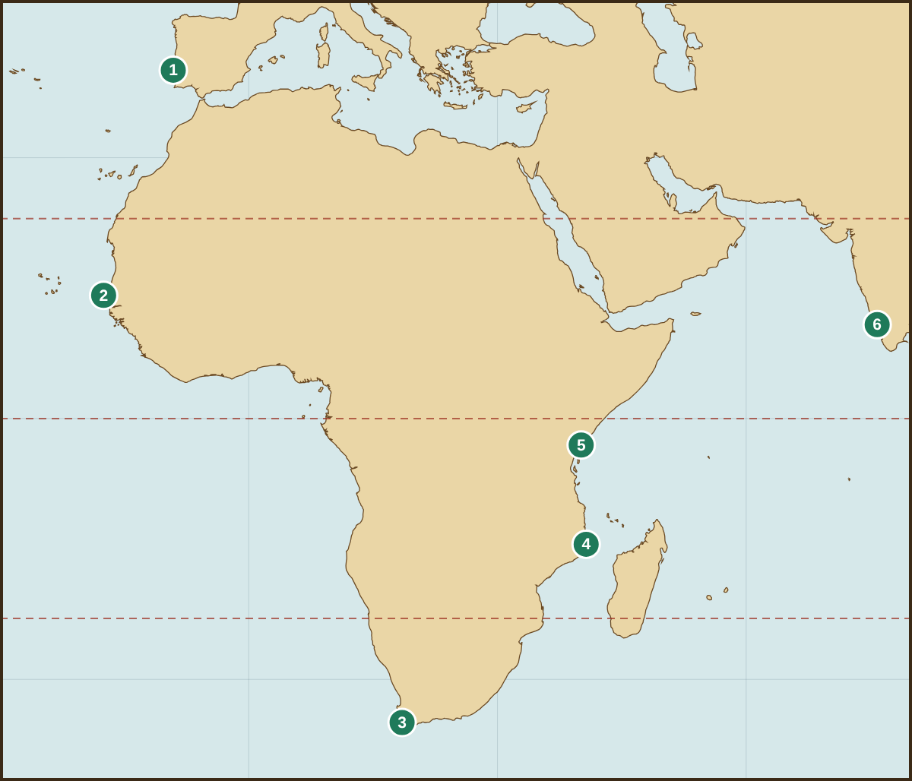
Trace da Gama's Route to India
G
Use the numbered stops to describe each leg of the voyage
GEOGRAPHY
Leg | From → To (place names) | Direction
1 → 2
2 → 3
3 → 4
4 → 5
5 → 6
Explain: Why did da Gama swing far out into the Atlantic on leg 2 → 3 instead of hugging the coast?
Notes:
Answers: 1→2 Lisbon to Cape Verde, south (southwest); 2→3 Cape Verde to the Cape of Good Hope, south then southeast (via the volta do mar); 3→4 Cape of Good Hope to Mozambique, northeast; 4→5 Mozambique to Malindi, north (north-northeast); 5→6 Malindi to Calicut, northeast across the Arabian Sea. Explain: the volta do mar avoided headwinds and calms along Africa's coast and used the westerlies to reach the Cape.

Slide 20
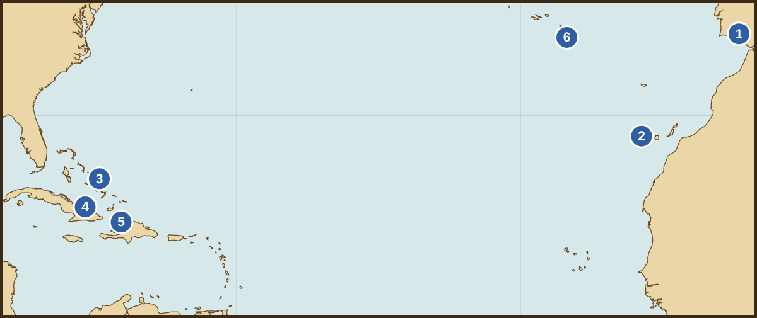
Trace Columbus's Atlantic Crossing
G
Put the numbered stops in order and describe the route
GEOGRAPHY
1
In which direction did Columbus sail from stop 2 to stop 3?
2
About how many degrees of longitude did he cross from 2 to 3? (He started near 17°W.)
Stops 1–6 (in any order): Palos · La Gomera · San Salvador · Cuba · Hispaniola · Azores
3
Why is the route home (5 → 6 → 1) farther north than the route out?
Name stops 1–6
Notes:
Stops: 1 Palos, 2 La Gomera (Canary Islands), 3 San Salvador, 4 Cuba, 5 Hispaniola, 6 Azores. Q1: west. Q2: about 57° (from about 17°W to 74°W). Q3: he sailed north to catch the westerlies, which blow toward Europe; the trade winds farther south would have been against him.

Slide 21
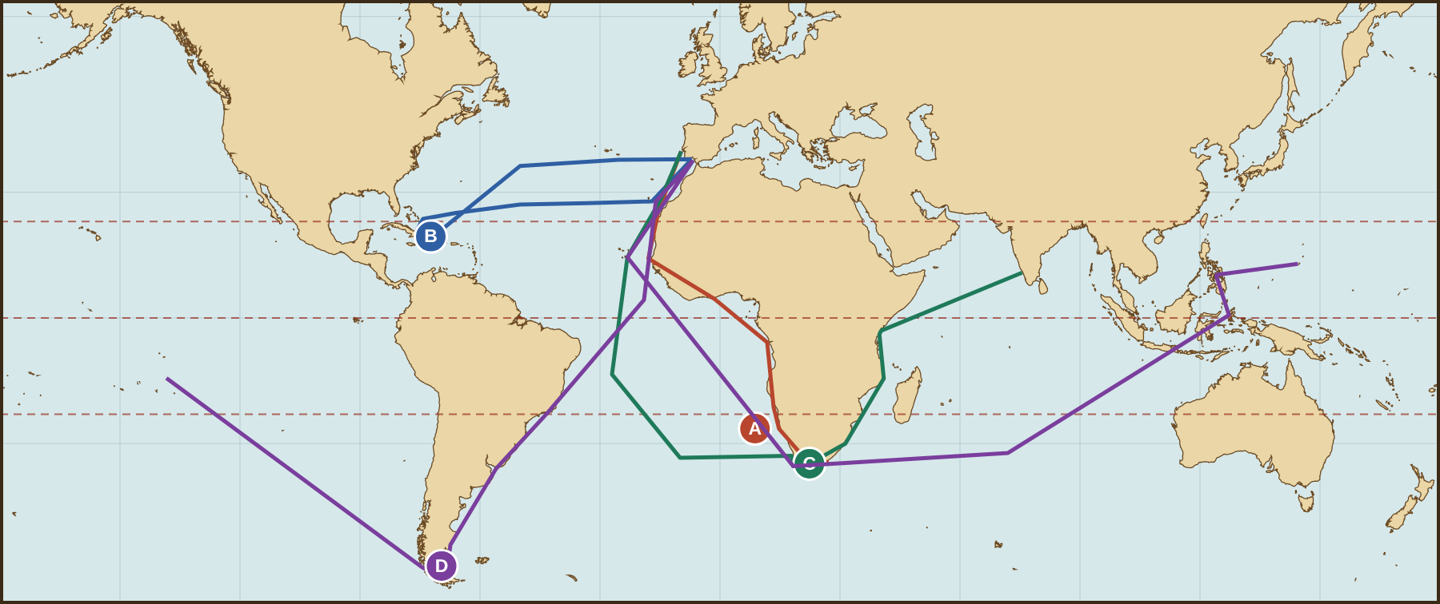
Whose Route Is It?
G
Match each colored route to its explorer, then answer the questions
GEOGRAPHY
Route A
Route B
Route C
Route D
1
Which route crosses the Pacific Ocean?
2
Which two routes both round the Cape of Good Hope?
3
Which route never goes south of the Equator?
4
Which route is the shortest? Why might that be?
Notes:
Answers: A Dias, B Columbus, C da Gama, D Magellan/Elcano. Q1: D. Q2: C and D (A reached and named it but turned back there; accept A, C and D). Q3: B (Columbus). Q4: A or B; Dias turned back at southern Africa and Columbus crossed only the Atlantic.

Slide 22
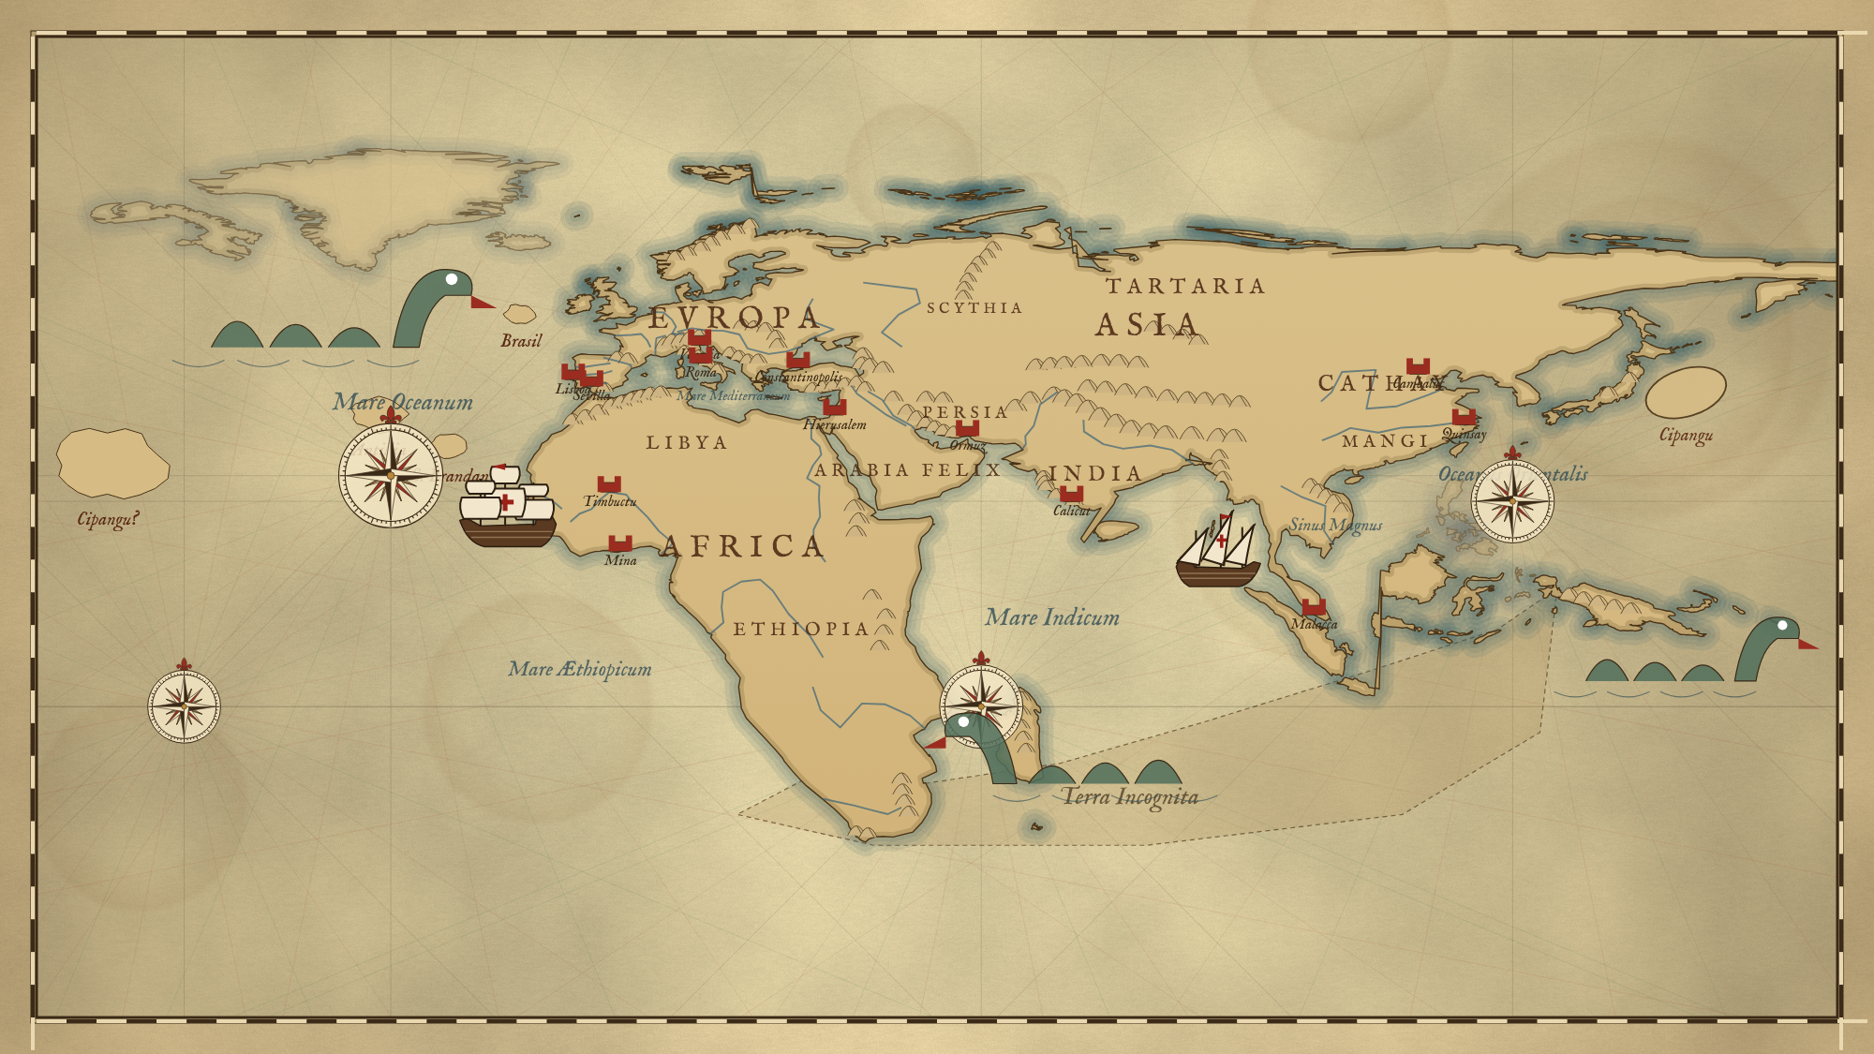
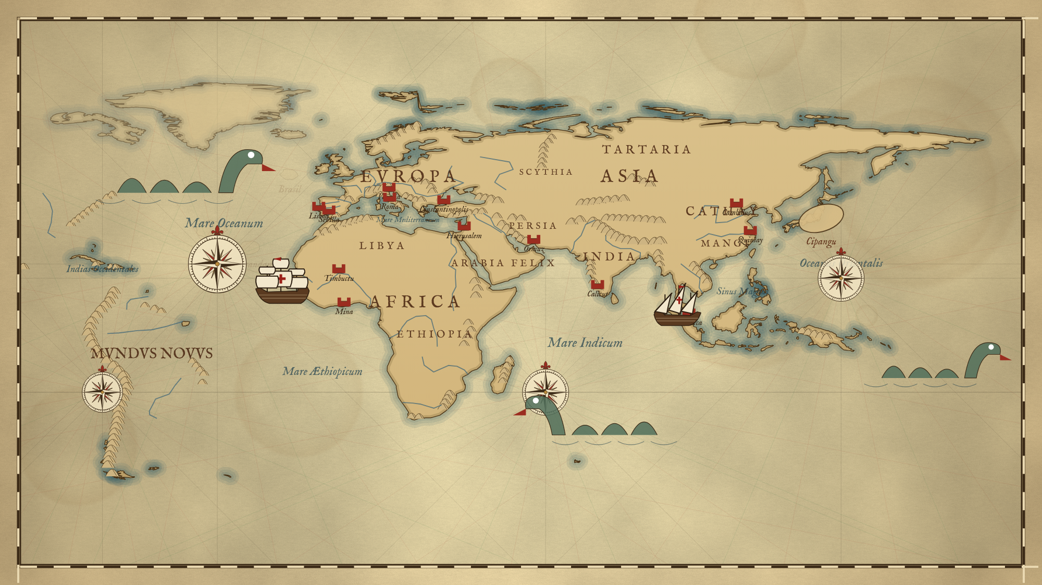
The World in 1490 vs. 1522
G
Compare how the map changed after the four voyages
GEOGRAPHY
Before: c. 1490
After: 1522
List three changes between the two maps.
Which explorer erased the "Terra Incognita" land bridge? How?
Which continents appear on the 1522 map but not in 1490?
Notes:
These are the game's reconstructions (inspired by maps such as Henricus Martellus, c. 1491), not original maps. Answers: changes include southern Africa redrawn correctly, India corrected, the Caribbean and South America added, the Pacific added, mythical islands removed. Dias erased the Terra Incognita by sailing around Africa's tip, proving the Indian Ocean was open. New on the 1522 map: South America (and the Caribbean islands of North America).

Slide 23
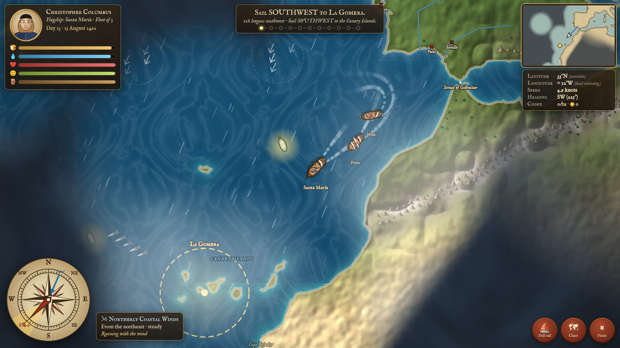
Captain's Log: Read the Instruments
G
A moment from Columbus's voyage in the game. Use the screen to answer.
GEOGRAPHY
1
What is the fleet's latitude?
2
In which compass direction is the ship heading?
3
From which direction is the wind blowing?
4
Is the ship sailing with or against the wind? How do you know?
5
Why does the game show longitude with "≈" (about)?
Hint: look at the panel in the top-right corner and the wind box beside the compass.
Notes:
Answers from this screenshot: latitude about 33°N; heading southwest (225°); wind from the north/northeast ("Northerly Coastal Winds"); with the wind—the game says "Running with the wind," because the wind blows from behind toward the southwest; longitude is shown as "about" because sailors could only estimate it by dead reckoning.

Slide 24
Build the Timeline
3
Write each event letter in the correct box on the timeline, oldest to newest
EVENTS
A
Columbus lands on San Salvador
B
The Ottomans capture Constantinople
C
Dias rounds the southern tip of Africa
D
The Treaty of Tordesillas is signed
E
Da Gama reaches Calicut, India
F
Magellan is killed at Mactan
G
The Victoria completes the first circumnavigation
H
Cabral claims Brazil for Portugal
I
Portugal builds São Jorge da Mina on the Gold Coast
1450
1525
Notes:
Order: B (1453), I (1482), C (1488), A (1492), D (1494), E (1498), H (1500), F (1521), G (1522).

Slide 25
Cause & Effect Chains
3
Complete each chain using the event bank
EVENTS
Chain 1: the road to the Americas
Ottomans capture Constantinople (1453)
The Columbian Exchange changes diets worldwide
Chain 2: Portugal's road to India
Prince Henry sponsors voyages along Africa
Portugal builds a trading empire in the Indian Ocean
Event bank: Asian goods become more expensive in Europe · Columbus sails west and reaches the Caribbean · Europeans look for sea routes to Asia · Dias rounds the Cape of Good Hope · Da Gama reaches Calicut · Portuguese sailors pass Cape Bojador and map the African coast
Notes:
Chain 1: Constantinople → Asian goods become more expensive → Europeans look for sea routes to Asia → Columbus sails west and reaches the Caribbean → Columbian Exchange. Chain 2: Prince Henry → Portuguese pass Cape Bojador and map the coast → Dias rounds the Cape of Good Hope → da Gama reaches Calicut → Indian Ocean trading empire.

Slide 26
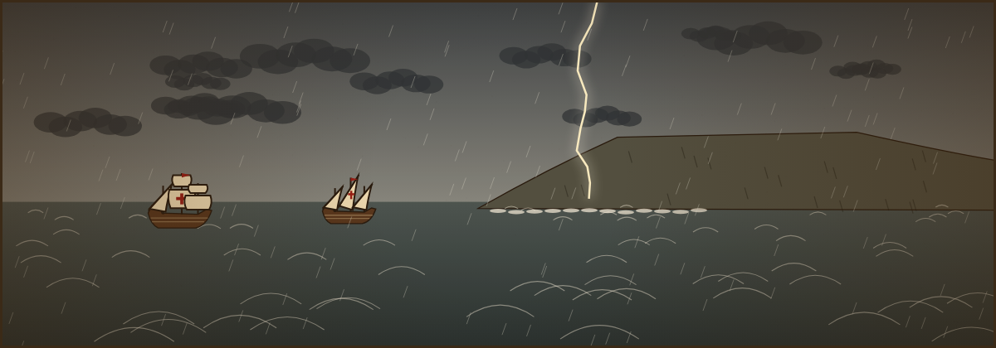
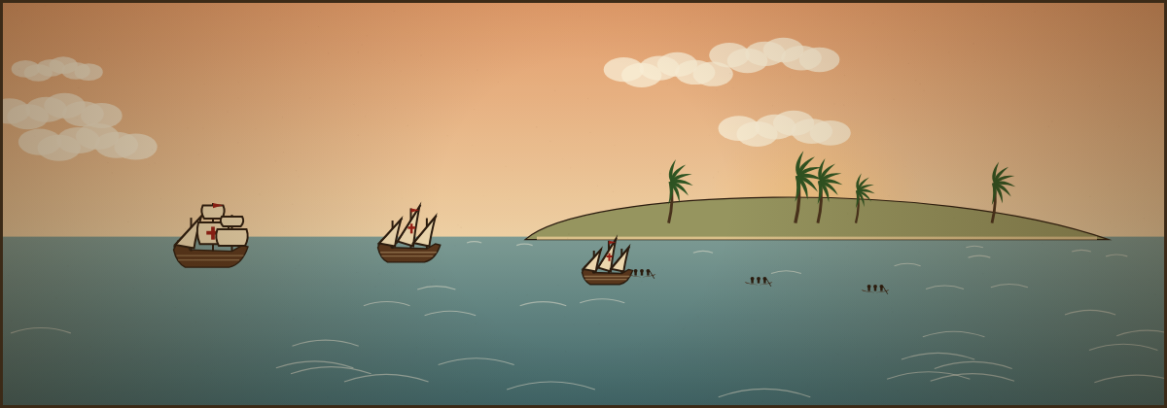
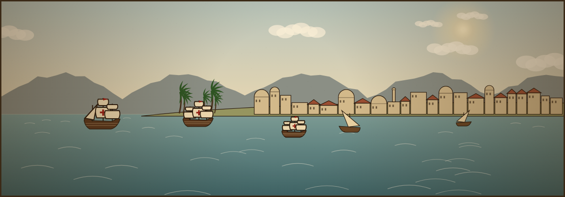
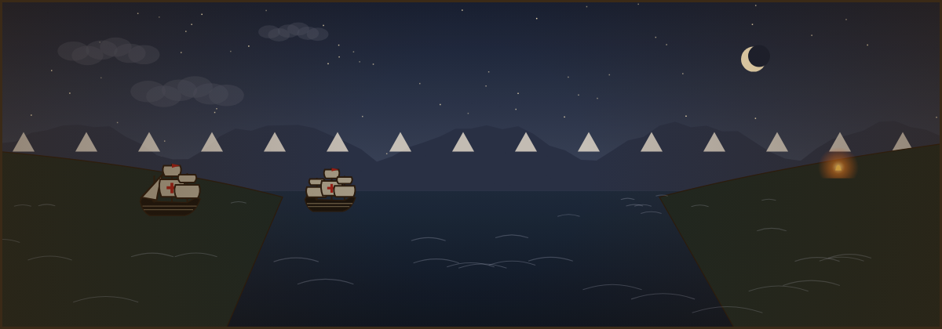
Picture the Moment
3
Each illustration from the game shows a key event. Write the event letter and the year under each picture.
EVENTS
1
2
Events
A. Magellan's fleet sees the fires of Tierra del Fuego
B. Da Gama arrives at the great pepper port
C. Columbus's fleet reaches its first island
D. Dias sees the cape he will call the "Cape of Storms"
Event
Year
Event
Year
3
4
Event
Year
Event
Year
Notes:
Answers: 1 D (1488); 2 C (1492); 3 B (1498); 4 A (1520).

Slide 27



Read Like a Historian
4
Use these four moves with every primary source in this level
SOURCES
Sourcing
Context
Who wrote it? When? For whom? Why? Was the author there?
What else was happening at the time? How might that shape the source?
Close reading
Corroboration
What does it say? Which words show the author's attitude or purpose?
Do other sources agree or disagree? Which is more trustworthy?
Primary source: created by someone who lived at the time. A translation or summary of one is still a primary source, but ask who translated or summarized it.
Notes:
These moves follow the Stanford History Education Group's "Reading Like a Historian" framework. Every source excerpt in this level is quoted from a published English translation; citations appear on each slide.

Slide 28

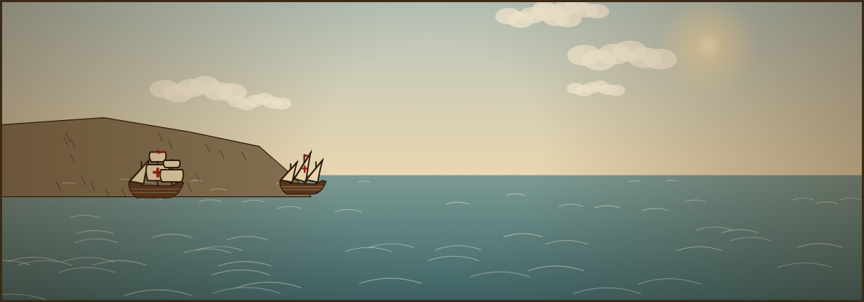
Source A: The Fear of Cape Bojador (1453)
4
Gomes Eanes de Zurara, royal chronicler of Portugal, explains why sailors would not pass Cape Bojador
SOURCES
1
Sourcing: Who was Zurara, and who paid for his chronicle?
"For, said the mariners, this much is clear, that beyond this Cape there is no race of men nor place of inhabitants … and the sea so shallow that a whole league from land it is only a fathom deep, while the currents are so terrible that no ship having once passed the Cape, will ever be able to return."
2
Close reading: List two dangers the sailors believed in.
3
Context: Gil Eanes passed the Cape in 1434. Why might Prince Henry's chronicler stress how terrifying it was?
Gomes Eanes de Zurara, The Chronicle of the Discovery and Conquest of Guinea (completed 1453), ch. VIII; trans. C. R. Beazley and E. Prestage (Hakluyt Society, 1896).
↩ Back to Claim Task 2
Notes:
Zurara was the official royal chronicler of Portugal and wrote to celebrate Prince Henry (the Navigator). Dangers: no people/inhabitants, shallow seas, terrible currents preventing return. Purpose: stressing the fear makes Henry's persistence and Gil Eanes's success look heroic.

Slide 29
Source B: Columbus Meets the Taíno (1492)
4
From Columbus's journal entry covering October 11–12, 1492, when he landed on Guanahani (San Salvador)
SOURCES
1
Sourcing: The original journal is lost. Who summarized it, and why does that matter?
"They neither carry nor know anything of arms, for I showed them swords, and they took them by the blade and cut themselves through ignorance. … They should be good servants and intelligent, for I observed that they quickly took in what was said to them, and I believe that they would easily be made Christians, as it appeared to me that they had no religion."
2
Close reading: What two plans for the Taíno does Columbus reveal?
3
Point of view: What does Columbus assume about Taíno beliefs? Was he in a position to know?
Christopher Columbus, Journal of the First Voyage, entry for Oct. 11–12, 1492. The original log is lost; this text survives in a summary by Bartolomé de las Casas. Trans. in J. E. Olson and E. G. Bourne, eds., The Northmen, Columbus and Cabot (1906).
↩ Back to Claim Task 2
Notes:
Sourcing: the text is Bartolomé de las Casas's abstract (summary and partial quotation) of the lost log, made decades later—historians cannot be sure every word is Columbus's. Plans: to use them as servants and to convert them to Christianity. Point of view: he assumed they had "no religion" after only hours of contact and no shared language; the Taíno had their own religion (zemis, spirits).

Slide 30
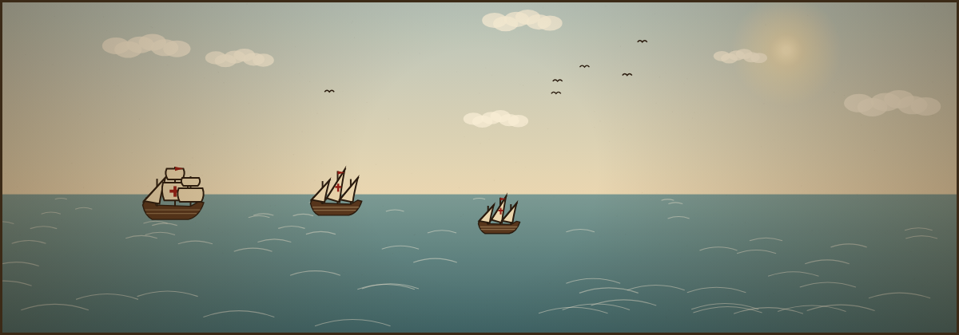
Source C: Columbus Reports Home (1493)
4
From Columbus's letter to Luis de Santángel, an official of the Spanish court who helped fund the voyage
SOURCES
1
Sourcing: Who was the audience, and why did Columbus need to impress them?
"…in thirty-three days I passed over to the Indies with the fleet which the most illustrious King and Queen, our Lords, gave me; where I found very many islands peopled with inhabitants beyond number. And, of them all, I have taken possession for their Highnesses, with proclamation and the royal standard displayed; and I was not gainsaid."
2
Close reading: Where does Columbus say he has been? Was he right?
3
Corroborate with Source B: "I was not gainsaid" means no one objected. What does Source B suggest about why?
Christopher Columbus, Letter to Luis de Santángel, written on the return voyage, dated February 15, 1493; printed in Barcelona in 1493. Trans. in J. E. Olson and E. G. Bourne, eds., The Northmen, Columbus and Cabot (1906).
↩ Back to Claim Task 2
Notes:
Audience: Santángel and, through him, Ferdinand and Isabella, who paid for the voyage and could fund more voyages; the letter was quickly printed as publicity. Columbus claims he reached "the Indies" (Asia); he was actually in the Caribbean. Source B describes the Taíno as unarmed and unfamiliar with swords, so they could not have opposed a formal proclamation they did not understand.

Slide 31
Source D: "Christians and Spices" (1498)
4
An anonymous sailor on Vasco da Gama's fleet describes the first Portuguese man sent ashore at Calicut
SOURCES
1
Sourcing: The author is unknown. What clues tell us he was an eyewitness?
"The first greeting that he received was in these words: 'May the Devil take thee! What brought you hither?' They asked what he sought so far away from home, and he told them that we came in search of Christians and of spices."
2
Close reading: Which motives from "God, Gold and Glory" appear in the answer?
A Journal of the First Voyage of Vasco da Gama, 1497–1499 (the "Roteiro"), author unknown—often attributed to Álvaro Velho; trans. E. G. Ravenstein (Hakluyt Society, 1898). The people who greeted him were merchants from Tunis who spoke Castilian and Genoese.
3
Context: Why were North African merchants already in Calicut, and what does that show about Indian Ocean trade?
↩ Back to Claim Task 2
Notes:
Eyewitness clues: "we came," first-person account of events on the voyage. Motives: God (Christians) and Gold (spices). Context: Calicut was a hub of an old, busy trade network linking Africa, the Middle East and Asia; Muslim merchants from across the Mediterranean and Indian Ocean already traded there—the Portuguese were newcomers.

Slide 32
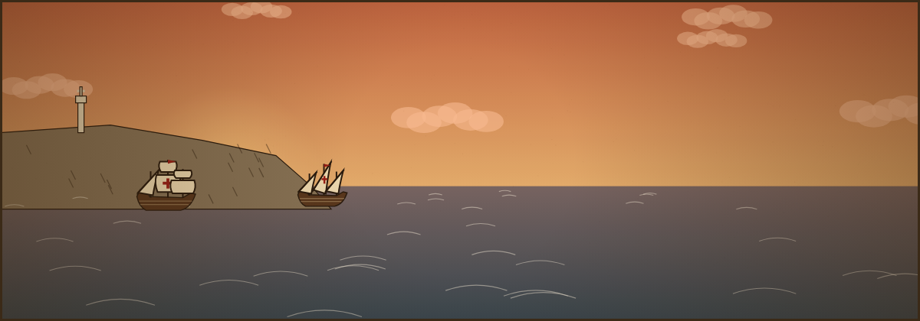
Source E: Dividing the World (1494)
4
From the Treaty of Tordesillas between the monarchs of Spain and Portugal
SOURCES
1
Geography: About where would a line 370 leagues west of Cape Verde fall? Which continent does it cut?
"…that a boundary or straight line be determined and drawn north and south, from pole to pole, on the said ocean sea, from the Arctic to the Antarctic pole. This boundary or line shall be drawn straight, as aforesaid, at a distance of three hundred and seventy leagues west of the Cape Verde Islands…"
2
Close reading: Who is NOT mentioned as having any say in this division?
3
Effect: Explain how this treaty helps explain why Brazilians speak Portuguese.
Treaty of Tordesillas, June 7, 1494. Trans. in Frances Gardiner Davenport, ed., European Treaties Bearing on the History of the United States and Its Dependencies to 1648 (Carnegie Institution, 1917).
↩ Back to Claim Task 2
Notes:
Geography: roughly 46°–50°W, cutting through the eastern bulge of South America (Brazil). Not mentioned: the Indigenous peoples who lived in these lands (and other European kingdoms). Effect: Brazil's eastern coast lay east of the line, so it fell to Portugal; Cabral claimed it in 1500.

Slide 33
Source F: Starving on the Pacific (1521)
4
Antonio Pigafetta, an Italian scholar who sailed with Magellan, describes the Pacific crossing
SOURCES
1
Sourcing: Pigafetta was one of only 18 men to return. How does that make his account valuable—and limited?
"Wednesday, November 28, 1520, we debouched from that strait, engulfing ourselves in the Pacific Sea. We were three months and twenty days without getting any kind of fresh food. We ate biscuit, which was no longer biscuit, but powder of biscuits swarming with worms … We drank yellow water that had been putrid for many days. … Rats were sold for one-half ducado apiece, and even then we could not get them."
2
Close reading: Which details show how desperate the crew became?
3
Connect: Which disease from the Word Bank was the hidden danger here, and what caused it?
Antonio Pigafetta, First Voyage Around the World (written after 1522); trans. James Alexander Robertson, Magellan's Voyage Around the World (Arthur H. Clark, 1906).
↩ Back to Claim Task 2
Notes:
Valuable: eyewitness who kept a daily journal; limited: one person's view, written for patrons after the voyage. Details: wormy biscuit powder, putrid water, rats sold for half a ducat each. Disease: scurvy, caused by a lack of vitamin C from fresh food.

Slide 34
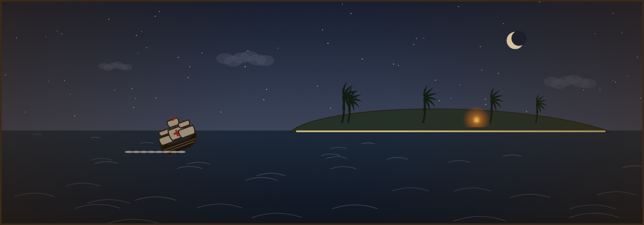
Source G: A Spanish Priest Accuses (1542)
4
Bartolomé de las Casas, who came to Hispaniola as a colonist and later became a priest and reformer
SOURCES
1
Sourcing: Las Casas once held Indigenous laborers himself. Does that make his testimony more or less believable? Why?
"Among these gentle sheep, gifted by their Maker with the above qualities, the Spaniards entered as soon as they knew them, like wolves, tigers, and lions which had been starving for many days, and since forty years they have done nothing else; nor do they otherwise at the present day, than outrage, slay, afflict, torment, and destroy them…"
2
Close reading: What do the animal comparisons say about each group?
3
Purpose: Las Casas wrote to the Spanish king. What change was he trying to bring about?
Bartolomé de las Casas, A Brief Account of the Destruction of the Indies (written 1542, printed 1552); trans. Francis Augustus MacNutt, Bartholomew de Las Casas: His Life, His Apostolate, and His Writings (1909).
↩ Back to Claim Task 2
Notes:
Las Casas saw events firsthand and changed his mind, which adds weight; but as an advocate he may exaggerate to persuade (some of his numbers are disputed). Animals: Indigenous people as gentle sheep (innocent victims); Spaniards as starving predators. Purpose: to persuade the Crown to stop abuses and protect Indigenous people (contributing to the New Laws of 1542).

Slide 35
Corroborate: Source B vs. Source G
4
Compare two Spanish views of the Taíno, written fifty years apart
SOURCES
 | Source B: Columbus (1492) | Source G: Las Casas (1542)
Author's role
Audience & purpose
How the Taíno are described
How trustworthy? Why?
Big question: Both authors were Spanish. Why do they describe the encounter so differently? Can both sources be useful to a historian?
Your answer to the big question
Notes:
Look for: Columbus was the commander, writing in his log for the monarchs, describing first contact and the Taíno as servants/converts; Las Casas was a colonist-turned-priest writing to the king decades later to expose abuses and win reforms. Both are useful: Columbus shows European intentions at first contact; Las Casas shows the consequences. Each has a purpose that shapes its tone.

Slide 36


Claim, Evidence, Reasoning
5
A strong historical argument has three parts. Study the model.
CLAIMS
Claim
Winds shaped the routes that explorers took more than any other geographic factor.
A clear answer to the question that someone could disagree with.
Evidence
Columbus sailed south to the Canaries to catch the northeast trade winds, and returned north on the westerlies. Da Gama swung far into the Atlantic (the volta do mar) to reach the westerlies.
Specific facts, events, quotes or map details that support the claim.
Reasoning
This shows that sailors did not take the shortest path; they followed the wind belts because sailing ships could barely move against the wind.
Explain HOW the evidence proves the claim. Use "because," "this shows."
Notes:
Model paragraph uses the wind belts students experienced in the game. Point out the signal words: "This shows," "because." Encourage students to add a counterclaim at Level 5 tasks.

Slide 37
Claim Task 1: The Most Significant Voyage
5
Which voyage changed the world the most? Choose one and defend it.
CLAIMS
Dias
CLAIM: The most significant voyage was … because …
Proved the Atlantic and Indian Oceans connect; erased the "Terra Incognita" idea.
EVIDENCE 1 (use a fact, map, or source from this deck)
Columbus
Began lasting contact between hemispheres and the Columbian Exchange.
da Gama
EVIDENCE 2
Opened a sea route to India; Portugal built an Indian Ocean trading empire.
Magellan
REASONING: This shows … because …
First circumnavigation; proved the oceans connect and the Earth is enormous.
Notes:
Any explorer can be defended. Strong answers use at least two specific pieces of evidence (e.g., dates, places, a source quotation, map changes from the 1490 vs. 1522 slide) and explain the impact on people beyond Europe, not just on Europe.

Slide 38
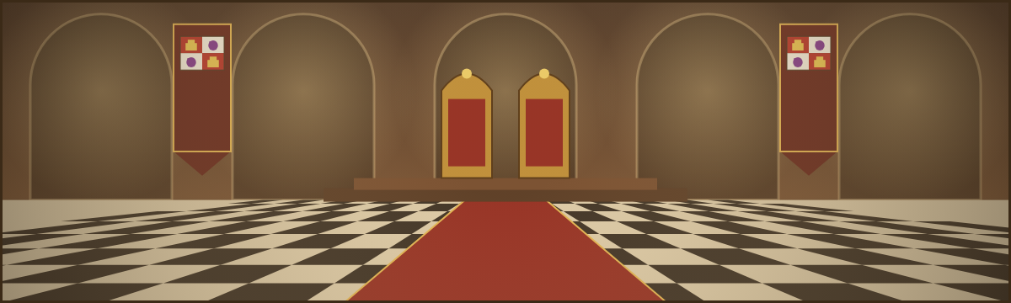
Claim Task 2: Triumph, Tragedy, or Both?
5
Was the Age of Exploration a triumph, a tragedy, or both? Use at least TWO sources from Level 4.
CLAIMS
CLAIM
EVIDENCE from Source __
EVIDENCE from Source __
Source menu
A · Zurara on Cape Bojador (1453) full text ↗
B · Columbus's journal (1492) full text ↗
C · Columbus's letter (1493) full text ↗
REASONING: These sources show … because …
D · Da Gama's Roteiro (1498) full text ↗
E · Treaty of Tordesillas (1494) full text ↗
F · Pigafetta on the Pacific (1521) full text ↗
COUNTERCLAIM: Some might argue … however …
G · Las Casas (1542) full text ↗
Click a source to reread it in this deck. “Full text ↗” opens the whole published translation online.
Notes:
Strong responses source their evidence (who wrote it and why) and consider multiple perspectives: European achievement in navigation and geography (Sources A, D, F), the costs to sailors (F), and the devastating consequences for Indigenous peoples (B, C, G). "Both" is a defensible and sophisticated claim if supported with evidence on each side.

Slide 39
Answer Key: Levels 1 & 2
For teachers and self-checking. Answers also appear in each slide's speaker notes.
Matching:
1-E 2-F 3-B 4-C 5-G 6-A 7-H 8-D
Who Am I?:
1 Prince Henry 2 Dias 3 Columbus 4 Lapu-Lapu 5 da Gama 6 Elcano
Fill in the Story:
1 Constantinople 2 spices 3 Prince Henry 4 patron 5 caravel 6 Cape of Good Hope 7 Calicut 8 Indies 9 Taíno
Explorer table:
Dias: Portugal; find Africa's southern end
Columbus: 1492–1493; reached the Americas
da Gama: Portugal; reach India for spices; first to sail Europe to India
Magellan: 1519–1522; reach the Spice Islands sailing west
God, Gold or Glory:
God C, H · Gold A, D, G · Glory B, E, I · F = God + Gold
Portugal or Spain:
Portugal: Dias, da Gama, John II, Africa route, Brazil, Calicut
Spain: Columbus, Magellan's expedition, Ferdinand & Isabella, Atlantic route, Caribbean
Both: Spice Islands goal
Tools:
Heading A · Latitude B · Time C · Coasts D
Cause or Effect:
1 C 2 C 3 E 4 E 5 C 6 E 7 C 8 E

Slide 40
Answer Key: Geography & Events
For teachers and self-checking. Answers also appear in each slide's speaker notes.
Compass:
1 NE 2 NE 3 SW 4 NE 5 NW 6 E 7 SW
Continents & oceans:
A Europe B Africa C Asia D N. America E S. America F Australia
1, 2 Atlantic 3 Indian 4, 5 Pacific
Unknown in 1490: D, E, F
Key places:
1 Lisbon 2 Canaries 3 Cape Verde 4 Cape of Good Hope 5 Malindi 6 Calicut 7 San Salvador 8 Hispaniola 9 Strait of Magellan 10 Guam 11 Philippines 12 Moluccas
Latitude & longitude:
A 39°N 9°W Lisbon · B 11°N 76°E Calicut · C 34°S 18°E Cape of Good Hope · D 24°N 74°W San Salvador · E 53°S 70°W Strait of Magellan · F 13°N 145°E Guam
Wind belts:
W westerlies · X NE trade winds · Y doldrums · Z SE trade winds
da Gama legs:
S/SW · S then SE · NE · N · NE
Columbus:
1 Palos 2 La Gomera 3 San Salvador 4 Cuba 5 Hispaniola 6 Azores · west · about 57° · westerlies
Routes:
A Dias · B Columbus · C da Gama · D Magellan
Timeline:
B 1453 · I 1482 · C 1488 · A 1492 · D 1494 · E 1498 · H 1500 · F 1521 · G 1522
Picture the Moment:
1 D 1488 · 2 C 1492 · 3 B 1498 · 4 A 1520

