Slide 1
Voice imitation with VQ-VAE
Introduction to Autoencoders
Convolutional Neural Networks
Posterior Collapse
VQ-VAE
Conditional VQ-VAE
Demonstration

Slide 2
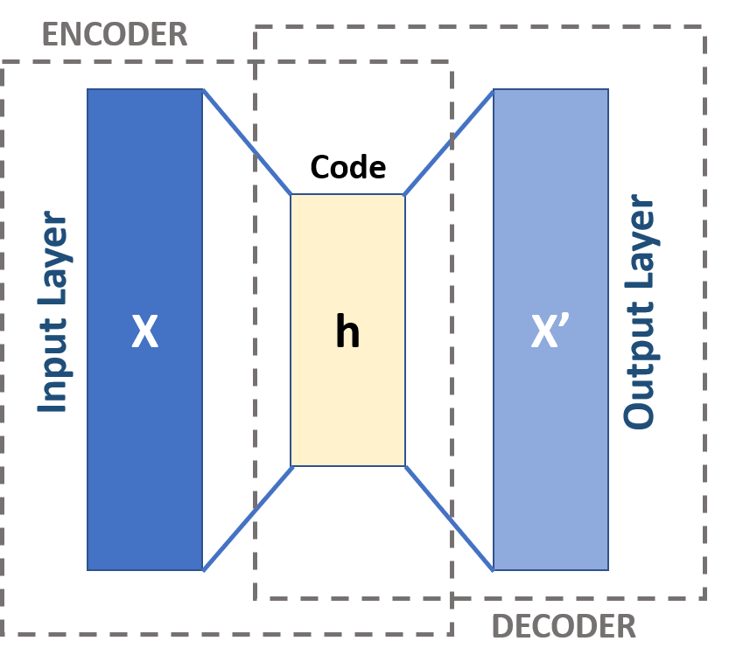
Introduction I
What are Autoencoders ?
Autoencoders aim to learn a useful compressed representation z of the input data x by training to reconstruct x from z
The goal is therefore to maximize the log-likelihood log(p(x))
The log-likelihood log(p(x)) is however intractable
Variational Autoencoders (VAE) solve this problem by maximizing the Evidence Lower Bound (ELBO)
Visualization of an Autoencoder from [I1]

Slide 3
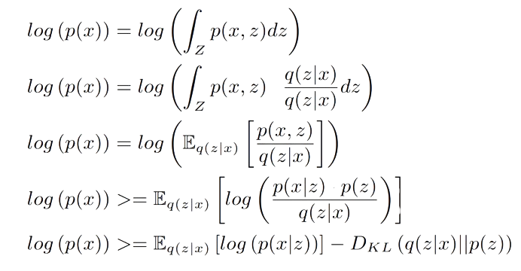
Introduction II
How do we derive the ELBO ?
However how do we approximate q(z|x) and p(x|z) ?
For Audio data : with Convolutional Neural Networks !

Slide 4
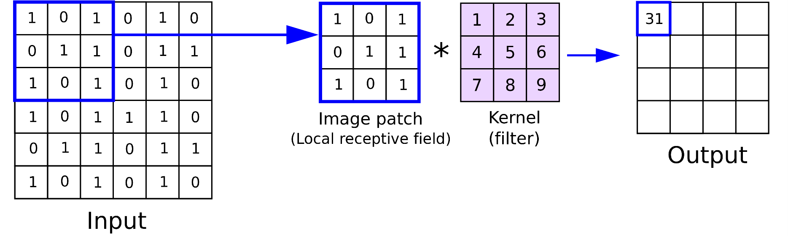
Convolutional Neural Networks
Convolutional Neural Networks (CNNs) were first introduced by Yann LeCun et al. in [Cnn1]
CNNs stack convolutional layers with non-linearities in between
Convolutional layers introduce the inductive bias that only local information is relevant
This assumption allows us to drastically reduce the number of parameters in the network
CNNs have been successfully used in Image and audio processing
Visualization of a convolution from [I2]

Slide 5
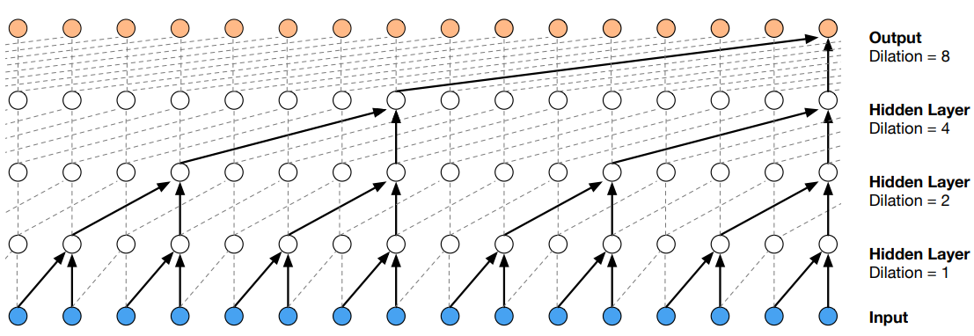
Dilated Causal Convolutional Neural Networks
Encoding and Decoding long time-series with CNNs is challenging
Generative models, that can be sampled from, must furthermore be causal
Dilated causal CNNs, such as WaveNet, alleviate these problems
Strided Convolutions allow the network to tend to longer sequences more efficiently
Masked Convolutions hide future inputs and therefore enforce causality
WaveNet structure from [Cnn2]

Slide 6
Posterior Collapse
A recurring problem in Variational Autoencoders is Posterior Collapse
Posterior Collapse happens the distribution q(z|x) collapses towards the prior p(z)
This means that the encoder learned an uninformative representation due to the decoder p(x|z) being too powerful
VAEs usually model the prior p(z) with a normal distribution. q(z|x) therefore collapses towards a normal distribution independent from x and with high variance.
The decoder can still approximatively reconstruct x from the uninformative encoder and the KL Divergence term dominates the ELBO
The learned representation q(z|x) is therefore useless
Vector Quantized – Variational Autoencoders (VQ-VAEs) were introduced in order to alleviate this problem

Slide 7
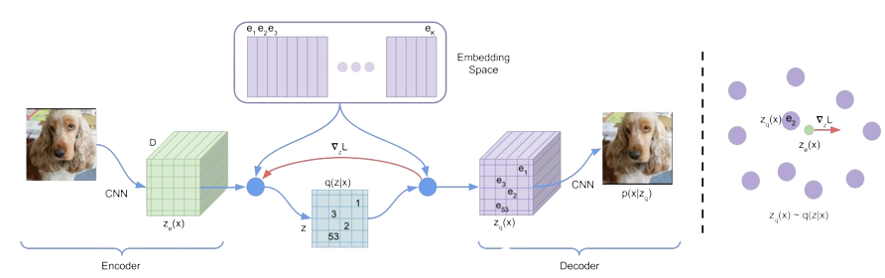
VQ-VAE
VQ-VAEs replace the usual normal distribution assumption for p(z) with a discrete categorical distribution
z is therefore replaced with the nearest codebook entry through Vector Quantization
The KL divergence term is furthermore replaced with two codebook loss terms
The discrete representation encourages q(z|x) to be less noisy and is a great fit for discrete modalities such as speech as codebook entries could represent words for example.
VQVAE structure and loss function from [Vae1]

Slide 8
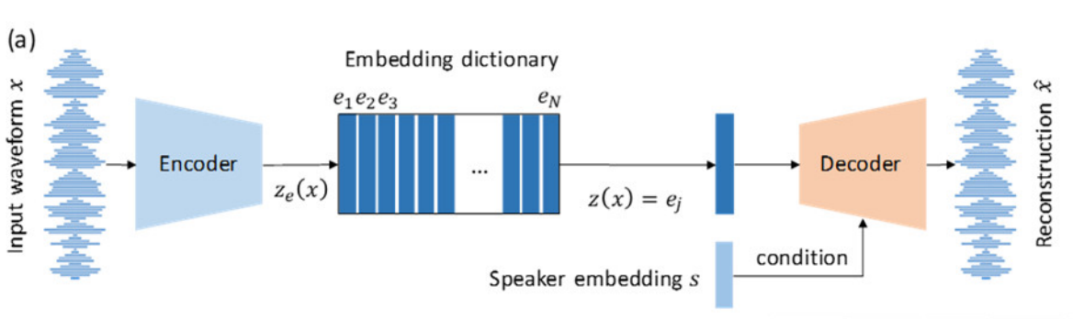
Conditional VQ-VAE
Conditional VQ-VAEs integrate external additional information in the decoder
Additional Information can also be used to encourage the encoder to ignore some aspects of the data
Voice Imitation with VQ-VAE relies on conditioning on a speaker specific embedding s
This encourages the encoder to ignore speaker specific information and only focus on shared aspects such as words
Conditional VQVAE structure and loss function from [Vae2]

Slide 9
Demonstration
Time for a
demonstration
The code for the demonstration is available at :
https://github.com/JH2k00/VoiceConversion

Slide 10
References
Variational Autoencoders :
[Vae1] Van Den Oord, A., & Vinyals, O. (2017). Neural discrete representation learning.
Advances in neural information processing systems, 30.
[Vae2] Ding, Shaojin, and Ricardo Gutierrez-Osuna. "Group Latent Embedding for
Vector Quantized Variational Autoencoder
in Non-Parallel Voice Conversion." Interspeech. 2019.
Convolutional Neural Networks :
[Cnn1] LeCun, Yann, et al. "Gradient-based learning applied to document recognition."
Proceedings of the IEEE 86.11 (1998): 2278-2324.
[Cnn2] Oord, Aaron van den, et al. "Wavenet: A generative model for raw audio."
arXiv preprint arXiv:1609.03499 (2016).
Images:
[Im1] Michela Massi – Own Work, CC BY-SA 4.0,
https://commons.wikimedia.org/w/index.php?curid=80177333
[lm2] Anh H. Reynolds – Own Work, https://anhreynolds.com/blogs/cnn.html

