Slide 1
Improving the classification
performance of MusicBert
2022 Fall Introduction to Natural Language Processing
Na Junghyun, Wangjiayue

Slide 2
Motivation
MIDI file
MusicBert takes MIDI file input to classify performer ID
Utilizing the annotation data could help improve performance of classification
MusicBert
Performer ID

Slide 3
Auxiliary Classifier
Corresponding
annotation
MIDI file
MusicBert
Auxiliary
Classifier
Softmax output
Softmax output
Player ID

Slide 4
MusicBert Classifier
MIDI file
Confidence: score of the predicted class
False positive cases with high confidence were found
The model is overconfident of its prediction.
(may affect the ensemble results)
MusicBert
Softmax output
Player ID

Slide 5
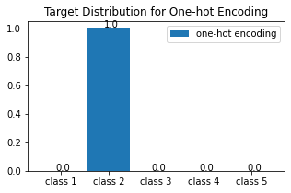
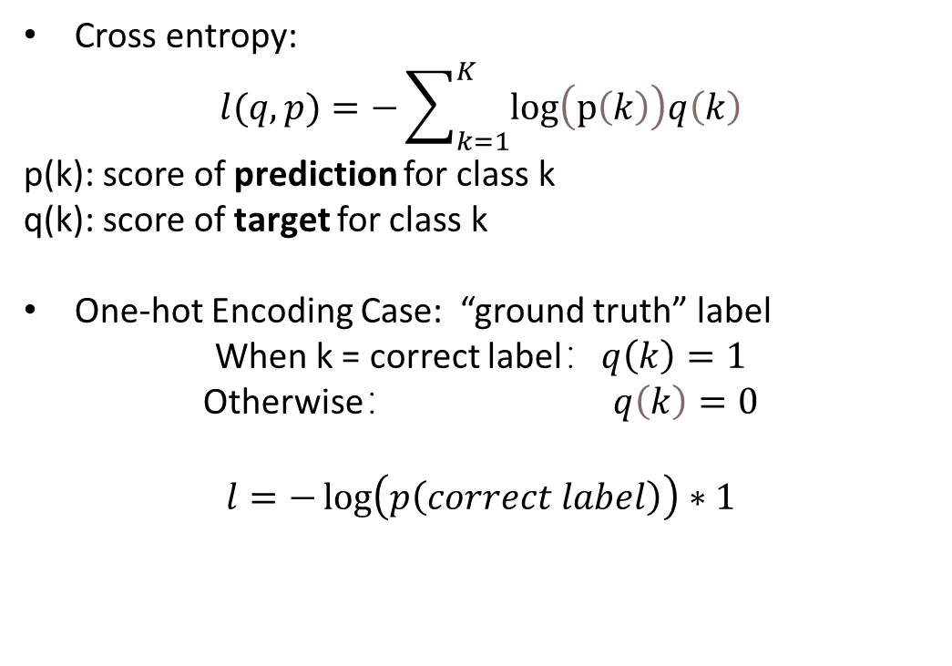
Loss function
Cross entropy:
$$l(q,p)=−\sum_{k=1}^{K}{\log\left(p\left(k\right)\right)q\left(k\right)}$$
p(k): score of prediction for class k
q(k): score of target for class k
One-hot Encoding Case: “ground truth” label
When k = correct label：$q\left(k\right)=1$
Otherwise： $q\left(k\right)=0$
$$l=−\log\left(p\left(correct label\right)\right)∗1$$
Notes:
In general, the output of a CNN will go through a “softmax” layer for normalization at the end. The output of softmax is called probability or confidence.
The traditional way for represent the target is the one- hot encoding:
(as shown in the figure)
correct class gets full probability and others are zero.
….
The problem is that: only care about whether the answer is true and ignore the similarity and relationship between classes.

Slide 6
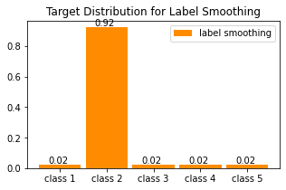
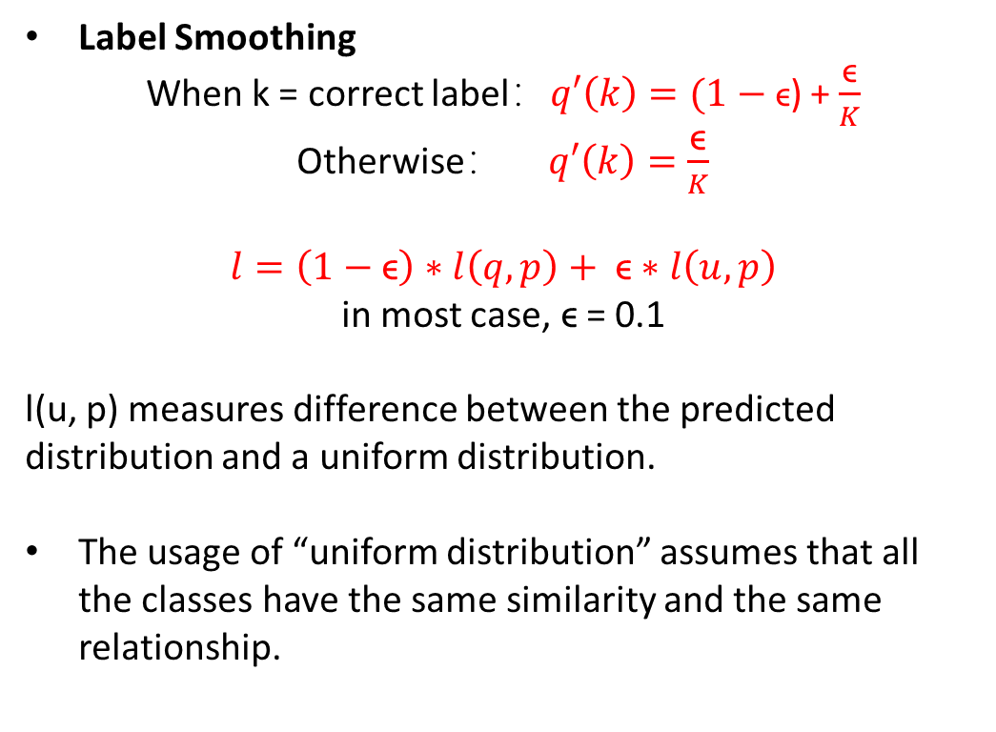
Loss function: label smoothing
Label Smoothing
When k = correct label：$q′\left(k\right)=(1−\text{ϵ}$) + $\frac{\text{ϵ}}{K}$
Otherwise： $q′\left(k\right)=\frac{\text{ϵ}}{K}$
$$l=\left(1−\text{ϵ}\right)∗l\left(q,p\right)+ \text{ϵ}∗l\left(u,p\right)$$
in most case, $\text{ϵ}$ = 0.1
l(u, p) measures difference between the predicted distribution and a uniform distribution.
The usage of “uniform distribution” assumes that all the classes have the same similarity and the same relationship.
Related paper:
Rethinking the Inception Architecture for Computer Vision, Christian Szegedy, CVPR(2016)
Notes:
In order to make the model be less confident and improve generalization…
As shown in the figure, label smoothing reduces the full score of correct label and distribute the reduced score uniformly to all classes.
…
In another way, it is a weighted average between the uniform distribution and the one-hot encoding.
The first part of loss function is similar to the one-hot but the second part..
If the model is over-confident, the second part of the loss function will give a punishment by increasing the loss function.

Slide 7

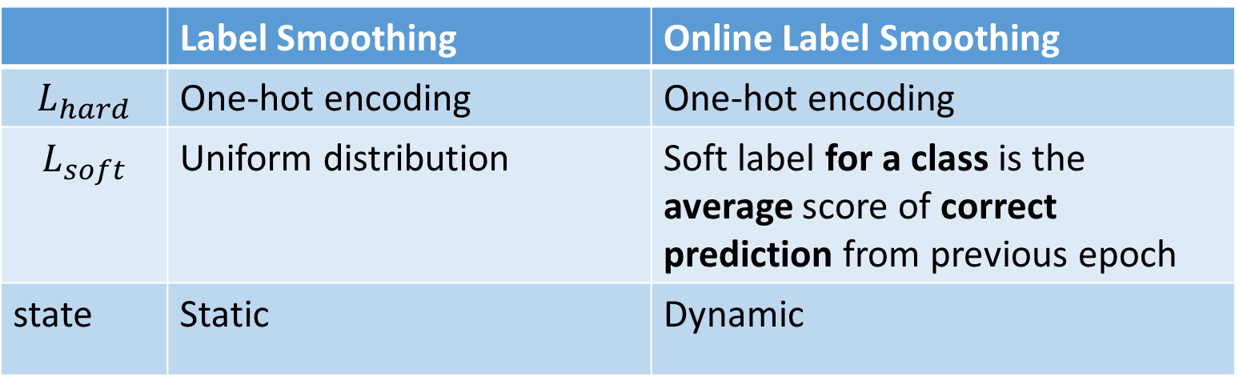
Loss function: Online Label smoothing
$$L=a∗L_{hard}+\left(1−a\right)∗L_{soft}$$
 | Label Smoothing | Online Label Smoothing
$$L_{hard}$$ | One-hot encoding | One-hot encoding
$$L_{soft}$$ | Uniform distribution | Soft label for a class is the average score of correct prediction from previous epoch
state | Static | Dynamic
Related paper:
Delving Deep Into Label Smoothing,
Chang-Bin Zhang, Transactions on Image Processing(2021)
Notes:
Online label smoothing is similar to the label smoothing, but instead of using the uniform distribution, the soft labels it uses are from the previous epoch like knowledge distillation, and this time it is the average distribution of the correct prediction.
It will ignore the output distribution if prediction is wrong.

Slide 8
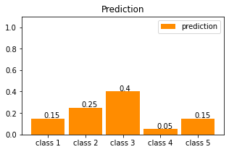
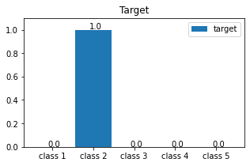
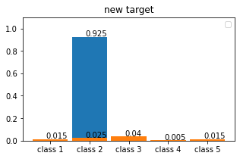
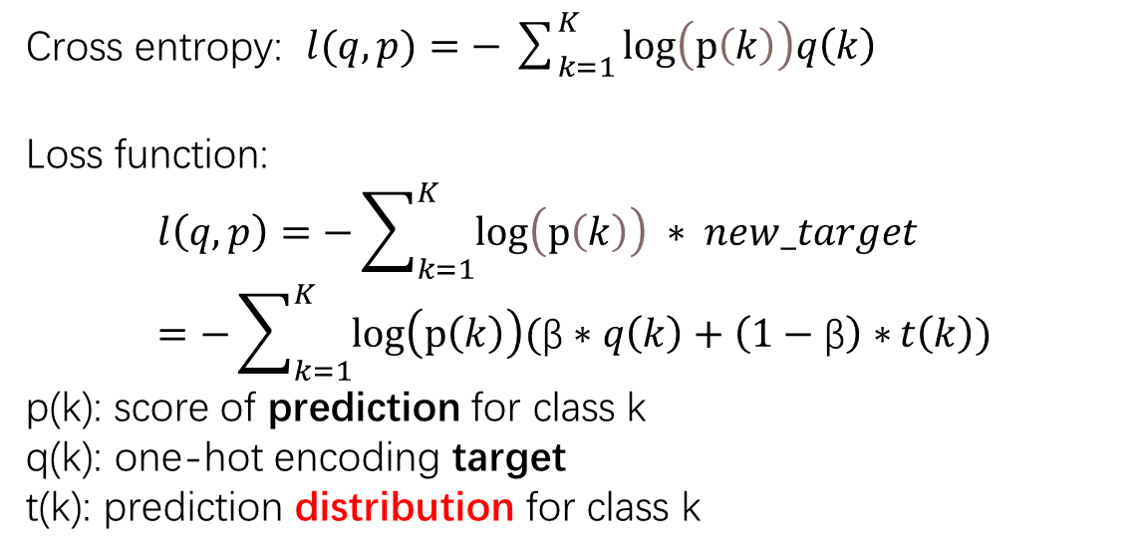
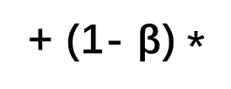
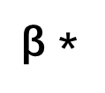
Loss function: Soft Bootstrapping
Cross entropy: $l(q,p)=−\sum_{k=1}^{K}{\log\left(p\left(k\right)\right)q\left(k\right)}$
Loss function:
$$l\left(q,p\right)=−\sum_{k=1}^{K}{\log\left(p\left(k\right)\right) ∗ new_target}=−\sum_{k=1}^{K}{\log\left(p\left(k\right)\right)(\text{β}∗q\left(k\right)+\left(1−\text{β}\right)∗{t\left(k\right))}}$$
p(k): score of prediction for class k
q(k): one-hot encoding target
t(k): prediction distribution for class k
P(k)
$\text{β}$ *
+ (1- $\text{β}$) *
=
q(k)
t(k)
New target

Slide 9
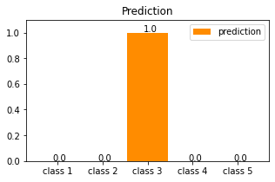
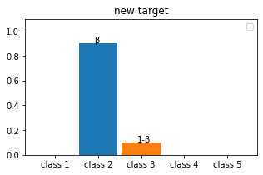
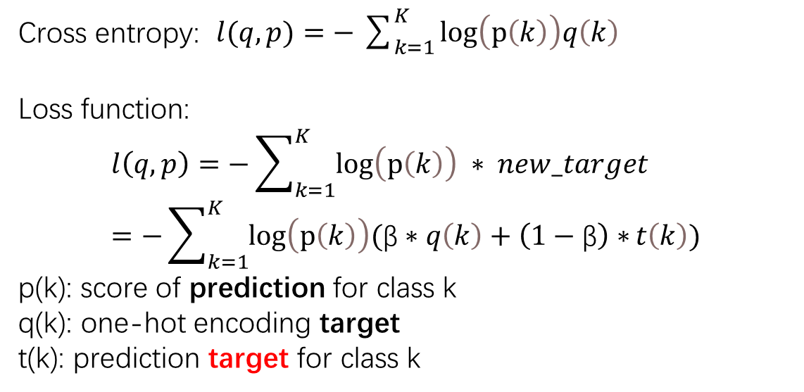
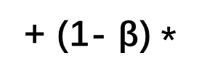
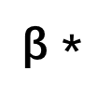
Loss function: Hard Bootstrapping
Cross entropy: $l(q,p)=−\sum_{k=1}^{K}{\log\left(p\left(k\right)\right)q\left(k\right)}$
Loss function:
$$l\left(q,p\right)=−\sum_{k=1}^{K}{\log\left(p\left(k\right)\right) ∗ new_target}=−\sum_{k=1}^{K}{\log\left(p\left(k\right)\right)(\text{β}∗q\left(k\right)+\left(1−\text{β}\right)∗{t\left(k\right))}}$$
p(k): score of prediction for class k
q(k): one-hot encoding target
t(k): prediction target for class k
P(k)
$\text{β}$ *
+ (1- $\text{β}$) *
=
q(k)
t(k)
New target
Notes:
the labeling may be subjective; handle noisy and incomplete labeling b

Slide 10
Experiment design
Annotation input from map_midi_to_label.py
Average, KDE & whole data
Eliminated non-professional annotators
Various types of classifier to compare accuracy
SVM, RandomForest, MLP, etc.
Various loss function to reduce the problem of overconfidence
Label smoothing, online label smoothing
soft bootstrapping, hard bootstrapping

Slide 11
Experiment result
 | Kernel density estimation | Professional annotator | all data | mean value
SVM | 0.2 | 0.1567 | 0.1455 | 0.1875
RandomForest | 0.175 | 0.1336 | 0.1455 | 0.1375
Adaboost | 0.0875 | 0.1475 | 0.1255 | 0.175
DecisionTree | 0.15 | 0.1152 | 0.1369 | 0.2125
SGDClassifier | 0.075 | 0.0553 | 0.1327 | 0.1125
MLPClassifier | 0.2375 | 0.1567 | 0.127 | 0.2
Classification accuracy for each classifier type
and data preprocessing methods

Slide 12
Experiment result
 | acc | avg correct prediction confidence | avg wrong prediction confidence
One-hot encoding(baseline) | 0.8375 | 0.9614 | 0.9003
label smoothing | 0.85 | 0.9539 | 0.7795
online label smoothing | 0.8375 | 0.9357 | 0.8441
bootstrapping hard | 0.8 | 0.9381 | 0.8884
bootstrapping soft | 0.85 | 0.9623 | 0.8608
Accuracy and confidence results for loss-function modifications

Slide 13
Experiment result
Auxiliary classifier shows poor performance
Annotation data alone is not enough to classify the players
Loss functions for noisy label learning slightly improves accuracy and significantly improve the confidence wrong prediction.

