Slide 1
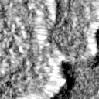
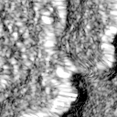
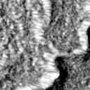
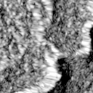

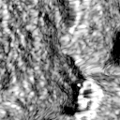
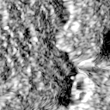
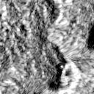
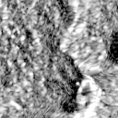
Teacher
(dual-orbit training)
Counter-guided
Teacher supervision
Counter orbit
Adaptive Search (Teacher)
Teacher
GT
ConvNeXt-Tiny
Policy
TGD (optional)
⋮
P2
Prediction
+ FPN
(DESC)
P3
F_{T}
pre
P4
post
VV
VH
VV
VH
P2
P3
P4
Decoder
Target orbit
⋮
ConvNeXt-Tiny
(ASC)
pre
+ FPN
Seg. loss + optional TGD
post
VV
VH
VV
VH
P2
P3
5-channel SAR input
P4
Knowledge Distillation (training only)
Teacher search (on target features)
F_{T}
Policy KD
Align
Student search (on target features)
F_{S}
Evidence KD
Student
(target-only inference)
Policy
Adaptive Search (Student)
Training Supervision (Student)
Student
Target orbit
P2
GT
ConvNeXt-Tiny
P3
Prediction
⋮
P4
F_{S}
(ASC)
pre
+ FPN
post
VV
VH
VV
VH
Decoder
P2
P3
5-channel SAR input
P4
Seg. Loss
L_{S} = L_{seg} + λ_{KD}(0.5 L_{policy} + 0.5 L_{evidence})

