Slide 1
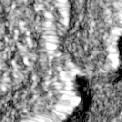
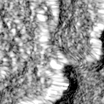
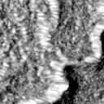
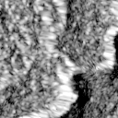

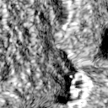
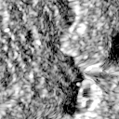
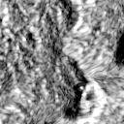
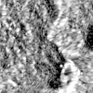
Teacher
(dual-orbit training)
Counter-guided
Teacher supervision
Counter orbit
Adaptive Search (Teacher)
Teacher
Reference
ConvNeXt-Tiny
Policy
Geometric loss
⋮
P2
Prediction
+ FPN
(Descending)
P3
F_{T}
pre
P4
post
VV
VH
VV
VH
P2
P3
P4
Decoder
Target orbit
⋮
ConvNeXt-Tiny
(Ascending)
pre
+ FPN
Segmentation loss
post
VV
VH
VV
VH
P2
P3
5-channel SAR input
P4
Knowledge Distillation (training only)
Teacher policy on Student memory
F_{T}
Policy KD
Align
Student policy on same memory
F_{S}
Evidence KD
Student
(target-only inference)
Policy
Adaptive Search (Student)
Training Supervision (Student)
Student
Target orbit
P2
Reference
ConvNeXt-Tiny
P3
Prediction
⋮
P4
F_{S}
(Ascending)
pre
+ FPN
post
VV
VH
VV
VH
Decoder
P2
P3
5-channel SAR input
P4
Segmentation loss
L_{S} = L_{seg} + λ_{KD}(0.5 L_{policy} + 0.5 L_{evidence})

