Slide 1
Nuts and Bolts:
Analyzing the Development of Technological Breakthroughs Through Clustering
Jayden Huang

Slide 2

Background
What is a patent?
What are patent citations?
A quick example...

Slide 3

Methodology
Patent Database
Longitudinal Analysis
Clustering Algorithm

Slide 4
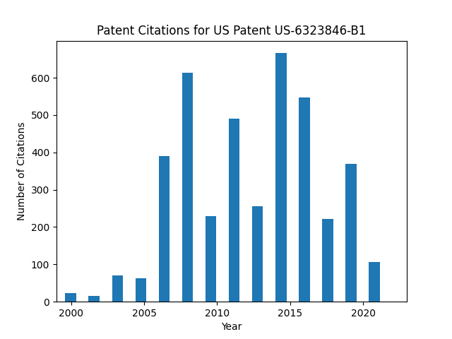

Slide 5
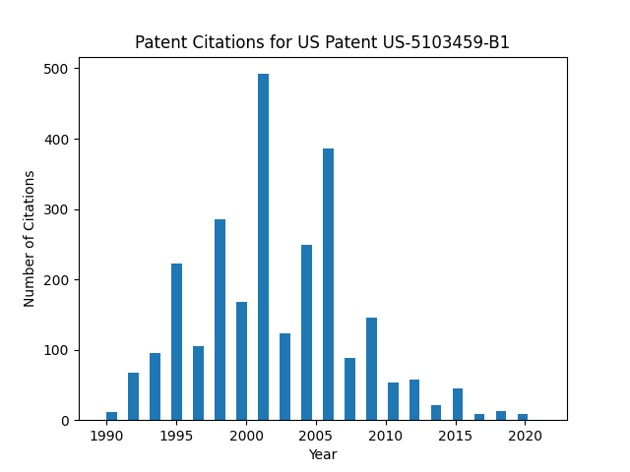
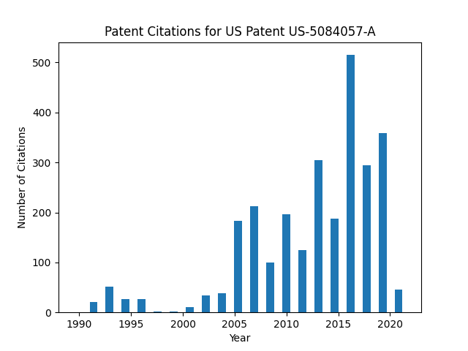

Slide 6
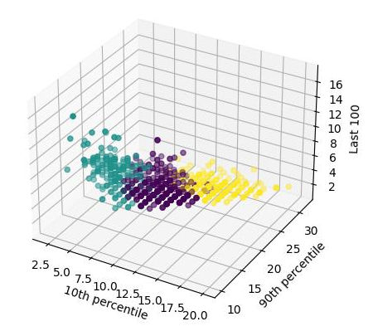

Slide 7
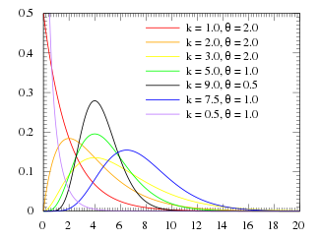

Slide 8
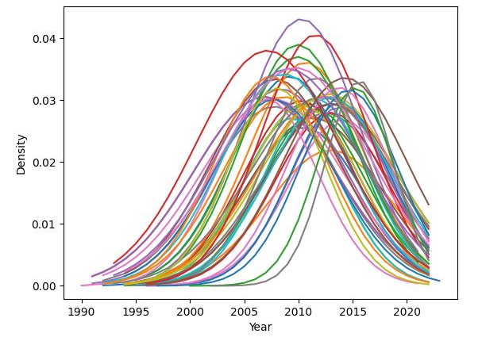
Cluster 1

Slide 9
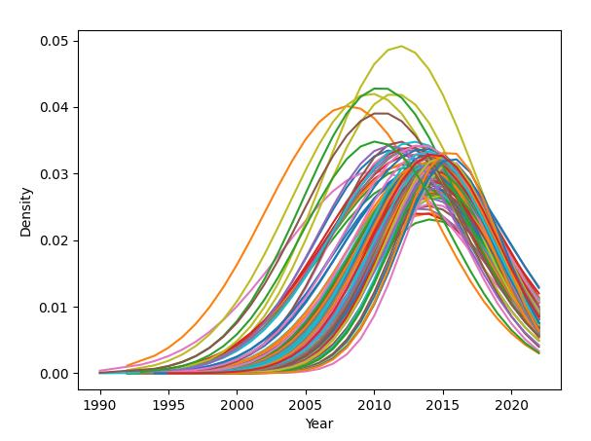
Cluster 2

Slide 10
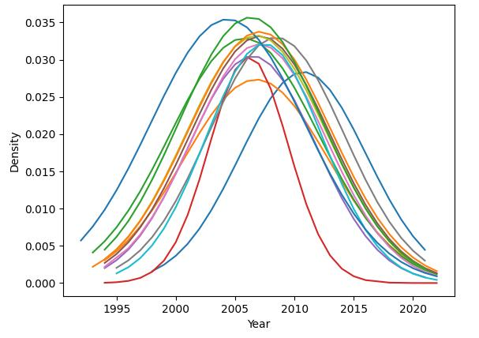
Cluster 3

Slide 11
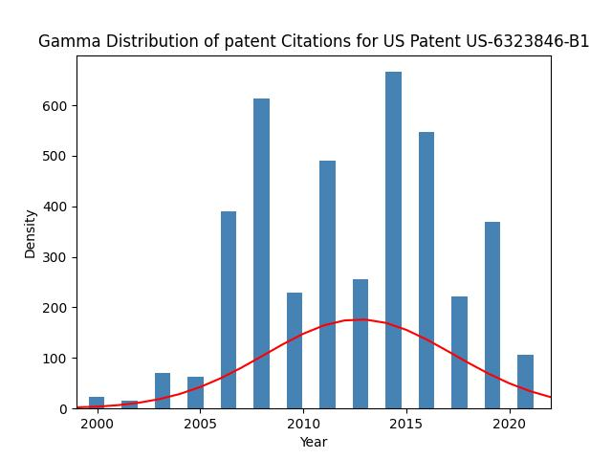
Back to basics...

Slide 12

Results

Slide 13
Thank you for listening!
Please ask questions!

