Slide 1
Industry 4.0
12.12.2024
Jumana Hassan IS-02-09

Slide 2
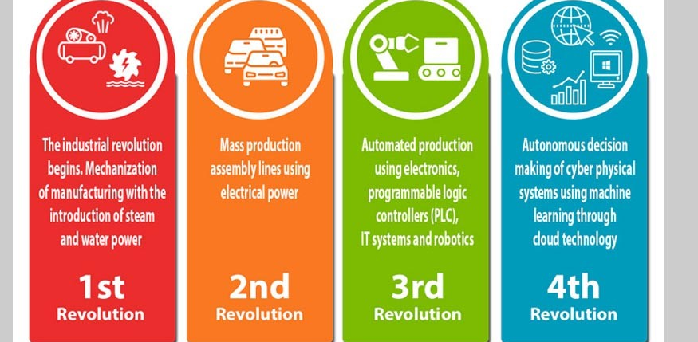
Artificial Intelligence
Internet of Things (IOT)
Gene Editing
Robotics
Autonomous Vwhicle
Blockchain
Quantum Computing
Augmented Reality (AR) and Virtual Reality (VR)

Slide 3
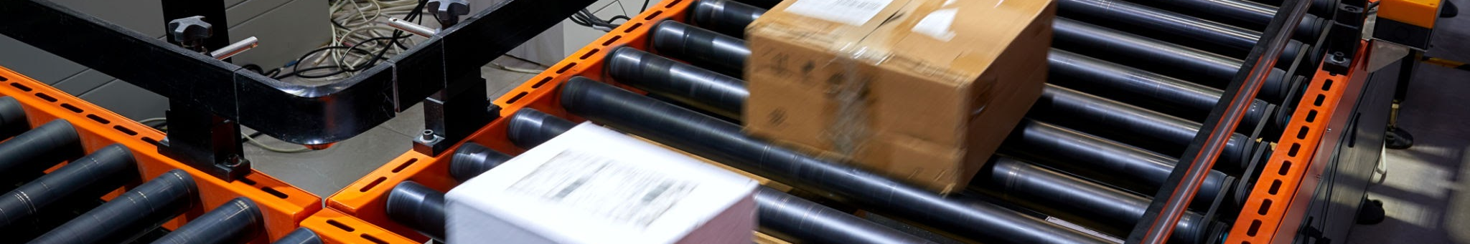
What is 4IR?
Fusion of physical, digital and biological technologies.
BUSINESS NAME

Slide 4
4IR
1st IR
2nd IR
3rd IR
The First Industrial Revolution was marked by a transition from hand production methods to machines through the use of steam power and water power. The implementation of new technologies took a long time, so the period which this refers to was between 1760 and 1820, or 1840 in Europe and the United States. Its effects had consequences on textile manufacturing, which was first to adopt such changes, as well as iron industry, agriculture, and mining
also known as the Technological Revolution, is the period between 1871 and 1914 that resulted from installations of extensive railroad and telegraph networks, which allowed for faster transfer of people and ideas, as well as electricity.
The Third Industrial Revolution, also known as the Digital Revolution, began in the late 20th century. It is characterized by the shift to an economy centered on information technology, marked by the advent of personal computers, the Internet, and the widespread digitalization of communication and industrial processes.
In essence, the Fourth Industrial Revolution is the trend towards automation and data exchange in manufacturing technologies and processes which include cyber-physical systems (CPS), Internet of Things (IoT), cloud computing,cognitive computing, and artificial intelligence.
BUSINESS NAME

Slide 5
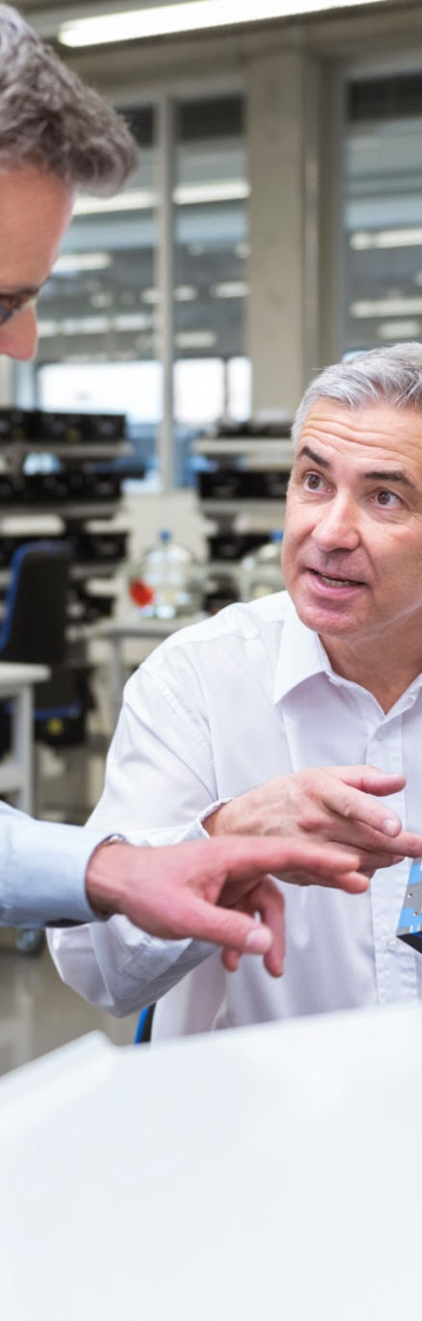
1
Convergence of
Physical, Digital, and
Biological:
4IR is characterized by the seamless integration of these fields, creating new possibilities and innovations.
Example:
Smart cities, where IoT sensors collect data, AI analyzes it, and robotic systems interact with the environment.

Slide 6

2
Artificial Intelligence (AI): AI enables machines to learn, adapt, and make decisions without human intervention.
Applications:
Autonomous vehicles
Predictive analytics
Personalized healthcare

Slide 7

3
Robotics and Automation
Role in 4IR: Robotics is transforming manufacturing, logistics, healthcare, and more, making processes more efficient, precise, and cost-effective.
Example: Robots in warehouses (like Amazon's fulfillment centers) and autonomous drones in logistics.

Slide 8

4
Internet of Things (IoT)
Definition: IoT refers to the interconnected network of physical devices that collect and exchange data.
Impact:
Smart homes
Smart factories
Predictive maintenance in industries

Slide 9

5
What is 3D Printing?
The process of creating three-dimensional objects by layering materials based on digital models.
Applications:
Prototyping and product design
Medical implants
Custom manufacturing

Slide 10

6
Blockchain and Distributed Ledger Technology
Definition: Blockchain is a decentralized digital ledger that records transactions across many computers, ensuring security and transparency.
Applications:
Cryptocurrencies (Bitcoin, Ethereum)
Supply chain management
Secure voting systems

Slide 11
7
Augmented and Virtual Reality
Augmented Reality (AR): Overlaying digital information on the real world (e.g., smartphone apps or AR glasses).
Virtual Reality (VR): Immersive, simulated environments often used in gaming, education, and training.
Applications:
Healthcare (surgical training)
Education (virtual classrooms)
Retail (virtual shopping experiences)

Slide 12
8
The Impact of 4IR on Jobs
Job Displacement:
Automation and AI may replace some jobs, especially in manufacturing and routine tasks.
Job
Creation:
New jobs are emerging in areas
like AI development, data science, and renewable energy.
Upskilling and Reskilling:
Continuous learning will be essential for workers to adapt to new technologies.

Slide 13
9
Transforming Industries
Manufacturing:
Smart factories and
automation are improving
productivity and flexibility.
Healthcare:
AI diagnostics, robotic surgery, and personalized medicine.
Finance:
Blockchain, AI-driven financial services, and cryptocurrencies.
Retail:
E-commerce, personalized customer experiences, and automated supply chains.

Slide 14
10
4IR and Society
Social Impacts:
Digital divide: Not everyone has equal access to new technologies.
Privacy concerns: Increased data collection and surveillance.
Ethical issues: AI decision-making, deepfakes, and security risks.

Slide 15
11
Sustainability and 4IR
Environmental Benefits:
Smart grids and energy-efficient technologies.
Sustainable agriculture and climate monitoring through IoT.
Challenges:
E-waste from rapid tech innovation.
Energy consumption of blockchain and AI.

Slide 16
12
The Role of Government in 4IR
Policy Development: Governments need to regulate emerging technologies, protect citizens' rights, and encourage innovation.
Public-Private Partnerships: Collaboration between governments, industries, and academia is crucial for advancing 4IR.

Slide 17
4IR in the Developing World
Leapfrogging Technology: Developing nations skipping traditional infrastructure.
Access to Global Markets: E-commerce and digital platforms connecting local businesses to global customers.
Challenges: Access to technology, skills gap, and digital divide.
BUSINESS NAME

Slide 18
The Future of Work in 4IR
Hybrid Work Models: Remote work and digital collaboration.
AI and Human Collaboration: Augmenting human capabilities with AI.
Workplace Evolution: Emphasis on creativity, problem-solving, and critical thinking.
01
The Role of Innovation and R&D
02
Research in AI & Machine Learning: Advancing capabilities of intelligent systems.
Collaboration Across Industries: Open-source innovation and cross-disciplinary teams.
03
Investment in Emerging Technologies: Ensuring continuous innovation for future growth.
BUSINESS NAME

Slide 19
Conclusion
Summary: 4IR is transforming every aspect of society, offering both unprecedented opportunities and significant challenges.
Call to Action: Embrace technology, adapt to changes, and invest in future skills to thrive in the 4IR era.

Slide 20
References
McGinnis, Devon (27 October 2020). "What Is the Fourth Industrial Revolution?". The 360 Blog from Salesforce. Retrieved 22 January 2023
Marr, Bernard. "Why Everyone Must Get Ready For The 4th Industrial Revolution". Forbes. Retrieved 22 January 2023

Slide 21
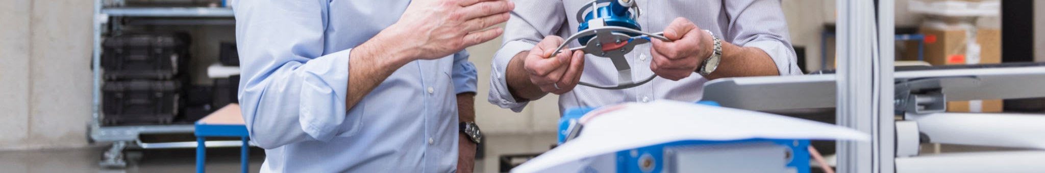
THANK YOU
Jumana Hassan
IS-02-09

