Slide 1
TEAM MEMBERS Golla Mounika – 22AT1A3211 M Jhansi Lakshmi – 22AT1A3228 S Arshiya Tarannum – 23AT5A3207 Vidapanakallu Harshini – 22AT1A3247
INTEGRATING EFFICIENTNET-B0 AND VISION TRANSFORMERS FOR ENHANCED GLOBAL AND LOCAL DIAGNOSTIC REASONING
Project Co-Ordinator
Dr.M.Janardan
M.Tech,PhD
HOD
Dr.P.Suman Prakash
M.Tech,PhD
Project Guide
K VINOD KUMAR REDDY M.Tech, PhD
DEPARTMENT OF DATA SCIENCE
G PULLAIAH COLLEGE OF ENGINEERING AND TECHNOLOGY
(An Autonomous Institute affiliated to JNTUA, Ananthapuramu)

Slide 2
CONTENTS
Project Title
Objectives
Abstract
Problem Statement
Introduction
Literature Review
Existing Systems
Proposed Systems
Tools for Implementation
Methodology
Advantages and Applications
Conclusion

Slide 3
Objectives
To develop a hybrid deep learning model that combines CNN (EfficientNet- B0) and Vision Transformer (ViT) for accurate skin cancer classification.
To improve classification performance by capturing both local features (textures, edges) and global features (spatial relationships and symmetry) in dermoscopic images.
To perform multi-class classification of seven types of skin lesions using the HAM10000 dataset.
To enhance diagnostic accuracy and achieve better performance metrics such as accuracy, precision, recall, and F1-score.
To reduce misclassification between benign and malignant cases by leveraging attention mechanisms.

Slide 4
Abstract
With the rise in skin cancer incidence, there is a growing need for improved diagnostic methods that allow physicians to identify skin cancers during routine examinations. While traditional convolutional neural networks (CNNs)—the backbone of image detection today— are good at detecting local characteristics (texture and edges), traditional CNNs do not provide information about the overall structure or spatial symmetry of an object. We present a new hybrid deep learning model for seven-class classification of skin cancer derived from the HAM10000 dataset to address this limitation. The proposed architecture integrates a CNN-B0 model with the Vision Transformer (ViT), which enables the ability to represent global relationships within the input data. The model also uses a 1x1 convolutional layer to convert local characteristics into a latent variable, and then integrates that latent variable with the ability of the Transformer to model the context of the input. The combination of these two architectures produces a greater degree of accuracy 87.32.

Slide 5
Problem Statement
Rapid increase in skin cancer cases demands early, accurate, and automated detection systems.
Traditional diagnosis by dermatologists is time-consuming, subjective, and dependent on expertise, leading to possible inconsistencies.
Skin lesion images exhibit high variability in color, size, shape, and texture, making classification challenging.
Conventional CNN-based models are limited to local feature extraction (edges, textures) and fail to capture global structural information.
This limitation leads to misclassification, especially between visually similar classes such as benign and malignant lesions in multi-class datasets like HAM10000.
Hence, there is a need for a robust hybrid model integrating CNN and Vision Transformer to capture both local and global features, improving diagnostic accuracy and reliability.

Slide 6
Introduction
Skin cancer is a rapidly increasing health issue, where early and accurate detection is essential for effective treatment.
Diagnosis is challenging due to high variability in skin lesions (color, shape, size, and texture).
CNNs are effective in extracting local features, but they fail to capture global contextual information.
Vision Transformers (ViTs) can analyze the entire image context, capturing long-range dependencies and improving classification.
This project proposes a hybrid EfficientNet-B0 + ViT model using the HAM10000 dataset to enhance multi-class skin cancer classification accuracy.

Slide 7
Literature Review
Skin cancer detection is challenging due to high variation in lesion appearance, making early and accurate diagnosis difficult.
Traditional methods rely on manual examination by dermatologists, which can be time-consuming and subjective.
CNN-based models (e.g., ResNet, VGG) have been widely used and perform well in extracting local features like edges and textures.
However, CNNs have limitations in capturing global context and spatial relationships, affecting classification accuracy.
Vision Transformers (ViTs) use attention mechanisms to capture global dependencies and improve performance in image classification tasks.
Recent studies focus on hybrid CNN + ViT models, which combine local and global feature extraction, resulting in higher accuracy and better skin cancer classification.

Slide 8
Existing System
Skin cancer detection is mainly performed through manual examination by dermatologists, which is time-consuming and subjective.
Early automated approaches use Computer-Aided Diagnosis (CAD) systems to assist in analyzing skin lesion images.
Most existing systems are based on Convolutional Neural Networks (CNNs) for image classification.
CNN models extract local features such as edges, textures, and patterns from dermoscopic images.
These systems use datasets like HAM10000 for training multi-class skin lesion classification models.
However, existing systems have limitations such as:
Inability to capture global context
Lower accuracy in complex multi-class classification
Difficulty distinguishing similar lesions (benign vs malignant)

Slide 9
Proposed System
The proposed system uses a hybrid deep learning model combining CNN (EfficientNet-B0) and Vision Transformer (ViT).
EfficientNet-B0 (CNN) is used to extract local features such as edges, textures, and fine details from skin images.
A 1×1 convolution layer is applied to transform extracted features into a suitable representation for further processing.
Vision Transformer (ViT) captures global contextual information and spatial relationships using attention mechanisms.
The model is trained on the HAM10000 dataset for multi-class classification of skin diseases.
This hybrid approach improves:
Classification accuracy
Feature representation (local + global)
Detection of both benign and malignant lesions

Slide 10
Tools for Implementation
Programming Language: Python (used for model development and data processing)
Deep Learning Frameworks: TensorFlow / Keras or PyTorch (for building CNN and Vision Transformer models)
Libraries: NumPy, Pandas (data handling), Matplotlib / Seaborn (visualization), OpenCV (image processing)
Dataset: HAM10000 dataset (used for training and testing skin lesion classification)
Development Environment: Jupyter Notebook / Google Colab (for coding and experimentation)
Hardware/Platform: GPU support (NVIDIA GPU or Google Colab GPU) for faster model training

Slide 11
Methodology
Data Collection: HAM10000 + ISIC
Preprocessing: Resize, normalize, noise removal
Data Augmentation: Flip, rotate, zoom, brightness
Model Selection: CNN baseline + Vision Transformer
Model Training: AdamW, Cross-Entropy/Focal Loss, class balancing
Model Evaluation: Accuracy, Precision, Recall, F1-Score, Confusion Matrix
Deployment: Streamlit web app for telemedicine

Slide 12
Data Preprocessing
Dataset: Leveraged HAM10000 (10,015 dermatoscopic images) covering 7 disease classes.
Preprocessing: Standardized inputs to 224x224 pixels with ImageNet normalization (μ, σ).
Augmentation: Applied rotations, flips, and color jitter to prevent overfitting and improve robustness.
Class Balancing: Implemented WeightedRandomSampler to handle heavy data imbalance.
Inverse Weighting: Assigned image weights based on Weight_class = 1 / Count_class.
Effect: Ensures rare conditions like Dermatofibroma receive equal training visibility as common moles.

Slide 13
Hybrid Model Architecture
CNN Backbone (Local): Utilized EfficientNet-B0 to capture intricate textures, colors, and local spatial patterns.
Bridge Layer: Employed a 1 × 1 Convolution to compress 320 channels into 192 for Transformer compatibility.
Transformer Blocks (Global): Integrated ViT-Tiny self-attention mechanisms to analyze global lesion symmetry and long-range structural relationships.
Feature Fusion: Combined local and global data through Global Average Pooling to create a unified feature vector.

Slide 14
Optimization & Inference
Optimizer: Used AdamW (LR = 5e-5) with weight decay for stable training and superior generalization.
Loss Function: Optimized via Cross-Entropy Loss to maximize prediction probability for the correct class.
Validation Strategy: Implemented "Best-Model" saving based on peak validation accuracy across 15 epochs.
Clinical Mapping: Converted raw model scores into human-readable Confidence Percentages using the Softmax function.

Slide 15
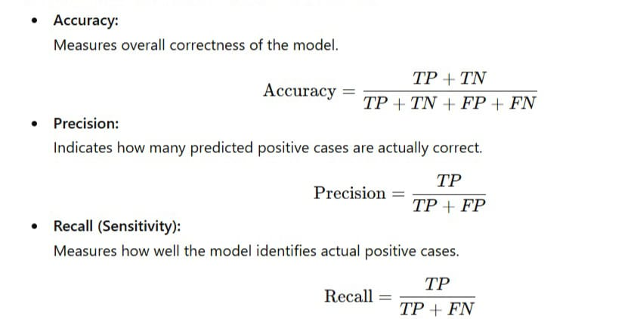
Evaluation Metrics

Slide 16
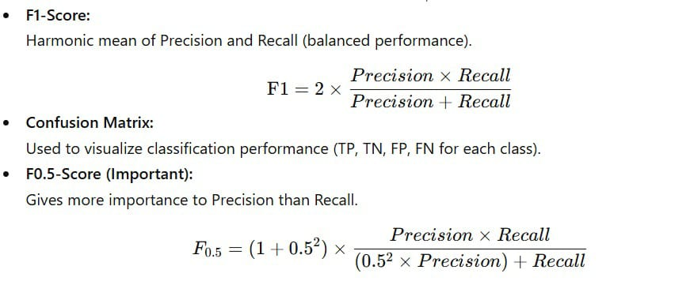

Slide 17
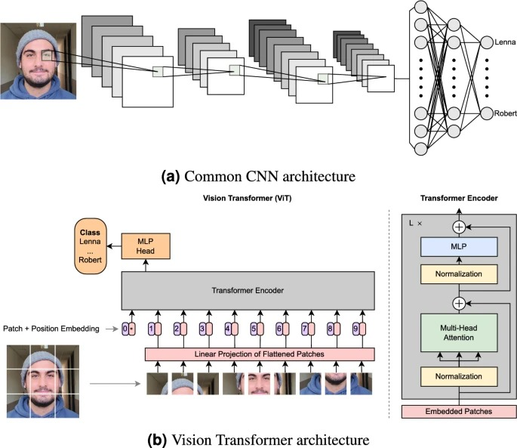
Working of CNN & VIT Architecture

Slide 18
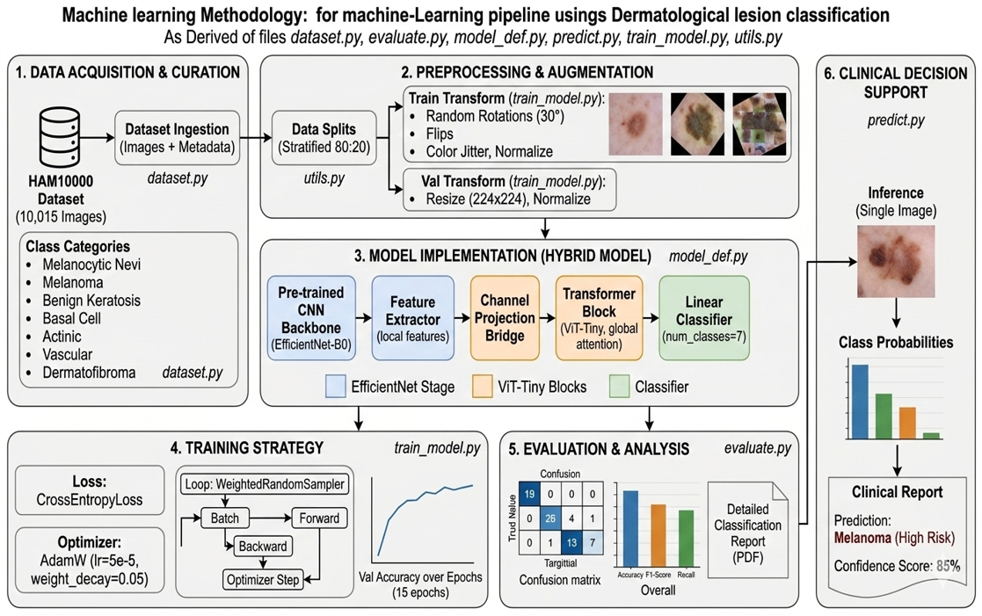
Project Architecture Overview

Slide 19
Advantages
High Accuracy: Captures both local and global features for precise skin disease diagnosis.
Early Detection: Identifies skin cancer and other diseases at an early stage, improving patient survival rates.
Handles Imbalanced Data: Effective even for rare or under-represented conditions.
Consistency: Produces reliable and consistent results, reducing human error and dependency on doctor experience.
Cost-Effective & Time-Efficient: Faster and cheaper than traditional diagnostic procedures.
Remote Accessibility: Suitable for telemedicine and digital health platforms, including rural and underserved areas.

Slide 20
Applications
Medical Diagnosis: Automated classification of melanoma, nevi, basal cell carcinoma, and other skin diseases.
Telemedicine: Enables remote consultation and early screening, especially in rural or underserved regions.
Digital Health Platforms: Integration with apps or web platforms for patient monitoring.
Clinical Decision Support: Assists doctors in making faster and more accurate decisions.
Research & Training: Supports dermatology research and AI-based healthcare studies, including analyzing skin lesion patterns.
Public Health Programs: Enables large-scale screening programs to detect skin cancer early.

Slide 21
Conclusion
Proposed a hybrid CNN (EfficientNet-B0) + Vision Transformer (ViT) model for skin cancer classification.
Successfully captured both local features (textures, edges) and global features (spatial relationships, symmetry).
Achieved high classification accuracy (~87%) on the HAM10000 dataset.
Improved ability to differentiate between benign and malignant lesions.
Use of attention mechanisms enhanced model performance and reliability.
The system can serve as an effective computer-aided diagnostic model to assist dermatologists in early detection.

Slide 22
THANK YOU

