Slide 1
Sales Dashboard Analysis
Task 8 - Data Analyst Internship
Tool: Tableau Public Edition

Slide 2
Dashboard Overview
This dashboard visualizes sales and profit data across multiple dimensions such as time, category, and region. Tools used: Tableau Public Edition.

Slide 3
Key Insights
1. The West region recorded the highest sales, followed closely by the East.
2. Technology category leads in sales, followed by Furniture and Office Supplies.
3. The Sales trend has shown a consistent upward trajectory from 2015 to 2017.
4. Products like Accessories and Phones generated high profits across all regions, while Tables and Appliances showed negative profits in some regions.

Slide 4
KPI Metrics & Visuals
• KPI 1: Total Sales = 2,297,201
• KPI 2: Profit Range = -11,025 to 19,327
• Visuals Used:
- Line Chart for Monthly Sales Trend
- Pie Chart for Category-wise Sales
- Bar Chart for Region-wise Sales
- Heatmap Table for Profit by Sub-Category & Region

Slide 5
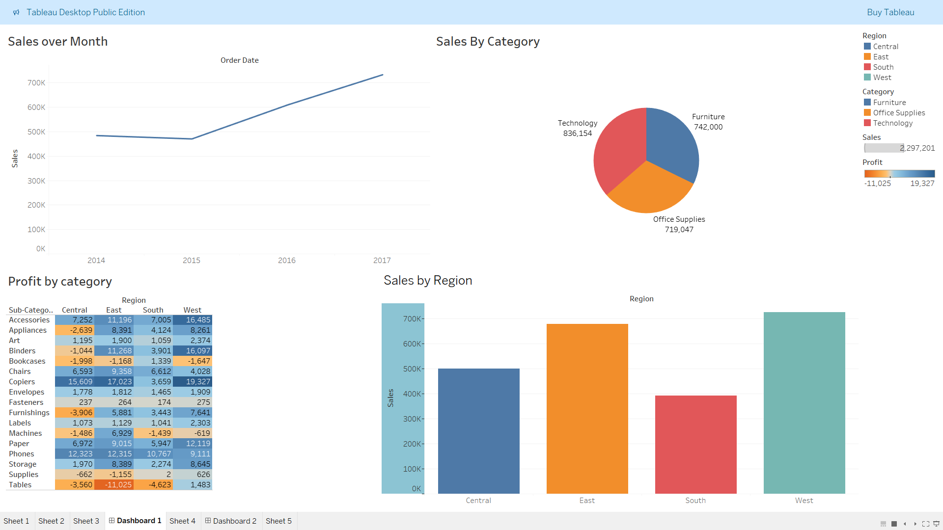
DASHBOARD

