Slide 1
Customer Segmentation Dashboard
Power BI Project | Dashboard Insights

Slide 2
Dashboard Overview
This dashboard visualizes key metrics from a customer dataset including:
- Total Annual Income and Spending Score
- Customer Demographics (Gender, Age)
- Gender-wise distribution and comparison
- Data source: Mall Customers Dataset (cleaned)

Slide 3
Visual Components
- Donut Chart: Age vs. Income Summary
- Bar Chart: Spending Score by Gender
- Pie Chart: Income by Gender
- Gauge Chart: Customer Count
- Area Chart: Gender-based Spending Score

Slide 4
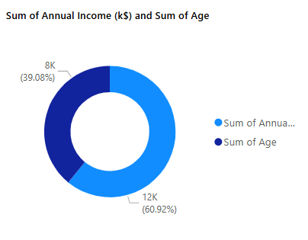
Donut Chart: Sum of Age and Annual Income
This donut chart compares the total sum of customer ages and their annual income (in k$).
- Total Annual Income contributes ~60.92%
- Total Age contributes ~39.08%
This gives a quick view of overall customer age versus their combined earning.

Slide 5
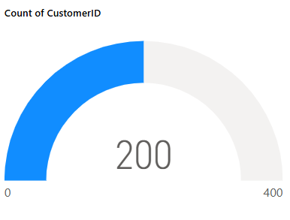
Card Visuals and Gauge Chart
- Card KPIs provide high-level metrics:
- Total Customers: 200
- Total Annual Income: 12,000 k$
- Total Spending Score: 10,000
- Gauge Chart confirms customer count (200 out of a 400 scale).
Useful for executive summary and quick health-check.

Slide 6
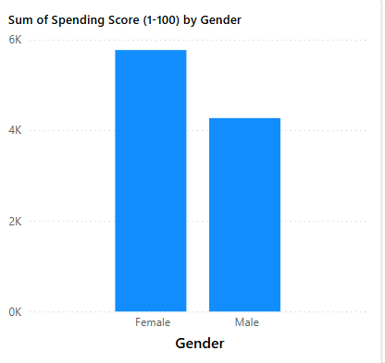
Bar Chart: Spending Score by Gender
This bar chart shows total spending score (scale 1–100) split by gender.
- Female customers have a higher spending score (~6K)
- Male customers show ~4K spending score
Indicates higher engagement from female customers.

Slide 7
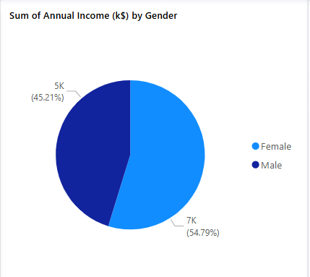
Pie Chart: Annual Income by Gender
Pie chart compares total annual income by gender.
- Female customers contribute ~54.79% (~7K)
- Male customers contribute ~45.21% (~5K)
Relatively balanced income distribution.

Slide 8
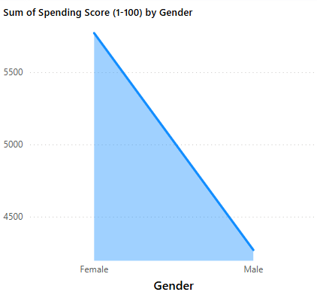
Area Chart: Spending Score Trend by Gender
Area chart visualizes cumulative spending scores by gender.
- Female segment shows a higher cumulative score
- Helps identify trend patterns and customer group strength
Supports decisions on gender-specific marketing strategies.

Slide 9
Insights and Recommendations
**Key KPIs:**
- Total Customers: 200
- Total Spending Score: 10,000
- Total Annual Income: 12,000 k$
**Insights:**
- Female customers show higher spending and income.
- Gender-wise segmentation reveals valuable patterns.
- Potential to target high-value customer groups through personalized offers.
- Foundation for deeper segmentation using clustering or ML.

Slide 10
Key Metrics Summary
- Total Customers: 200
- Total Annual Income: 12,000 k$
- Total Spending Score: 10,000
- Female customers have:
- Higher spending score (approx. 6K)
- Slightly higher annual income contribution (~7K vs 5K)

Slide 11
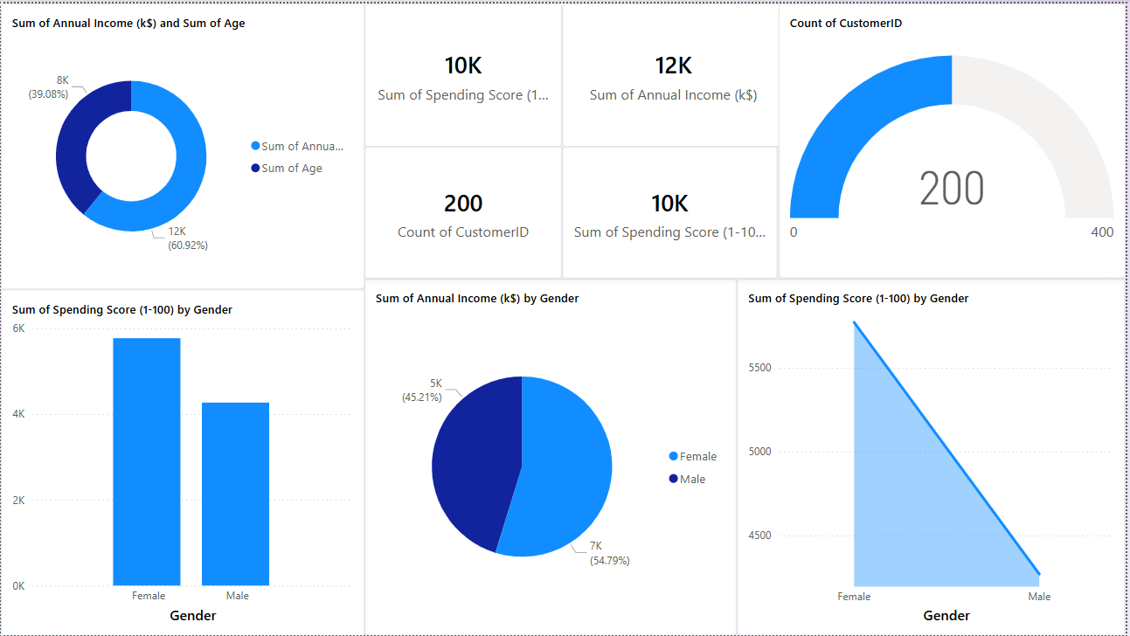
Dashboard Screenshot

