Slide 1



Classification & clustering methods
Decision Trees & Random Forests

Slide 2
Clustering v Classification
Clustering is an unsupervised machine learning approach which involves attempting to cluster similar data together without knowing its labels.
Classification is a supervised machine learning approach that attempts to identify what class or category new data should fit in by learning from training data (which contains the class/category labels for all the data points).

Slide 3
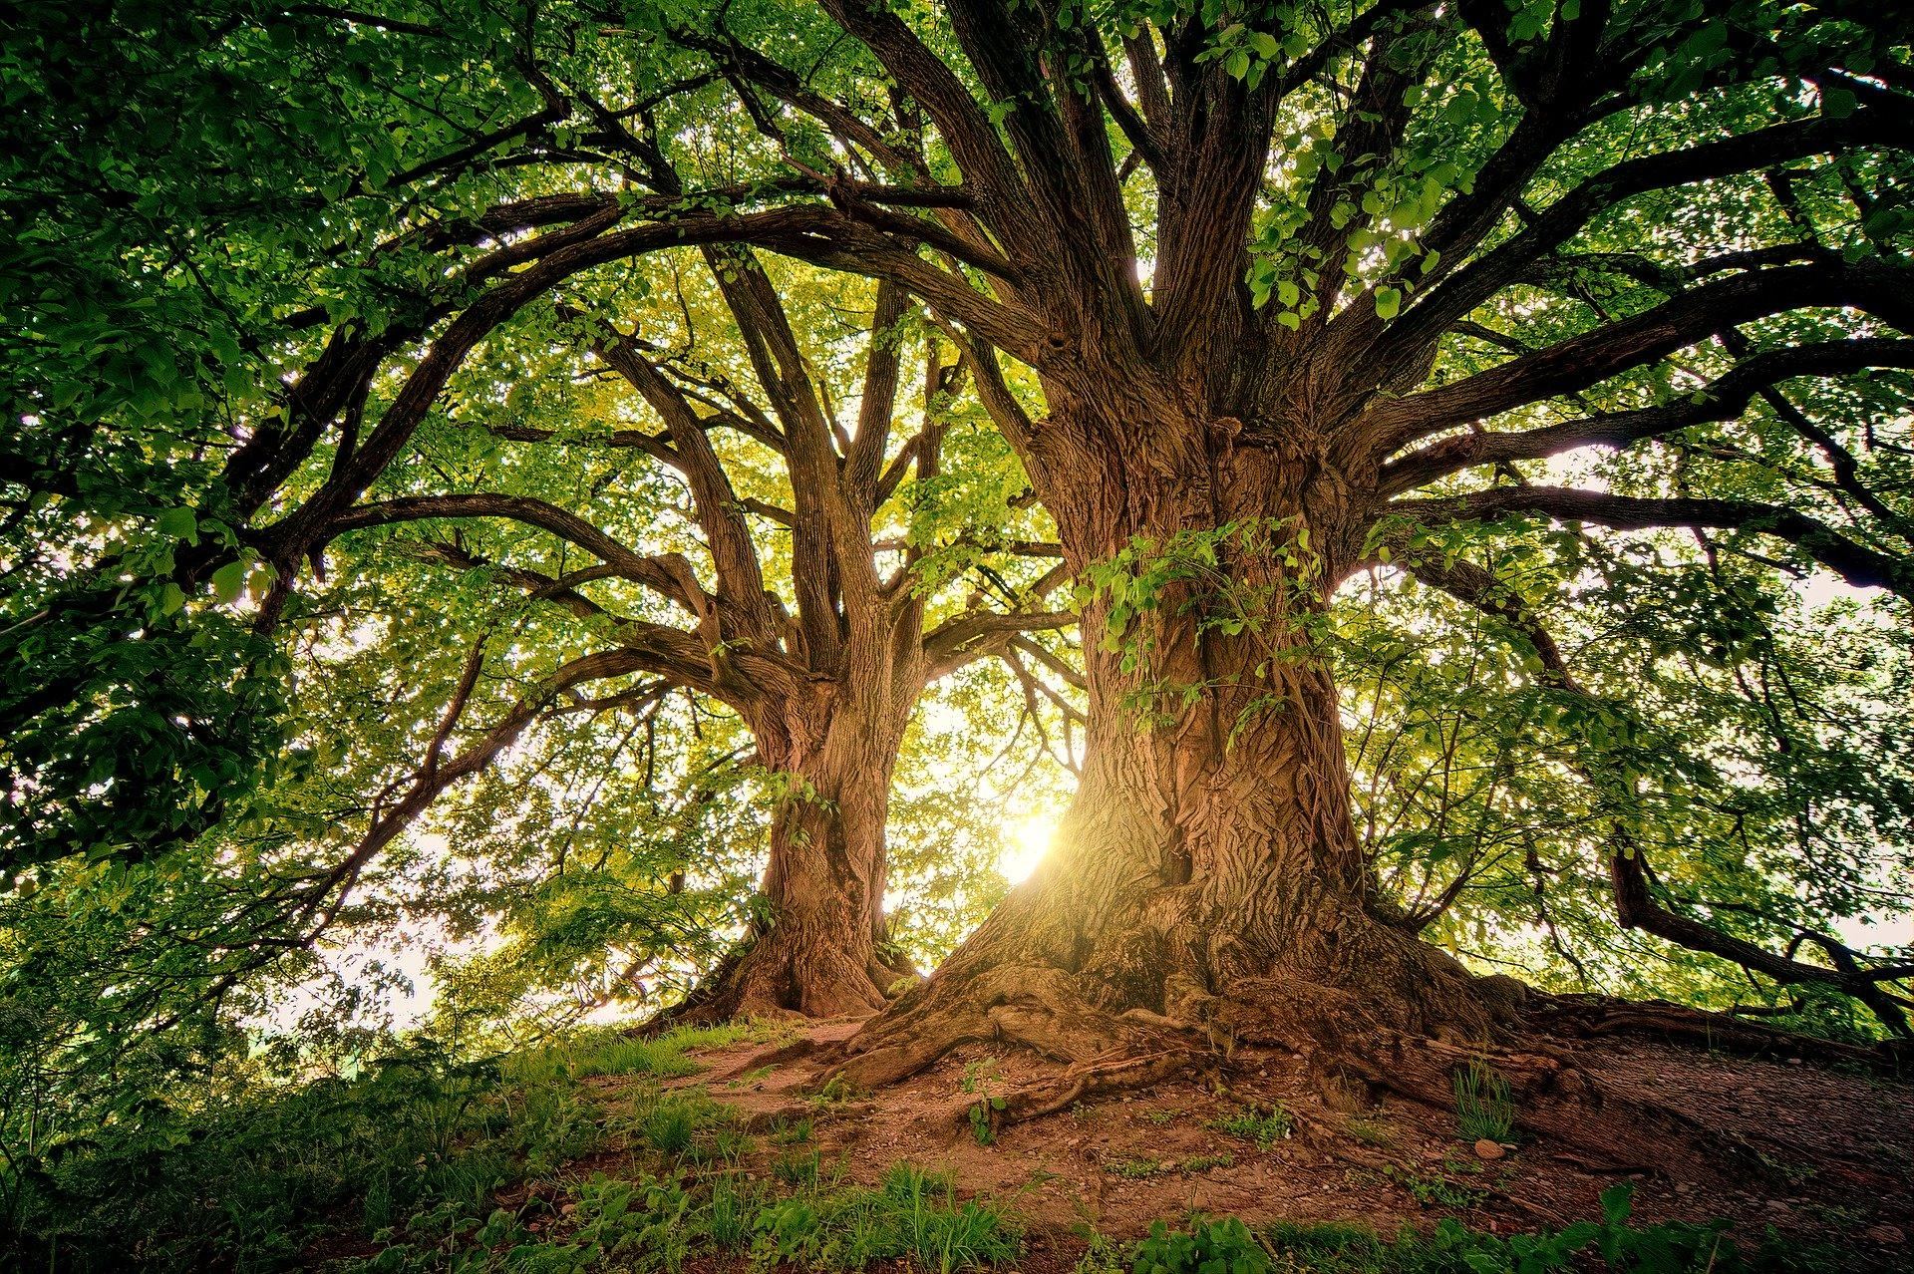
In this brief report I will look into the machine learning model of decision trees and Random Forest. I will provide a definition for these models and a list of strength and weakness, along with an example of where these models might be used.

Slide 4
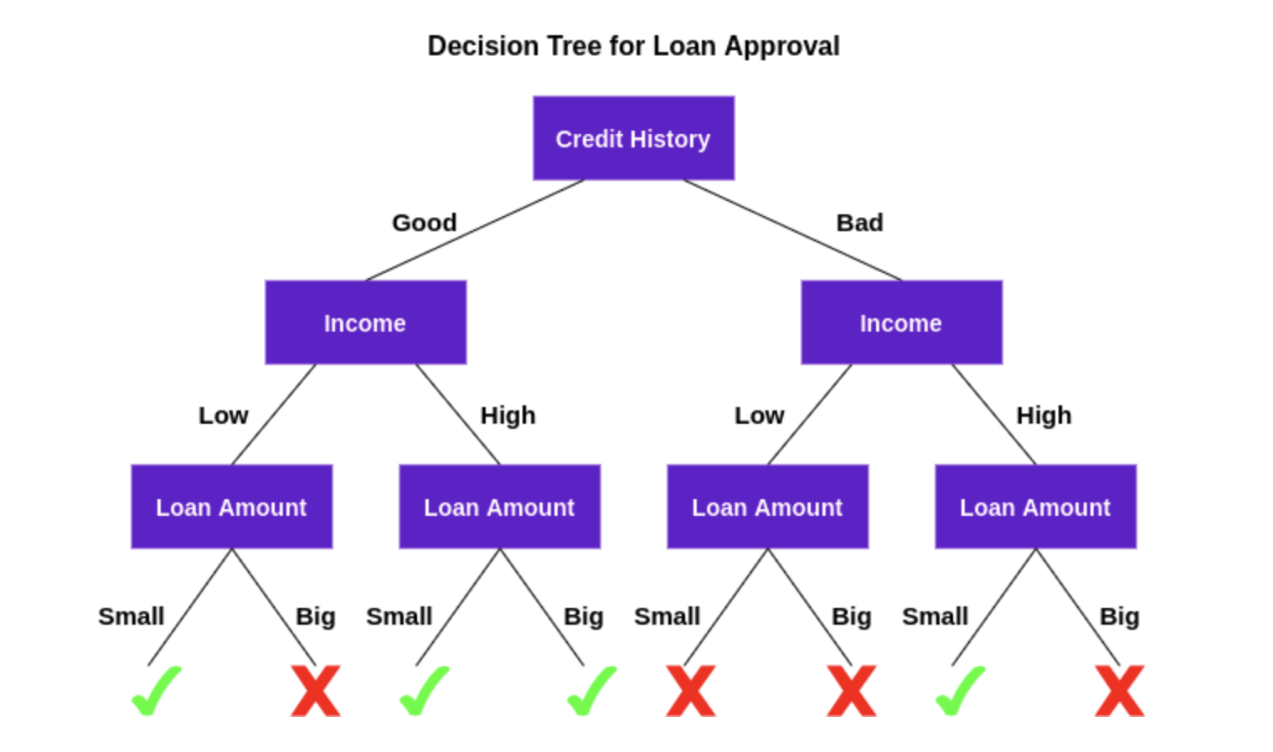
Decision trees
A decision tree is a supervised machine learning algorithm that can be used for both classification and regression problems. This type of model asks a series of questions and these sequential decisions are then used to reach a specific result. An example of this type of model could be a bank's decision to provide a customer with a loan.

Slide 5
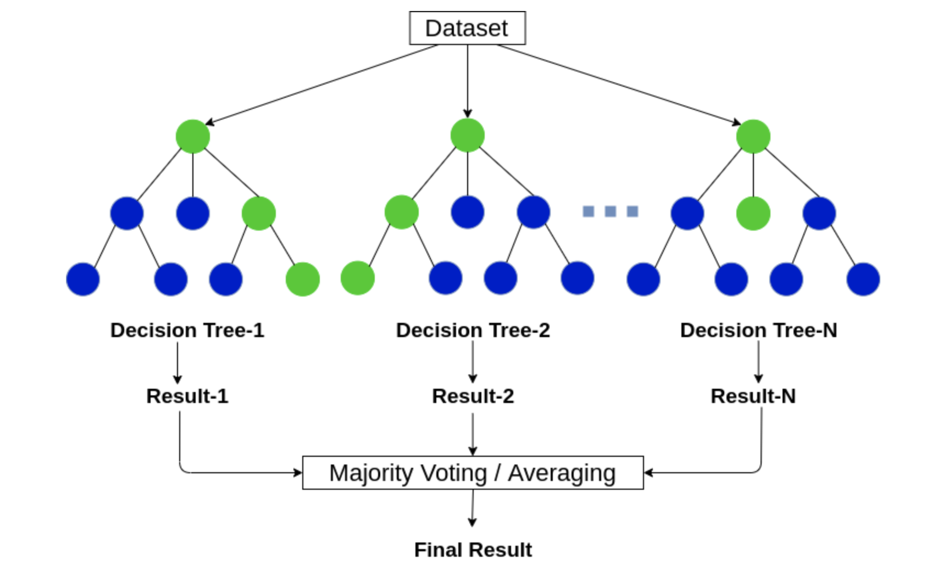
Random Forest
Random Forest is a machine learning algorithm that comes to a final decision by using multiple decision trees in order to come up with the best possible decision.

