Slide 1
Literature Review

Slide 2
Self-Regulated Learning is Essential for Mobile Learning
"SRL is a key predictor of success in mobile learning environments."
"Learners with higher SRL demonstrate greater engagement and better learning outcomes."
"Mobile learning requires learners to take greater responsibility for managing their own learning.“
Implication: Low-SRL learners may struggle in app-based English learning.
(Palalas & Wark,2020)

Slide 3
Technology Alone Does Not Ensure Engagement
"Technology alone does not guarantee student engagement."
"Teacher feedback, interaction, and emotional support play important roles in promoting engagement."
"A human-centered approach is more effective than a technology-centered approach."
Implication: Teacher support should be considered alongside technology use not treated as secondary.
(Bond et al.,2020)

Slide 4
Why Teacher Support Matters
Learners who lack SRL are precisely those least served by technology alone—pointing to teacher support as a potential compensatory mechanism.

Slide 5
Teacher Support Promotes Motivation and Engagement
Students are more motivated and engaged when teachers support:
Autonomy
Competence
Relatedness
Teacher support promotes:
Autonomous motivation
Engagement
Academic achievement
Well-being
Implication: Teacher support may increase learners' engagement with English learning apps.
(Ryan & Deci, 2020)

Slide 6
Teacher Support Enhances Self-Regulated Learning
Teacher support positively predicts self-efficacy.
Teacher support positively predicts SRL.
Self-efficacy partially mediates the relationship between teacher support and SRL.
Teacher Support → Self-Efficacy → SRL
Implication: Teacher support may strengthen learners' self-regulatory capacity.
(Rui & Liu, 2023)

Slide 7
Teacher Support May Compensate for Low SRL
Teacher support promotes growth mindset and grit.
Growth mindset and grit contribute to stronger SRL behaviors.
Teacher Support → Growth Mindset → Grit → SRL
Implication: Teacher support may play a compensatory role for learners with lower SRL.
(Zhang et al.,2025)

Slide 8
Low-SRL Learners Need Scaffolding
Many learners struggle to regulate their learning independently.
Adaptive scaffolding supports planning, monitoring, and strategy use.
External support can improve learners' self-regulatory processes.
Implication: Teacher support can function as scaffolding in app-based learning environments.
(Greene et al., 2011)

Slide 9
What Kind of Teacher Support Matters Most?
Teachers' answering of students' questions
Acknowledging students' confidence
These teacher behaviors were the strongest predictors of SRL.
Implication: Effective teacher support should include feedback, encouragement, and opportunities to seek help.
(Abdulhay et al.,2016)

Slide 10
Source of the SRL Questionnaire
24 items for English learners’ online self-regulation were adapted from Online Self-regulated Learning Questionnaire (OSLQ) designed by Barnard et al. (2009).
The questionnaire items were changed slightly by adding “English” to suit online English learners.
All items are rated on a five-point Likert-type items, from 1 (I don’t agree at all) to 5 (I strongly agree).
The data in the present study showed that Online self-regulated English learning (OSEL) has a desirable reliability (Cronbach’ s alpha=0.955)

Slide 11
Source of the SRL Questionnaire
Online Self-Regulated Learning Questionnaire (OSLQ)
<Original Dimensions>
Goal Setting
Environment Structuring
Time Management
Help Seeking
Task Strategies
Self-Evaluation

Slide 12
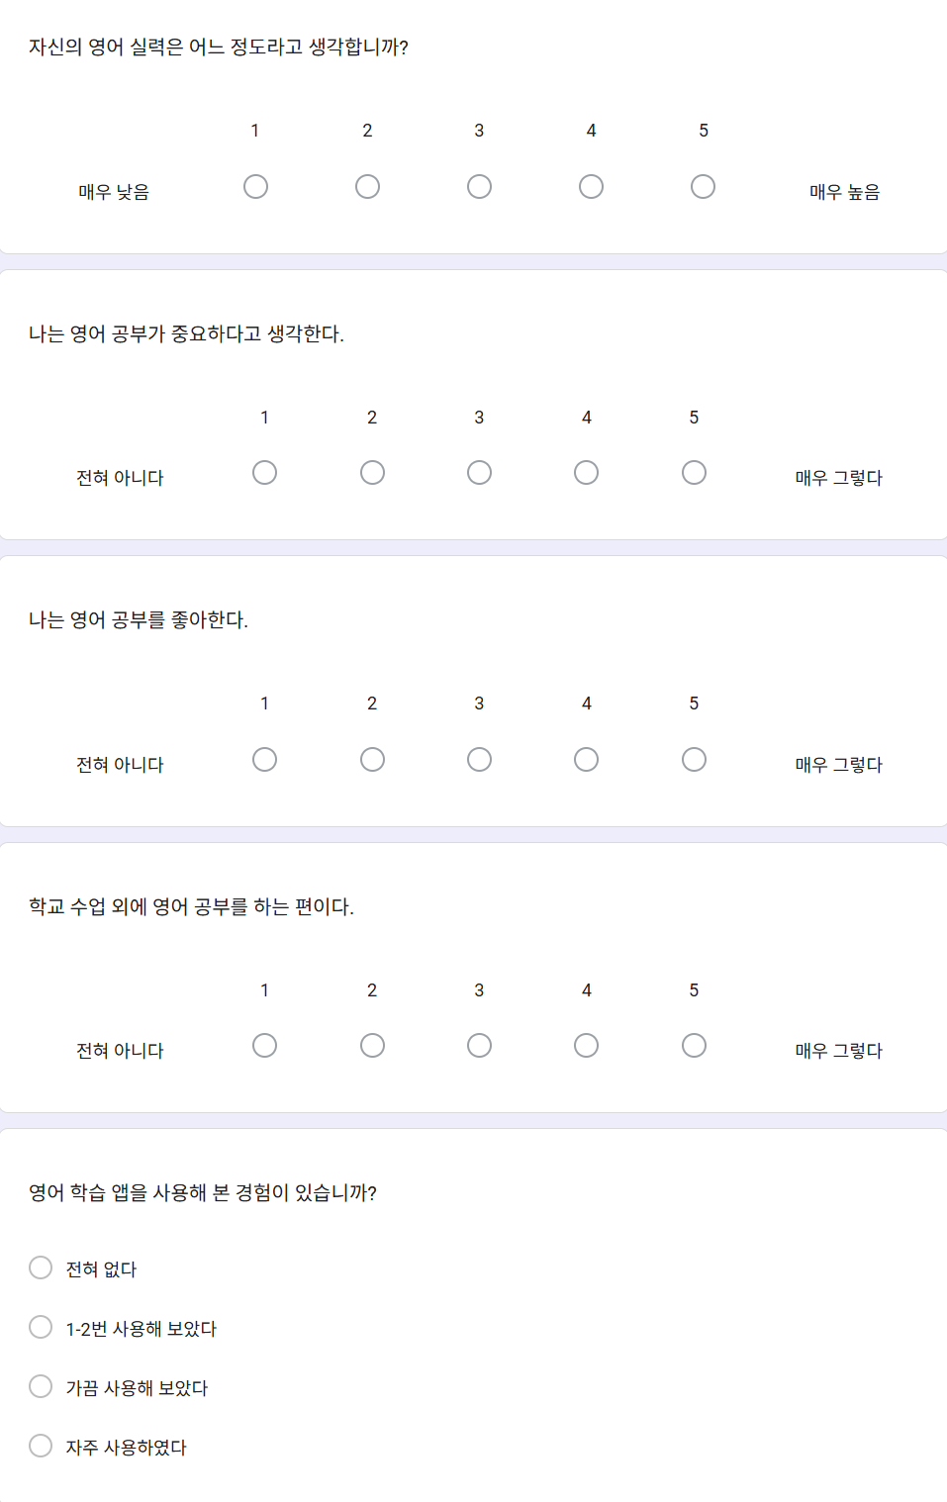
Self-Regulated Learning Questionnaire (15 Items)

Slide 13
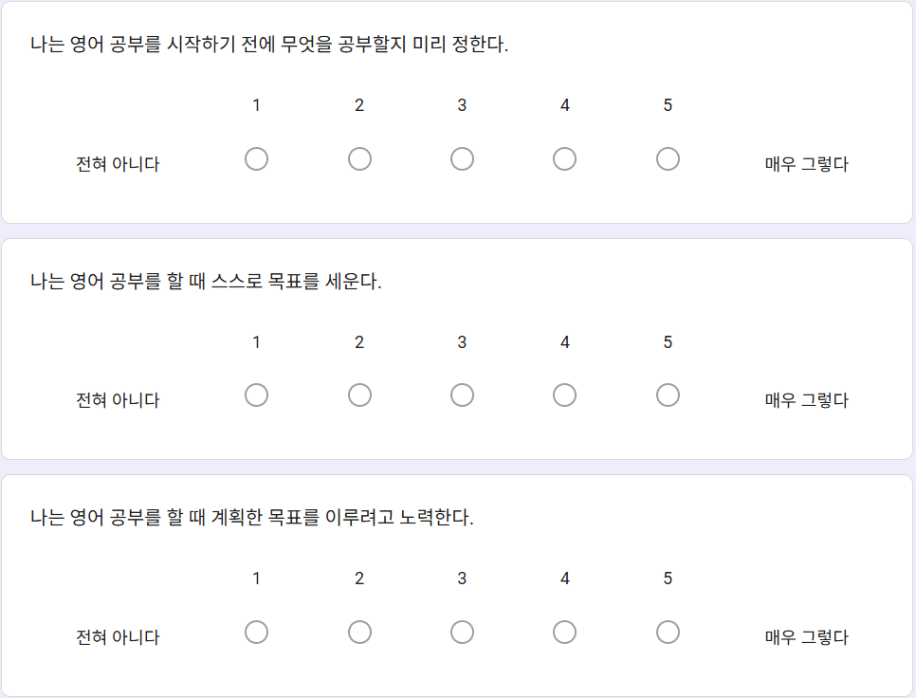
Self-Regulated Learning Questionnaire (15 Items)
목표 설정 능력

Slide 14
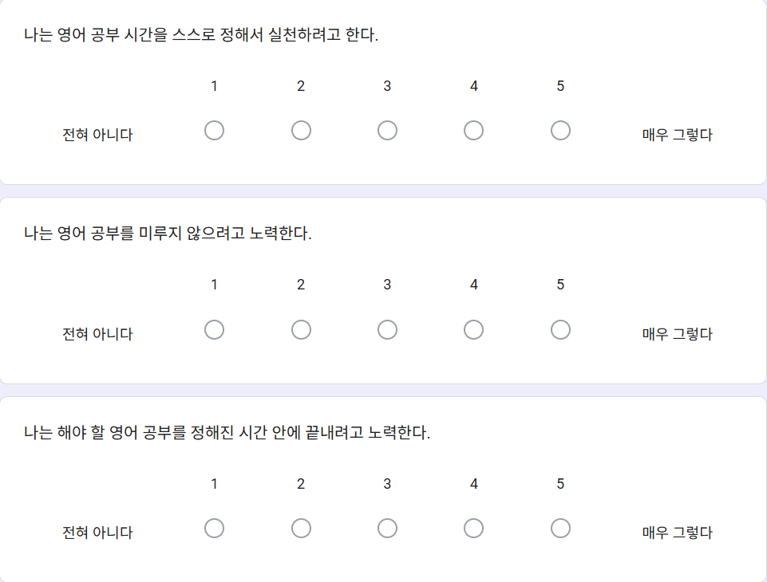
Self-Regulated Learning Questionnaire (15 Items)
시간 관리 능력

Slide 15
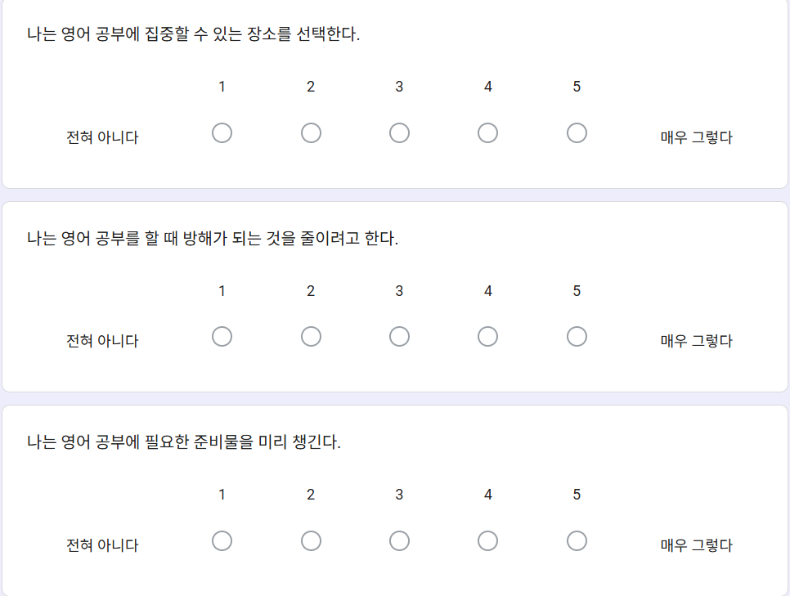
Self-Regulated Learning Questionnaire (15 Items)
학습 환경 관리

Slide 16
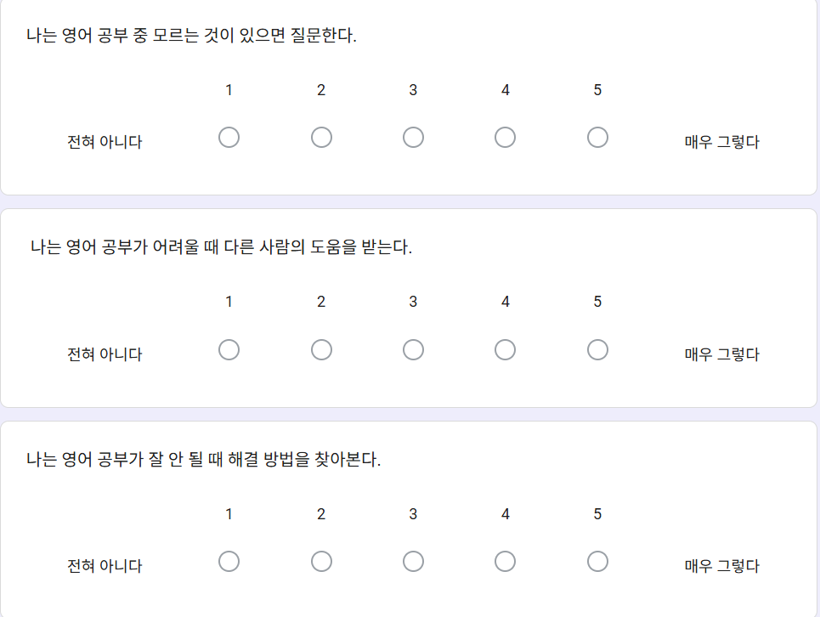
Self-Regulated Learning Questionnaire (15 Items)
도움 요청 행동

Slide 17
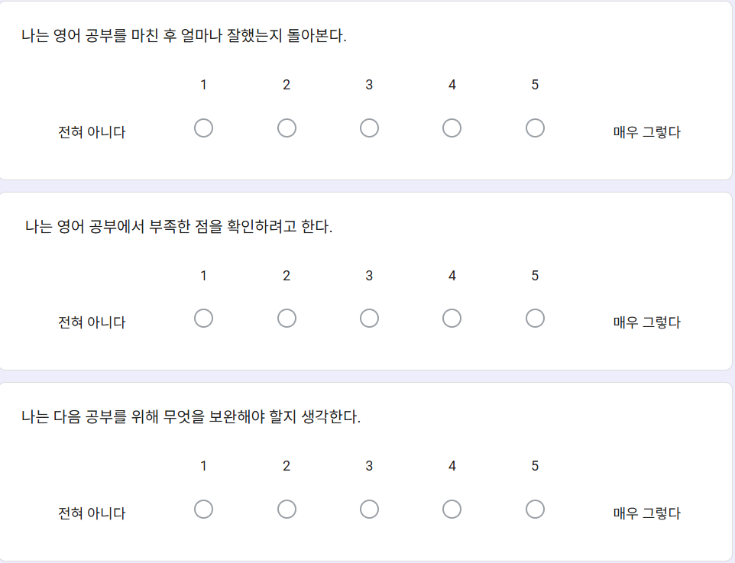
Self-Regulated Learning Questionnaire (15 Items)
자기 성찰 및 자기 평가

Slide 18
Pilot Survey Results
Participants
N = 25 Korean middle school students
Purpose of the Pilot Survey
The pilot survey was conducted to examine students' levels of self-regulated learning (SRL) before implementing the intervention.
The findings were used to:
identify students with lower levels of SRL,
explore areas of weakness in self-regulation,
inform the design of teacher support strategies.

Slide 19
Overall SRL Level -Mean :3.63 / 5.00
-a moderate level of self-regulated learning overall.
✅ Help Seeking was the strongest dimension.
-Students were generally willing to seek help when facing difficulties.
⚠ Goal Setting was the weakest dimension.
-Many students did not regularly establish learning goals before studying English.
*This finding provides a rationale for examining whether teacher support can compensate for low levels of self-regulated learning in app-based English learning.

Slide 20
Students were classified as low- or high-SRL learners based on their overall SRL scores rather than a single dimension.
However, the pilot survey revealed that Goal Setting was the weakest SRL dimension. Therefore, the teacher-support intervention was designed to provide goal-setting guidance, progress monitoring, and feedback.

Slide 21
Process vs. Content Scaffolding (Azevedo et al., 2011a)
APS — Process Scaffolding
Goal monitoring, strategy prompting, reflection
ACPS — Content + Process Scaffolding
Prior-knowledge activation, content feedback, guidance
Key finding: process scaffolding led to greater use of SRL strategies and more self-monitoring.
→ This study therefore adopts process scaffolding: goal-setting, monitoring, and reflection prompts.

Slide 22
Implications
The pilot results suggest that students may need support in:
setting learning goals
monitoring progress
maintaining learning routines
Therefore, the teacher-support intervention will focus on:
Goal-setting prompts
Progress monitoring
Weekly feedback
Reflection activities

Slide 23
Teachers support SRL through…
goal setting
prompts
feedback
reflection
(Abdulhay et al.,2016)

Slide 24
Teacher support
 | week1 | week2 | week3 | week4 | week5
피드백 | Goal-Setting prompts | Progress Monitoring Support | Confidence building feedback | Question opportunities | Reflection Support
예시 | This week's goal: Complete at least 3 learning sessions. Your personal goal: _______________ | How many sessions have you completed so far? □ 0 □ 1 □ 2 □ 3+ | You completed 4 sessions this week. Great job! Keep going! | what is the most difficult part while studying English this week? | What helped you study English this week? What was difficult?

Slide 25
Component | Implementation
Goal Setting | Weekly goal-setting form(google form)
Monitoring | Mid-week progress check(google form)
Feedback | Personalized feedback based on app logs (app log에 대한 messages)
Question Support | Opportunity to ask questions(google form)
Reflection | Weekly reflection form(google form)

Slide 26
Hwang et al. (2024) Acceptance and Engagement Patterns of Mobile-Assisted Language Learning Among Non-Conventional Adult L2 Learners: A Survival Analysis
Engagement should be examined through actual learning behaviors rather than relying solely on self-report surveys.
App engagement can be operationalized through:
Frequency (how often learners engage)
Intensity (how much they engage)
Duration (how long they engage)
Actual app-log data provide more objective evidence than self-report surveys.

Slide 27
Measurement of App Engagement
Dimension | Indicator | ClassCard
Frequency | Number of learning sessions | Learning sessions
Intensity | Number of completed activities | Completed activities
Duration | Total learning time | Learning time

Slide 28
Transition to the Main Study
The pilot survey revealed that students demonstrated relatively low levels of goal-setting behaviors.
Therefore, providing teacher support may help students regulate their learning more effectively when using English learning apps.

Slide 29
Research Gap

Slide 30
What We Do Not Know
✗ Few studies have examined middle school EFL learners.
✗ Few studies have used actual app-log data.
✗ The compensatory role of teacher support remains unclear.

Slide 31
Research Questions
RQ1
Can teacher support compensate for low levels of self-regulated learning in app-based English learning?
RQ2
Which dimension of self-regulated learning is most strongly associated with sustained app engagement?
RQ3
Does teacher support matter more for low-SRL learners than for high-SRL learners?

Slide 32
Expected Contribution
Theoretical Contribution
Extend SRL research in mobile-assisted language learning (MALL).
Examine the compensatory role of teacher support.
Practical Contribution
Provide evidence for supporting low-SRL learners.
Offer guidance for effective app-based English instruction.
Methodological Contribution
Use actual app log data rather than self-report measures.
Investigate engagement in a middle school EFL context.

Slide 33
Palalas & Wark (2020)
Bond et al. (2020)
Ryan & Deci (2020)
Rui & Liu (2023)
Greene et al.(2011),
Abdulhay et al.(2016),
Azevedo et al. (2011a)
Barnard et al. (2009)
Hwang et al.(2024)
Zhang et al. (2025)

