Slide 1
🦝
Verb Form Learner
Teaching Regular Past Tense (-ed) to Korean Middle School EFL Learners
최지현
newbasic.streamlit.app

Slide 2
1
Teaching Context
Who, where, and what challenges
👥
🏫
Learners
Environment
Grade 7 EFL students at a Korean public middle school. Mixed ability — lower to higher proficiency in the same classroom.
Regular English classroom with 1:1 devices (tablet / phone) or a shared screen. Wi-Fi access, browser-based — no install needed.
Geoje Gohyeon Middle School · Grade 7 · Mixed-ability EFL

Slide 3
2
Expected Learning Problem & Need
Why -ed is harder than it looks
Self-paced practice for a mixed-ability class
Instant feedback that explains the rule
Audible exposure to the three -ed sounds
A way to diagnose their own weak points
Motivation beyond rote worksheets
4
What learners actually need:
different cases
Ending with ‘e’ · ending with ‘y’ ·
CVC pattern
3
different -ed sounds
liked /t/ · played /d/ · wanted /ɪd/
Often invisible to learners
Spelling alone is insufficient — pronunciation distinction matters

Slide 4
3
Lesson Overview
Grade 7 · 50 minutes · Regular past tense
5'
18'
10'
12'
5'
Warm-up
Spelling Rules
Pronunciation
Practice
Wrap-up
App diagnostic quiz
Teacher explains 4 -ed rules
/t/, /d/, /ɪd/ focus
App games & quizzes
Homework via app
🎯 Objectives:
Identify the four -ed spelling rules (add -ed; consonant + e → -d; -y rules; double the final consonant) given a set of base-form verbs.
Distinguish the three -ed pronunciations (/t/, /d/, /ɪd/) by selecting the correct sound after listening to audio prompts.
App used at warm-up and wrap-up; teacher leads explanation

Slide 5
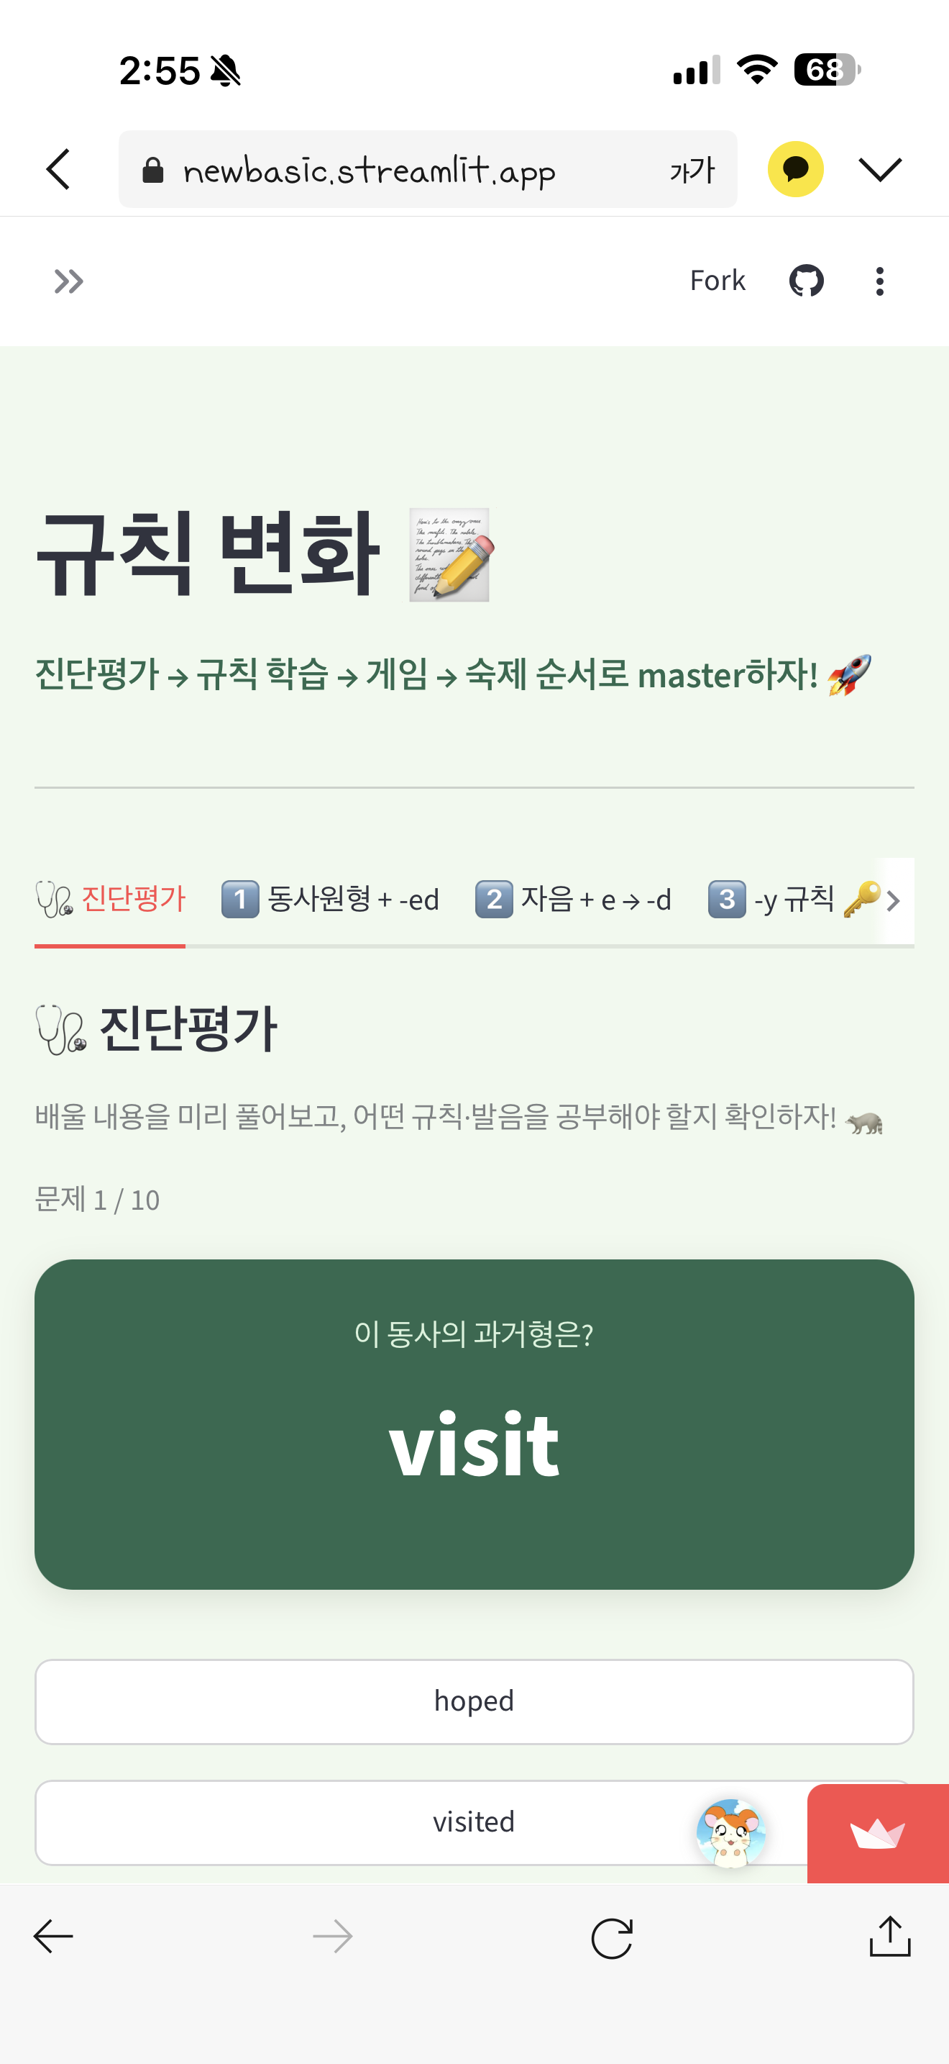
4
App Demonstration
Seven tabs, one learning flow
🩺
Diagnostic
10 Qs · personalized prescription
✨ Signature: 3 speaker buttons play walkt / walkd / walkid — pick the right -ed sound
1️⃣–4️⃣
4 Rule Tabs
Explanation + mini-quiz with instant feedback
🐦
Bird Game
60-second timed game · class leaderboard
📒
HOMEWORK
5 pronunciation + 5 three-form · completion certificate
Built with Streamlit · Python · browser TTS · Google Sheets

Slide 6
5
Classroom Use
Bookend strategy — app at the edges, teacher in the middle
WARM-UP
MIDDLE
WRAP-UP
🩺
👩‍🏫
🐦
Diagnostic
Teacher Lead
Practice & Homework
Students take the 10-question diagnostic. The app prescribes which rules and sounds to review.
Teacher presents the 4 -ed spelling rules and the 3 -ed sounds on the board.
Bird game and mini-quizzes for recall. HOMEWORK tab assigned with completion certificate.
Key insight: The app handles diagnosis, feedback, and motivation — freeing the teacher to circulate and give targeted individual support.
Differentiation by design · efficient feedback

Slide 7
1
App Demonstration
https://newbasic.streamlit.app/Irregular
Geoje Gohyeon Middle School · Grade 7 · Mixed-ability EFL

Slide 8
6
Expected Learner Benefits
What students gain from the app
⚡
Instant Feedback
🎚️
Self-Paced Differentiation
🔊
Pronunciation Awareness
Every wrong answer comes with the rule explained — no waiting for the teacher.
Each student works at their own level; Hard mode for advanced learners.
The three -ed sounds become explicit and audible, not just text on a page.
🧭
Self-Diagnosis
🏆
Motivation
🏠
Autonomy
Students see which rules and sounds they need to review — metacognition built in.
Games, a class leaderboard, and a personalized homework certificate.
Students keep practicing outside class via the HOMEWORK tab and review.
From passive worksheet drills to active, self-directed learning

Slide 9
7
Limitations & Future Improvement
Honest assessment and next steps
TTS quality varies; fake spellings (walkt/walkd/walkid) can sound unnatural
Leaderboard relies on honest input in a supervised setting
Content is curated, not adaptive — fixed verb set
Pronunciation is recognition only, not speaking practice
Current Limitations
Future Improvements
Replace TTS with recorded native-speaker audio for the 3 -ed sounds
Add speaking practice (record and compare own pronunciation)
Make the leaderboard fully automatic (direct score capture)
Adaptive difficulty responding to each learner's mistakes
Teacher dashboard to track class progress and homework
From a one-classroom tool to a richer, adaptive learning environment — built one limitation at a time.

Slide 10
🦝
Thank You
Questions & Discussion
Try it yourself: newbasic.streamlit.app

