Slide 1
Written homework

Slide 2
CONTENT
01. A Short Discussion
Restaurant require a big data analysis to change the menu?
02. Written Homework 1
Study IBM Watson big-data application
03. Written Homework 2
Find and briefly describe 1 big data application

Slide 3
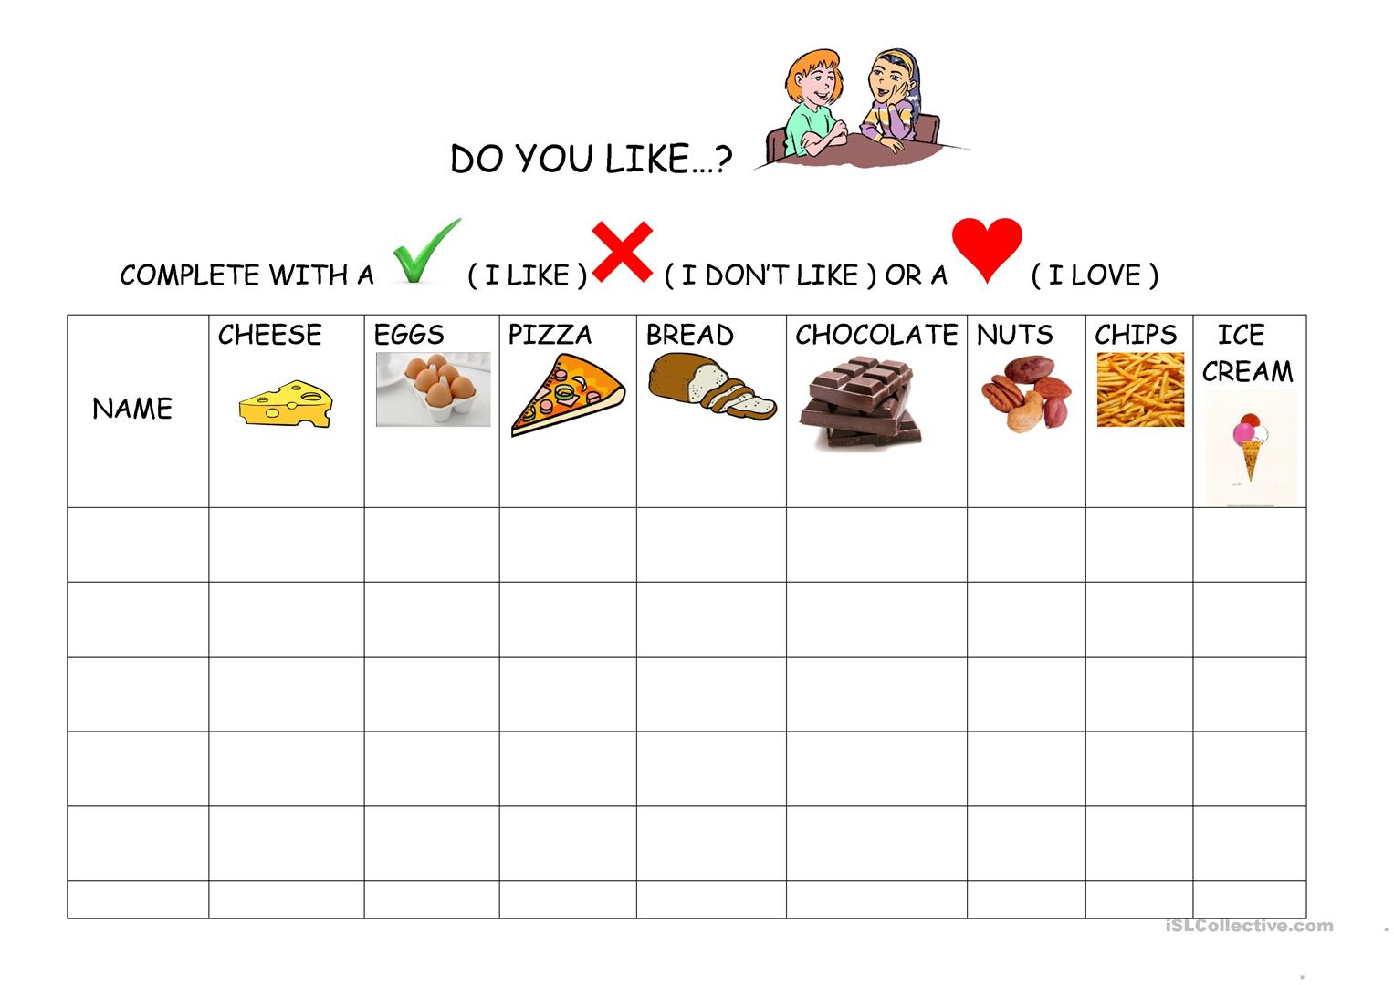

A Short Discussion
Changing the menu is not require a big data analysis.
It require just a small data.
The owner obtain data by doing a survey or chef’s experience

Slide 4





Written Homework 1
What is IBM Watson big-data application?
- IBM’s portfolio of business-ready tools, applications and solutions, designed to reduce the costs and hurdles of AI adoption while optimizing outcomes and responsible use of AI.
What is its business objective?
- Financial, travel, healthcare, retail, services, security

Slide 5
Describe the types and amount of data used
- 200 million pages data both structured and unstructured (books, encyclopedias, dictionaries)
Describe the technologies used
- Machine Learning, Natural language processing, semantic analysis, information retrieval and etc.
Is it a business success or failure? What is the reason?
- I think it is failure.
- IBM Watson was engineered to identify word patterns and predict correct answers for the trivia game but company advertise different ways.
- GIL medical center use it to diagnosed cancer. But it correspond with specialist only 56% (colon cancer). And cases in stage 4 colon cancer, Watson suggest common medicine but specialist suggest targeted medicine, and most patients choose targeted medicine.
If it is a failure, what is the lesson to be learned from it?
- Its failure is from arrogant. It designed for solve quiz but company advertise faintly.
- Machine learning and big data is not 100%, it provide common answer. But sometimes especially in medical facilities have to consider individual situation.

Slide 6
Reference
NYT What Ever Happened to IBM’s Watson?
https://www.nytimes.com/2021/07/16/technology/what-happened-ibm-watson.html
PCWorld IBM Watson Vanquisheds Human Jeopardy Foes
https://web.archive.org/web/20110217064116/http://www.pcworld.com/businesscenter/article/219893/ibm_watson_vanquishes_human_jeopardy_foes.html
IBM.com
https://www.ibm.com/watson/about
조선일보 돈 못버는 골칫덩이됐다… AI 선구자 ‘왓슨’의 몰락
https://www.chosun.com/economy/tech_it/2021/07/20/2ZE5MWL7MBBU5CGUUXXLUBD4PM/
길병원 블로그
https://m.blog.naver.com/PostView.naver?isHttpsRedirect=true&blogId=gilpr&logNo=221156944807

Slide 7


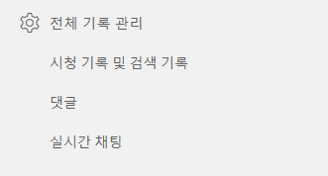
Written Homework 2 (Youtube)
Describe the types and amounts of data it has
- About 2 billion monthly logged-in users
- 700 millions hours watching youtube contents
- 500+ hours content uploaded every minute
- Users’ watching experience
- Users’ like or dislike
- Not only click also watching period(time)
- Users’ search history

Slide 8
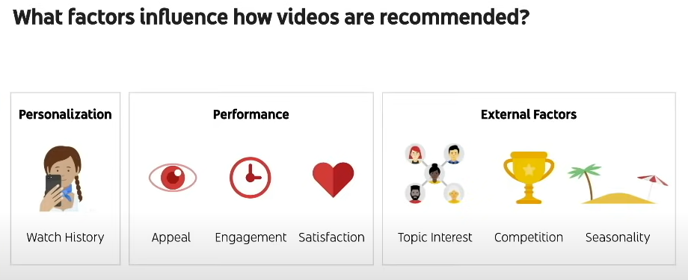
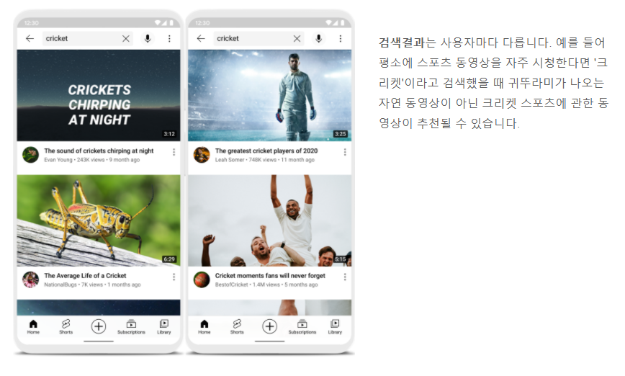
Increase user satisfaction.
Recommendation
- Organization use data for content recommendation. It use several factors to recommend video
Search Result
- Organization use data for user friendly search result. 3 Key points are relevance, engagement and quality

Slide 9
Reference
How youtube works?
https://www.youtube.com/intl/ALL_kr/howyoutubeworks/product-features/recommendations/
https://www.youtube.com/intl/ALL_kr/howyoutubeworks/product-features/search/
What Determines How Many Impressions Your Video Gets?
https://www.youtube.com/watch?v=BXfdvlvtW6Y
Deep Neural Networks for YouTube Recommendations – Paul Convington, Jay Adams, Emre Sargin
https://static.googleusercontent.com/media/research.google.com/en//pubs/archive/45530.pdf
How Big Data is Revolutionizing the Entertainment Industry – GOODWORK LABS
https://www.goodworklabs.com/big-data-in-entertainment/

