Slide 1
Written homework

Slide 2
CONTENT
01. Written Homework 1
Redundant data, Outdated data, Wrong data
02. Written Homework 2
Standard Scaling, Robust Scaling

Slide 3
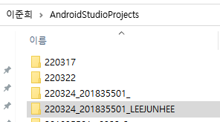

redundant data
Some class pdf files that used multiple weeks (ex - use same file week 3 and week 4)
I download file every week so some files are redundant.
I made same Android Studio project folders to submit homework.

Slide 4
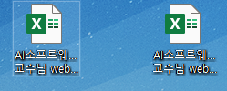
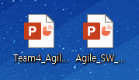
outdated data
School of Computing professor ‘Webex link’ files.
One is from March 2021, and another is updated August 2021.
Agile SW Development Active Learning presentation files.
It has 1st version and modify version so 1st is outdated.
Data Science numpy-matplotlib exercise file is updated by typo fixed and add submission guideline.

Slide 5
wrong data
Some “C files” or “Python files” that I code the wrong answer for homework.
Data Science numpy-matplotlib exercise file that has typo error and not have submission guideline.
Some report files that have grammar and typo error.

Slide 6
Standard scaling
Student test scores (total 60 points) : 28, 35, 26, 32, 28, 28, 35, 34, 46, 42, 37
Mean : 33.72727273
Standard Deviation : 5.986210048
Standard Scores : -0.95674, 0.21261, -1.29085, -0.28854, -0.95674, -0.95674, 0.21261, 0.045559, 2.050166, 1.381964, 0.546711
Which scores should receive an F : The student scores 26 stand out to receive an F

Slide 7
robust scaling
Student test scores (total 60 points) : 28, 35, 26, 32, 28, 28, 35, 35, 37, 42, 46
Sorted scores : 26, 28, 28, 28, 32, 34, 35, 35, 37, 42, 46
Q1(x) : 3rd data 28
Q3(x) : 9th data 37
Standard Scores : 0, 0.77778, -0.22222, 0.44444, 0, 0, 0.77778, 0.66667, 2, 1.55556, 1
Which scores should receive an F : The student scores 26 stand out to receive an F

