Slide 1
Written homework

Slide 2
CONTENT
01. Written Homework 1
Internet search about predict the result of an election
02. Written Homework 2
Stratified random sampling in my market research for food-delivery

Slide 3
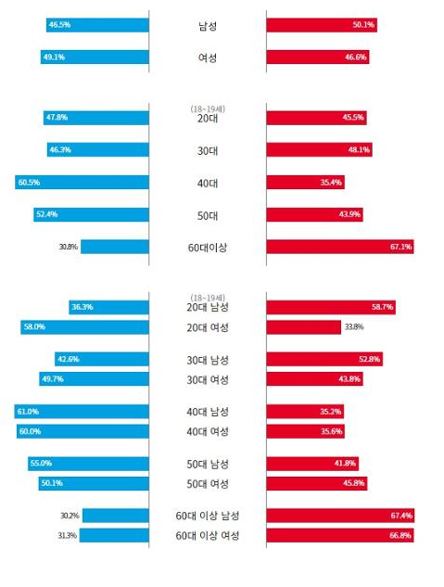
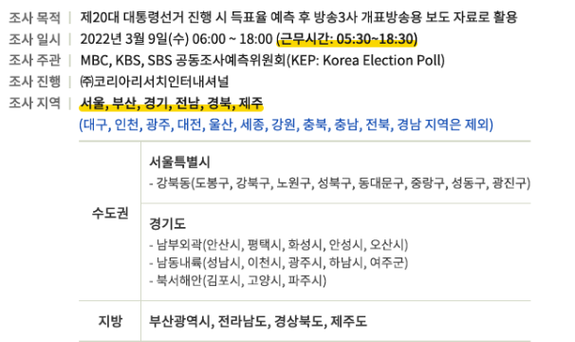
Written homework 1
20th president election sampling is done by KBS, SBS, MBC with Korea Research
About 1670 people is hired to election sampling
These people stand-by 50m out from polling place and ask to people
It is planned to select 85000 people and real reply people was 73297
It is done at several regions(서울, 부산, 경기, 전남, 경북, 제주)
It was analyzed by age, gender etc
It ask “Select whom?”, “Why select?”, “What is most important issue of government?”, “Satisfied with candidates?” etc
It predicted almost similar to real data.

Slide 4
reference
중앙일보 – 출구조사 응답자 49% ~ - https://www.joongang.co.kr/article/25054257#home
코리아리서치 - 20대 대통령 출구조사원 모집 - https://poll.kric.com/main/Info.asp
한겨레21 – 대선 출구조사 결과는 왜 정확했나 - https://h21.hani.co.kr/arti/politics/politics_general/51706.html
한국일보 - https://www.hankookilbo.com/News/Read/A2022030919580005949

Slide 5
Written homework 2
I want to do ‘hand-made hamburger delivery service’ in Pangyo.
Divide group by ‘apartment complex’
Employ researcher to each ‘apartment complex’
Select samples randomly from each stratum and do survey or interview. (phone call or home visit)
Survey or interview is done in 5pm ~ 8pm (Dinner time)
If not reply for survey or interview, then select other sample

Slide 6
Interview question
How many time you use food-delivery service at month?
When(time) do you use food-delivery service?
What kind of food do you prefer to use delivery service?
Is there any new food you want to use delivery service?
What kind of hamburger do you prefer? Hand-made or fast-food?
If you eat hamburger what kind of side dishes do you prefer?

Slide 7
reference
Investopedia – How Stratified Random Sampling Works - https://www.investopedia.com/ask/answers/032615/what-are-some-examples-stratified-random-sampling.asp
Naver Post – 시장 조사를 잘 하는 습관 - https://post.naver.com/viewer/postView.nhn?volumeNo=26697641&memberNo=2924457

