Slide 1
Online Education Adaptability
201835501 이준희
201835533 조현식
201835534 차원우
201934240 이민아

Slide 2
#Contents
Objective
Dataset Information
Algorithm

Slide 3


#Objective
Predict Effective Education
Online or Offline
By analyze Students Adaptability Level in Online Education

Slide 4
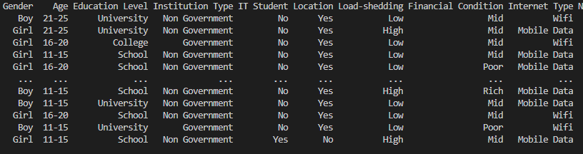
#Dataset Information
• • •
•
•
•
21205 X 14

Slide 5
#Dataset Features
Gender : Students’ gender
Age : Students’ age
Education Level : students’ education level (high school, middle school etc)
Institution type : Government, Non-government
IT Student : Who study about IT
Location : Is student location in town
Load shedding : Level of load shedding
Financial Condition : Financial condition of family
Network Type : Network connectivity type (4G, 5G)
Class Duration : Daily class duration
Self Lms : Institution’s own LMS availability
Device : Device used mostly in class
Adaptivity Level Adaptability level of the student

Slide 6
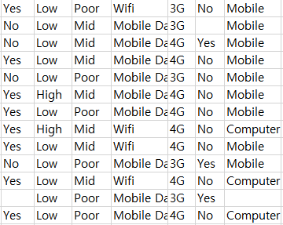
#Dirty Data
Each feature has missing values
(About 200 data)
Fill value or Delete row

Slide 7

#Dataset Information
We use ‘Students Adaptability Level in Online Education’ dataset
From kaggle

Slide 8
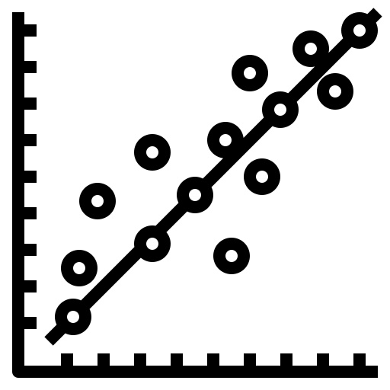
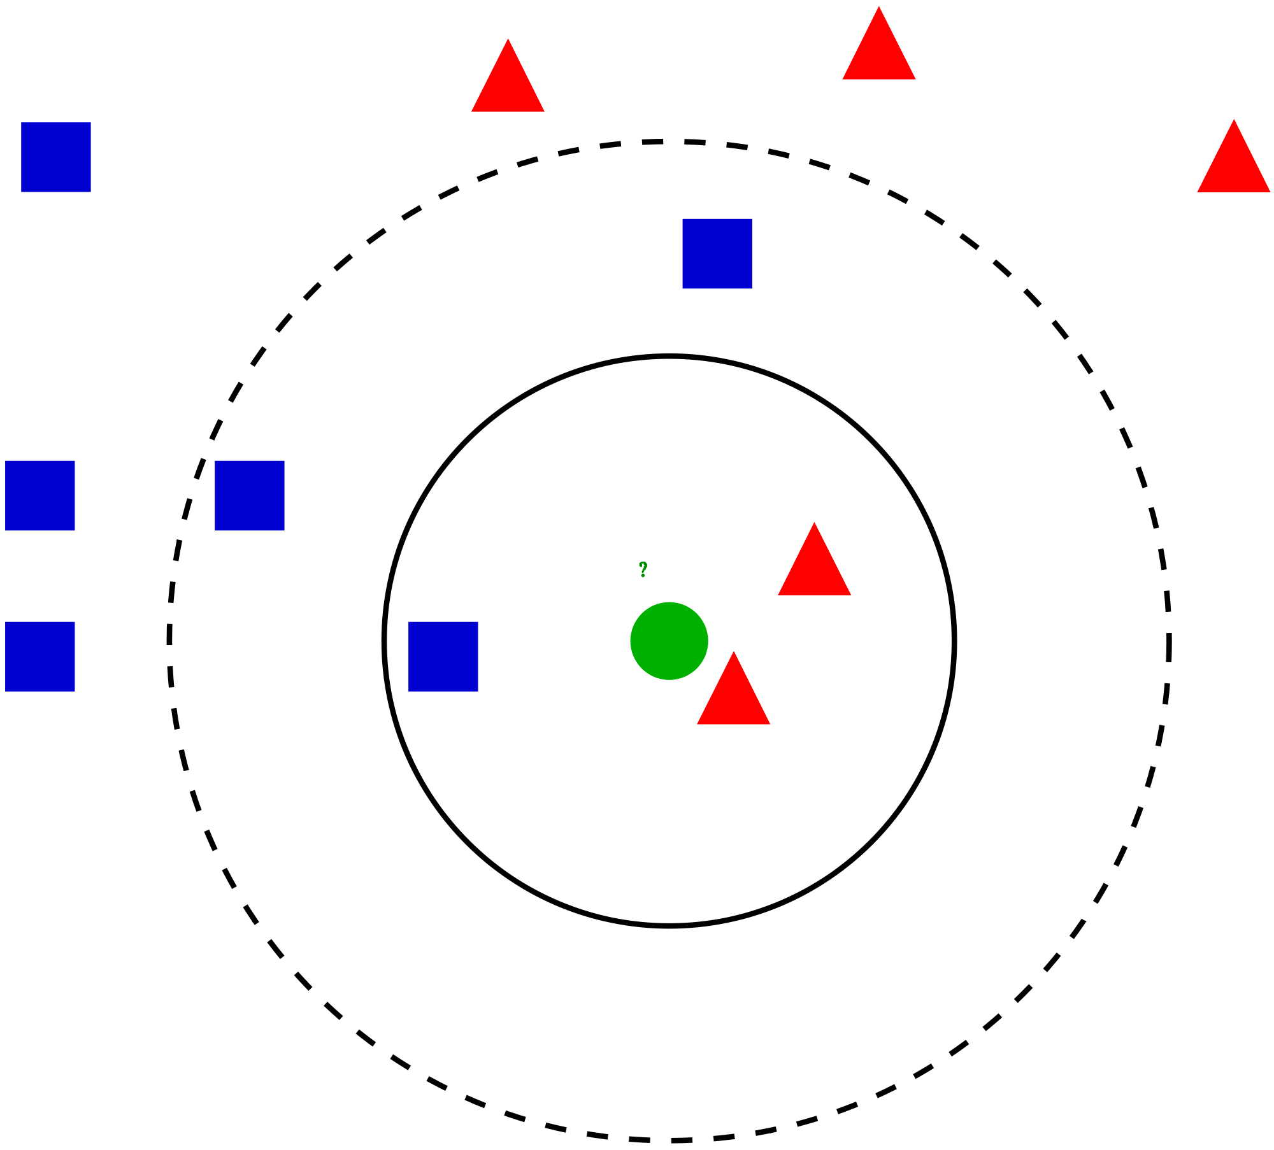
#Algorithm
Linear Regression
2. K-Nearest-Neighbor

