Slide 1


Data Science Online Education Adaptability
이준희, 조현식, 차원우, 이민아

Slide 2
Contents
End-to-End process
Learning Experience
Open Source SW

Slide 3

1. End-to-End Process – Business Objective
To Predict the Students’
Effective Education method.
(Offline vs. Online)

Slide 4
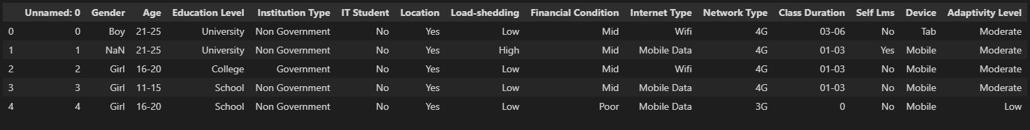
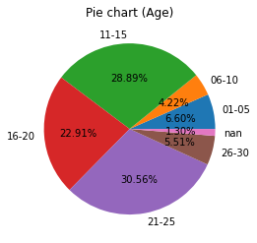
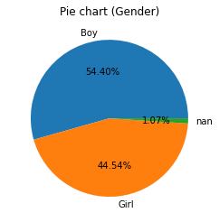
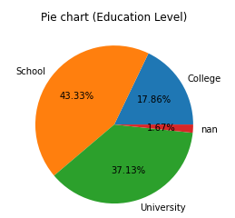
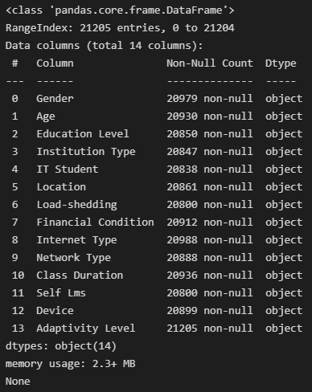
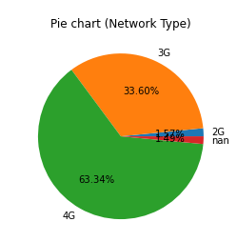
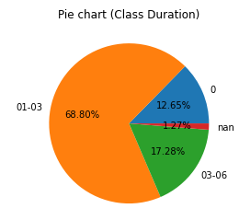
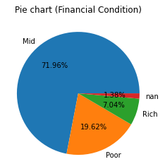
1. End-to-End Process – Data Exploration

Slide 5
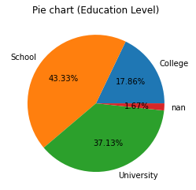
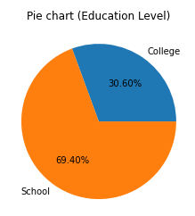
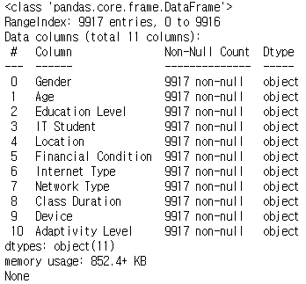
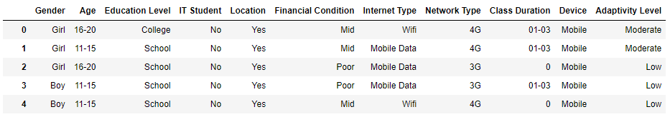
1. End-to-End Process – Data Preprocessing
Data preparation
Drop NaN values
Drop Useless features

Slide 6
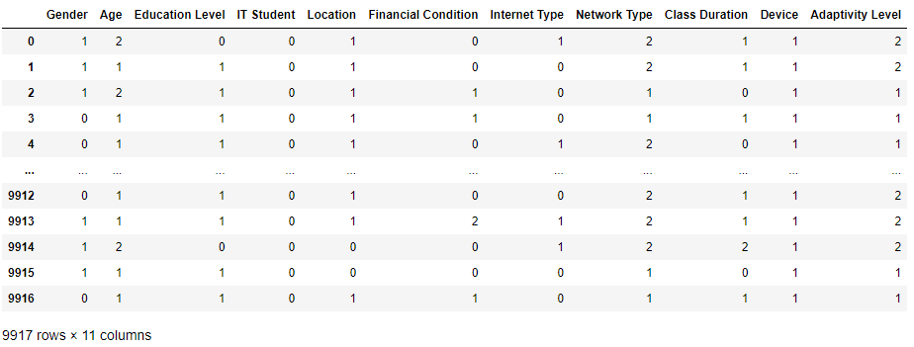
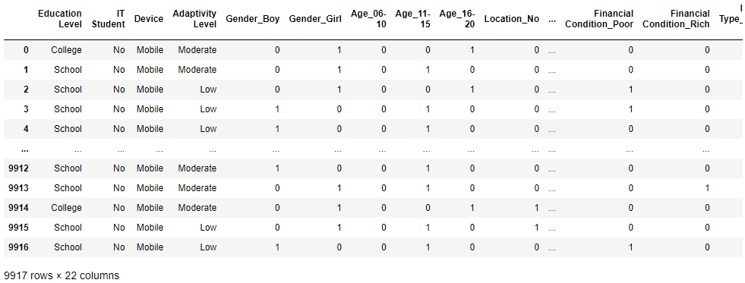
1. End-to-End Process – Data Preprocessing
Encoding
Label Encoding
One-Hot Encoding

Slide 7
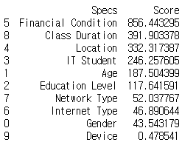
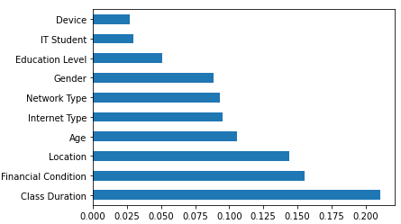
1. End-to-End Process – Data Preprocessing
Feature Selection
1) SelectKBest / 2) ExtraTreesClassifier
Our Decision : Use 7 features!!

Slide 8
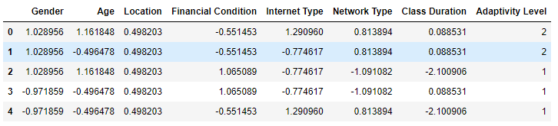
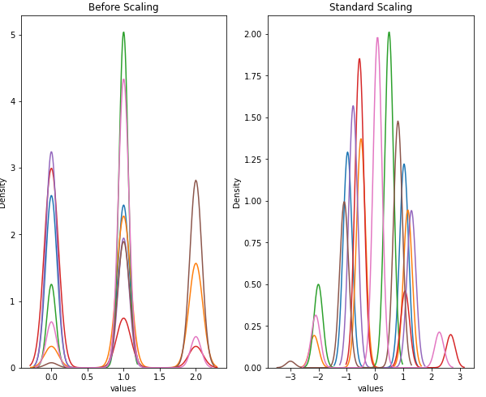
1. End-to-End Process – Data Preprocessing
Scaling
Standard Scaling
MinMax Scaling
Robust Scaling

Slide 9
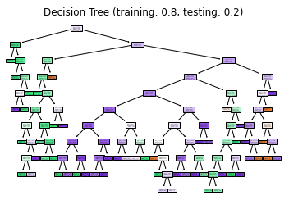
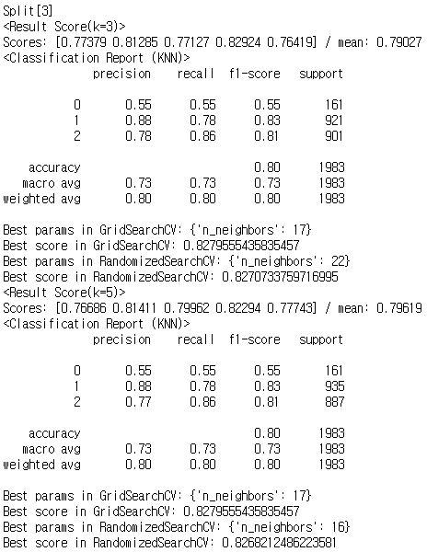
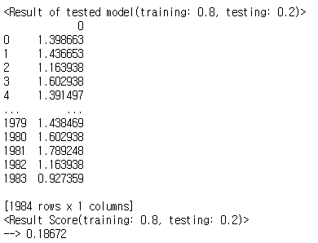
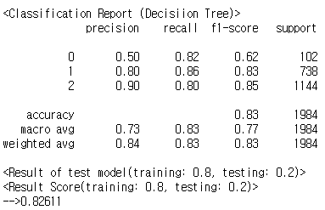
1. End-to-End Process – Data Modeling, Analysis
K-Nearest Neighbor
Use 3 models
Linear Regression
Decision Tree

Slide 10
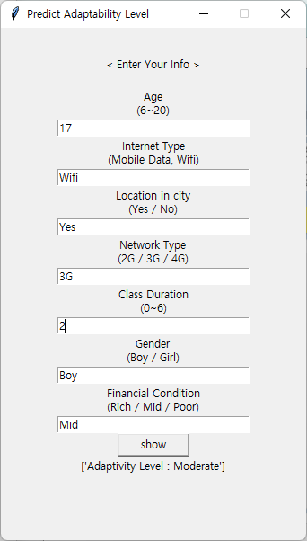


GUI New Student’s Information

Slide 11

2. Learning Experience … – Difficulties / Solving
(All Data : “Categorical”) -> Need to Encode
(Different Feature Selection Result)
-> We try Top5~All Feature Selection,
but All Feature Selection showed Best Accuracy.
(Trying to use Linear Regression)
-> Too low Evaluation Score
-> Target Class is Categorical

Slide 12


2. Learning Experience
What we Learned
How to use Big Data process
(in various topics and contribution)
We could not 100% trust the Algorithms
(there exists more sophisticate jobs)
Better Communicating Skills
(with different people’s characteristics)
Importance of Quality of the Data

Slide 13









3. Open Source SW
[Function Definition]
LabelEncoder - Categorical data -> Numerical data
MinMaxScaler - Scaling using MinMax algorithm
RobustScaler - Scaling using Robust algorithm
StandardScaler - Scaling suing Standard algorithm
DecisionTree - Data analysis using Decision Tree
KNN - Data analysis using k-nearest neighbors
LinearReg - Data analysis using Linear Regression
[Architecture]
module
data_preprocess
modeling
LabelEncoder
DecisionTree
MinMaxScaler
KNN
RobustScaler
LinearReg
StandardScaler

Slide 14
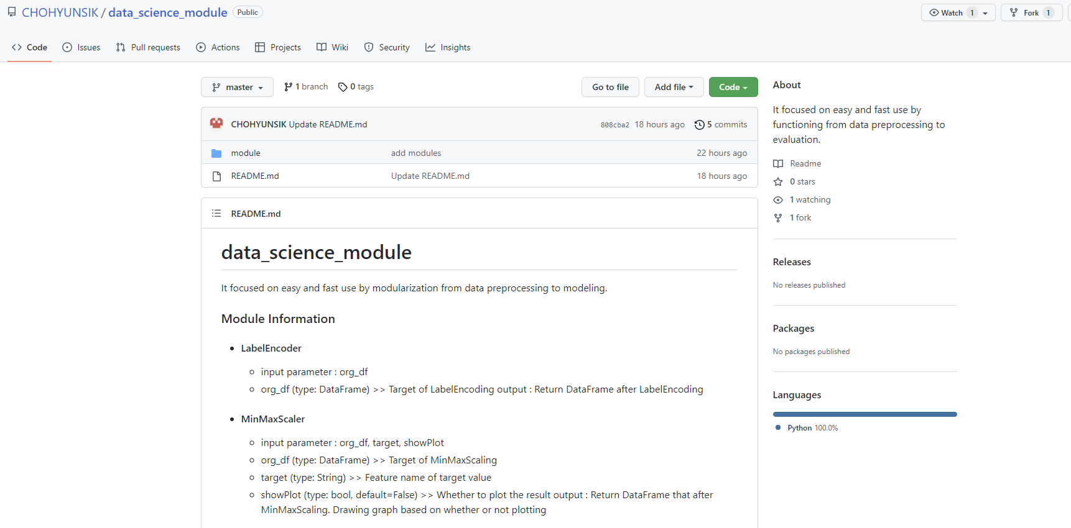
3. Open Source SW
[GitHub URL]
https://github.com/CHOHYUNSIK/data_science_module

Slide 15
* Team Member Roles *
이준희 (25%)
Make modules
Wrote Project Report
Code Implement
조현식 (35%)
Mostly Contributed to
Code Implement
Make GUI based program
Make modules
차원우 (20%)
Code Implement
Made PPT
Presentation
이민아 (20%)
Code Implement
Supported Extra works
Wrote Project Report

Slide 16
Q & A Thank You

