Slide 1
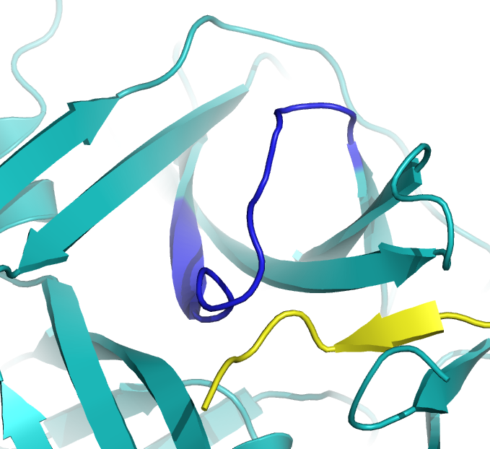
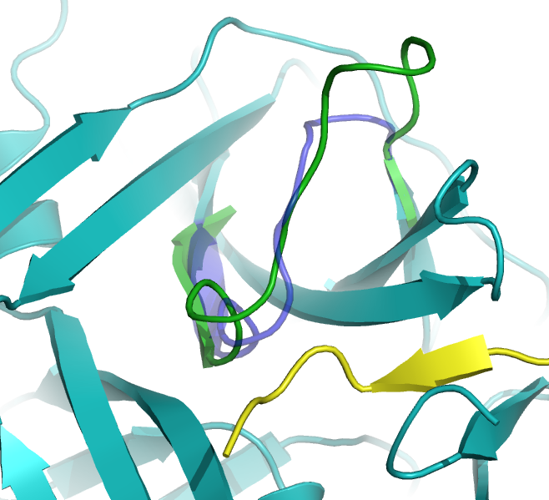

Original loop
3.25 x 4.5
1EQ9
2M9P

Slide 3
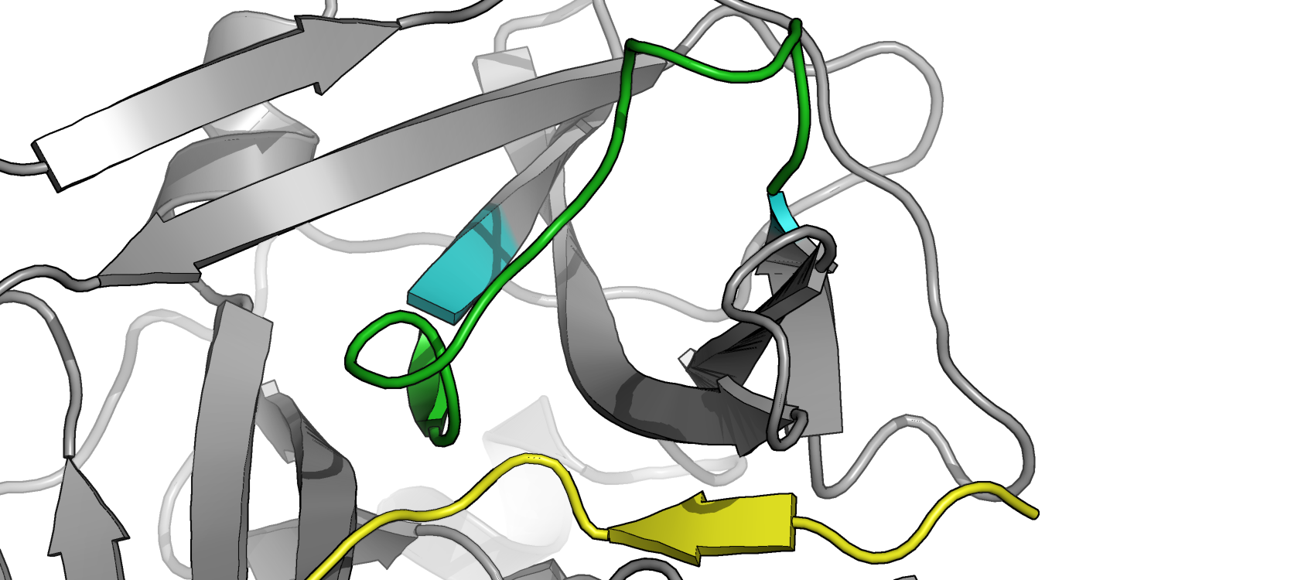
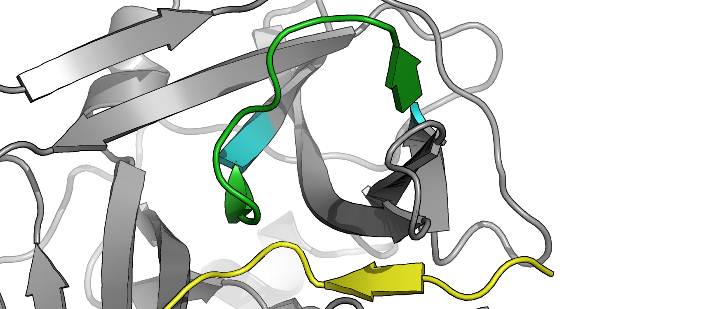
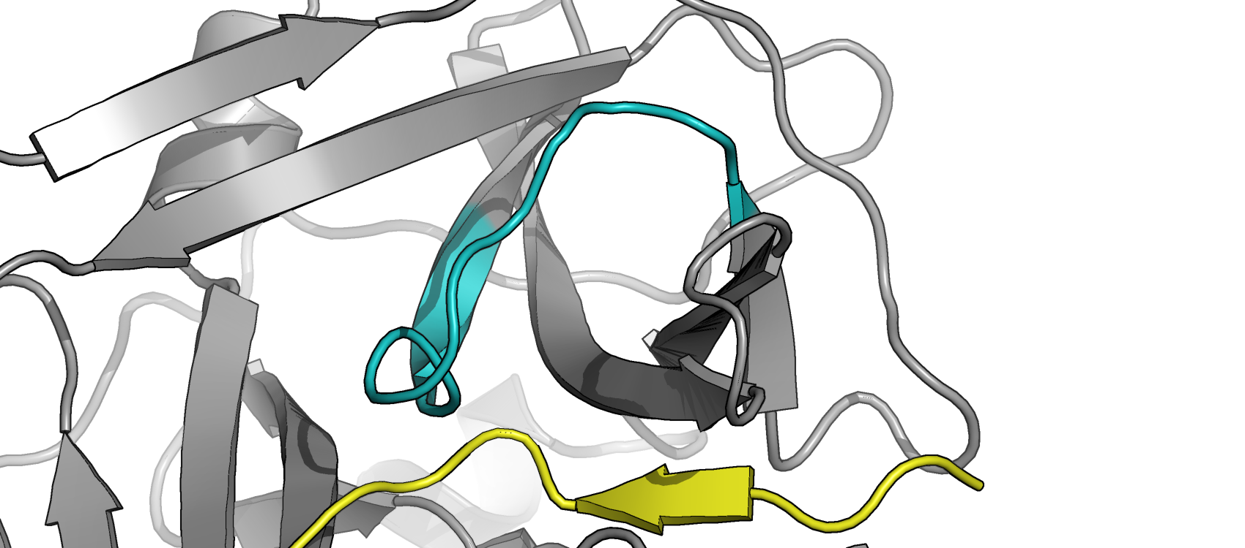

Slide 4
Original loop
1EQ9
2M9P

Slide 5
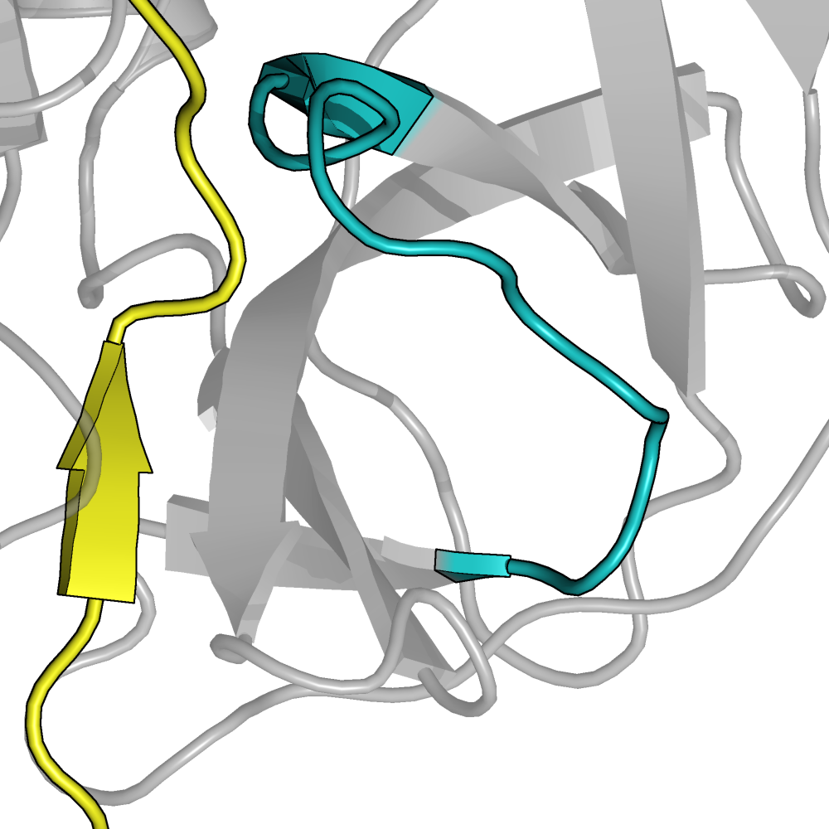
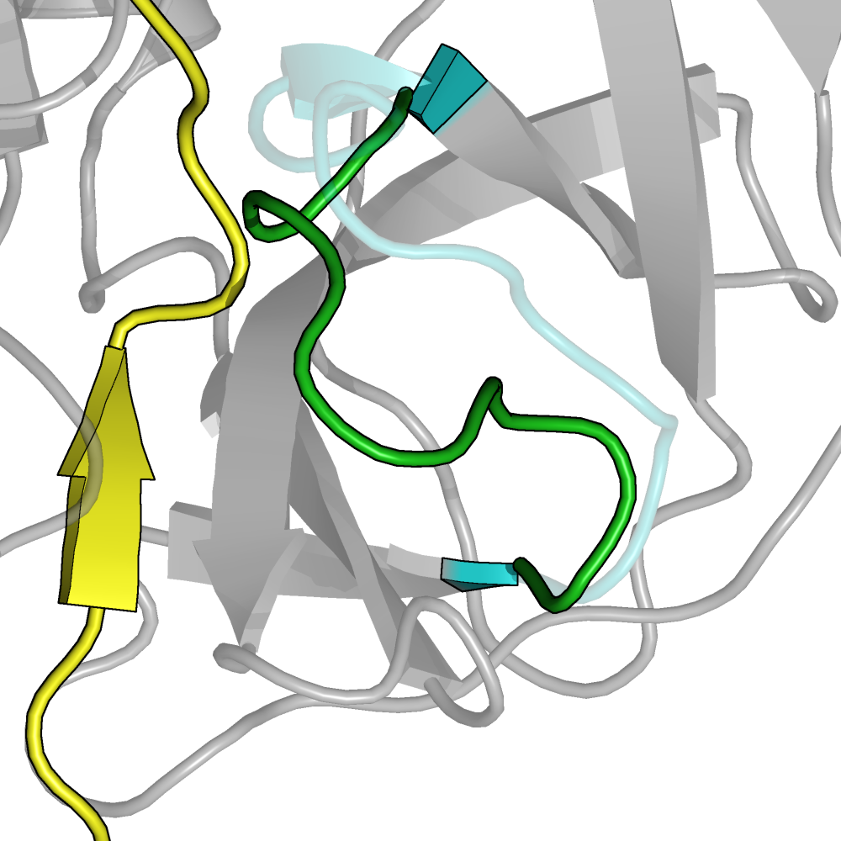
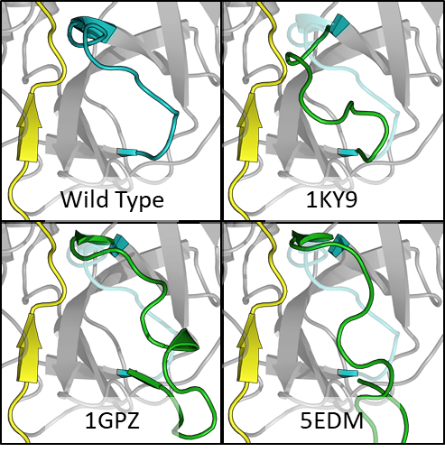
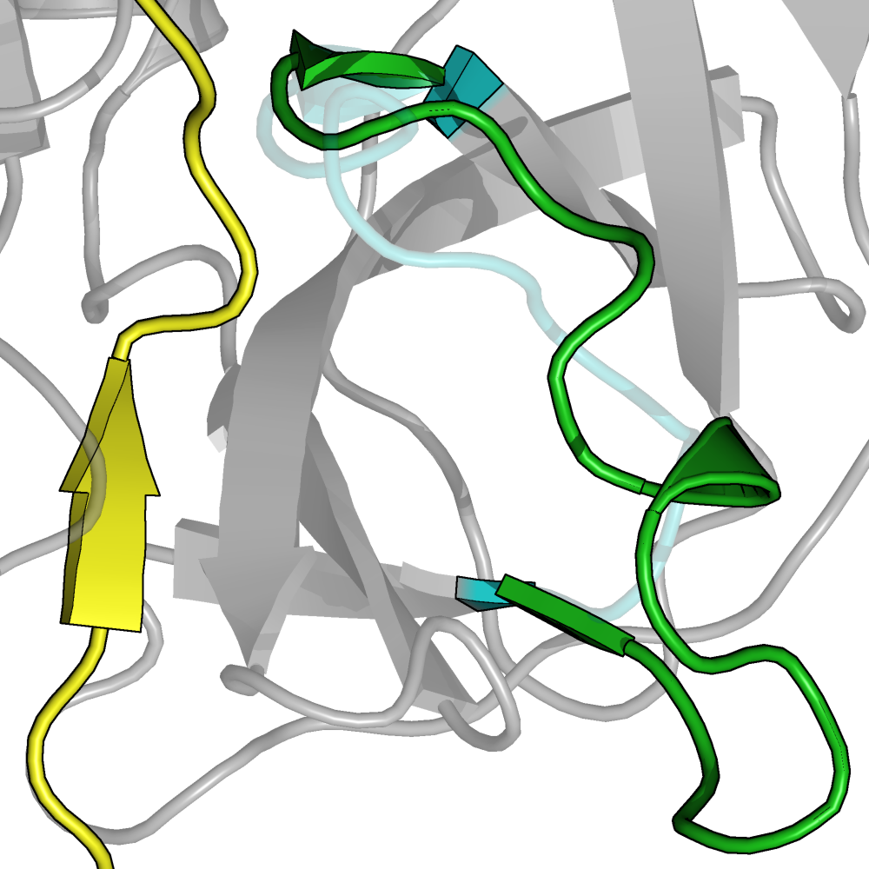
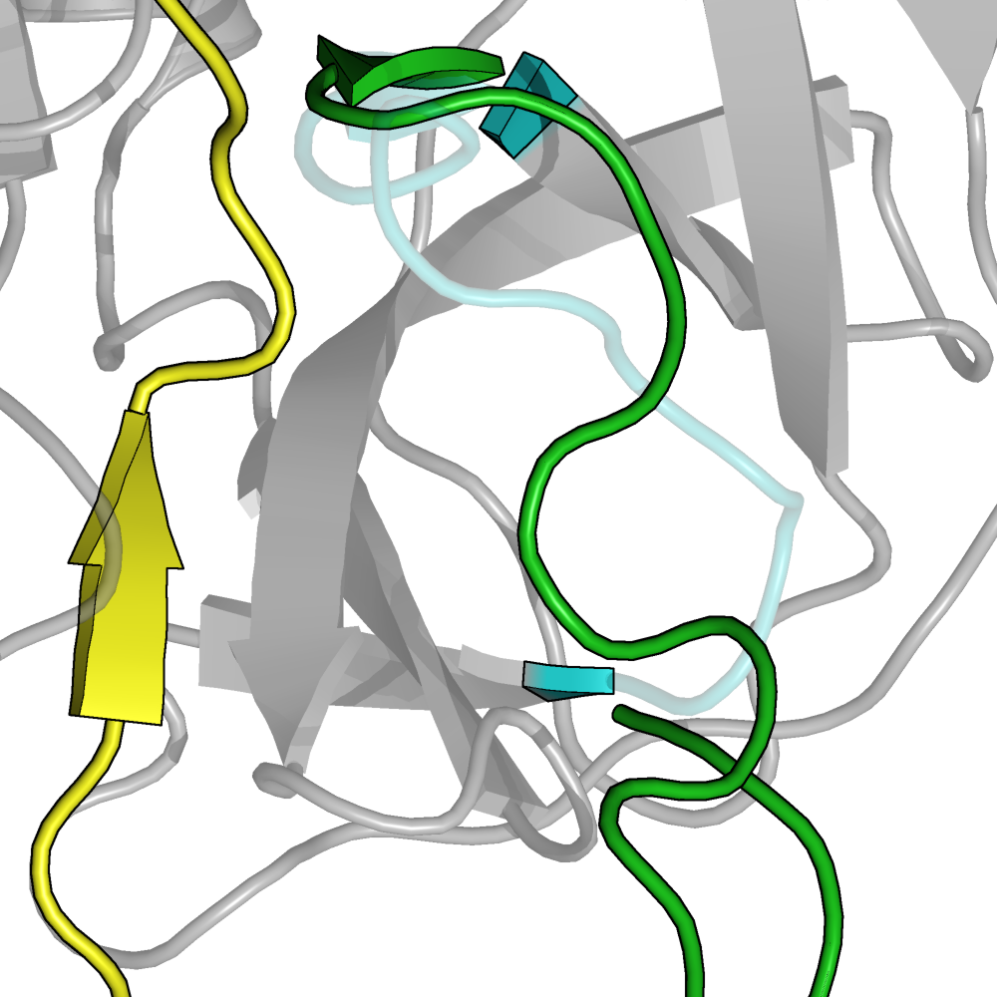
Wild Type
1KY9
1GPZ
5EDM

Slide 6
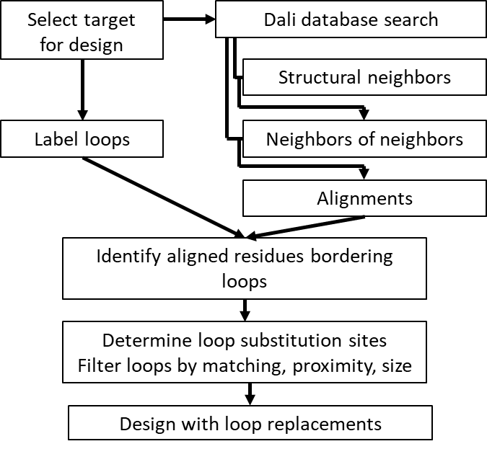
Select target
for design
Dali database search
Structural neighbors
Label loops
Neighbors of neighbors
Alignments
Identify aligned residues bordering loops
Determine loop substitution sites
Filter loops by matching, proximity, size
Design with loop replacements

