Slide 1

PROJECT 1
Bank Loans
Daniel Ortiz-Rubio, Jair Humberto Mijangos, Arturo Padilla, Alejandro Herrera

Slide 2
Which countries have the most reliable credit history?
For this project, we used a sample from a real data set from a bank (more than 1,000,000) and used it to find the countries with the most credits approves, amount of money lent, average amount of money lent, percent of default rate and amount of credits requested.

Slide 3
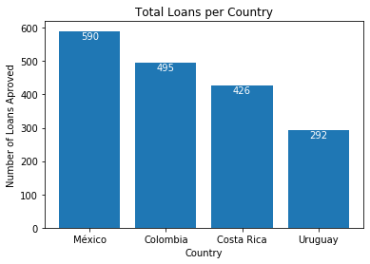
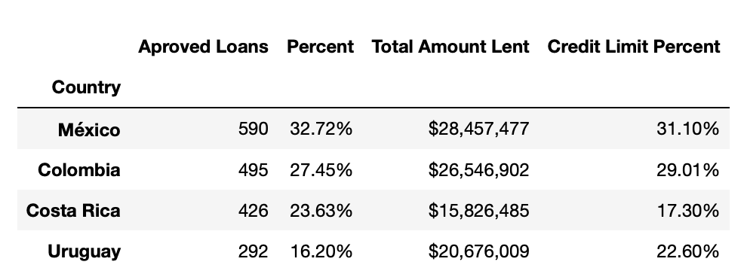
Total Loans Per Country

Slide 4
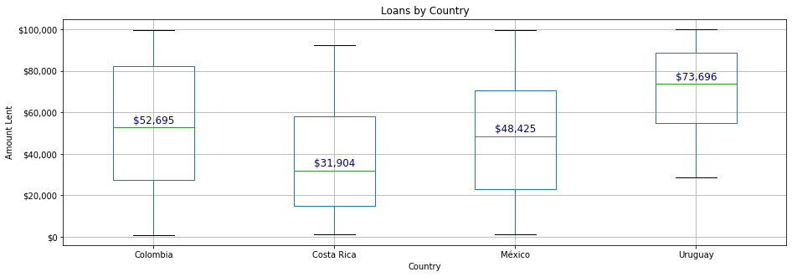
Amount Lent Per Country

Slide 5
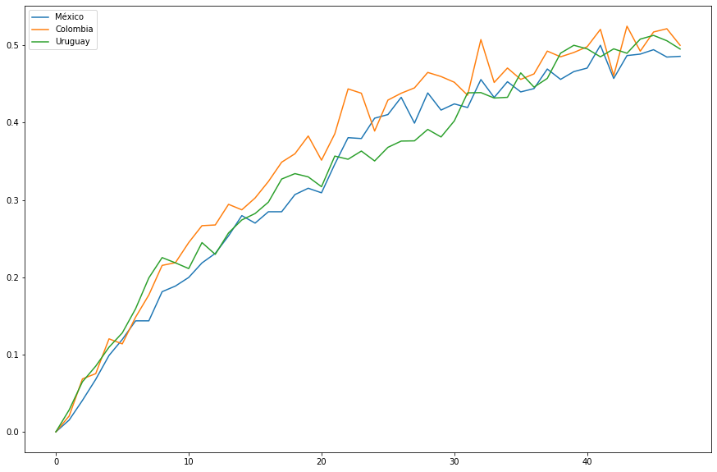
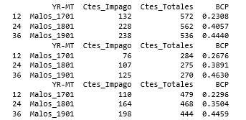
Default percentage

Slide 6
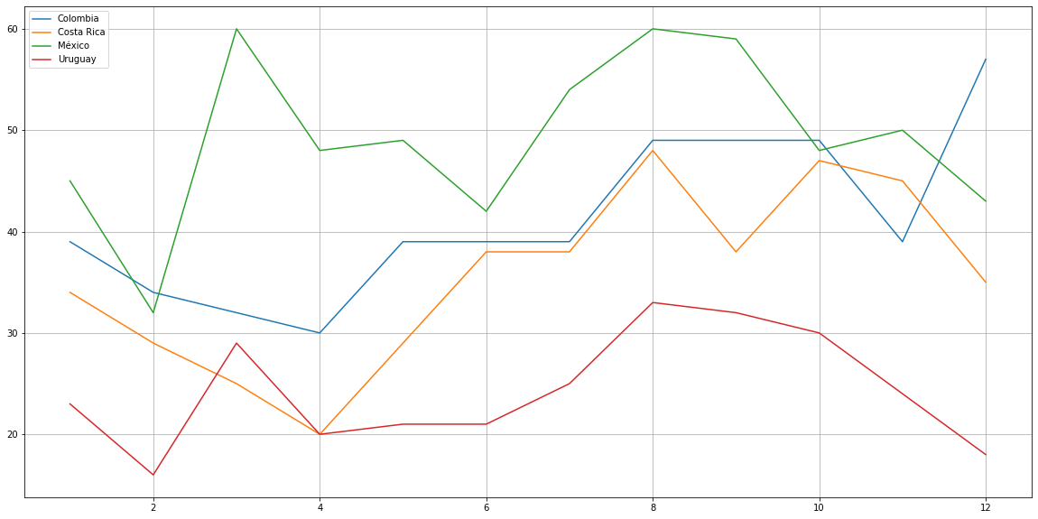
Amount of Loans Per Month

Slide 7

Data Cleansing
Visual Inspection with Excel
Adding Country names
Removal of irrelevant data
Renaming Columns

Slide 8

Conclusions
Mexico is the country with the most loans, the most money lent, and lowest default rate.
Based on the median of Money/Lent Uruguay has the highest $/per person even tough it has the lowest number of loans.
Overall Mexico has the lowest default rate while Uruguay has de highest.
We can recommend this bank to offer credit loans on a different season for every country:
(Colombia: December Mexico, Costa Rica and Uruguay: August)

