Slide 1
Presentation On Extreme Programming (XP)
Submitted By | Submitted To
Md.Jabir Hossen Nayan ID: IT-21023 Session: 2020-21 | Mr. Ziaur Rahman Associate Professor Dept. Of ICT, MBSTU

Slide 2
Introduction to Extreme Programming
Definition: Extreme Programming (XP) is an Agile software development methodology emphasizing customer satisfaction and responsiveness to changing requirements.
Key Goal: Deliver high-quality software quickly and continuously.

Slide 3
Key Principles of XP
Communication
Simplicity
Feedback
Courage
Respect

Slide 4
XP Practices Overview
Pair Programming
Test-Driven Development (TDD)
Continuous Integration
Frequent Releases
On-Site Customer

Slide 5
XP Lifecycle Diagram
(Include a simplified diagram showing stages: Planning → Design → Coding → Testing → Release → Feedback Loop)

Slide 6
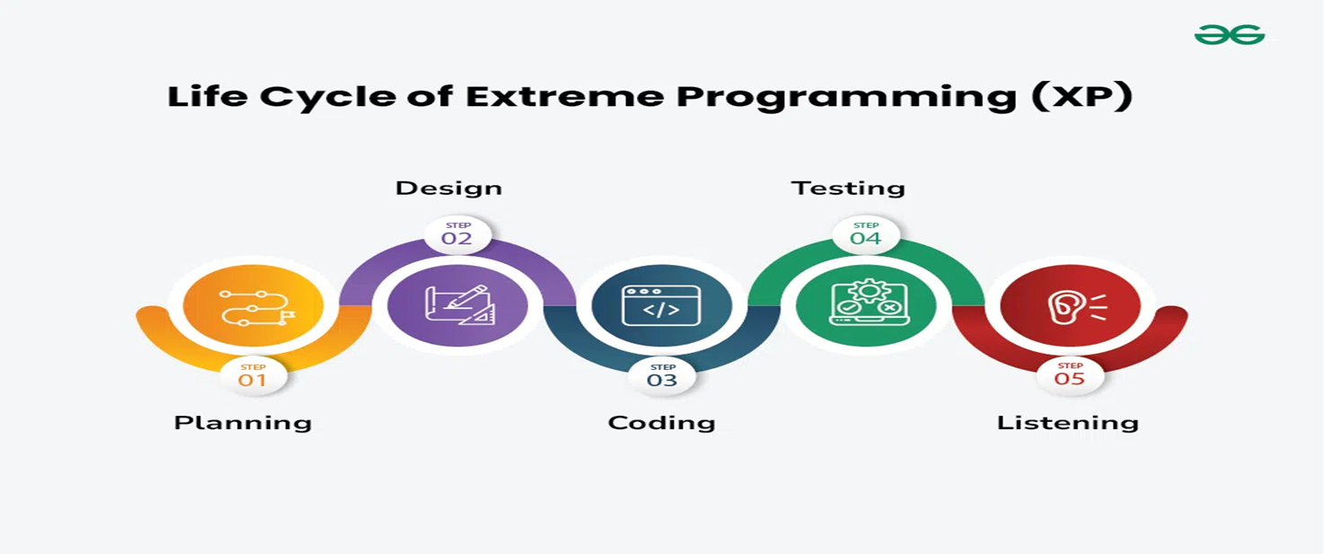

Slide 7
Planning in XP
User Stories
Iteration Planning
Prioritizing based on customer value

Slide 8
Design in XP
Focus on Simple Design
Avoid unnecessary complexity
Refactor frequently to improve the design

Slide 9
Development Practices
Pair Programming: Two developers, one codebase, better quality.
Test-Driven Development (TDD): Write tests before code to ensure functionality.
Continuous Integration: Merge and test code frequently to avoid integration issues.

Slide 10
Feedback Mechanism in XP
Continuous feedback from:
Automated tests
Customer reviews
Team retrospectives

Slide 11
Advantages of XP
Faster response to changing requirements
Improved software quality
High customer satisfaction
Better collaboration and team morale

Slide 12
Challenges of XP
Requires high discipline and commitment
May not suit all project types
Risk of customer unavailability

Slide 13
Conclusion
Extreme Programming emphasizes collaboration, adaptability, and quality.
Ideal for dynamic environments with rapidly changing requirements.

