Slide 1
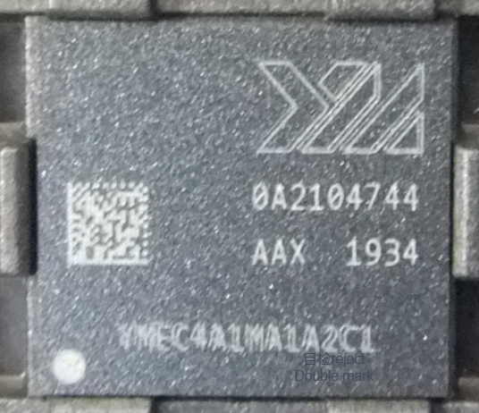
OPL For YMTC eMMC Illegible Mark Issue
Customer | YMTC | P/D/L | 4KZ1153 | MM/D,W,S | NA | Lot # | FTK355116529.01
Defect | Illegible Mark |  | Defect Ratio | 148ea/1.71% |  | Status# | N/A
Problem Description:
Operator detected 148 units with Illegible mark issue during in process monitor on Sep/20
T-Out Device | ATC Lot# | Wafer ID | Stage | In-Qty | Out-Qty | Final Rej | Final Yield | Reject Summary
EA1Y001B01M4-A2SC100-G1 | FTK355116529.01 | A21047.44 | L/M | 8639 | 8491 | 148 | 98.29% | Illegible/Double Marking 148ea
Possible Root Cause:
Laser scanner(control laser X/Y direction) worn out that caused laser head vibration and further induced unit illegible mark
Action Plan:
Replaced new scanner and followed new recipe setup rule to buyoff and released to production - Done
Verified illegible mark unit on AVI machine that confirmed such kind defect can be detected, no escape risk - Done
Check all 4 sets EO laser mark machine scanner lifetime within 5 years. - Done
Define laser mark machine scanner lifetime as 5 years and record it in PM system - Ongoing, 10/18
Notes:
This is a Title and Content slide.

