Slide 1
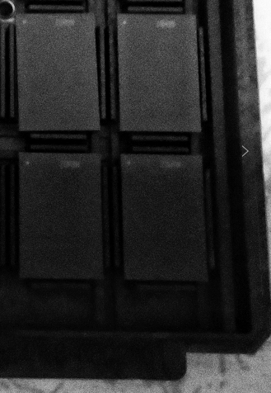
OPL for Intel B17A QDP Small Lot BURN-IN Zero Yield
Customer | Intel / 126 | P/D/L | 5X/1B/132 | MM/D,W,S | 10/25/2019 | Lot # | FTK415278584.01(S940C134)
Defect | Burn in zero yield |  | Defect Ratio | 257ea/100% |  | Status# | Pending Re-Burn to recover
Problem Description:
B17A QDP lot S940C134 encountered zero yield at BURN-IN process. All units fail on CAT030 (p35:fa_ers_all_cust:cycle:USTP2).
Wrong Pin1 orientation in BIB was found and such Pin1 orientation could simulate same fail phenomenon after analysis.
Date | Device | Customer Lot # | ATC Lot | Tester | Handler | Qty | Bin1 | Bin5 | Bin7 | Yield
10/12/2019 | B17A-42RF-C524 | S940C134 | FTK415278584.01 | OV-B67-011 | HD-JT-001 | 257 | 0 | 256 | 1 | 0%
Possible Root Cause:
Zero BUNR-In yield was related to wrong pin1 orientation when loaded units into BIB.
Rotate Pin1 in wrong position in tray when operator was doing ball check after prescreen test. Operator checked ball tray by tray for small lot and result in 100% pin1 orientation wrongly before Burn-in loader.
pin1
Incorrect pin1 orientation
Correct pin1 orientation
Action Plan:
Update OCAP to check pin1 orientation when whole lot or whole BIB zero yield.
Resp: Leo Wang Due Date: 11/4/2019 Status: On-going
Add pin1 orientation check at Burn-In loader process. Sample Size was one tray per lot.
Resp: Leo Wang/MFG Due Date: 11/4/2019 Status: on-going
Standardize in-process monitor check method, especially for tray rotate method and provide re-fresh training to FT operators
Resp: Xiaomin Ren Due Date: 11/4/2019 Status: on-going
Tray corner
Notes:
This is a Title and Content slide.

