Slide 1
OPS - SEC CP Wafer Lot SBL Trigger Skip Issue
ATC Test I Wafer Sort
Notes:
This is the First Slide of each and every presentation.

Slide 2
OPS - Samsung CP Wafer Lot SBL Trigger Skip Issue
Customer | SEC |  | P/D/L |  | N/A | MM/D,W,S |  | Apr23’20 |  | Lot # | SBBC9
Defect | SBL LOT released |  |  |  | Defect Ratio | 1pc/25 pcs wafer/1 lot |  |  |  | CAR # | N/A
RCVD | N/A | 4D |  | 4/28 | Sample | NA | 8D |  | N/A | Status | AR follow up
Problem Description:
SEC feedback that CP device SFK11N1XC1-X2Z one lot SBBC9 one wafer#16 was triggered SBL and released without customer’s disposition
Possible Root Cause:
ATC shift PE followed up current SOP to check the result PASS and released the lot without issue
Notes:
This is a Title and Content slide.

Slide 3
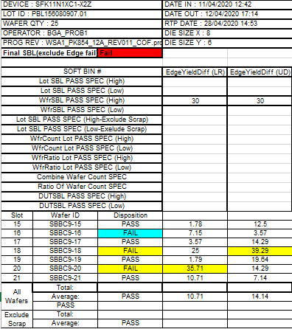
OPS - Samsung CP Wafer Lot SBL Trigger Skip Issue
Possible Root Cause:
Same case was happened in ATT in Dec’18 and ATT updated new rule in AWMS system for SBL trigger lot disposition, should follow “final SBL” result
ATC AWMS was upgraded with this new added function, but ATC PE still followed up with old SOP for lot disposition
New added “Final SBL” column result to dispose SBL triggered lot
Action Plan:
Check the impacted scope if have wrongly released by same reason - Done 3 of 29 lots found, hold in ATC inventory
Update SOP to apply new rule for SBL trigger lot disposition - Done
Work with sister factory on critical system criteria update sharing and notification - Ongoing, PE/QE
Old method：Check the 3 PASS then release lot
Notes:
This is a Title and Content slide.

Slide 4
Notes:
This is the Last Slide in your presentation.

