Slide 1
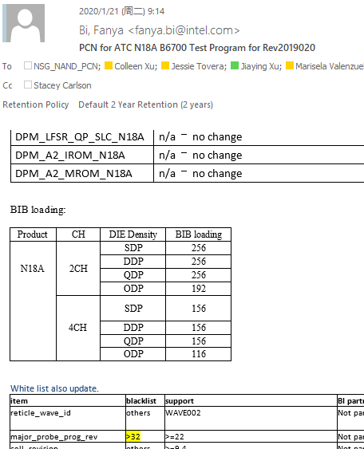
OPL – N18A ODP Miss Partial BIB Loading Requirement against PCN
Customer | Intel / 126 | P/D/L | 4P/1A/132 | MM/D,W,S | 6/9/2020 | Lot # | 40 lots / 190K
Defect | N18A ODP miss BIB requirement in PCN |  | Defect Ratio | NA |  | Status# | Lots release
Problem Description
N18A ODP BIB full loading (256ea per BIB) which against N18A PCN rev2019020 requirement ( PCN required close 4 line, 192EA per BIB)
Possible Root Cause:
Intel released PCN of N18A B6700 Test Program for Rev2019020 on Jan.21. PE follow internal checklist and miss checking BIB loading new requirement in PCN.
Usually Intel PCN format include two parts - test tape release note and whitelist. All changes will be highlight in yellow. For this time, BIB loading table is new added item in PCN, partial BIB request was not highlight and no mapping provided until 6/9/2020
Action Plan:
Update internal PCN checklist to cover BIB loading quantity for Burn and DSA DUT open quantity for ATE
Resp: Leo Wang Due Date: 6/11/2020 Status: Done
Help needed from Intel to highlight all the changes in PCN or add one column “change description” to summarize in PCN
Resp: Intel Due Date: TBD Status: on-going

