Slide 1
Notes:
This is a One Line Title Slide, used as a second slide option.
If you use this sample slide you can paste a photo onto the slide and send it to the back so it appears behind the blue bar. To add a photo (jpeg or png file format) from the photo library to this slide, follow the instructions in the User’s Guide. After you have added the photo and sent it to the back you will be able to add your text to the text placeholder boxes.

Slide 2
Investigation Report For
KIOXIA Burn In Pro-V Operator Injury Issue
ATC Test EE丨 Aug’2020
Notes:
This is a One Line Title Slide, used as a second slide option.

Slide 3
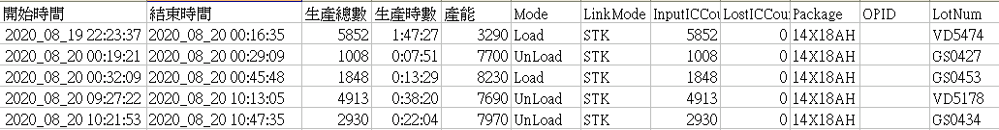
Problem Description
FT2 Operator(44685) was injured when he monitor the BIB position during operating the Pro-V HD-TP-005 handler about at 09:21 on 08/20/2020
Root Cause Analysis
HD-TP-005 Lot Summary
It’s the 1st lot on 8/20 dayshift

Slide 4
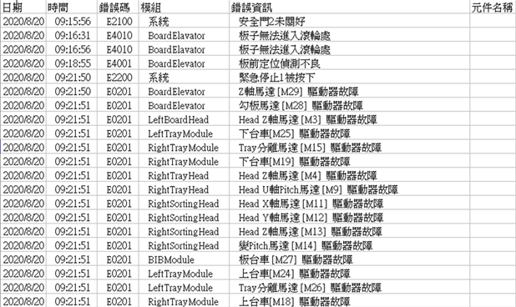
Root Cause Analysis
HD-TP-005 Alarm log
There is alarm before issue happened(BIB position error in Board Elevator)
EMO was pressed at 9:21:50

Slide 5
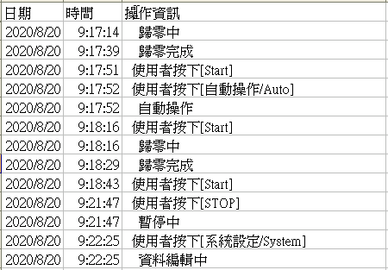
Root Cause Analysis
HD-TP-005 Operation Log
Operator start MC to monitor the machine after BIB position error

Slide 6
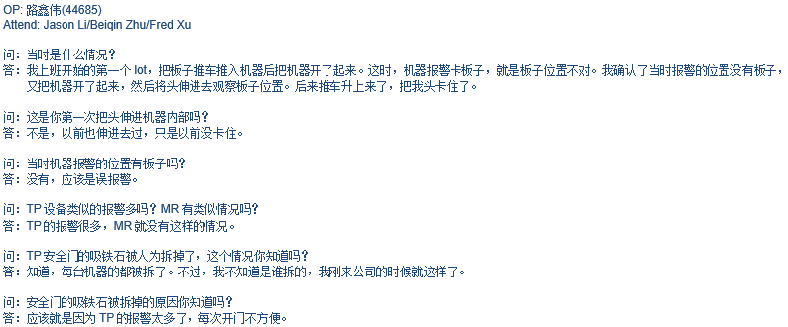
Root Cause Analysis
Operator interview result

Slide 7
Root Cause Analysis
HD-TP-005 Alarm log & Operation log analysis
NO | 日期 | 时间 | 错误码 | 模组 | 操作资讯\错误资讯 | Remark
1 | 20/08/20 | 9:16:56 | 错误码: E4010 | Board Elavator | 错误资讯: 板子无法进入滚轮处 | 异常报错
2 | 20/08/20 | 9:18:16 |  |  | 操作资讯: 使用者按下[Start] | 正常操作
3 | 20/08/20 | 9:18:16 |  |  | 操作资讯: 归零中 | 开始lot，设备自动复位
4 | 20/08/20 | 9:18:29 |  |  | 操作资讯: 归零完成 | 设备复位完成
5 | 20/08/20 | 9:18:43 |  |  | 操作资讯: 使用者按下[Start] | 按钮正常操作,由于电梯处安全门sensor被bypass, OP打开门观察 BIB 小车, 异常动作
6 | 20/08/20 | 9:18:55 | 错误码: E4001 | Board Elevator | 错误资讯: 板前定位侦测不良 | 分析是可能操作工被困挣扎, 导致BIB 异常推入, BIB保护感应报警, 机台停止动作
7 | 20/08/20 | 9:21:47 |  |  | 操作资讯: 使用者按下[Stop] | 未知
8 | 20/08/20 | 9:21:47 |  |  | 操作资讯: 暂停中 | 未知
9 | 20/08/20 | 9:21:50 | 错误码: E2200 | 系统 | 错误资讯: 紧急停止1被按下 | 王文俊 帮忙按下紧急停止
根据操作记录和报警记录合并, 步骤分析:
9:16:56 BIB进板异常报错 -- Lot未开始，异常报错
9:18:16 OP 按下Start -- 开始新的Lot 没有异常
9:18:16 机器自动开始复位 -- 新Lot开始, 机器开始复位提示, 没有异常
9:18:29 机器自动复位完成 -- 机器复位完成提示, 没有异常
9:18:43 OP 按下Start -- 机器复位完成, OP点Start 正常开始生产, 没有异常, 但是由于电梯处门被Bypass, OP打开门观察 BIB 车, 异常动作
9:18:55 BIB进板处BIB超出限位 -- 机器报警- 异常报错, 机器停止动作.
9:21:47 按下Stop -- 机器停止, 此时操作工头卡小车上边与电梯上门板中间, 具体操作未知
9:21:47 机器暂停中 -- 此时操作工头卡小车上边与电梯上门板中间
9:21:50 紧急停止1被按下 -- 主管按下紧急停止以防止2次伤害, 机器所有马达断电
结论: 根据Log 来看 9:18:43~ 9:18:55 期间, OP想观察BIB异常问题, 由于电梯处安全门sensor被Bypass, 小车一直在上升中, 导致操作工头卡小车上边与电梯上门板中间.

Slide 8
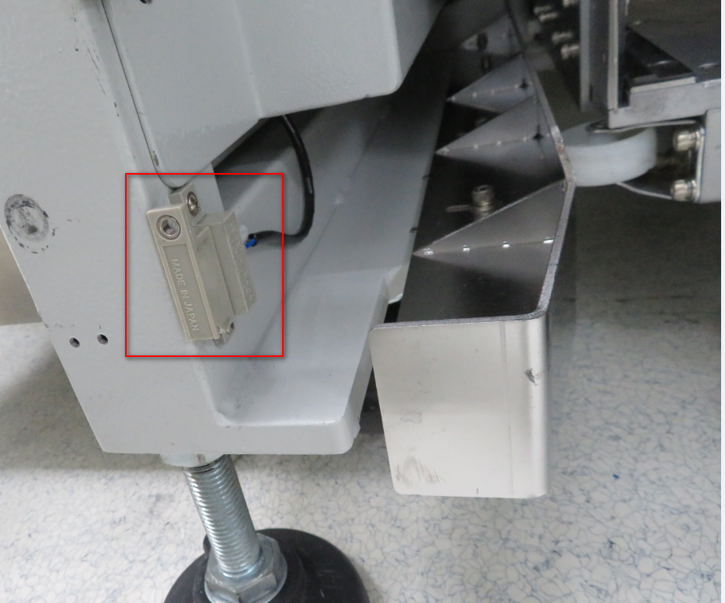
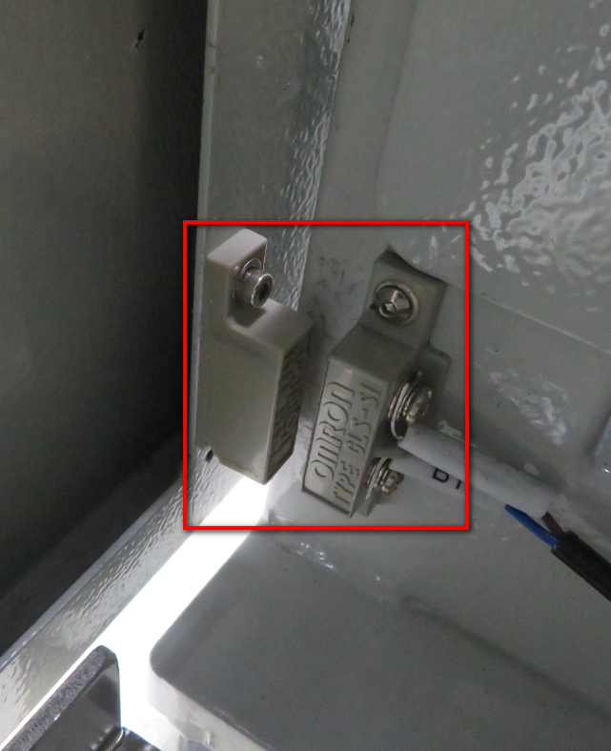
Preventive Action:
Restore the HD-TP-005 bypassed security door sensor -- Sun Shufeng / done
Daily check the status of the BI Handler safety door – MFG Line Tech / Continue activity
Strengthen PM and training technician about the abnormal issue handle -- Sun Shufeng / done
Check all BI handler Door bypass status, all MR handlers normal / All TP were recovered -- Sun Shufeng / Done
Improvement Plan:
Improve the screw type of the TP Handler safety sensor, use a special type of screw, it is not possible to disassemble. -- Owner: Fred Xu / Due date:Sep.8th
Received the special screw on 9/4, done
Increase the magnet to attract, improve the problem that the TP Handler safety door is twisted and cannot be attracted sometimes. -- Owner: Sun Shufeng / Due date: Sep.8th
Done
Oder the BIB roller parts to improve the BIB transfer position status – Fred Xu / Due Date: Sep.30th
Improve the material of the TP Handler Top panel of the door and change it to a soft material to prevent extrusion. --Owner: Fred Xu / Due date: Sep.30th
Try to contact the original factory to design a new grating for TP Handler safety door, and stop the machine once abnormal intrusion to prevent abnormal operation --Owner: Fred Xu & Supplier / Due date: Dec.30th
Safe Door sensor Bypass
Safe Door sensor normal

Slide 9
Notes:
This is the Last Slide in your presentation.

