Slide 1
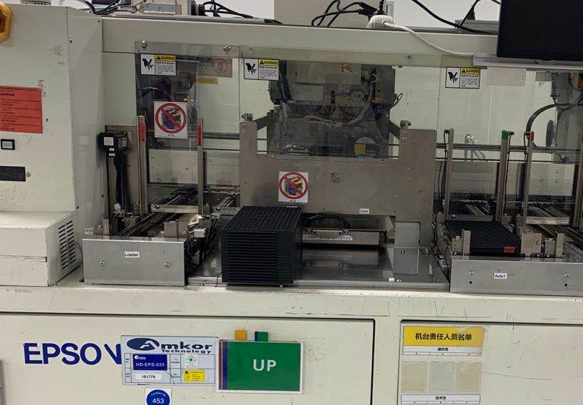
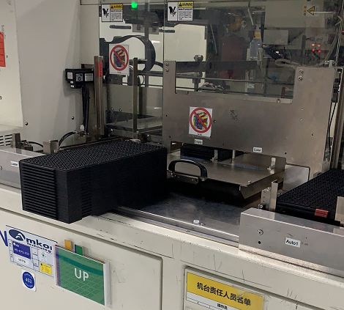
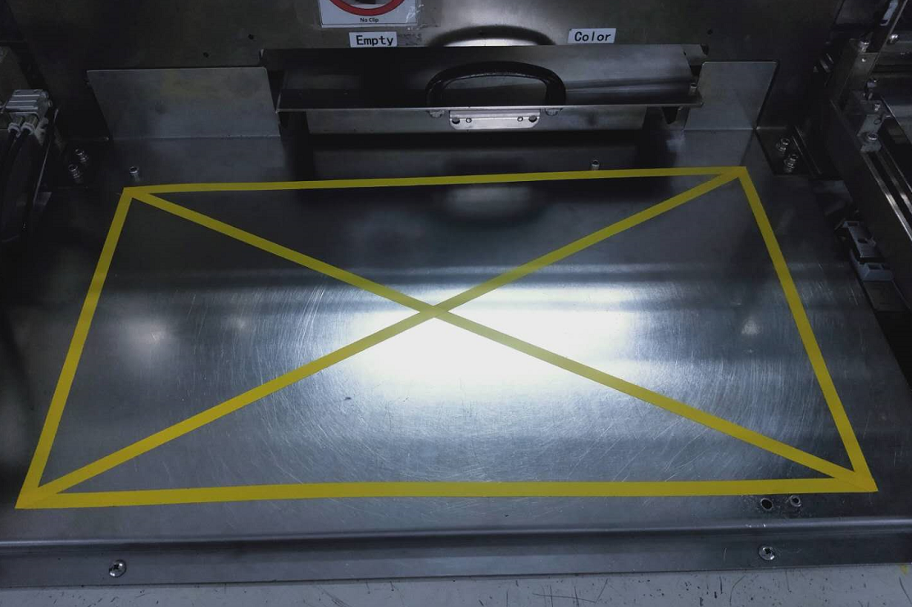
OPS For Montage Product Drop Issue
Customer | 2309 | P/D/L | 9U3A053 | MM/D,W,S | 8/29/2020 | Lot # | FTL356706118.01
Defect | 5147ea |  | Defect Ratio | 12.4% (206ea reject out of 5147ea) |  | Status# | Hold after FT2
Problem Description:
2309 Montage 15 full tray units(5147ea) drop to floor from Handler loader area
Possible Root Cause:
Technician placed the products from Handler loader area to buffer area mistakenly(in front of the drawer) while dealing the machine alarm
In order to find the CV units, the technician tried to pull out the drawer in the Handler, and the units fell to the floor by accident
Action Plan:
Optimize Loader area designs of NS8080 Handler to avoid abnormal alarm frequency ------ Zuo Huang, 9/1/2020, Ongoing
Highlights to all techs, don‘t do any product handling of production interruption and must be inform to related operator for handle the physical products to place in designated area according to Bin category ------ Jizhai Zhao, 8/29/2020, Done
Improve the buffer area designs
Short-term：add obvious warning on NS8080 Handlers (7 drawer type) ------ Jizhai Zhao, 8/29/2020, Done
Long-term：Install uneven barriers in the area to prevent any products from being placed here. ------ Zuo Huang, 9//26/2020, Ongoing

