Slide 1
Notes:
This is a One Line Title Slide, used as a second slide option.
If you use this sample slide you can paste a photo onto the slide and send it to the back so it appears behind the blue bar. To add a photo (jpeg or png file format) from the photo library to this slide, follow the instructions in the User’s Guide. After you have added the photo and sent it to the back you will be able to add your text to the text placeholder boxes.

Slide 2
History Quality Case Sharing Management
Henry Pan | Product Engineering Section Manager
Notes:
This is the First Slide of each and every presentation.

Slide 3
Agenda
1
Background and Purpose
2
TFT Team Organization
3
Current Situation
4
Project Development and Actions
5
Standardization and Future Plan
Notes:
This is an Agenda Slide.
Click on the text box, remove existing content and add your agenda content. Follow the instructions in the User’s Guide to add the photo and then change the color to grey.
After the photo has been added, send the photo to the back in order to add your text.

Slide 4
Background and Purpose
Similar & repeat case happened in different team sometimes, need improve quality mindset across all teams. System&coding enhancement only done in single team, need BKM knowledge sharing across all teams.

Slide 5
TFT Team Organization
Leader
Henry Pan
MFG Group
Equipment Group
Engineering Group
Sponsor
Wang Jun
Philip Yang
Jason Li
Joe Zhou
Jiaying Xu
Hongbing Sun
Jizhai Zhao
Yanbo Wang
Heaton Ge
Kary Ding
JC Xu
Jun Chen
Jason Zhang
Zhonghua Zhu
Andy Yin
Xiuli Jiang
Beiqin Zhu
Zuo Huang
Henry Pan

Slide 6
Current Situation
No case or knowledge sharing between different team.
No coordinator hold regular meeting to review cases happened.
No database for engineer to search and guide people how to deal the similar situation.

Slide 7


Project Development and Actions
Develop new database & system for user to register quality case & internal BKM if any. Owner: Henry Pan/JC Xu Due Date: Refer Page#8
Organize regular meeting with all section, share and study the quality case. Owner: Henry Pan Frequency: Weekly.
Awareness &
No repeat case

=
Robust Database
Regular Meeting Sharing

Slide 8
Project Development and Actions
System Level Preparation Plan – Owner: Test IT/Henry
Phase I
May.16th
Phase II
May.30th
Phase III
TBD(~Q3)
Use existing page of ATCTEST to upload summarized material.
Enable email function, auto trigger and send to all section manager.
Support user-self upload and enable search function.

Slide 9
Project Development and Actions
Overall Schedule

Slide 10
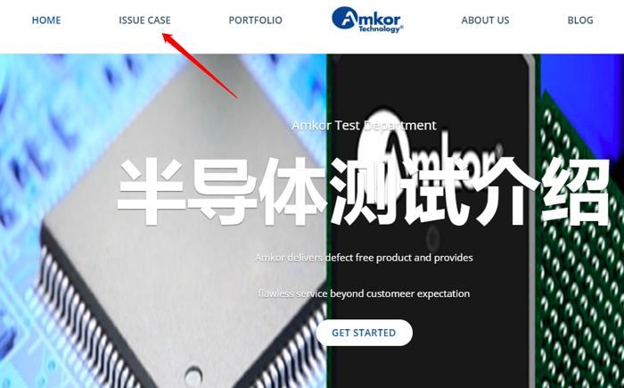
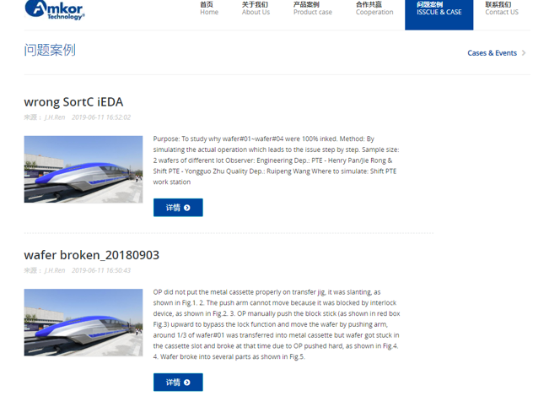
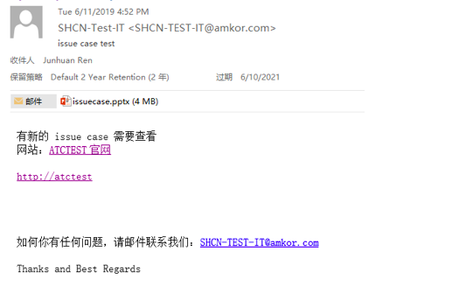
Project Development and Actions
Phase I&II Demonstration

Slide 11
Standardization and Future Plan
Any customer complaint or internal case, improvement, BKM, need prepare OPS and upload to database.
An auto triggered email with attachment would send to each section manager, manager need feedback if need fan in, to close loop.
Project owner need hold weekly meeting with team to review all the cases.
Monthly review with quality team if any case missing in the database.
Reward and punishment (Like Qty of BKM, Qty of 8D, etc..)
Create user manual(WI) for the system and define related rule inside.

Slide 12
Notes:
This is the Last Slide in your presentation.

