Slide 1
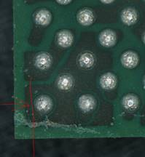
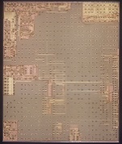
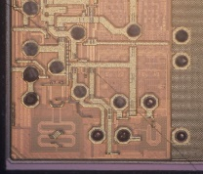
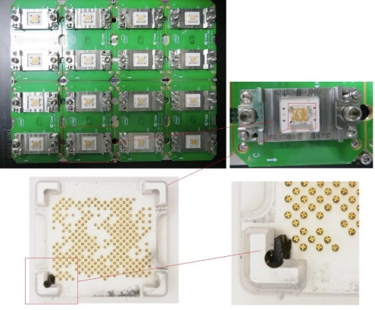
XG742 Bin5 Limit Trigger By Unit Dent
Description / Site
PKG : XG742/4A-6B-396
Issued date : 09/29/2020
Failure mode : Three XG742 lots trigger Bin5 limit(>0.3%) by unit dent
Affected lots : Total 3x lots(18k units)
Problem : Three XG742 lots trigger Bin5 limit(>0.3%) at FT2 on 9/29/2020, PFA found the Bin5 units were die crack at dent corner
Material Disposition : Reject all dent units at FVI, report to customer
Background
Total 14 lots tested FT1 from 9/25, the yield of 14 lots were normal and released to FT2.
After FT2, the first 3 lots trigger Bin5 limit and the PFA showed corner dent and die crack at the same corner. The other lots yield was normal without Bin5 trigger
Root Cause
3ea units damaged at FT1 first lot, and the damaged part was stuck at the socket corner.
The FM was not detected by technician during MF jam clear and socket online clean.
Operator did not detect the units dent during inline process monitor with the standard method.
Corrective Actions:
Update OCAP to dispose the mechanical fail on T5586 -- On-going, due date 10/23/2020
Update the inline process monitor method to use different angle to check the units visual defect -- On-going, due date 10/23/2020

