Slide 1
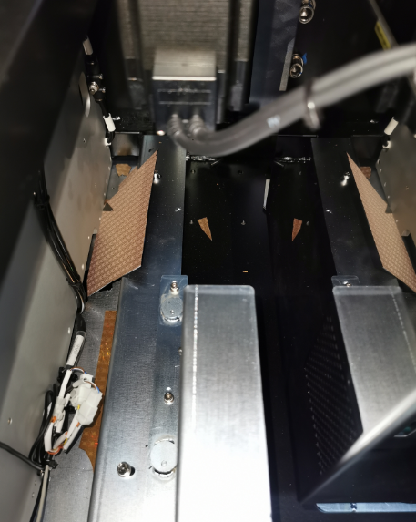
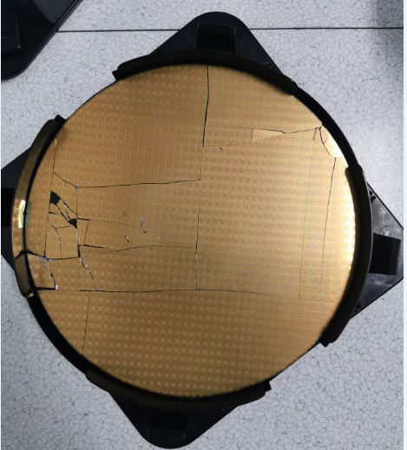
SEC Wafer Broken
Description / Site
PKG : 12 inch wafer
Issued date : 01/01/2021
Failure mode : 1 pcs wafer broken
Affected lots : Total 1256 dies
Problem : Production line found wafer broken during wafer#02 of Lot SD5G4 loading
Material Disposition : Store the broken wafer and report to customer
Background
Production line load wafer#2 for offline retest as per PTE instruction, the wafer#2 dropped before robot arm take wafer to pre-aligner area.
Root Cause
Cassette was oblique placed cassette table and scan result judgement criterion is discursive(+/-30 factory setting)
The wafer was pulled out of the cassettes without being fully vacuumed, the vacuum limit setting is discursive(-30kpa)
Machine software don’t check wafer status before it was moved to pre-aligner
Corrective Actions:
Standardize vacuum limit setting -- on-going, due date 1/20/2021
Standardize slot-tolerance setting -- done, due date 1/5/2021
Do an overall risk assessment for critical factory settings – ongoing, due day 2/7/2021

