Slide 1
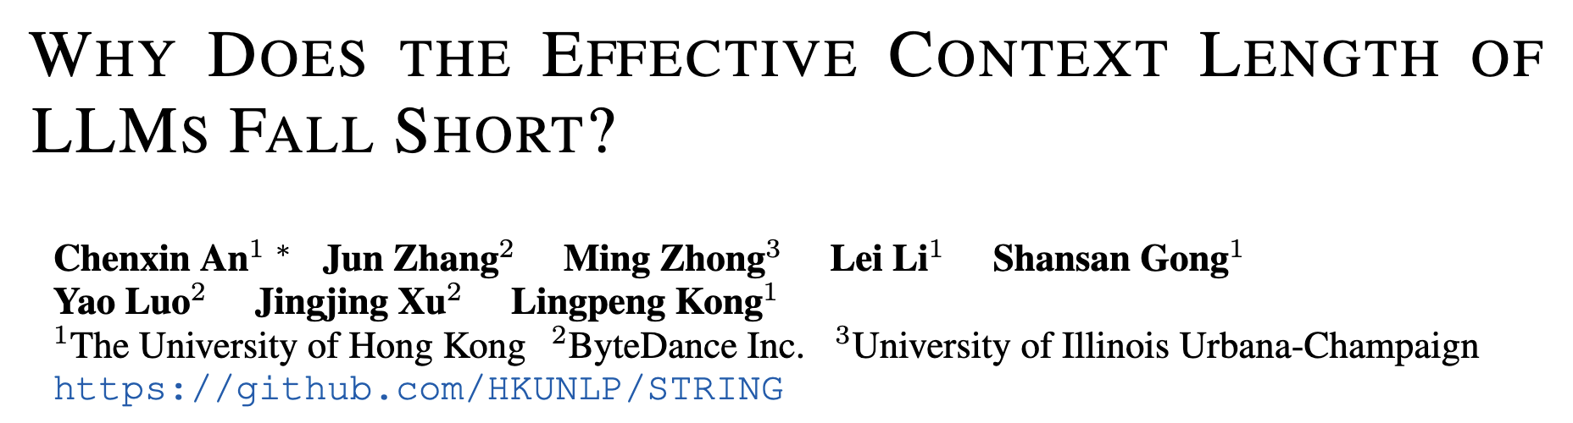
Gus Fridell, Jason Zuo
10/14/2025 CS 601.771

Slide 2
Motivation
There is a discrepancy between theoretical improvements and observed performance in context length
LLMs demonstrate effective context lengths <50% of training length
2 main reasons:
undertraining of long distance position indices during pre-training and post-training (left skewness)
Compounded by inherent difficulty in modeling long-range dependencies

Slide 3
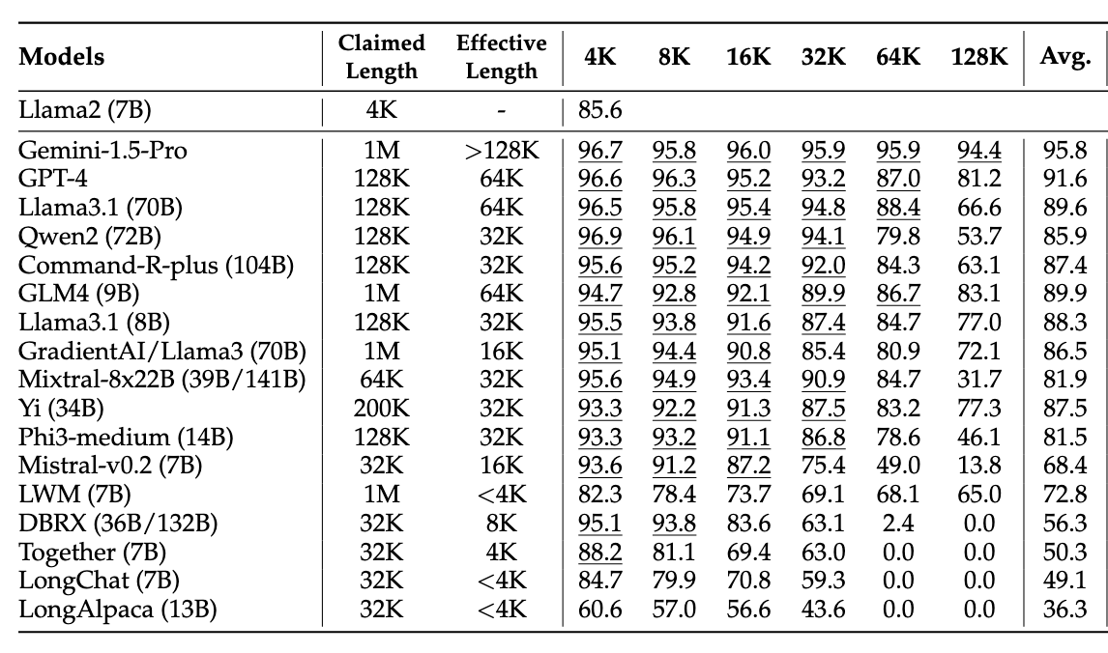
RULER: What's the Real Context Size of Your Long-Context Language Models?
Hsieh, et al., 2024.
Eff. Length := max(length) >= Llama2(7B) 4K
Notes:
RULER: 17 LLMs, 13 tasks
tasks: retrieval, variable tracking, common/frequent word extraction, QA they use llama2-7b as a threshold performance for effective length
Effective length

Slide 4
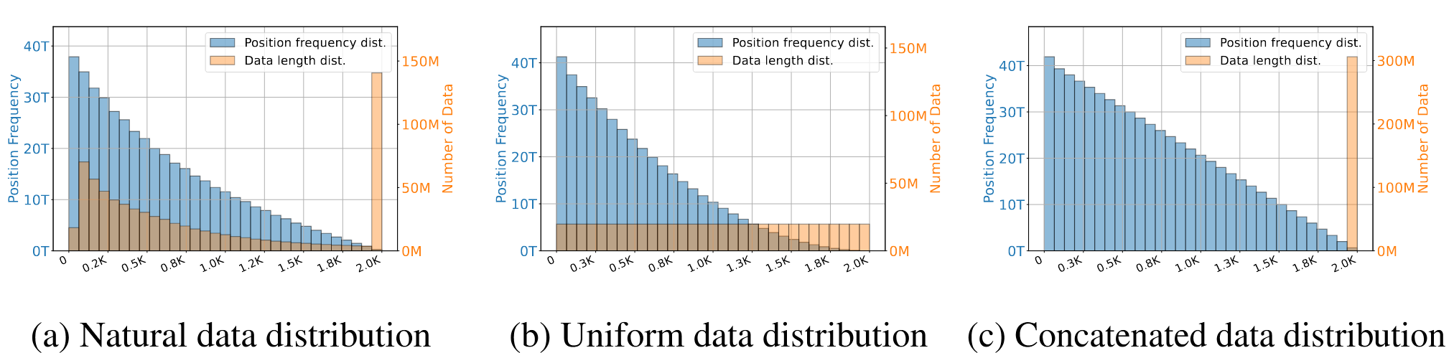
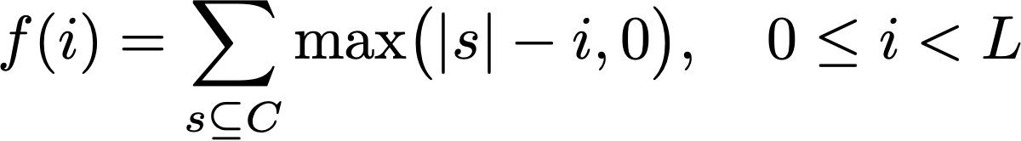
Problem: Left-Skewed Position Frequency Distribution
“How many times do we compute attention between tokens separated by distance i?”
Notes:
Natural data distribution comes from SlimPajama 627B token, deduplicated open dataset
Actual length distribution, long docs are truncated into multiple 2K chunks, training length L = 2048

Slide 5
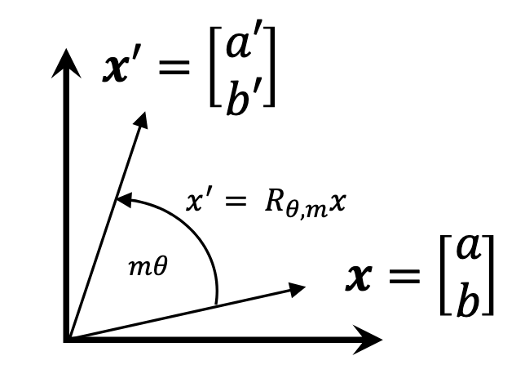
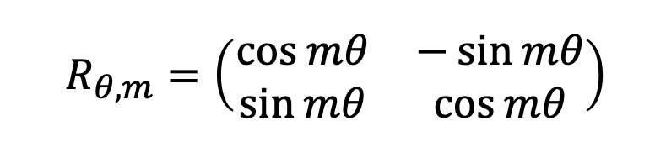
Intuition: Properties of RoPE
for queries and keys, qᵢ = Rᵢ · q (rotate query with rotation matrix Rᵢ)
kⱼ= Rⱼ· k (rotate key with rotation matrix Rⱼ)
attention score: qᵢ^{T} * kⱼ = (Rᵢ · q )^{T} · (Rⱼ· k) = q^{T} · Rᵢ^{T} · Rⱼ· k = q^{T} R_{j-i}k
rotation matrices are orthogonal: Rᵢ^{T} = Rᵢ⁻¹, the inverse rotation “undoes” the rotation
Rᵢ rotates q by angle of iΘ, Rᵢ^{T} rotates by angle of -iΘ
rotations compose additively: Rᵢ^{T} · Rⱼ = R_{-i + j}

Slide 6
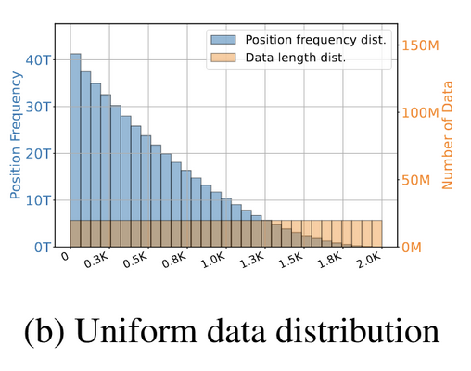

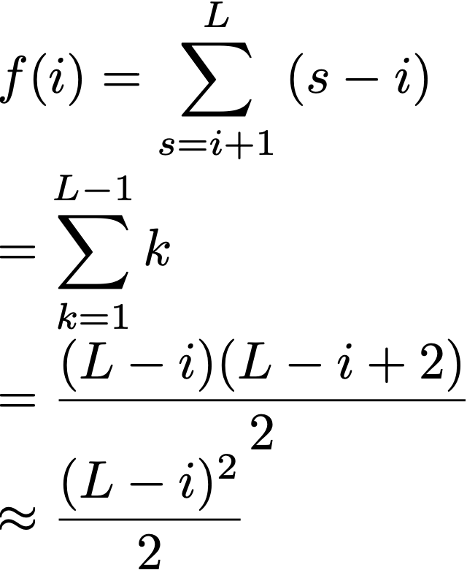
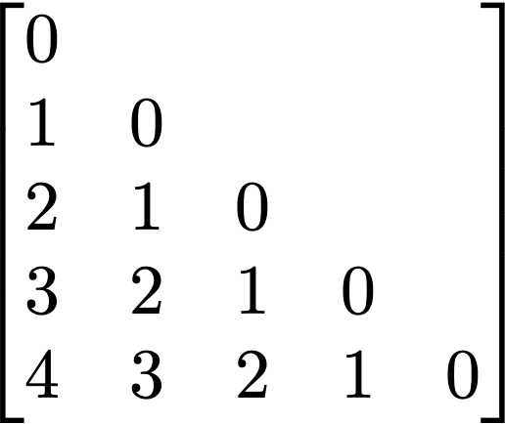
Intuition: Building the Position Matrix
Q^{T}K gives L x L matrix of attention scores
P[m][n]:
row m = query token at position m
col n = key token at position n
value = relative position between them = m - n
Key Positions (n)
[only docs longer than i contribute]
[substitute k = s-i]
[POV: you’re 7y/o Carl Gauss]
[quadratic in distance from end]
← query 0 attending to keys
← query 1 attending to keys
Query Positions (m)
Notes:
Toeplitz matrix

Slide 7
Challenges
Effective-vs-training context length gap is still a problem for models that use RoPE
Position frequency imbalance problem
Toeplitz matrix structure is fundamental to relative PE + attention
even with perfect data, we still have linear decay
Continual training is cost-ineffective
Llama3.1 used 6 stages of continual training with 800B tokens, you can’t do this
Interpolation and Extrapolation approaches fail for the same reasons
Extrapolation (YaRN, NTK-RoPE, etc) train on length L, test on length > L
Problem: if we make position 200K behave like position 100K, what happens if position 100k is already undertrained?
Standard interpolation shares this problem: tail positions are effectively OOD

Slide 8
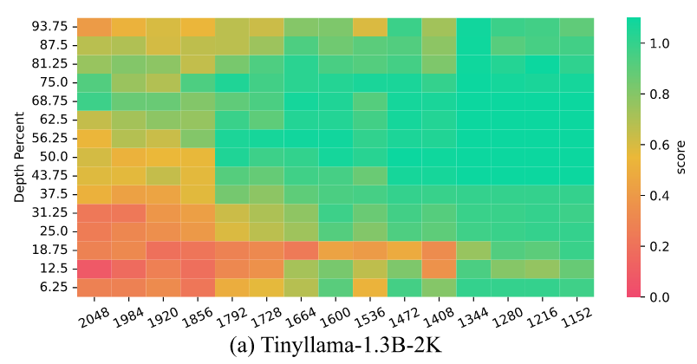
A PROBING EXPERIMENT
Question:
Setup
Training
1.3B models: max length of 2k and 4k
SlimPajama (1T tokens)
Position frequency is difficult to control directly, so instead:
Consumed tokens
Training context window size
How does position frequency observed in the training corpus and the model’s effective length relates?
Notes:
Since the training data distributions for most open-source LLMs are opaque and cannot be directly analyzed by researchers, this study represents the first exploration of the impact of position frequency during the pretraining stage.
The Setup: They specifically use a 4-needle setting. This involves inserting four unique "needles" (which are 6-digit numbers) into various positions within the long context document ("the haystack").

Slide 9
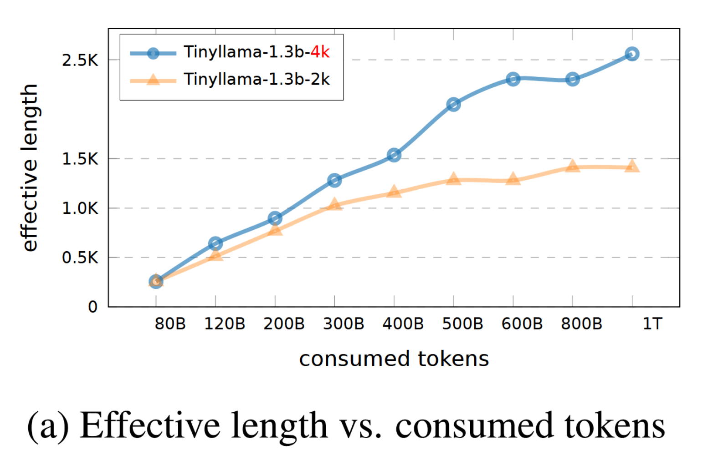
Observations
Larger training context window consumes fewer tokens to achieve the same effective context length. (Sounds intuitive)
Notes:
In Figure 2a, a notable observation is that training with longer sequences results in a greater effective context length when the same number of tokens is consumed. Specifically, the model trained with a sequence length of 4K tokens achieves an effective context length of 1.4K after consuming 400B tokens. In contrast, the model with a 2K training length needs around 1T tokens to attain the same effective context length.

Slide 10
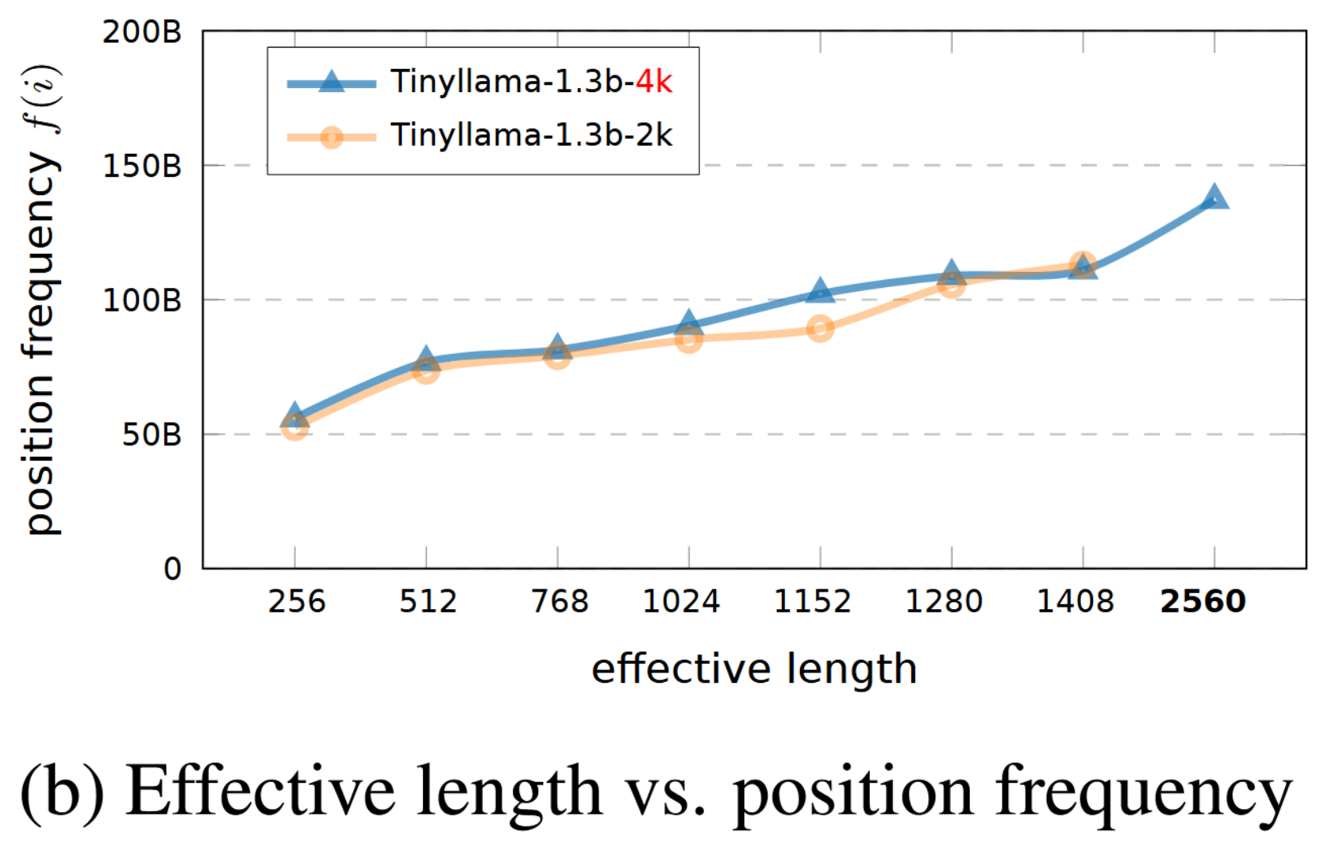
Observations
2. Models can achieve similar effective context lengths if they have been exposed to similar frequencies of position indices, even if their maximum training lengths differ. (The true underlying driver for effective length 🔑)
Notes:
Figure 2a shows that training on longer sequences (4k) allows the model to accumulate these necessary "position knowledge" much faster.
Figure 2b shows why this works—it's the frequency of exposure to these distant positions that is the true underlying driver of long-context capability.

Slide 11
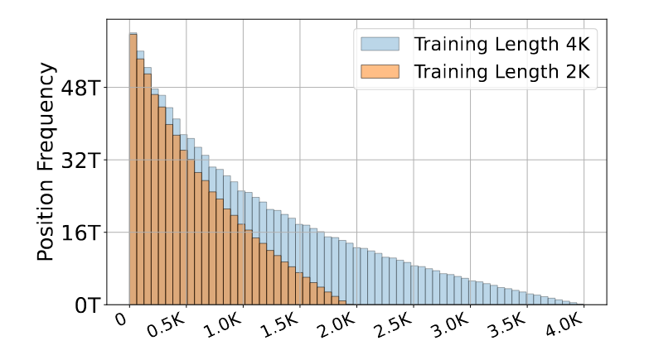
Observations
3. The growth trend of the model’s effective length aligns with the position frequency distribution: 4k has higher frequency at distancing positions.
Notes:
Further more

Slide 12
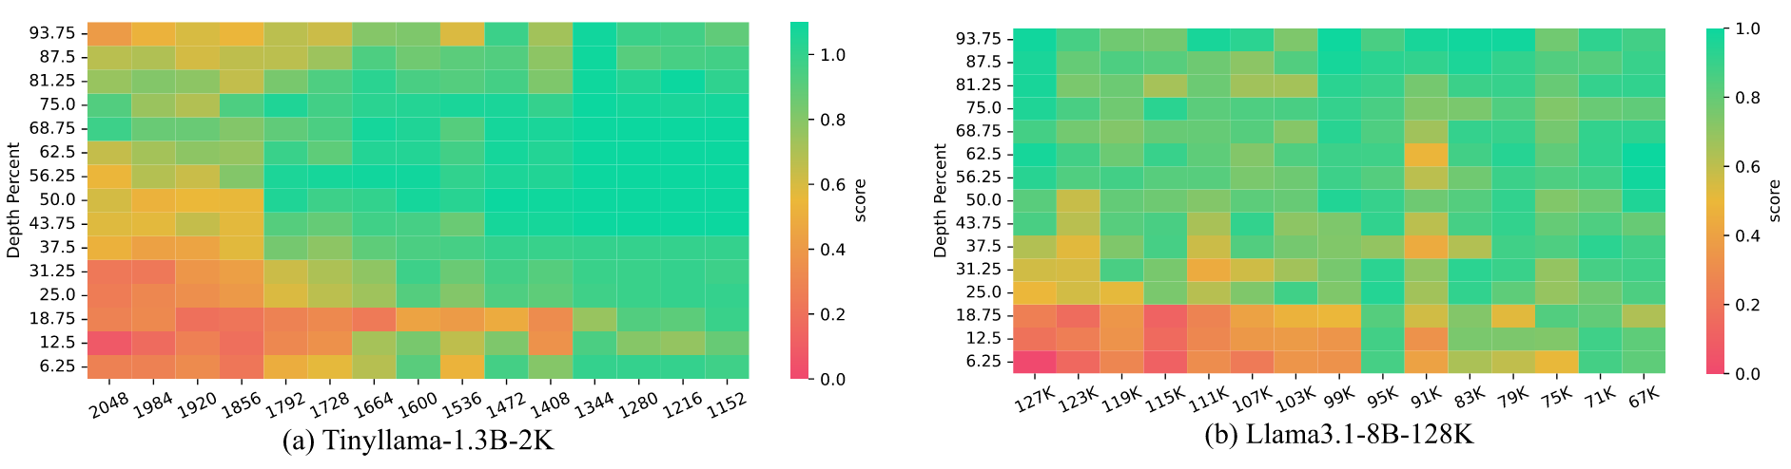
Observations
Bonus. TinyLlama struggles to gather information when the distance exceeds 1,536 tokens. Most failure cases occur within the first L/3 of the document. This may indicate that:
The last L/3 positions of current LLMs all fall in the tail of the position frequency distribution.
What can we do about that? 😱 Let’s just discard them!🗑️

Slide 13
STRING: ShifTed Rotary position embeddING
Key Takeaways from Observations:
Model’s knowledge on position (i.e. position frequency) is important.
But model only knows shorter distance much more than longer ones.
Long distance dependency is also Long Tail in natural corpus.
Core Idea:
Instead of training with longer positions, let’s shift position indices for RoPE, so that long-range indices are now under well-trained positions.

Slide 14
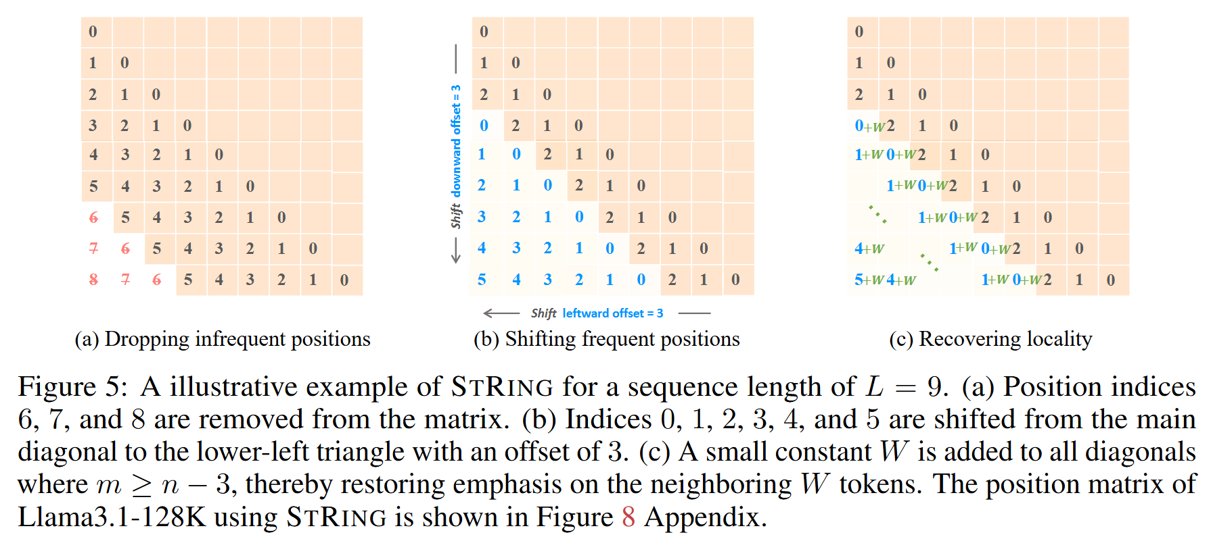
STRING: ShifTed Rotary position embeddING
Why after messing the up positions, we would still it expect to work?
Notes:
In this figure, the matrices shown there are just the positional index matrix P that we discussed previously, which will be used by the Rotary positional embeddings to modify the keys and values.
So the upper rows are for earlier tokens, whereas lower rows are the later ones
Question. What why would this be allow
Why after messing the up positions, we would still expect to it work?

Slide 15
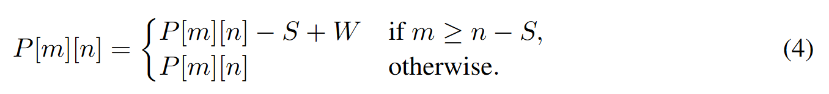
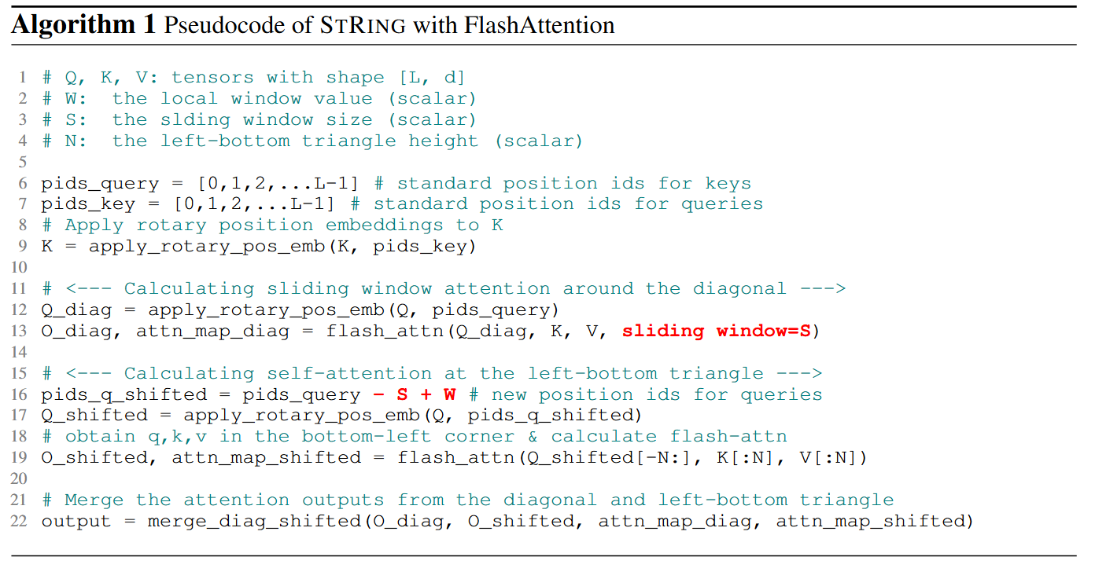
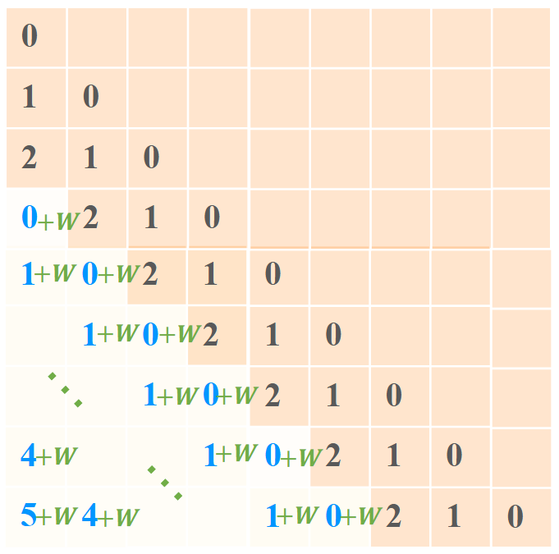
STRING: Simple Training-fRee embeddING

Slide 16
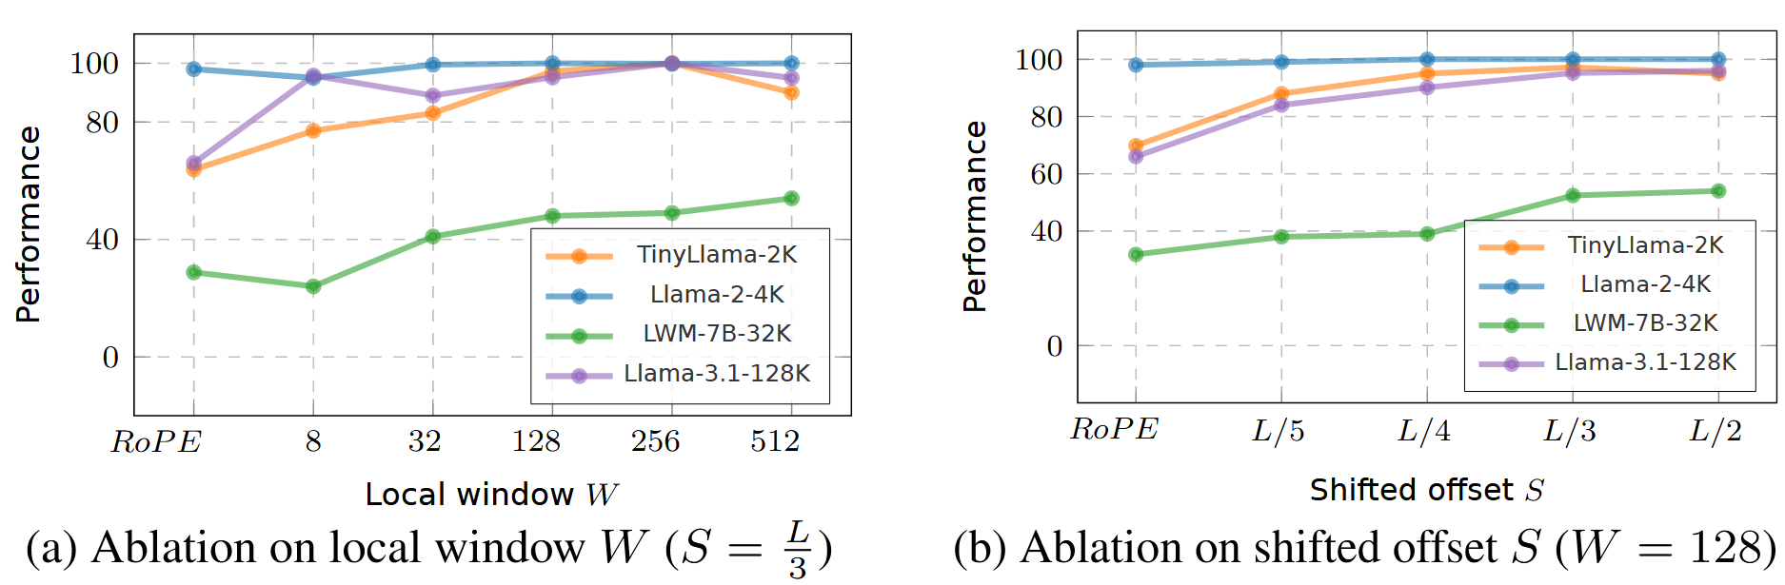
STRING: Parameters
W from 4 to 512
When W ≥ 32, performance improved significantly compared to RoPE
As long as W ≪ S, further increasing W does not cause a performance drop.
S from L/5 to L/2 .
As S increases, more position indices are discarded, the performance increases.
The trend slowed down when S > L/3, indicating that at least the last 33% to 50% of the position can be overwritten.

Slide 17
Experimental Setup: Baselines
NTK-Aware RoPE: Adjusts the RoPE base frequency to scale rotational wavelengths for longer contexts.
YaRN: Introduces temperature scaling to the attention softmax to stabilize score distributions.
Resonance RoPE: Clamps the query’s position index to a known maximum for long-range interactions.
Self-Extend: Remaps the key’s position index based on its distance from the query during inference.
DCA: Adds a cross-attention mechanism for each layer to query a summary of all preceding layers.

Slide 18
Experimental Setup
STRING focus on improving the performance within the training context size.
NTK-Aware RoPE and YaRN implement extrapolation by increasing the base frequency of RoPE.
Meanwhile, ReRoPE, Self-Extend, and DCA modify the position matrix to avoid unseen positions.
The training length of the model to 2/3 of the original length and set the extrapolation scaling factor to 3/2, meaning the test sequence length is 1.5 times the training length.

Slide 19
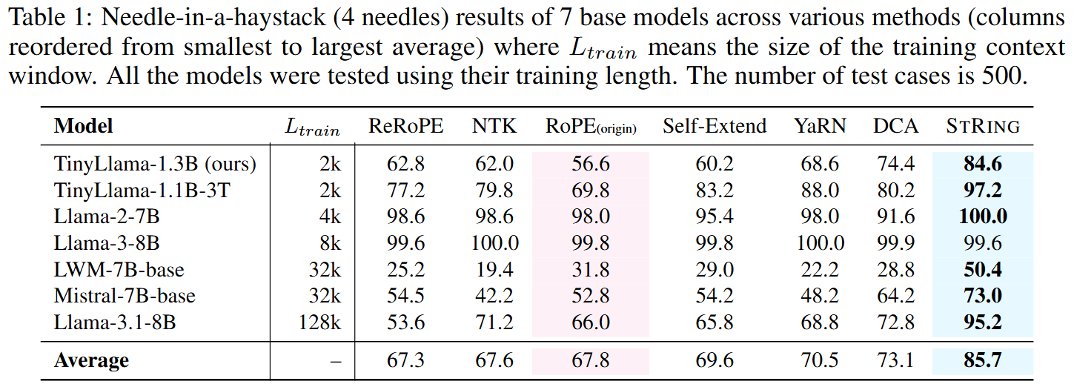
Main Results
NO TRAINING!
Notes:
string achieves highest score on every single model
Methods: baseline: original RoPE
training free extrapolation: training length ⅔, 1.5x extension
post-hoc modify the position embeddings to extend beyond training length. for a 128k trained model, configure yarn as if the model was trained on 85k, then extrapolate to 128k…

Slide 20
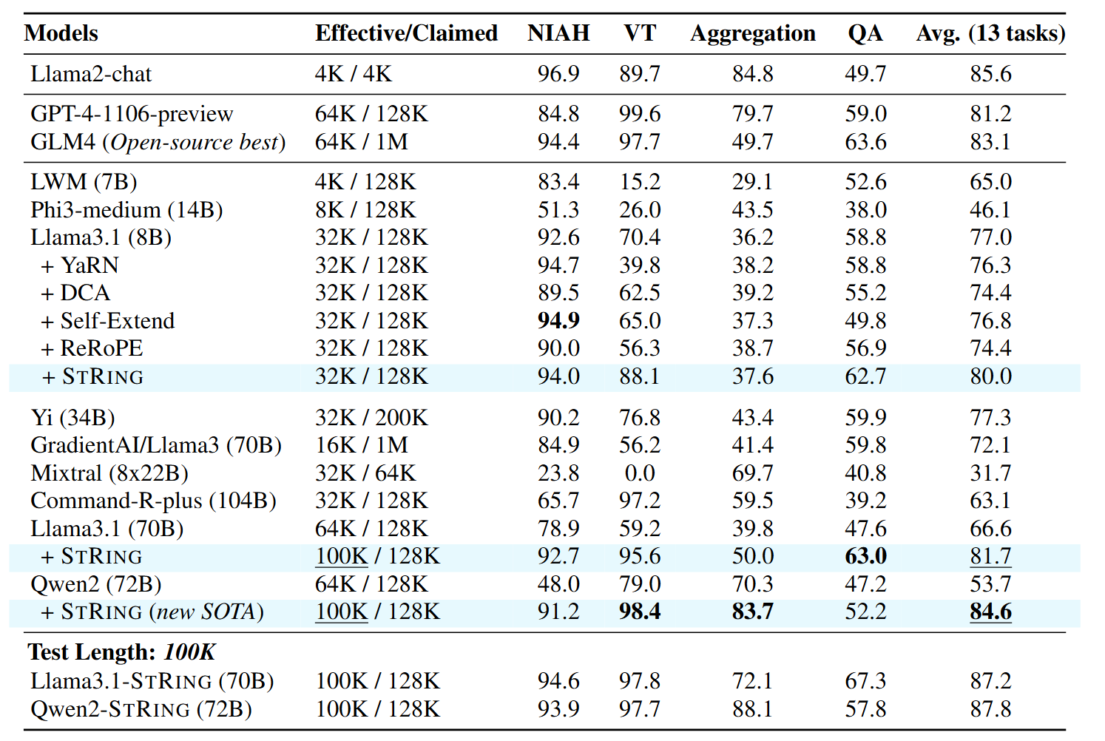
Main Results
Notes:
RULER benchmark
all extrapolation baselines don’t improve
STRING gives new SOTA, surpasses commercial models
13 distinct tasks (NIAH, variable tracking, aggregation, QA)
each task has 500 test cases
all models tested at 128k length
use RULER definition of actual usable context

Slide 21
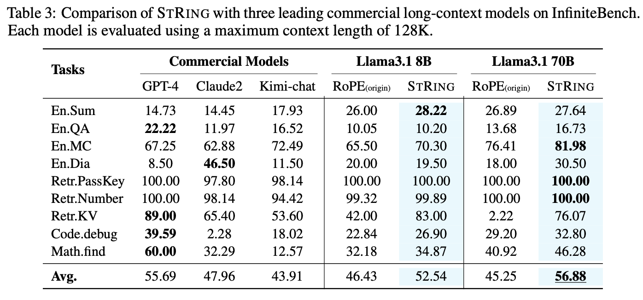
Main Results
Notes:
real world tasks
long-context summarization, QA, mcQA, long dialogue, retrieval, code debugging, mathematical reasoning
all models tested at max 128k context
STRING shows practical gains

Slide 22
Conclusions
STRING achieves highest performance on all 7 models in 4-NIAH evaluation (2k-128k lengths)
Extrapolation methods fail within training windows
STRING extends effective context length to 100k (up from 64k)
Improvements hold from controlled tasks to practical applications
Benefits increase with model size
Results suggest that addressing undertrained positions improves long-context performance

Slide 23
Critiques
Is it fair to use extrapolation methods as a comparison? (⅔ compression * 3/2 extension)
STRING results are impressive, but do they create position ambiguity?
well-trained positions become pleiotropic by design → possibly introduce issues with superposition/representation interference?
relying on content to disambiguate → does STRING struggle when content is repetitive?
Claim: position frequency during training → quality of learned attention patterns for that relative distance
High position frequency → better learned attention → better retrieval and context utilization
if reusing positions works, why didn’t training learn to make all positions work? positions are just indices in the same RoPE encoding function
STRING *fits* model bias, doesn’t correct it, fundamental architectural constraints remain
model’s just need *sufficient* frequency for positions and content does the rest
Notes:
perhaps the content embeddings provide enough disambiguation
position frequency imbalance is unavoidable due to Toeplitz structure, left skewness of natural data exacerbates this → STRING is a post-hoc way of fixing this

Slide 24
Future Experiments
Evaluation is biased towards retrieval, let’s see some long-form generation
When does STRING fail?
STRING leaves a gap in position indices, why doesn’t this matter?
Pretty crazy that losing ~⅓ of position indices doesn’t hurt the model
Some attention visualization could help explain *why* STRING works so well
Show how the model effectively reuses positions
Is STRING effective for SFT?
Authors should train with forced uniform position distribution
Train with oversampled long sequences, or gradient reweighting 1/f(i)
If this fixes the problem, then position frequency is causal
Test position-critical tasks (find the Nth occurrence of X)
should test limits of content disambiguation

Slide 25
Further Readings
Dissecting Transformer Length Extrapolation via The Lens of Receptive Field Analysis
Information Entropy Invariance: Enhancing Length Extrapolation in Attention Mechanisms

Slide 26
Appendix

Slide 27
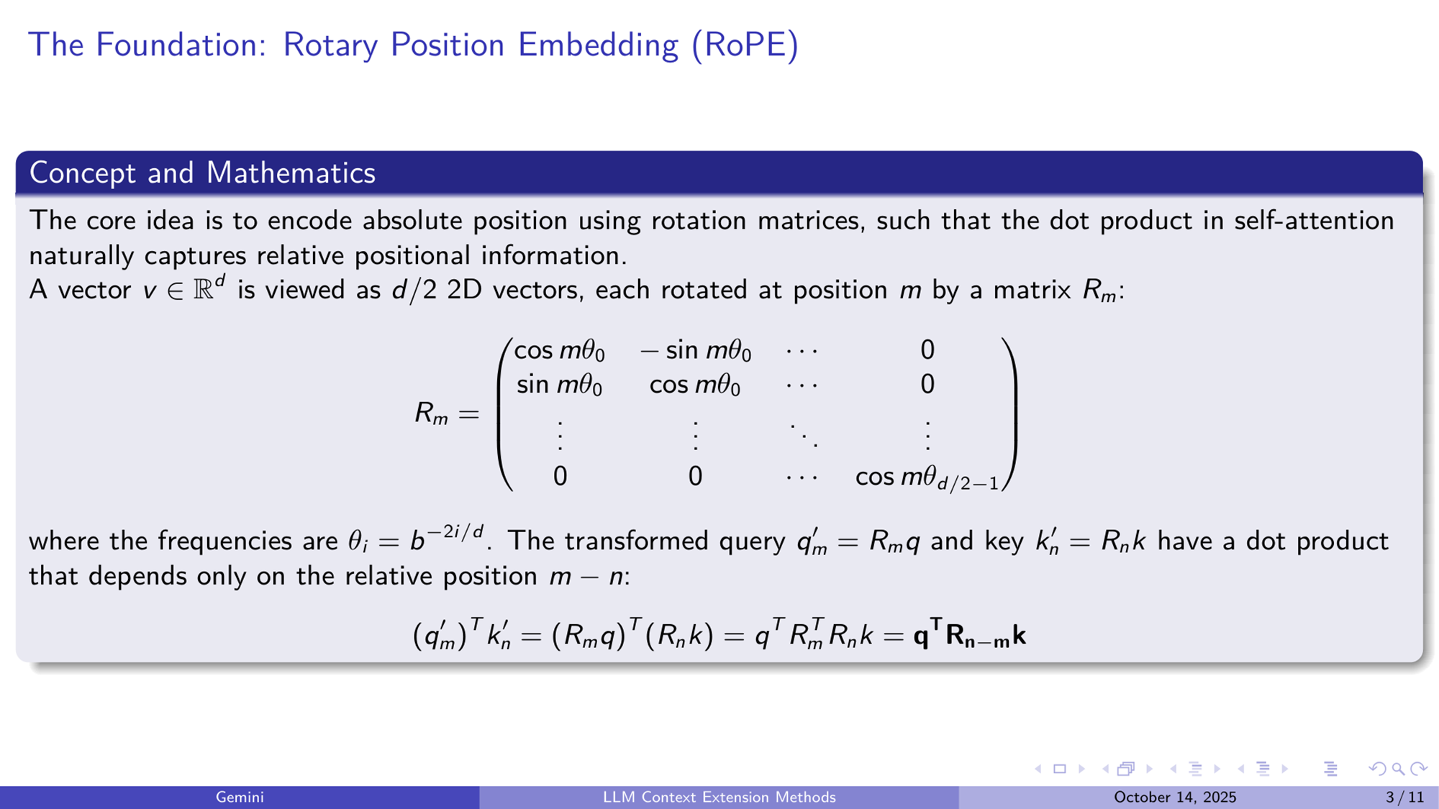

Slide 28
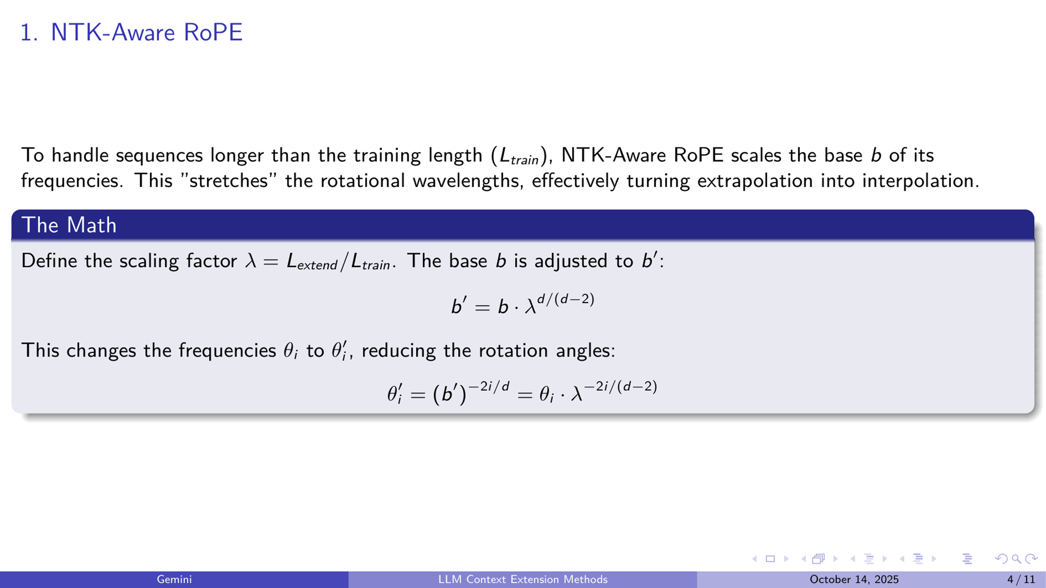

Slide 29
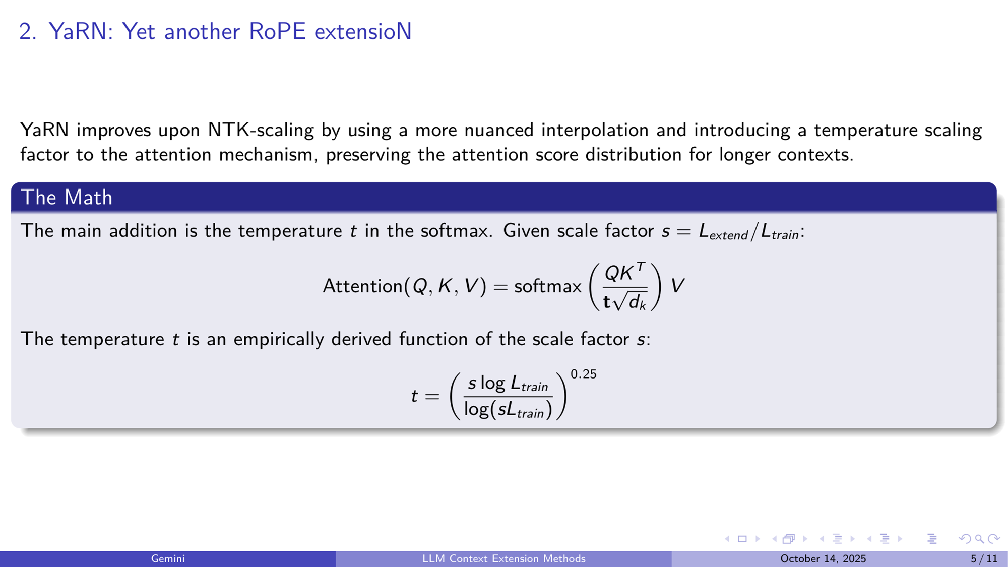

Slide 30
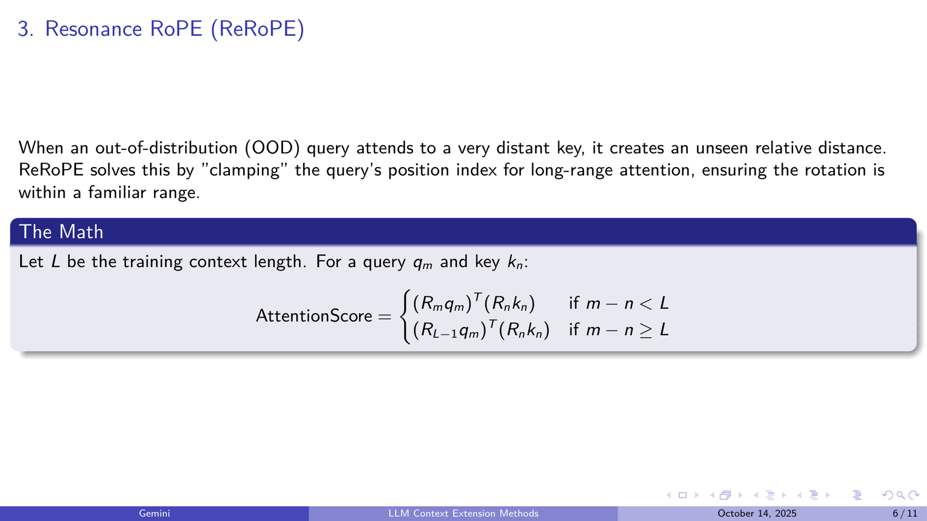

Slide 31
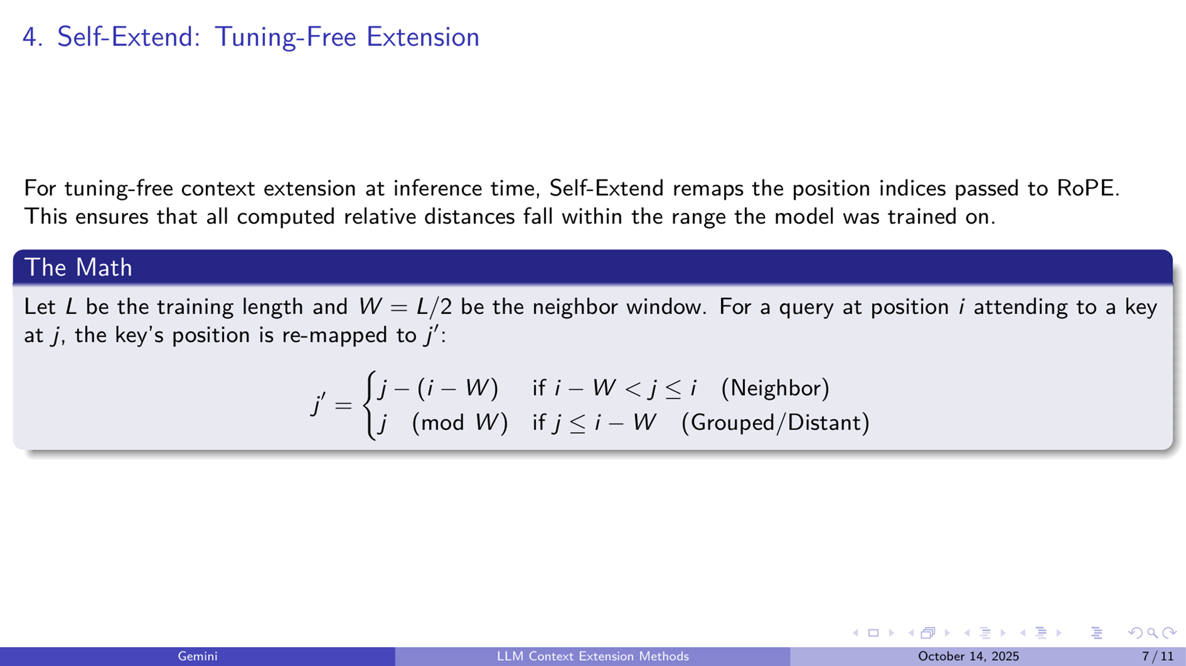

Slide 32
