Slide 1
KV Cache Compression
Gabriel Pernell, Alexander Martin

Slide 2
Background & Motivation

Slide 3
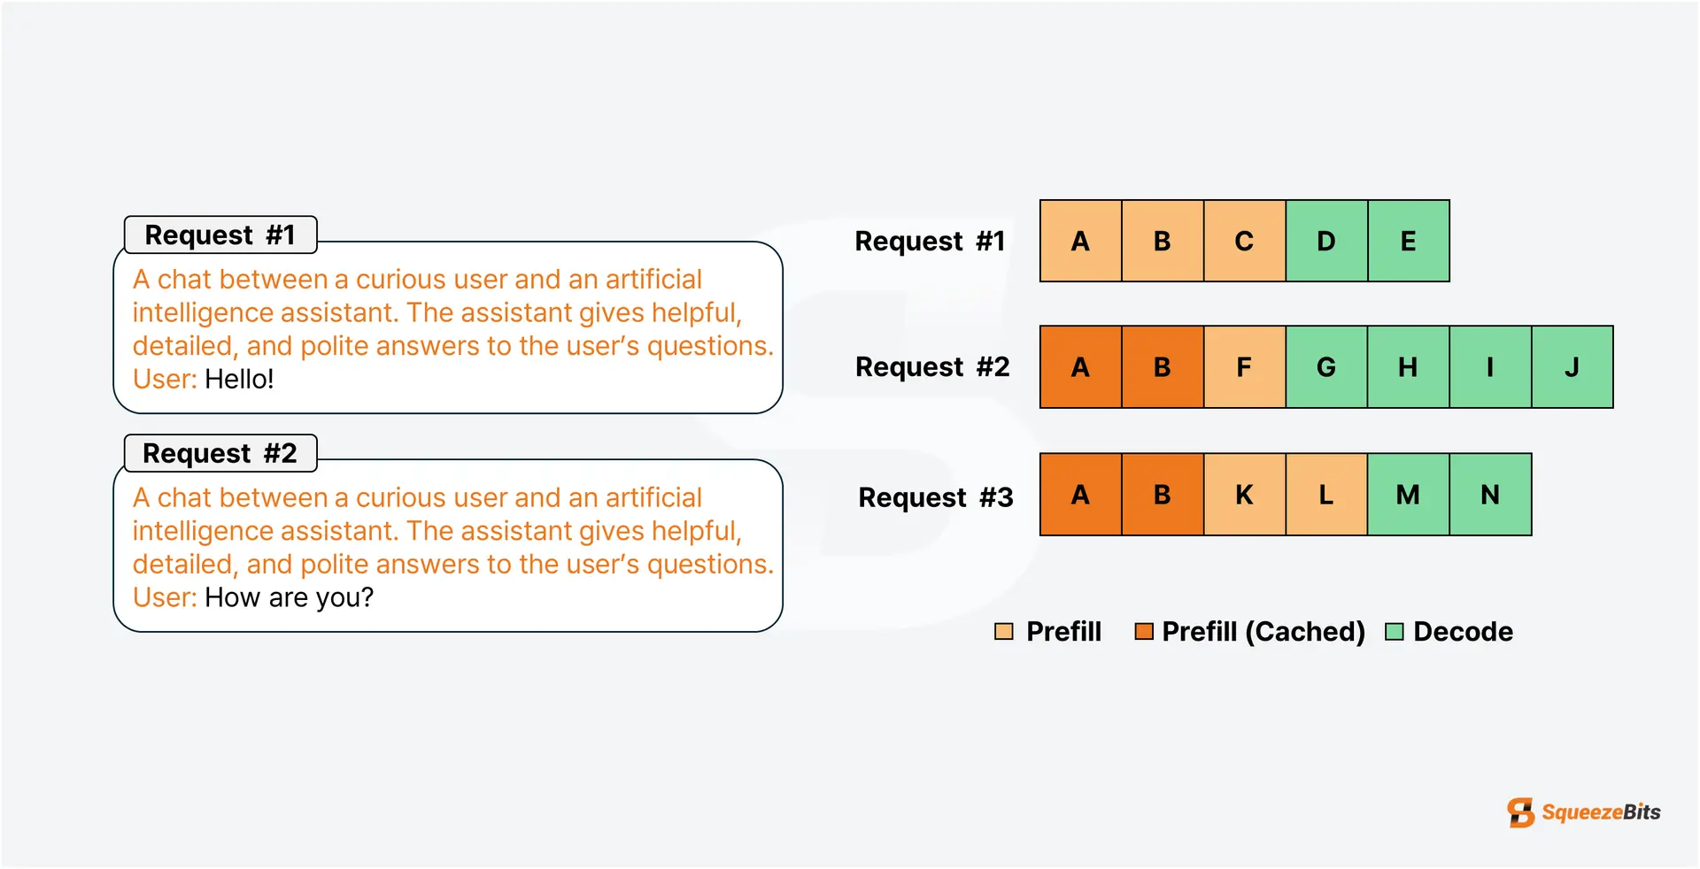
Prefix Caching (Prefilling)
https://blog.squeezebits.com/vllm-vs-tensorrtllm-12-automatic-prefix-caching-38189

Slide 4

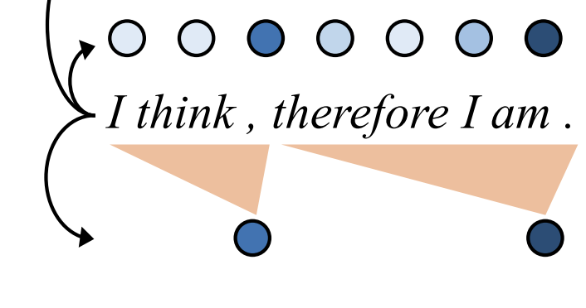
Token Selection / Eviction
Tokens
Selected Tokens

Slide 5

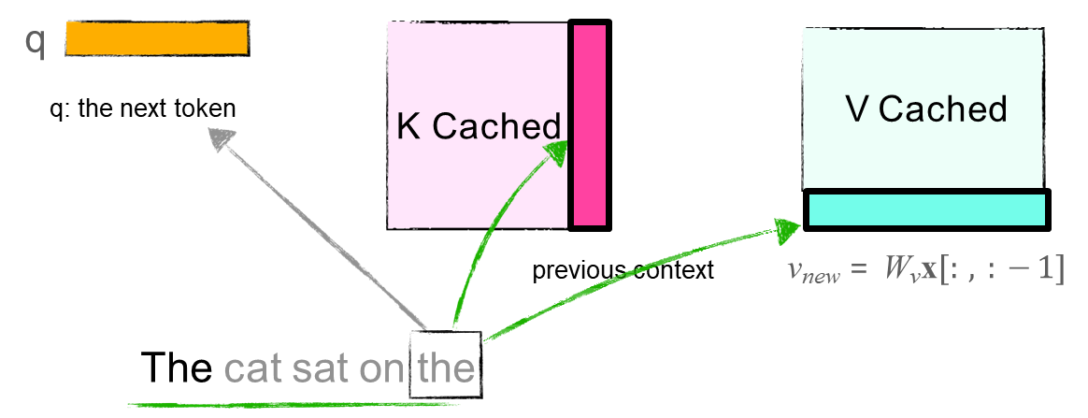
Reminder: Longer Context = Longer Inference Time
Long inference times motivate using a KV Cache
Cache the keys and values to reduce redundancy and save inference time
Memory required: 2𝑏𝑛𝑑𝐿𝑘
Larger models → many GBs of memory
Notes:
REMINDER: As more LLMs are trained to handle longer contexts, we get a longer delay in inference due to quadratic nature of attention. This motivates using the KV cache, which reduces inference time but requires extensive GPU memory storage.
batch size 𝑏,
embedding dimension is 𝑑,
the length of the sequence seen so far is 𝑛,
your model has 𝐿 layers,
Each param is stored 𝑘 bytes (e.g., FP16 takes 2 bytes)
x[:,:-1] → the hidden state for the latest token just processed
Wk​,Wv → learned projection matrices that map hidden states into key and value vectors for attention

Slide 6
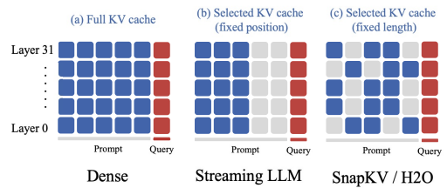
KV Cache Compression
KV cache memory consumption with larger models motivates cache compression & optimization methods.
Existing methods use a fixed cache size per transformer layer
Is this efficient?
Authors say no, does not take into account attention varying by layer.
Notes:
The previous slide detailing KV cache memory consumption motivates KV cache compression/optimization methods
It has been shown that maintaining only 20% of the KV cache can preserve a substantial level of performance.
Questions arise as we use these optimized KV caches:
Can we apply this to all layers?
Is it efficient to use the same KV cache size across all layers?
Authors say no, does not take into account attention varying by layer.
“We compare PyramidKV with three baselines, all of which keep the same KV cache size
across different layers, with different strategies for KV cache selection.
StreamingLLM (SLM) (Xiao et al., 2023) is an efficient framework that enables
LLMs to accept infinite input length.
SnapKV/H2O: which tokens are kept can vary because methods like SnapKV and H2O choose important tokens dynamically within each layer
Heavy Hitter Oracle (H2O) (Zhang et al., 2024) is a KV cache compression policy
that dynamically retains a balance of recent and Heavy Hitter (H2) tokens.
SnapKV (SKV) (Li et al., 2024) automatically compresses KV caches by selecting clustered important tokens for each attention head.
FullKV (FKV) caches all keys and values for each input token in each layer. All methods are compared to the FullKV simultaneously.

Slide 7
Goals & Research Questions
Do LLMs aggregate information in recognizable patterns across layers?
If so, can this inform a smarter KV cache compression method?
Goal: develop a compression method that
Allocates KV cache size based on layer and attention patterns
Preserve long-context performance while reducing memory

Slide 8
PyramidKV: Dynamic KV Cache Compression based on Pyramidal Information Funneling
Zefan Cai , Yichi Zhang , Bofei Gao , Yuliang Liu , Yucheng Li , Tianyu Liu , Keming Lu , Wayne Xiong , Yue Dong , Junjie Hu , Wen Xiao
Presented by Gabriel Pernell

Slide 9
Background & Motivation

Slide 10
Reminder: Longer Context = Longer Inference Time
Long inference times motivate using a KV Cache
Cache the keys and values to reduce redundancy and save inference time
Memory required: 2𝑏𝑛𝑑𝐿𝑘
Larger models → many GBs of memory
Notes:
REMINDER: As more LLMs are trained to handle longer contexts, we get a longer delay in inference due to quadratic nature of attention. This motivates using the KV cache, which reduces inference time but requires extensive GPU memory storage.

Slide 11
KV Cache Compression
KV cache memory consumption with larger models motivates cache compression & optimization methods.
Existing methods use a fixed cache size per transformer layer
Is this efficient?
Authors say no, does not take into account attention varying by layer.
Notes:
The previous slide detailing KV cache memory consumption motivates KV cache compression/optimization methods
It has been shown that maintaining only 20% of the KV cache can preserve a substantial level of performance.
Questions arise as we use these optimized KV caches:
Can we apply this to all layers?
Is it efficient to use the same KV cache size across all layers?
Authors say no, does not take into account attention varying by layer.

Slide 12
Goals & Research Questions
Do LLMs aggregate information in recognizable patterns across layers?
If so, can this inform a smarter KV cache compression method?
Goal: develop a compression method that
Allocates KV cache size based on layer and attention patterns
Preserve long-context performance while reducing memory

Slide 13
Pyramidal Information Funneling

Slide 14
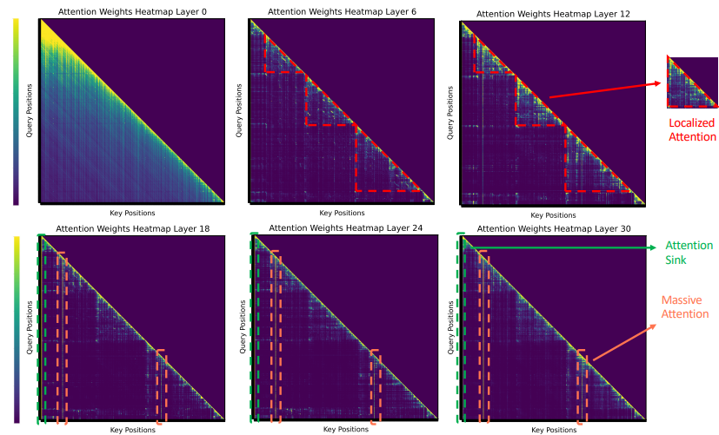
Observational Study: Information Flow via Attention
Setup: Multi-document QA task on LLaMA: visualized attention scores across layers
Model given several interrelated documents plus a question.
Notes:
Methodology for understanding attention over layers:
Model presented w multiple interrelated docs and prompted to generate an answer for given query.
Investigated how model aggregates dispersed info within interrelated docs for accurate responses
They compute avg attention from all heads within each layer
This pattern of attention allocation, where extremely high attention scores are registered, signifies that the model has aggregated the essential information into these focal tokens.

Slide 15
Observational Study: Information Flow via Attention
Notes:
Methodology for understanding attention over layers:
Model presented w multiple interrelated docs and prompted to generate an answer for given query.
Investigates how model aggregates dispersed info within interrelated docs for accurate responses
They compute avg attention from all heads within each layer
This pattern of attention allocation, where extremely high attention scores are registered, signifies that the model has aggregated the essential information into these focal tokens.
the color intensity shows how much the token at position y attends to the token at position x

Slide 16
Findings & Interpretation
Findings:
Lower Layers: broad, uniform attention
Middle Layers: localized
attention (e.g. info within
documents)
Upper layers:
“massive attention” /
attention sink, focus on a
few key tokens
Attention narrows like a
pyramid
Notes:
Uniform distribution of attention scores in lower layers, suggesting that model operates in broad-spectrum mode at lower layers, aggregating info from all available content.
In middle layers, attention directed towards tokens within same doc (aggregating info within individual contexts)
Attention sink: small set of early tokens that draw high attention from many later tokens across layers. It’s an emergent behavior in LLMs, where these tokens act like “anchors” that the model repeatedly references when integrating global context.

Slide 17
PyramidKV

Slide 18
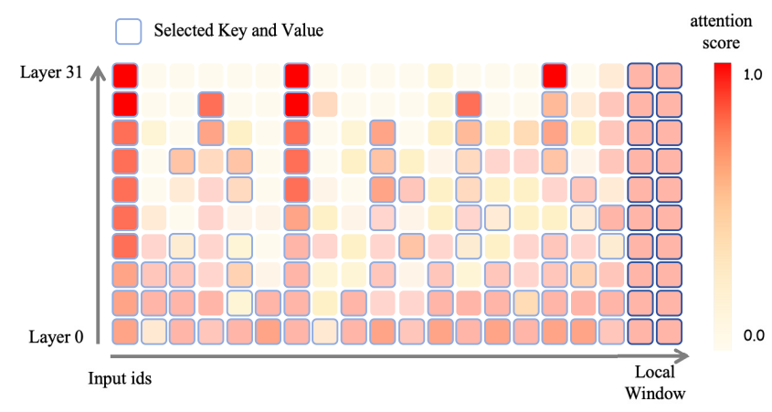
PyramidKV: Pyramidal KV Cache Compression Method
More cache is allocated at lower levels, less at higher levels.

Slide 19


Two Key Components (1)
Dynamic KV Cache Budget Allocation:
Retain the KV cache for the last α tokens (instruction tokens)
Determine the top and bottom layer budgets:
Use an arithmetic sequence to compute cache sizes in between, forming the pyramidal shape.
Total cache budget:
Top:
Bottom:
Notes:
KV Cache Size/Budget Allocation (How big each layer’s cache can be):
According to findings in Figure 2, using a fixed KV cache size per layer may be suboptimal (retain unimportant tokens).
Authors fix this by dynamically allocating the cache budgets across layers to reflect the aggregated info flow.
They retain the KV cache for the last α tokens of the input across all layers, since these tokens contain the most immediate task-related info.
Given the remaining total cache budget, authors determine the cache sizes for the top and bottom layers, then use an arithmetic sequence to compute the cache sizes in between to form the pyramidal shape.
Following the common practice in KV cache compression, retain instruction tokens (local window)
The tokens that appear at the end of the input sequence, right before generation begins, basically the user’s actual query or task prompt
k^l is the cache budget for layer l
k^total is the number of tokens kept in the cache
HYPERPARAMS: We conducted hyperparameter testing on the original development sets of 16 datasets in LongBench. The parameter β demonstrated remarkable stability, showing minimal sensitivity to varying hyperparameter settings, which highlights its robustness. Conversely, α consistently produced superior results when set to 8 or 16 (small is better).

Slide 20

Two Key Components (2)
KV Cache Selection
Which tokens do we keep?
Instruction tokens - Keep
Compute how much each token is attended to by the instruction tokens
Keep the tokens with the highest attention scores
Notes:
The authors preserve instruction tokens, then need to decide which other tokens are worth keeping using attention scores
They measure how much attention each token receives from the instruction tokens
Keep the tok k^l tokens with the highest scores (most looked at by instruction tokens).
A^h is the attention mechanism in each head
Aijh​ How much token i is attended to by instruction token j
where [n − α, n] is the range of the instruction tokens.
sih​ = the importance score of token iii in attention head hhh.

Slide 21
Experiments & Results

Slide 22
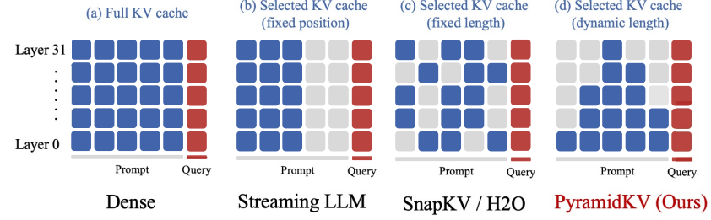
Setup
Models: LLaMA-3-8B, LLaMA-3-70B, Mistral-7B
Benchmark: LongBench (17 datasets across QA, summarization, code, few-shot learning).
Baselines: FullKV, StreamingLLM, H2O, SnapKV.
Same total KV budget on average across methods.
Notes:
Compare constant KV cache size per layer to PyramidKV using varying cache sizes per layer.
Kept avg KV cache size in PyramidKV same as baseline models to keep total memory consumption the same.
Used same prompt for each dataset
“We compare PyramidKV with three baselines, all of which keep the same KV cache size
across different layers, with different strategies for KV cache selection.
StreamingLLM (SLM) (Xiao et al., 2023) is an efficient framework that enables
LLMs to accept infinite input length.
SnapKV/H2O: which tokens are kept can vary because methods like SnapKV and H2O choose important tokens dynamically within each layer
Heavy Hitter Oracle (H2O) (Zhang et al., 2024) is a KV cache compression policy
that dynamically retains a balance of recent and Heavy Hitter (H2) tokens.
SnapKV (SKV) (Li et al., 2024) automatically compresses KV caches by selecting clustered important tokens for each attention head.
FullKV (FKV) caches all keys and values for each input token in each layer. All methods are compared to the FullKV simultaneously.

Slide 23
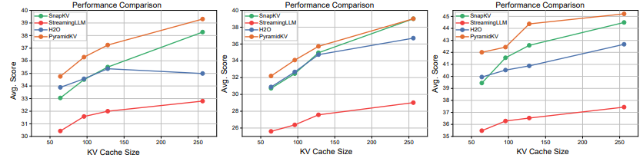
Results
PyramidKV consistently outperforms baselines, especially with small cache sizes.
Maintains near-full performance using only 12% of full KV cache
Even with 0.7% of KV cache, accuracy drop is minimal
LLaMA-3-8B
Mistral-7B
LLaMA-3-70B
Avg score across datasets for 64, 96, 128, and 256 cache sizes
Notes:
“In Table 1, we report the results for two different KV cache sizes with 64 and 2048. These two sizes represent two distinct operational scenarios—the memory-efficient scenario and the performance-preserving scenario, respectively for a trade-off between memory and model performance.
PyramidKV generally outperforms other KV Cache compression methods across various cache sizes and LLMS.
PyramidKV shine in small KV Cache sizes.
PyramidKV preserves the performance with only 12% of the KV cache
Performance pronounced in constrained environments where on 0.8% if KV Cache is retained.

Slide 24
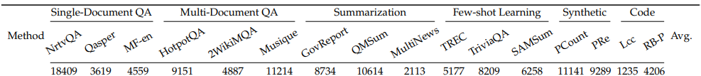
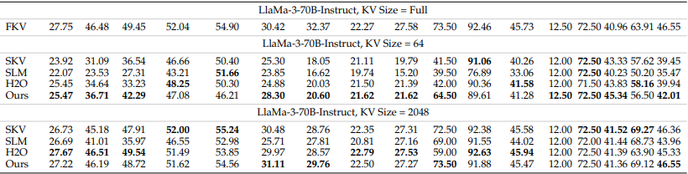
Results Cont’d
PyramidKV excels with small cache sizes:
Notes:
“In Table 1, we report the results for two different KV cache sizes with 64 and 2048. These two sizes represent two distinct operational scenarios—the memory-efficient scenario and the performance-preserving scenario, respectively for a trade-off between memory and model performance.
PyramidKV generally outperforms other KV Cache compression methods across various cache sizes and LLMS.
PyramidKV shine in small KV Cache sizes.
PyramidKV preserves the performance with only 12% of the KV cache
Performance pronounced in constrained environments where on 0.8% if KV Cache is retained.

Slide 25
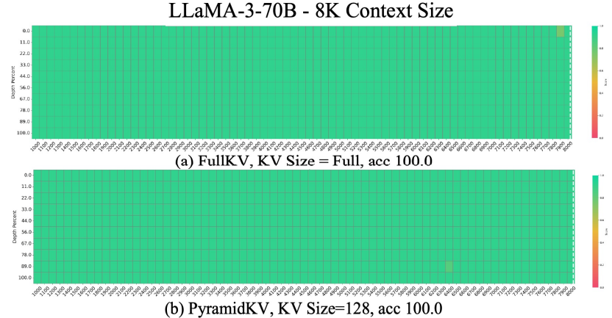
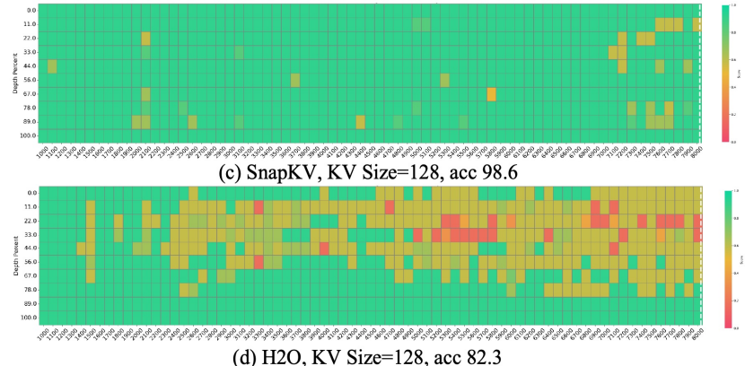
Needle In A Haystack Experiment
Purpose: test long-context factual retrieval
Result: LLaMa-3-70B achieves 100% accuracy with 128 KV entries using PyramidKV, matching full cache performance
Significance: PyramidKV preserves long-range memory and retrieval ability.
Notes:
PyramidKV preserves long-context understanding ability
In Needle In A Haystack task, PyramidKV is able to preserve 100% accuracy at only cache size 128
KV size = # of tokens kept in cache

Slide 26
KVzip: Query-Agnostic KV Cache Compression with Context Reconstruction
Jang-Hyun Kim, Jinuk Kim, Sangwoo Kwon, Jae W. Lee , Sangdoo Yun, Hyun Oh Song

Slide 27
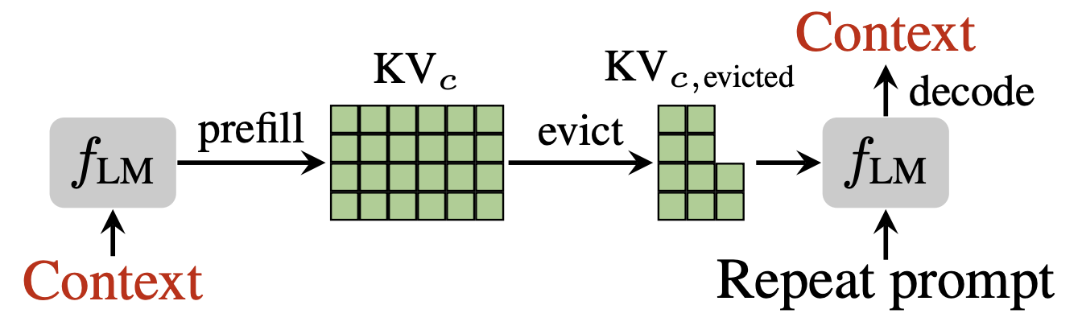
KVzip
Notes:
Methodology for understanding attention over layers:
Model presented w multiple interrelated docs and prompted to generate an answer for given query.
Investigates how model aggregates dispersed info within interrelated docs for accurate responses
They compute avg attention from all heads within each layer
This pattern of attention allocation, where extremely high attention scores are registered, signifies that the model has aggregated the essential information into these focal tokens.

Slide 28
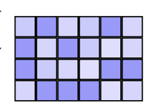
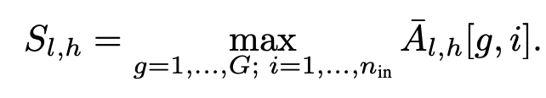
KVzip: How to evict?
Evict tokens that don’t contribute to reconstructing the context
Here is some context to compress
Here is some context to compress
Importance
Notes:
Methodology for understanding attention over layers:
Model presented w multiple interrelated docs and prompted to generate an answer for given query.
Investigates how model aggregates dispersed info within interrelated docs for accurate responses
They compute avg attention from all heads within each layer
This pattern of attention allocation, where extremely high attention scores are registered, signifies that the model has aggregated the essential information into these focal tokens.

Slide 29
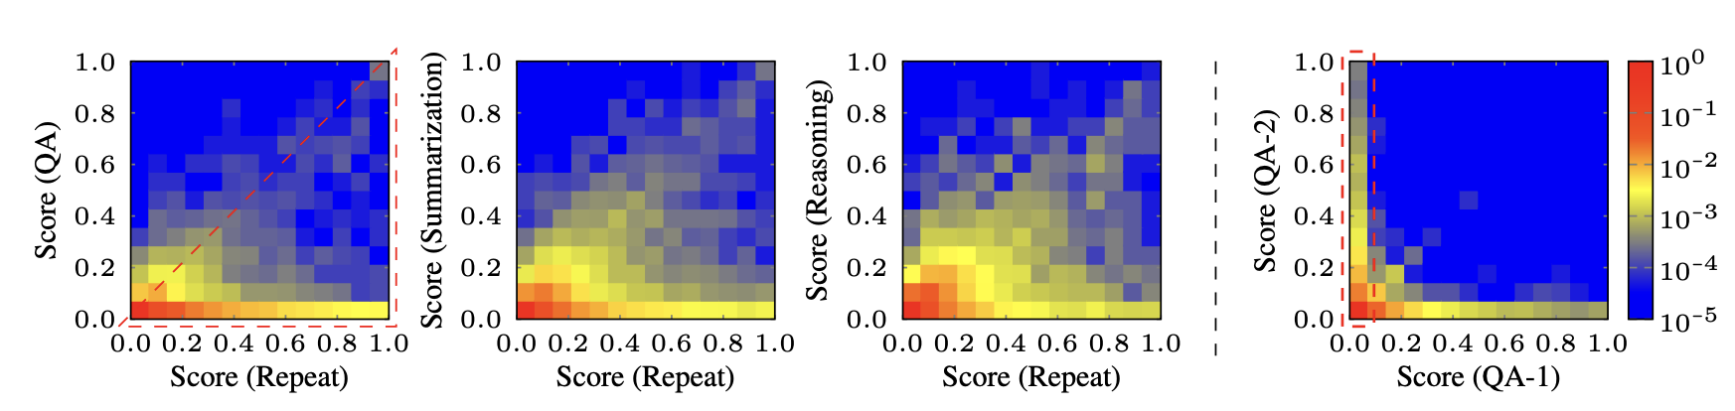
KVzip: Attention Sparsity

Slide 30
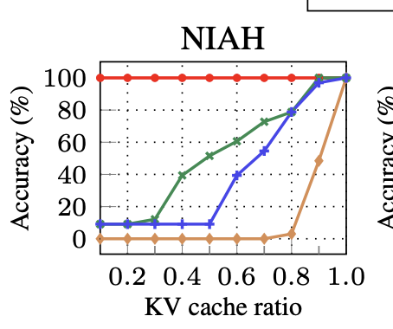
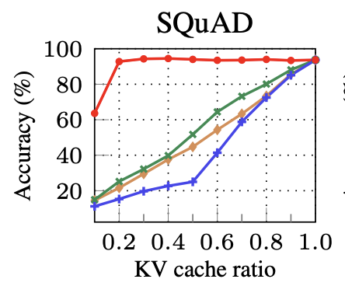
KVzip: Performance

Slide 31
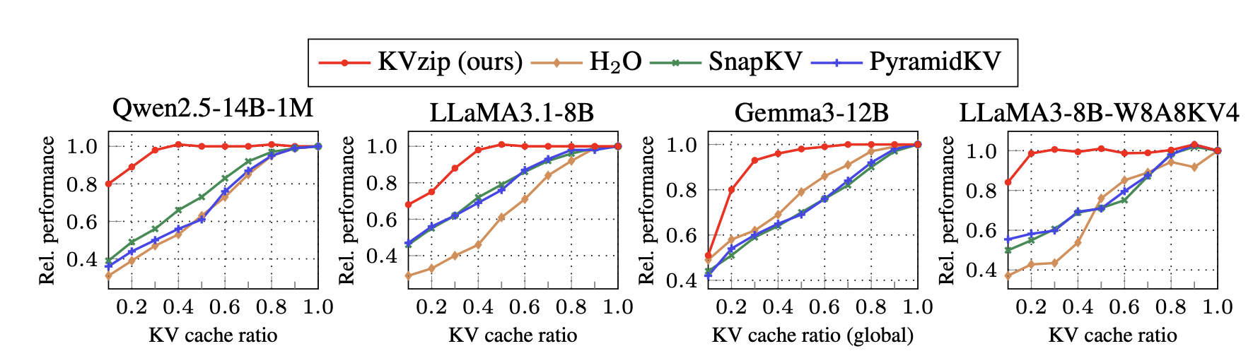
KVzip: Model Comparison

Slide 32
Conclusions & Critiques

Slide 33
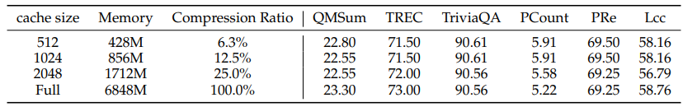
Conclusions
Main takeaway: PyramidKV mirrors attention naturally funneling through layers
Performance:
Preserves accuracy while using only 12% of KV cache
Preserves long-context understanding ability
Efficiency: Up to 90% GPU-memory reduction, minimal runtime overhead:
Notes:
PyramidKV significantly reduces memory with Limited Performance Drop
Table 2: Memory reduction effect and benchmark result by using PyramidKV. We conducted a comparison of memory consumption between the Llama-3-8B-Instruct model utilizing the Full KV cache and the Llama-3-8B-Instruct model compressed with the PyramidKV.

Slide 34
Critiques
My thoughts: Very impressive results, lots of memory reduction with a simple implementation.
Limits:
Evaluated only on 3 English models.
No multilingual testing.
The pyramid could fail on tasks with different attention shapes.
The observed attention phenomenon was only for multi-doc QA tasks.
Notes:
They only used 3 base models, could expand experiment to involve broader array of model families.
Research conducted only in English, could expand to other languages We conducted hyperparameter testing on the original development sets of 16 datasets in LongBench. The parameter β demonstrated remarkable stability, showing minimal sensitivity to varying hyperparameter settings, which highlights its robustness. Conversely, α consistently produced superior results when set to 8 or 16.

Slide 35
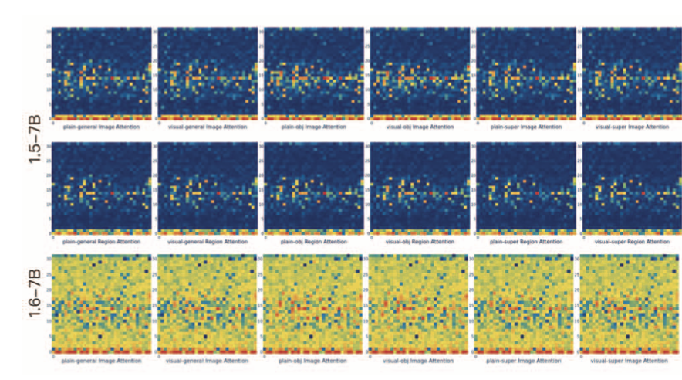
Critiques: Attention Sparsity, Do you really want that?

Slide 36
Thank You!
Any Questions?
Gabriel Pernell, Alexander Martin

