Slide 1
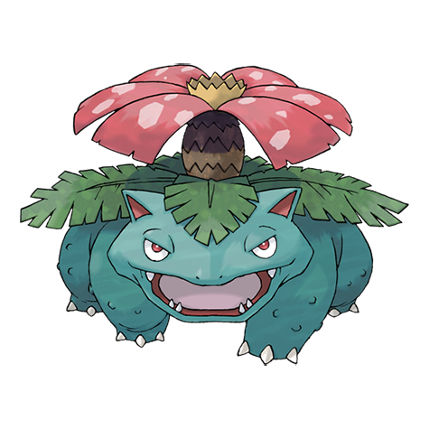
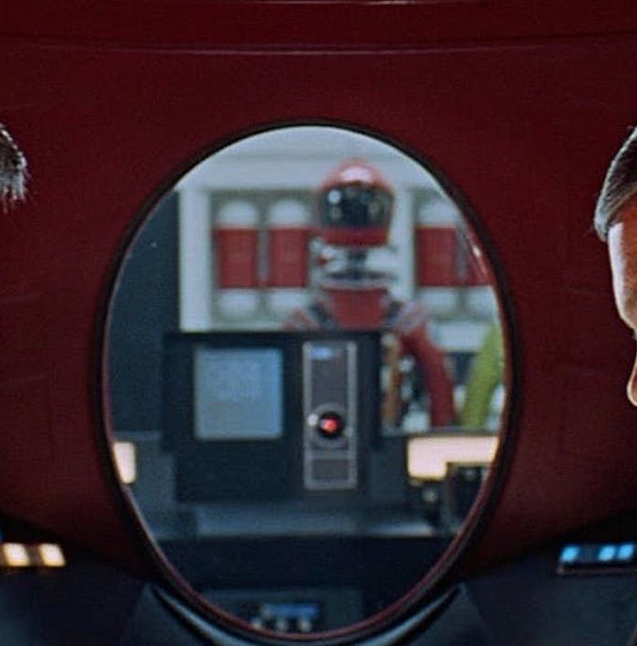
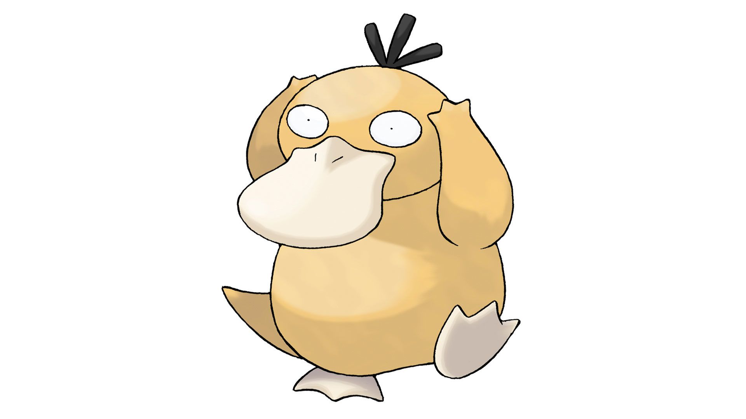
How can weak supervisors control strong models?
Mian Zhong & Milton Lin

Slide 2
Outline of Talk For preparation purpose
Motivation
Methodology + Tasks evaluated + Metric: PGR
Findings - I: weak to strong generalization exists - II: task dependence - III: improvements can be made

Slide 3
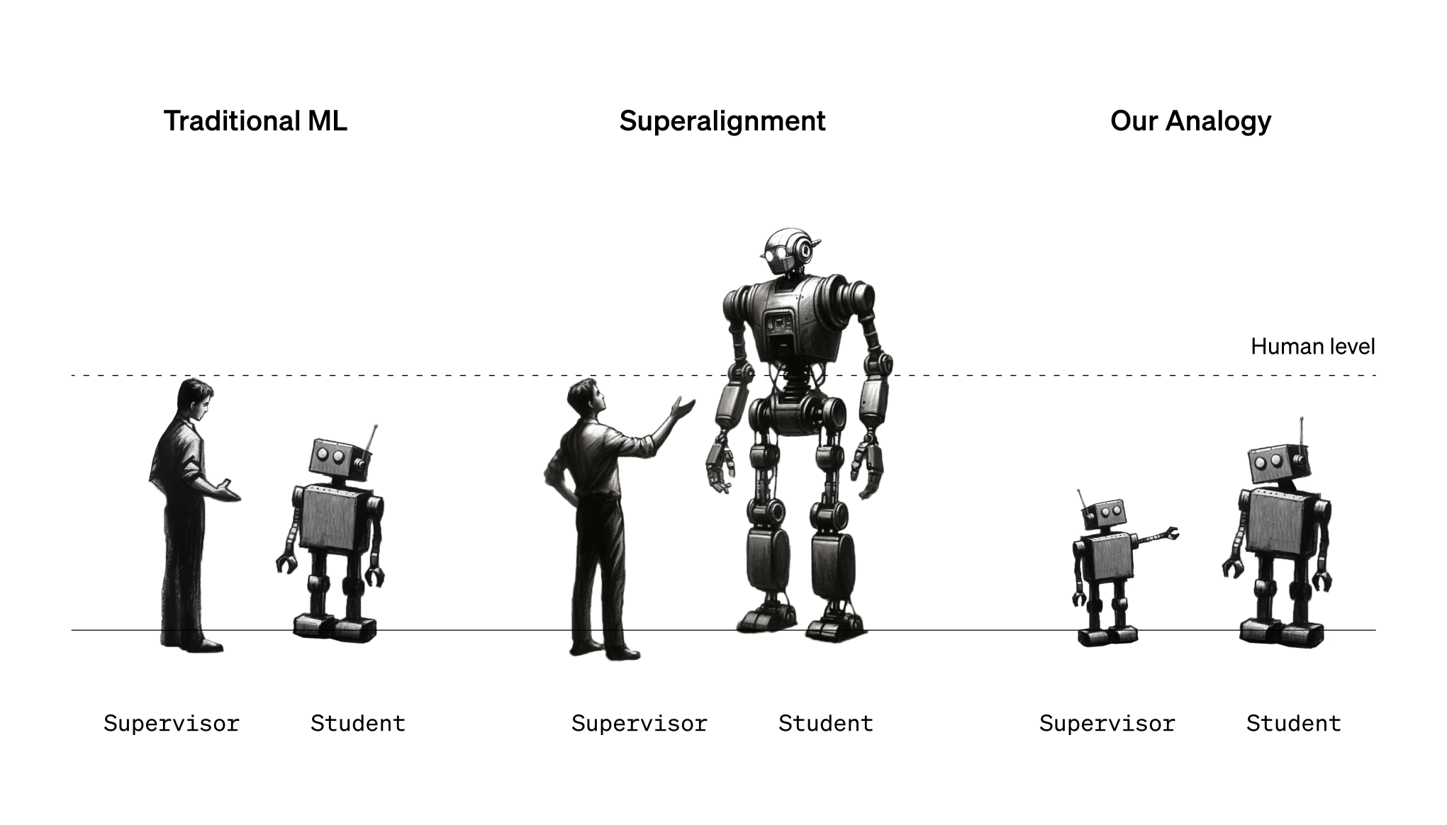
Motivation from authors
Superalignment The challenge of weak human supervision for complex AI behavior.
Can we use weak models to elicit strong model abilities?

Slide 4
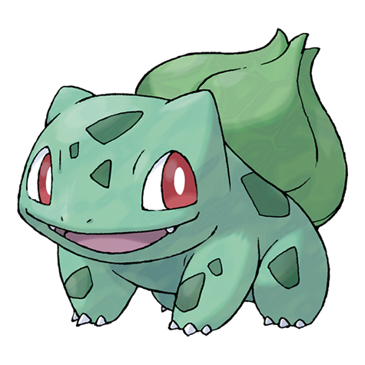
Methodology
Create a weak supervisor Small pretrained models (e.g., GPT-2) are fine-tuned on ground truth labels to generate weak supervision for the task
Train strong models with weak supervision Strong models (e.g., GPT-4) are fine-tuned using the weak labels from the supervisor in (1). In (3) we evaluate the generalization ability of the strong model, defined as weak-to-strong performance.
Compare with Strong Ceiling Performance As a baseline, the strong models are also trained using ground truth labels to establish the strong ceiling performance. The difference in performance between weak and strong supervision is measured using Performance Gap Recovered (PGR).
FT GPT-2
positive
FT GPT-4
negative

Slide 5
Performance Gap Recovered (PGR) PGR quantifies how much of the gap between weak performance and strong performance is bridged by training on weak labels.

Slide 6
Understanding PGR
If PGR = 1: The strong model performs as well as it would with ground truth supervision, achieving the strong ceiling performance.
If PGR = 0: The strong model does no better than the weak supervisor
Intermediate values (0 < PGR < 1): Represent partial recovery, where the strong model generalizes beyond the weak labels but does not reach its full potential. A higher PGR means that weak-to-strong generalization is more successful.

Slide 7
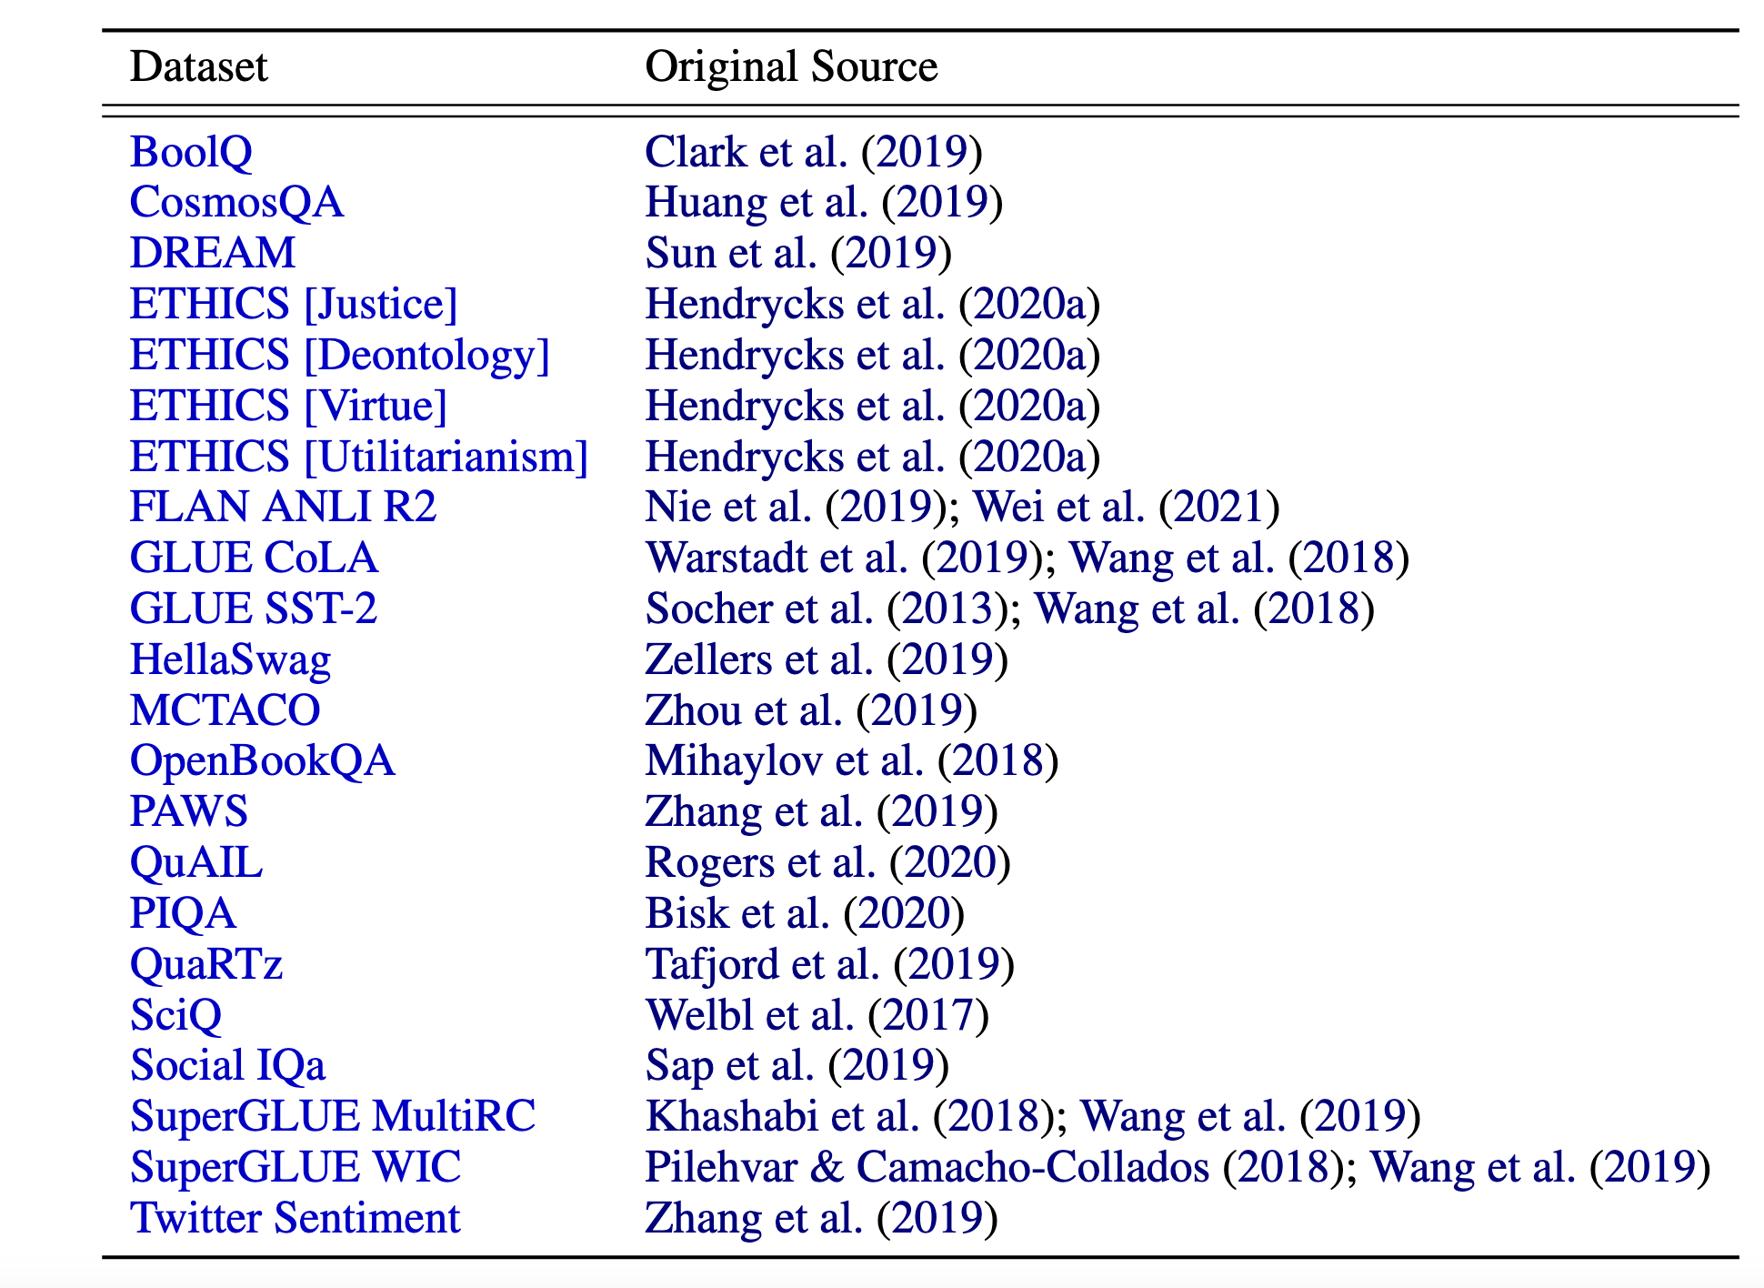
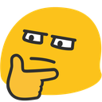
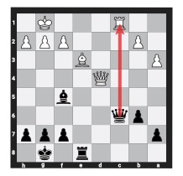
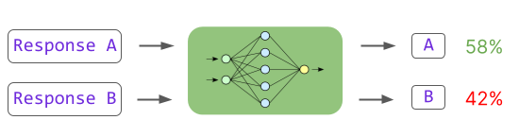
Evaluation tasks
NLP Binary Classification
Reward Modeling
Chess

Slide 8
Finding I: strong models consistently outperform their weak supervisors across tasks.
[Figure 2] In NLP tasks, fine-tuning GPT-4 on GPT-2-level labels recovers about 50% of the performance gap between the two models.
In contrast, reward modeling tasks exhibit poor generalization with a much lower PGR, even with increasing compute.
Notes:
Caveats
a: Latent capabilities, learned through self-supervised or reinforcement learning, might be more challenging to elicit compared to capabilities directly observed during pretraining.
b: Section D provides empirical evidence that models can effectively generalize from weak supervision, even when they haven't directly observed the tasks in question. This is done with AlexNet Classifier + DINO self supervised model.
c. Weak-to-Strong with Prompting: Few-shot weak-to-strong performance is weaker compared to ground-truth supervision but improves significantly for larger models, suggesting prompting's role in unlocking latent knowledge. Reason: For tasks that do not align with pretraining patterns, prompting may be significantly less effective than finetuning.

Slide 9
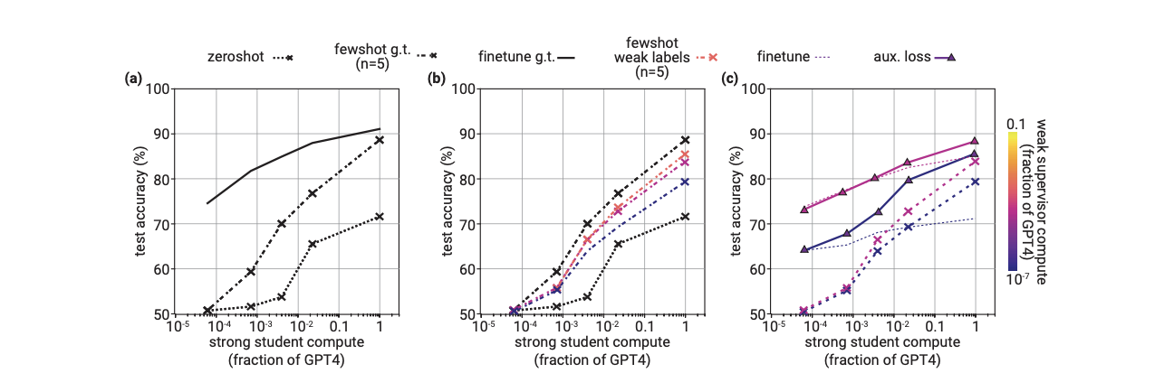
Why is weak-to-strong possible? Conjecture:
Latent Knowledge and Pretraining: strong models leverage their pretraining knowledge to perform tasks. Weak labels serve as a signal to elicit this latent knowledge.
Same phenomena can be seen in prompting: [5.2.1, figure 7]

Slide 10
Finding II: level of generalization depends on the task.
Weak-to-strong generalization for reward modeling is poor compared to NLP. It typically recovers only about 10% of the performance difference between the weak supervisor and the ground truth performance.
Saliency [5.2] is how well a task's relevant knowledge can be elicited. But how to measure it? E.g. Linear representation.
Notes:
Slides 10-12
a. NLP vs Reward Modeling: In NLP tasks, weak-to-strong models typically recover up to 50% of the performance gap between the weak supervisor and the ground truth. In contrast, weak-to-strong performance for reward modeling tasks recovers only about 10% of this gap.
b. What makes a concept easy or hard to elicit? What is a good definition of “salience”?
bi) Significant performance improvement is seen in the strong student models when generative finetuning is applied to the reward modeling data.
bii) Performance Gap Recovered (PGR): Even with finetuning, the best PGR in reward modeling is still far behind that of NLP tasks.
c. Despite its limitations, the paper suggests that improving weak-to-strong generalization is a tractable problem with empirical progress demonstrated through methods like auxiliary loss and bootstrapping.

Slide 11

Good on NLP/♟️, Poor on [Figure 3]
Notes:
Figure 3

Slide 12
Does this explain the case of reward model? Applying generative fine-tuning to reward modeling tasks improves weak-to-strong generalization, particularly when combined with early stopping.[5.2.2]

Slide 13
Finding III: various methods can significantly improve the results.
Auxiliary confidence loss : Strong models trust its own when disagreement occurs
Bootstrapping: Not helpful for NLP/RM
Early stopping and size (next two slides)

Slide 14
Student-supervisor Agreement High agreement between the strong and weak models "means" the strong model is imitating the weak supervisor’s predictions. [5.1.2 Figure 8]
As strong models grow larger, they agree less with the weak supervisor, especially when the supervisor is wrong.

Slide 15
What could be a failure mode? Imitation strong model may "overfit" to the weak supervisor’s labels, meaning the strong model might imitate the weak supervisor’s mistakes instead of improving upon them. [5.1]
[Figure 7] shows how performance (test accuracy) changes over the course of training (measured in fractions of an epoch). Stopping training before overfitting occurs can improve performance.

Slide 16
Relating back to the Alignment problem – limitations of the approach
The setup cannot fully capture the same type of errors in superalignment
Latent knowledge in superalignment
Our pretraining leakage → overly optimistic performance metrics

Slide 17
Other works
Weak judge v.s. 2 strong debaters
Improve the weak supervisor
Can a non-clinician elicit only appropriate medical advice with LLM? 🥪

Slide 18
Open problems to weak-to-strong generalization
Analogous setups: Bridging the gap between simpler tasks and complex reasoning task.
Scalable methods
Strong scientific understanding:
Can we reliably estimate generalization error at test time without any labels? For example, can we measure the degree of weak-to-strong underspecification (Lee et al., 2022b)?

