Slide 1
Model Efficiency
CSCI 601 471/671
NLP: Self-Supervised Models
https://self-supervised.cs.jhu.edu/sp2023/

Slide 2
Distillation, efficiency, Quantization, etc.

Slide 3
PROBLEM
- BERT is too big
- Bert uses roughly 110 million parameters for its base form which means it take a long time to train , the larger form of BERT has 340 million parameters.
- This means a 12 layer transformer BERT takes 4 days to train !!
🔭: Muzzi Godil

Slide 4
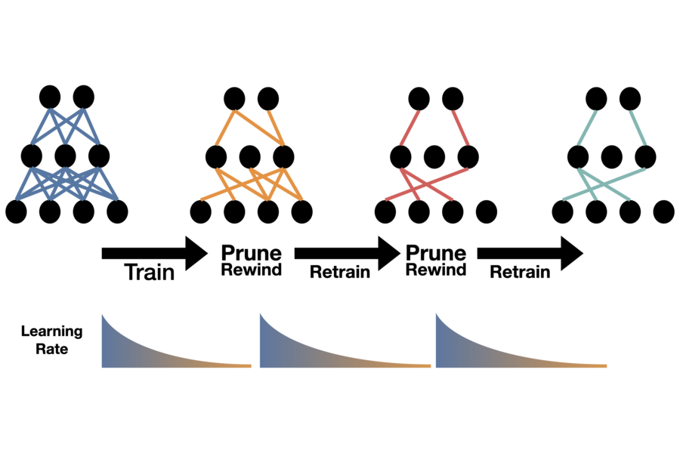
How do we make BERT smaller ?
1) Pruning:
This helps us identify the correct subnetwork needed
A MIT ICLR Study says rewinding and training gives great factorization results
🔭: Muzzi Godil

Slide 5
How do we make BERT smaller ?
2) Parameter sharing:
Creates a shared feature space which enables the same feature detector to be used across everything on one plane
To put into context for AlexNet: 105,415,600‬ weights vs 34,944 weights
🔭: Muzzi Godil

Slide 6
How do we make BERT smaller ?
3) Knowledge Distillation:
This allows efficient distilling of information from a pretrained BERT to a smaller model that can still work with great accuracy but much faster
Student-Teacher training where a teacher network adds its error to the student’s loss function, thus, helping the student network to converge to a better solution.
🔭: Muzzi Godil

Slide 7

Concerns
There are several issues to be aware of:
It is very costly to train these large models. The companies who develop these models easily spend an entire month training one model, which uses incredible amounts of electricity.
BERT alone is estimated to cost over
$1M
for their final models
Source: https://arxiv.org/pdf/2004.08900.pdf

Slide 8
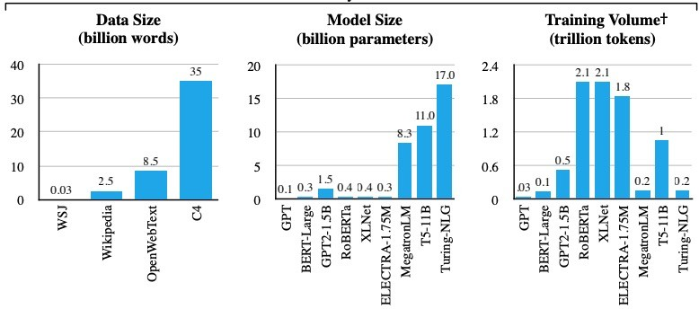
Concerns
It is very costly to train these large models.
Source: https://arxiv.org/pdf/2004.08900.pdf

Slide 9
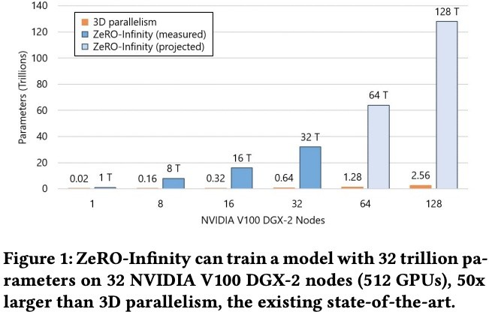
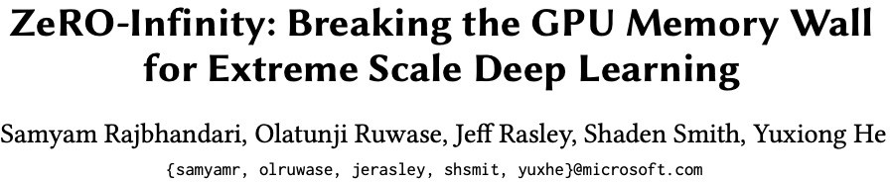
Concerns

Slide 10
Eﬃcient pretraining
295
No direct impact on zero/few-shot downstream performance but more eﬃcient pretraining translates to a better model using the same budget
Examples of eﬃcient pretraining methods
Curriculum learning: gradually increasing sequence length during training
Staged training: gradually grow model size during training
8-bit Optimizers: saves memory at training time
- …
Li et. al., 2021: Curriculum Learning: A Regularization Method for Eﬃcient and Stable Billion-Scale GPT Model Pre-Training Shen el. al., 2022: Staged Training for Transformer Language Models

Slide 11
Engineering Considerations
296
No impact on zero/few-shot downstream performance but helps with pretraining
Engineering
Instabilities: fp16 or bﬂoat16
Model parallelism: pipeline parallelism (PP), tensor parallelism (TP)
Hardware: V100, A100, TPUs
Hardware throughput
- Small tweaks to ratio of depth/width lead to huge diﬀerence in throughput
- …

Slide 12
