Slide 1
Are Emergent Abilities of Large Language Models a Mirage?
Yiran Zhong, Niyati Bafna

Slide 2
What are “emergent” capabilities?
Defined by the following things:
Sharpness: these abilities simply “appear” without warning
Unpredictability: we don’t know when they will appear
Mysticism: they are part of the LLM dark arts, a miracle of scale
Hype: they indicate that the LLM is *fundamentally* different from the LM.
(Wei et al, 2022)
Notes:
Described by prior work as capabilities that appeared “only” at scale, making large LMs fundamentally different from smaller LMs. Cannot be extrapolated from smaller-scale models. More-is-different idea.

Slide 3
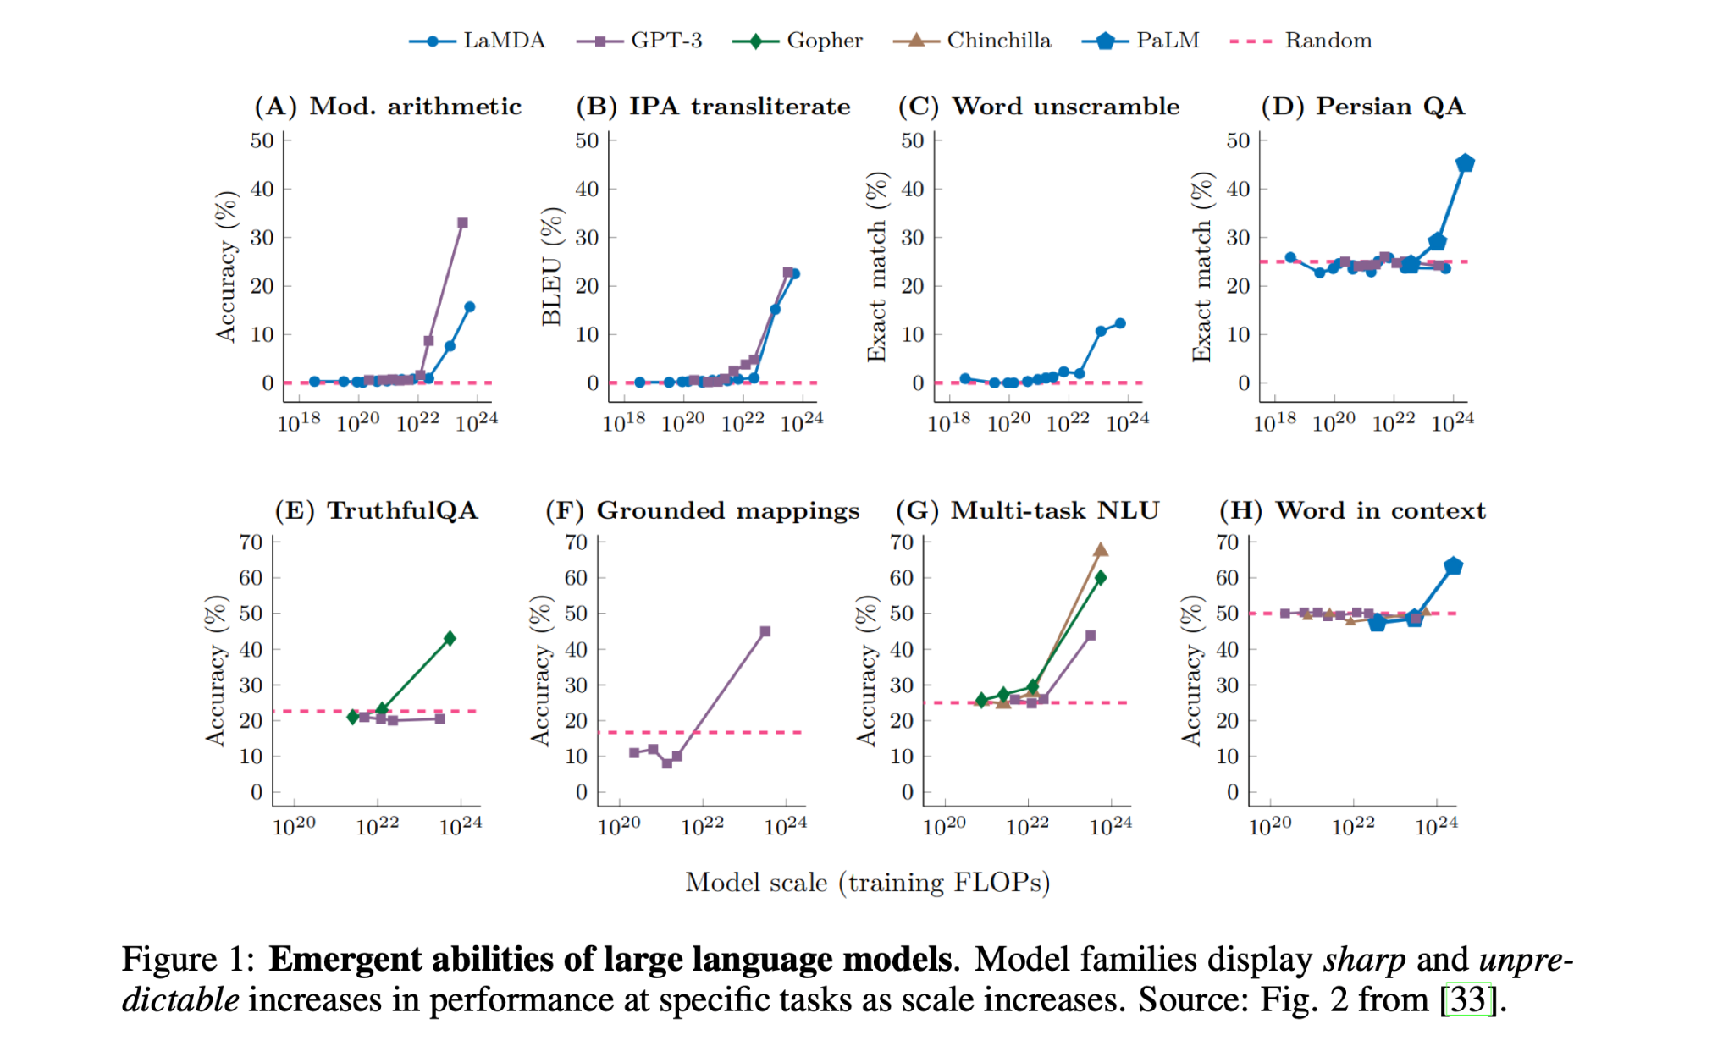

Slide 4
But…
These abilities only show up on tasks measured by metrics with certain properties
→ Claim of paper: emergent properties are a mirage ←
Implying
The LLM is still a familiar creature…
…which we can understand from the little LM. (*phew*)

Slide 5
Culprit properties of evaluation
“Non-linear or discontinous metric”
Bad statistics
Test dataset resolution
Insufficient sampling

Slide 6
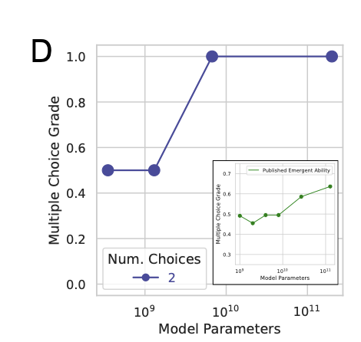
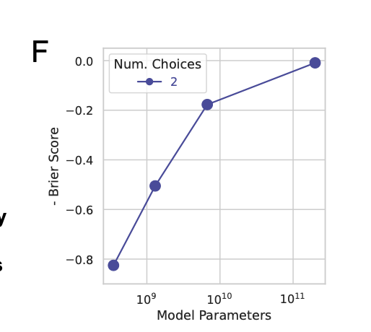
Discontinuity
Intuition #1: All-or-nothing evaluation doesn’t let you see in-between progress
Example: Multiple-choice
Instead, using Brier Score (MSE b/w probs)
(Note that you can still might argue that a dataset-level metric like a sum of accuracies is continuous…)

Slide 7
Statistics: Resolution and Sampling
Intuition #2: a dataset has an inherent granularity that it lets you evaluate any model at. If the resolution is too high, you will miss things.
Resolution: 1/size
Resolution of n coin flips: (½)^n
If resolution is too high, existing model performance will be missed
Intuition #3: If the dataset covers a small range of difficulty, you will see all-or-nothing performance given a model
Sample over a good enough range!
And LLMs will show expected behaviour in performance degradation

Slide 8
Non-linearity (IMO: explained by previous insights)
(Stated) Intuition #4: We know that per-token cross-entropy behaves smoothly. If measured metric is non-linear function of length, then long sequences become very hard…
(1) Non-linear: each token needs to be right (p^L)
(2) Linear: number of tokens we got right (L.f(p))
Why is (2) better than (1)?
This can be understood as a resolution/discontinuity problem per sample
(2) lets us measure in-between progress of getting some tokens right

Slide 9
So…what’s the big deal with “linearity in target length”?
Unclear to me
We are not measuring performance along target length, so this seems irrelevant
Instead, it seems that this is another way of saying that each test sample should not be too hard, or you will see jumps in performance
The authors say that decreasing resolution was a way of fixing this problem, indicating that the real problem here is resolution
If somebody understood the argument, please explain it to me!

Slide 10
A little deeper into the linearity argument (1)
Let’s think about
A = p^L , B = f(p).L, where p is the model probability of the right token
A, B: probability of scoring 1 given metric (Accuracy, Token edit distance)
We know that loss scales as a power law of N
and that L_x = - log p
Now, imagine that for small N, p is small, and grows smoothly with N
There will come a sudden time when p is sufficient,
For B: We see a little jump every time some token p becomes sufficient
For A: We’ll see a single, dramatic, jump when all L p’s become sufficient

Slide 11
A little deeper into the linearity argument (2)
Note that
Dependence on p (rather than L) seems more relevant, since p varies with N
Both A and B are smooth in p and therefore in N
But A and B are just prob(metric = 1) , not metric = 1
Both Accuracy and TED are unsmooth in p and therefore in N
This is because we do thresholding/maxing per token
Seems like: if we switched to Brier Score for (non-linear) Accuracy, we would end up with a final smooth metric wrt N despite it being non-linear
Non-smoothness is coming from discontinuity (which can be thought of as per-sample high resolution), not from non-linearity (either in p or L)
But when metric is non-linear, non-smoothness is more dramatic

Slide 12
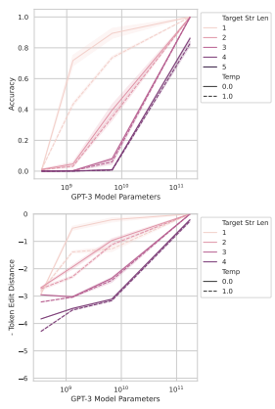
InstructGPT/GPT3’s emergent abilities
Changing from a nonlinear/discontinuous metric to a linear/continuous metric reveal smooth improvements in model performance
– Nonlinear metrics, like Accuracy making improvements look sharp and unpredictable
– linear metrics like Token Edit Distance make improvements look more gradual and continuous

Slide 13
InstructGPT/GPT3’s emergent abilities (2)
Increasing the resolution of measured model performance by using a larger test dataset should also reveal smooth, continuous improvements
– For nonlinear metrics, a smaller dataset can make the model look like it's suddenly getting better
Longer sequences of input data should lead to predictable changes in model performance
– For accuracy, performance should degrade sharply for longer sequences (geometrically).
– For token edit distance, performance should degrade more smoothly (quasilinearly).

Slide 14
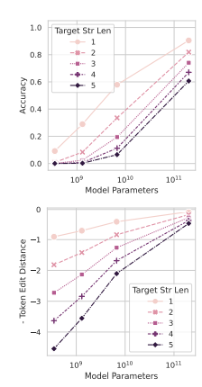
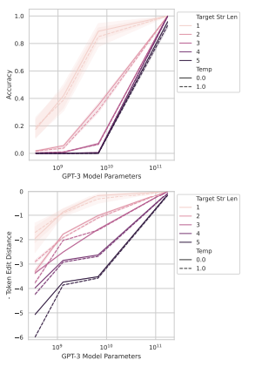
Prediction 1
When switching from a nonlinear to a linear metric, the sudden appearance of abilities vanishes, and performance improvement becomes gradual and predictable.
– Top rows shows the model's performance using Accuracy, a nonlinear metric
(performance appears to suddenly improve when dealing with longer input sequences)
– Bottom row shows the model’s performance using Token Edit Distance, a linear metric
(performance improvement is much smoother and more gradual)
emergent abilities can be an illusion caused by using a sharp, nonlinear metric

Slide 15
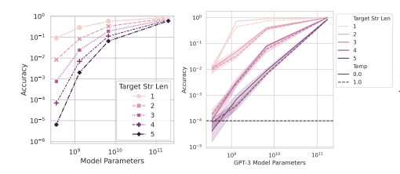
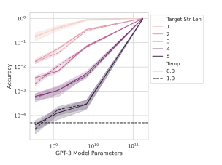
Prediction 2
using more test data, the emergent abilities smooth out, showing that smaller models are not entirely incapable of solving tasks—they just appear to be due to low-resolution measurements.
– further testing with more data (resolution), confirming that, even with accuracy as a metric, the model's improvements follow a smoother, more predictable path.

Slide 16
Meta-Analysis
Use BIG-Bench, a collection of benchmark tasks used to evaluate language models.
Key prediction:
Emergent abilities should appear predominantly on specific metrics, not task-model family pairs.
Changing the metric from a nonlinear/discontinuous metric to a linear/continuous one should remove the emergent ability.

Slide 17
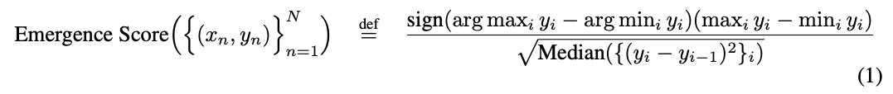
Emerging score
Y is model performance at scale x
Numerator: the difference between the best and worst performance scores.
Denominator: how gradual the performance improvements are over model scale.
higher score indicates sharper, less gradual changes in performance, suggesting the presence of an emergent ability

Slide 18
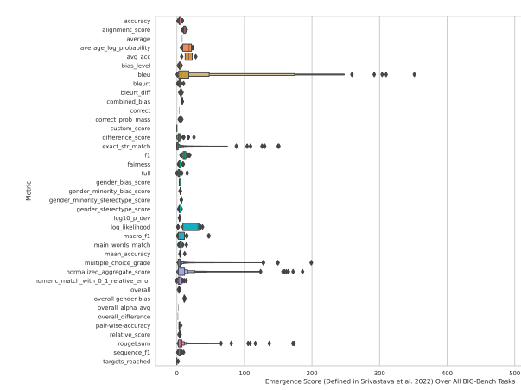
Emergent abilities appear only under specific metrics
Of the 39 preferred metrics in BIG-Bench, only 5 showed any evidence of emergent abilities
5 metrics that did show emergent abilities were primarily nonlinear and/or discontinuous metrics

Slide 19
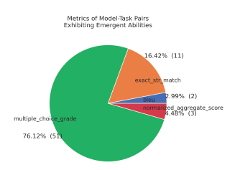
Two metrics account for over 92% of emergent abilities
Multiple Choice Grade (a discontinuous metric)
Exact String Match (a nonlinear metric)

Slide 20
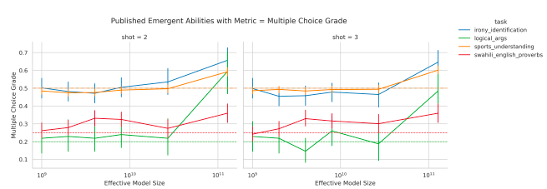
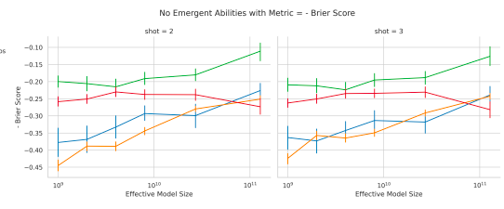
Changing metric
focusing on the LaMDA model family
exhibited emergent abilities under the Multiple Choice Grade
evaluation metric was switched to a continuous one—Brier Score
Finding: emergent abilities are more smooth when switching to a continuous metric

Slide 21
Emergent ability on vision task
emergent abilities can be artificially induced in neural networks for vision tasks by manipulating the metric
1: reconstruct emergent in autoencoder using CIFAR100 dataset
2: induce emergent abilities in autoregressive transformers trained to classify handwritten characters from the Omniglot dataset.

Slide 22
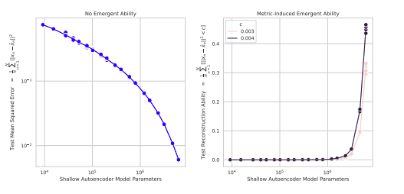
Experiment 1
Left plot: under the traditional continuous metric (mean squared error), the autoencoder’s reconstruction error decreases smoothly as the model size increases.
Right plot: When newly defined Reconstruction metric is applied, a sharp and seemingly unpredictable emergent ability is induced

Slide 23
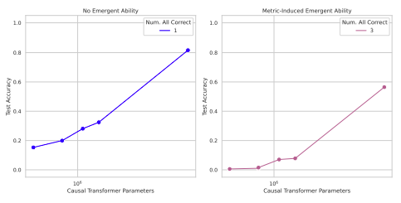
Experiment 2
Left plot: When Autoregressive transformers trained to classify Omniglot images,accuracy improves smoothly as the model size increases.
Right plot: When accuracy is redefined as classifying all images correctly (subset accuracy), a seemingly emergent ability appears, with sharp improvements as model size increases. This further demonstrates that emergent abilities can be induced by using stricter metrics.

Slide 24
Artifacts or Abduction: How Do LLMs Answer MCQs without the Question?
Yes this is a thing
LLMs are able to do well on MCQ benchmarks without the question
Paper looks at
Memorization: show that the models haven’t simply memorized the benchmark
Priors: Correct answer text is not inherently more probable than others
Choice dynamics and question inference: This is largely what’s happening
Takeaway: LLM evaluation on MCQA benchmarks needs to be further investigated - what is it actually learning?

