Slide 1
Session #17: ​ Self-Supervised Vision-Lang Models​
Thursday, October 25
CSCI 601.771: Self-supervised Statistical Models

Slide 2
Strengths
Personally think this is a impactful paper
Tackle an important problem in zero-shot learning (no need retraining, labeling new dataset)
Very well written paper
Provided detailed experiment settings
Easy access to additional resources: slides, source-code, talk after publication
🔎: Ha, Elisée

Slide 3
Strengths
Broader Impact of paper:
CLIP allows for easy classification for categorization
Significant promise of varied task handling such as Image search and retrieval
Addresses Bias
Addresses acknowledgement of data gathering source, participants and researchers involved
🔎: Ha, Elisée

Slide 4
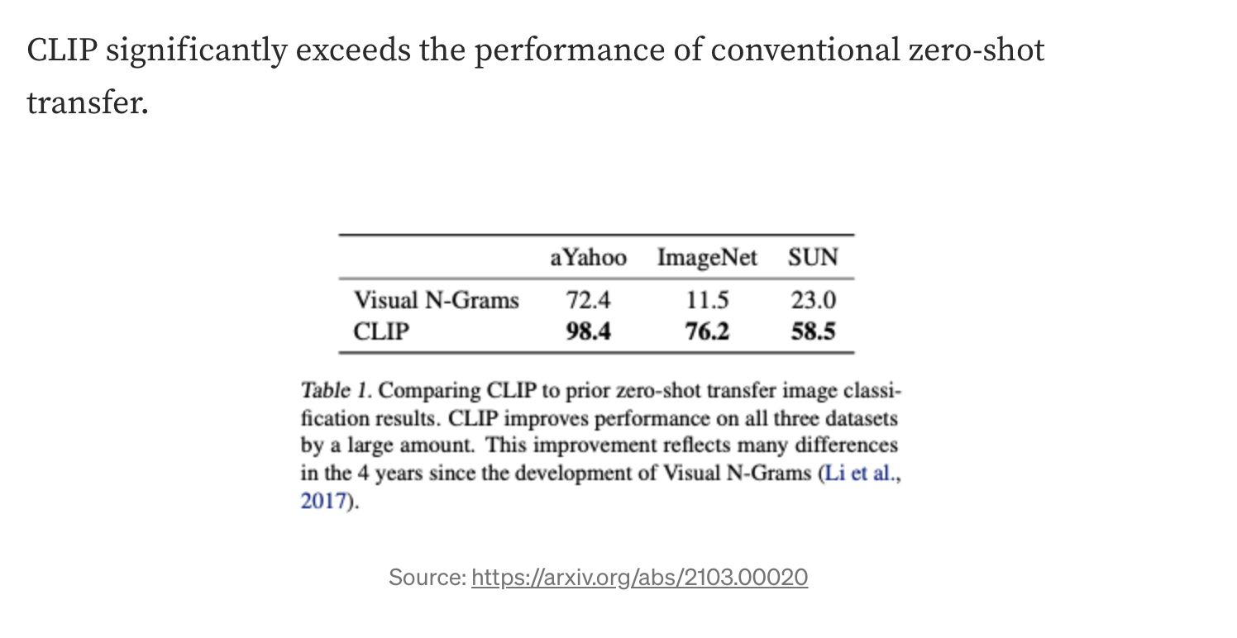
Strengths
🔎: Ha, Elisée

Slide 5
Weaknesses
Often require prompt engineering
Detail paper, but also too many words in arXiv version
Lack of notation clarification
Personally expect more theoretical analysis for a ICML paper
Contrastive Learning
Uncertainty under Distributional-Shift
Personally expect more investigation on distributional shift experiment
🔎: Ha, Elisée

Slide 6
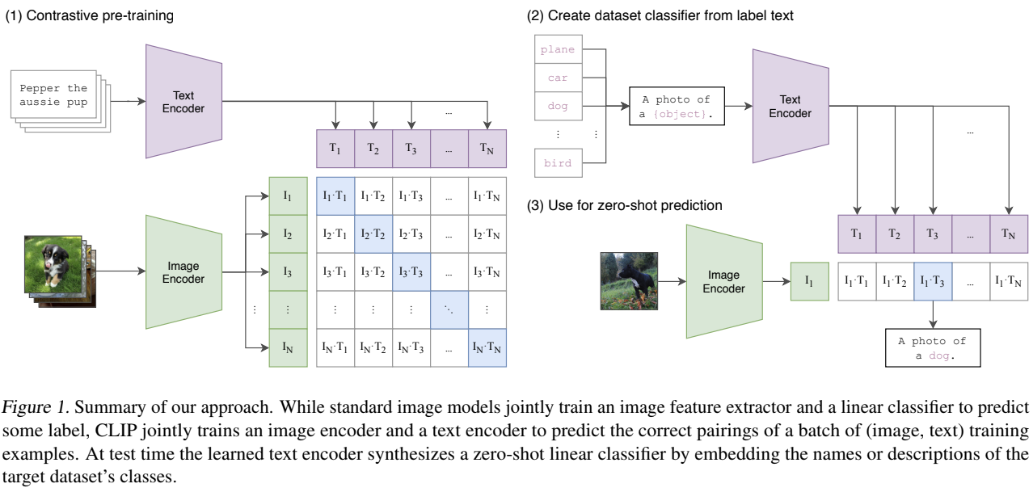
Weaknesses - notation
Misunderstand the number of probability spaces, definition clarification:
N need to be the same as test and train?
🔎: Ha, Elisée

Slide 7
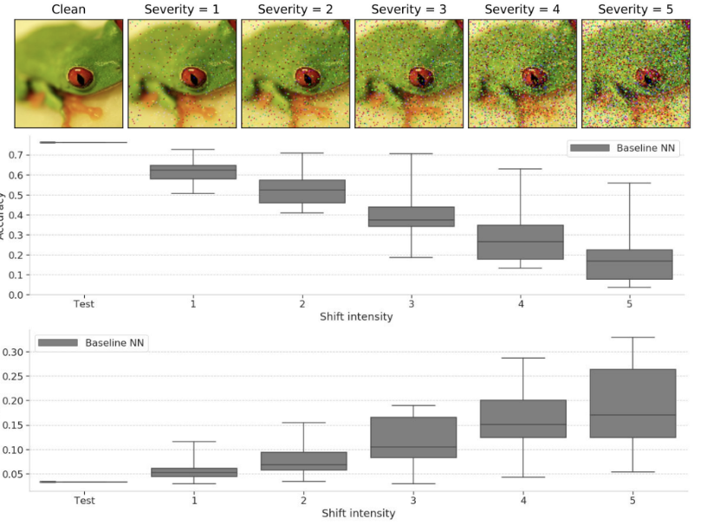
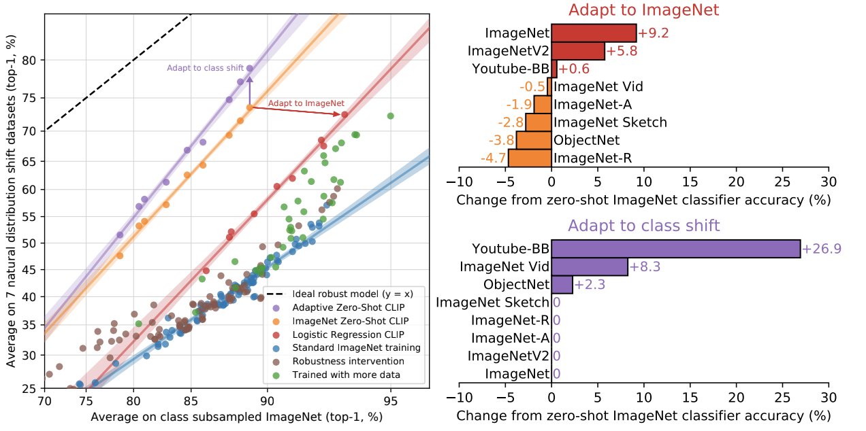
Weaknesses - distributional shift experiment
Distributional-shift experiment:
Expect shift intensity by ImageNet-C
Adapt to ImageNet: There is still unsolved question like “How is it possible to improve accuracy by 9.2% on the ImageNet dataset with little to no increase in accuracy under distribution shift?”
Adapt to class shift is look obvious
🔎: Ha, Elisée

Slide 8
Conclusion
Personally think:
An impactful paper: very well written and experiments
Expect more theoretical analysis and notation elaboration
=> Strongly accept.
🔎: Ha, Elisée

Slide 9
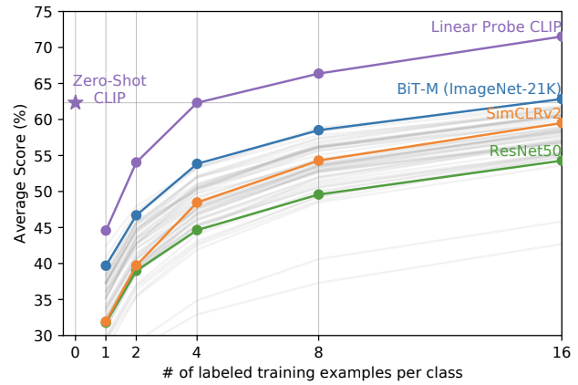
Questions
Figure: Why does zero-shot perform better than 1 and 2 few-shot?
🔎: Ha, Elisée

Slide 10
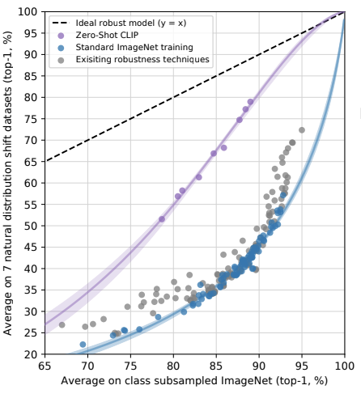
Questions
Figure: Question how visualize the line? Interpolation?
🔎: Ha, Elisée

