Slide 1
Session #19: Self-Supervised Speech/Audio Models
Tuesday, November 1
CSCI 601.771: Self-supervised Statistical Models

Slide 2
Stakeholder
Learning robust representations from speech audio alone, followed by fine-tuning on transcribed can outperform the best semi-supervised methods ,Also conceptually simpler.
wav2vec 2.0 masks the speech input and solves the contrastive learning task
A framework for self-supervised learning of representations of raw audio data.
Steven Tan,Neha Verma ,Zhiqing Zhong

Slide 3
Stakeholder: Method
Encodes speech audio through a multilayer convolutional neural network
Latent representations are fed into the Transformer network to build context-based representations
As part of training, we learn discrete speech units via softmax to represent latent representations in contrast tasks.
Steven Tan,Neha Verma ,Zhiqing Zhong

Slide 4
Stakeholder: Method
The model is fine-tuned on labeled data
Method end-to-end Both problems are solved in a straightforward manner.
Other related work includes learning representations by auto-encoding input data or directly predicting future time steps
Our results show that jointly learning discrete speech units with contextual representations achieves better results than fixed units learned in a prior step .
The feasibility of ultra-low-resource speech recognition
We achieve state-of-the-art sota on TIMIT phoneme recognition as well as Librispeech's 100-hour clean subset.
Steven Tan,Neha Verma ,Zhiqing Zhong

Slide 5
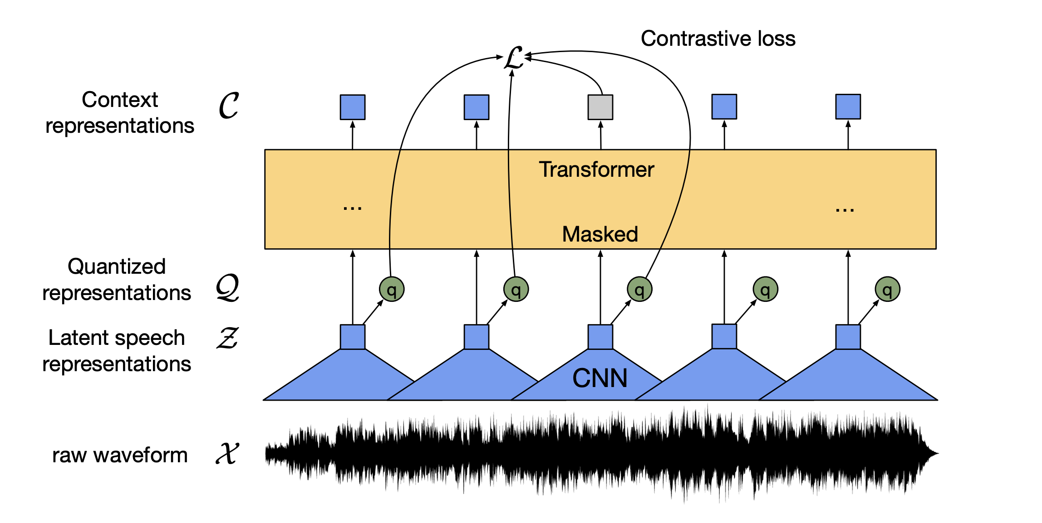
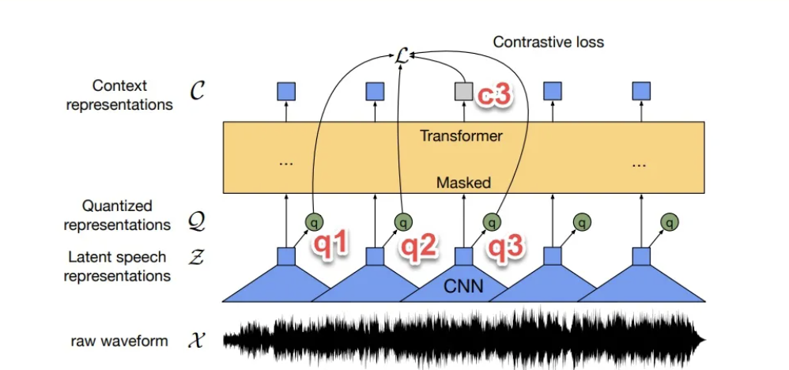
Stakeholder: Models
X = {x1, x2, ..., xT'}, this is the original wave form, e.g. sample rate = 16000;
Z = {z1, z2, ..., zT}, this is the "latent speech representation" (hidden layer speech representation) obtained after subsampling with 7-layer CNN; the combination of these 7-layer CNNs is called "" feature extractor".
Q = {q1, q2, ..., qT}, "quantized" from Z. For example, in the default code of fair seq, if there are two codebooks, each codebook has 320 codewords, and each codeword is represented by a 128-dimensional vector. That is to say, a tensor with shape (2, 320, 128) (similar to codeword embedding matrix) is what we need to learn.
C = {c1, c2, ..., cT}, is the "context representations" obtained by inputting Z through multiple layers of transformer encoders.
Steven Tan,Neha Verma ,Zhiqing Zhong

Slide 6
Stakeholder:Models
Algorithm:
From X to Z, the original speech is represented as, the hidden layer speech representation;
From Z to Q, quantization operation;
A part of Z is given to the mask, for example, five 10-gram positions, these positions are replaced with a uniform vector; then Z_mask after the mask is thrown to the transformer encoder;
The result C predicted by the transformer is compared with the reference answer (= quantization of the (unmasked) Z sequence to get the Q sequence), and the "contrastive learning loss" is calculated, as well as several other Loss.
Steven Tan,Neha Verma ,Zhiqing Zhong

Slide 7
Stakeholder:Models(which has been masked?)
In the above figure, the z3 corresponding to q3 in q1, q2, q3, q4, q5, is masked
In order to predict q3, two interference terms are randomly found: q1, q2.
After pretraining on unlabeled speech, the model is fine-tuned on labeled data with a connectionist temporal classification (CTC) loss for downstream speech recognition tasks .

Slide 8
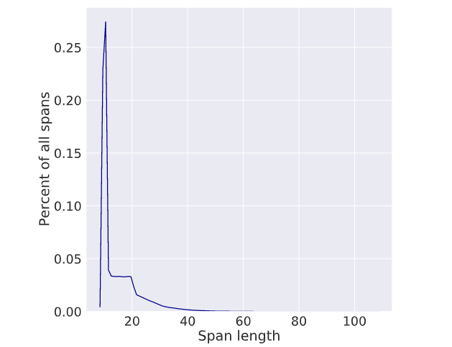
Training
Mask length distribution
Mask:
P: portion of time steps to start masking (p=0.065)
M: consecutive time steps (M=10)
✍️: Steven Tan, Neha Verma, Zhiqing Zhong

Slide 9
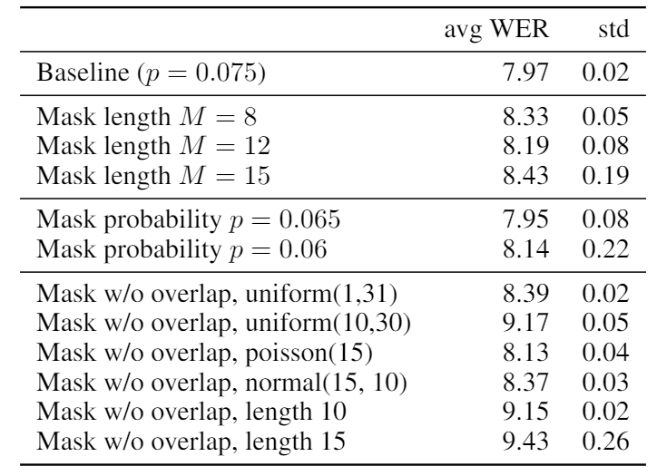
Different Masking Strategies
✍️: Steven Tan, Neha Verma, Zhiqing Zhong

Slide 10
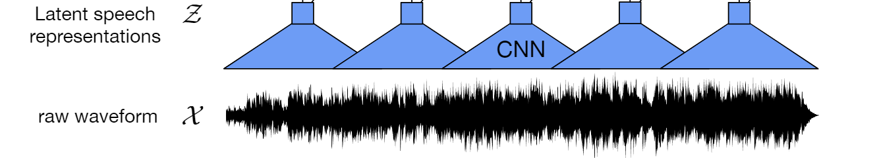
CNN for Feature Extraction
7-layer CNN block
Receptive field 400 input sample/25 ms of audio
✍️: Steven Tan, Neha Verma Zhiqing Zhong

Slide 11

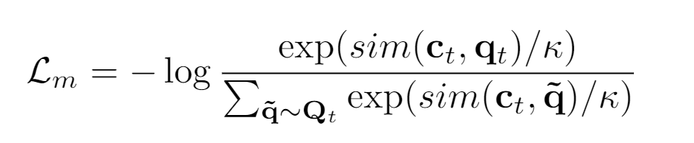
Training Objective
Lm: contrastive loss
C: contextual representation from transformer
Q: quantized candidate of input
K = 100 (# distractors), temperature=0.1
✍️: Steven Tan, Neha Verma, Zhiqing Zhong

Slide 12
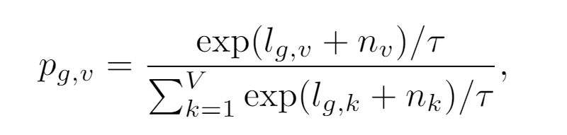
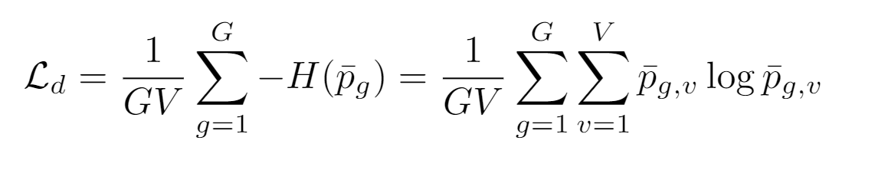
Training Objective
Ld: diversity loss
V: entries
G: #codebooks
✍️: Steven Tan, Neha Verma, Zhiqing Zhong

Slide 13
Training Objective
Ld: diversity loss
V=320
G=2
Entry dimension: input dim / G = 768 /2 =384
✍️: Steven Tan, Neha Verma, Zhiqing Zhong

Slide 14
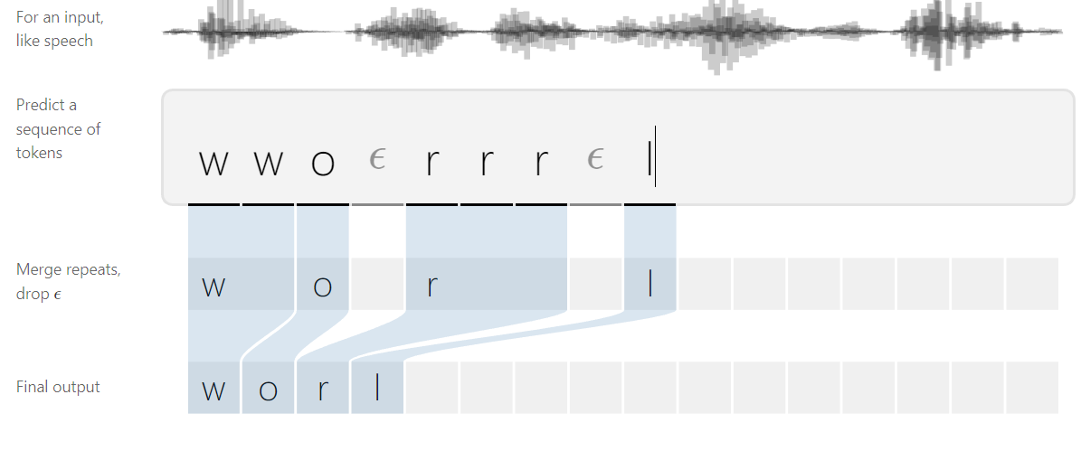
Finetuning
CTC loss
✍️: Steven Tan, Neha Verma, Zhiqing Zhong

Slide 15
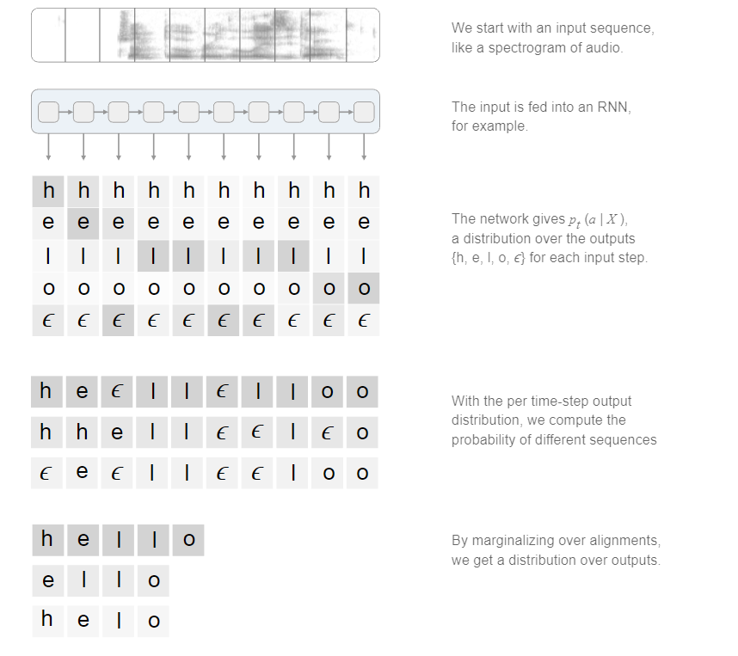
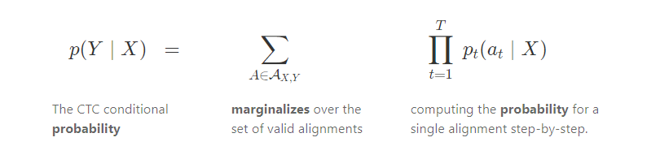
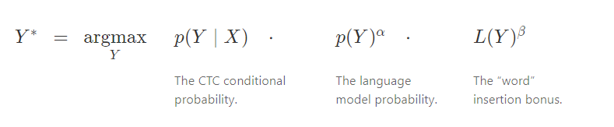
CTC loss
Our favorite: intractable marginalization!
Inference: beam-search
✍️: Steven Tan, Neha Verma, Zhiqing Zhong

Slide 16
Datasets and Evaluation
Pretraining
Librispeech (no labels): 960 hrs
LibriVox: 53.2K hrs
Language Model (for Speech Recognition)
Librispeech LM corpus
2. Fine-tuning
960 hrs of Librispeech (labels)
Librispeech subsets
Train-clean-100 hrs
Libri-light 10 hrs
Libri-light 1 hr
Libri-light 10 min
TIMIT Acoustic-Phonetic Speech Corpus (5 hrs)
✍️: Steven Tan, Neha Verma, Zhiqing Zhong

Slide 17
Model varieties
Size
Base
12 Transformer layers
Large
24 Transformer layers
LM used
4-gram
Transformer-based
20-layer
✍️: Steven Tan, Neha Verma, Zhiqing Zhong

Slide 18
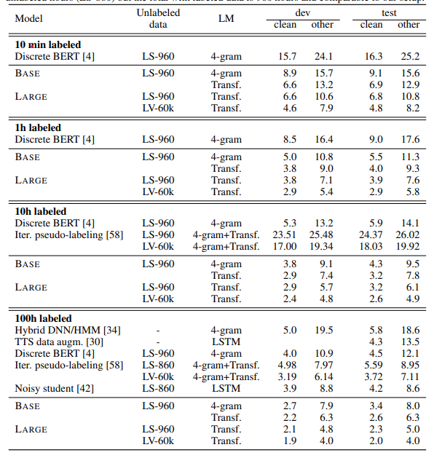
Results: Low-Resource Labeled Data
Very good WER for ultra-low resource 10 min recording
New state-of-the-art on Librispeech train-clean-100
✍️: Steven Tan, Neha Verma, Zhiqing Zhong

Slide 19
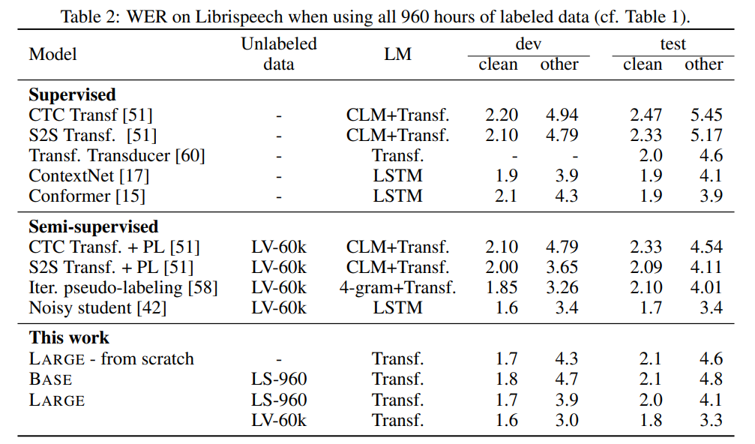
Results: High-Resource Labeled Data (Librispeech)
New state-of-the-art
Other architectures from scratch work better
but self-supervision technique is very helpful
✍️: Steven Tan, Neha Verma, Zhiqing Zhong

Slide 20
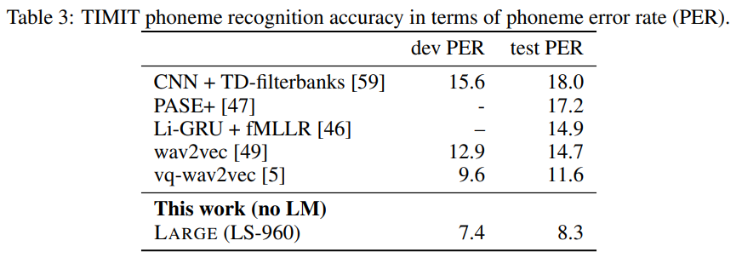
Results: TIMIT Phoneme Recognition
Task: transcribe speech using 39 phones
✍️: Steven Tan, Neha Verma, Zhiqing Zhong

Slide 21
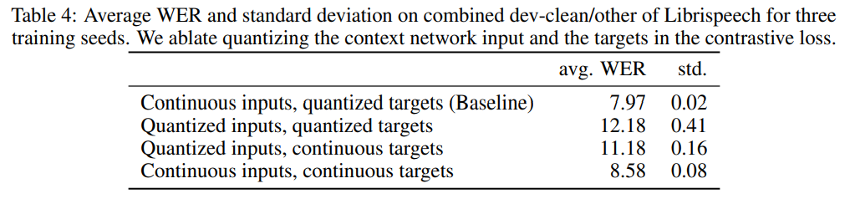
Results: Ablations
Quantizing happens only for latents as targets, not for latents as inputs
Continuous input – retain more info
Quantized output – more robust training
✍️: Steven Tan, Neha Verma, Zhiqing Zhong

Slide 24
Empiricists
https://colab.research.google.com/drive/1gR5rMqy3H5D74qVGlZCE2iSJT4E5VNyp?usp=sharing
👩🏽‍🔬: Lingfeng Shen, Isabel Cachola

Slide 25
Reviewer: Strengths
Extensively open-sourced codes and models.
Great results on low-resource labelled data, huge potential impact for uncommon languages.
A lot of moving parts work together well.
Quantization module: a great way to downscale feature representation
Motivation: consider real world
Experiments based on public dataset
🔎: Tianqi, Yongrui, Aayush

Slide 26
Reviewer: Weaknesses
Paper is too dense: hard to follow all the techniques.
No evaluation for the pretrained model.
No reasoning for using relative positional embedding vs absolute in contextualized representations.
Tons of other hyperparameter choices mentioned with explanations or ablation studies either missing or left in appendix.
Not end-to-end, needs secondary recognition model.
Relies heavily on the pre-training model, which is very large and hard to train.
🔎: Tianqi, Yongrui, Aayush

Slide 27
Reviewer: Weakness
Limited argumentation
Why such design decision has made
Quantization: yes, discretize to smaller space, and then …
Less clarity
Denotes not clear: G, V
Not easy to reproduce to evaluation
Large computational resources
Aayush, Tianqi, Yongrui

Slide 28
Visionary: Few-shot speech recognition for close languages
Paper shows impressive performance on low-resource languages and phenome recognition.
However, it doesn't show the verbal equivalent of zero or few-shot performance.
Additionally, it doesn't show how proficiency in one language may generalize to proficiency in similar languages.
Create a study of the few-shot performance of wav2vec and see how finetuning on one language generalizes to similar languages.
Ex: Fine-tune on Spanish and see if it has generalization properties in Italian.
Ex: Japanese has 2 written forms expressing different aspects of the language and it doesn't necessarily correlate 1-to-1 with spoken Japanese.
Motivation: For languages with no written form, you may be able to use a similar language that has written language and then generalize.
🔭: Vicky Zeng and Iliana Maifeld-Carucci

Slide 29
Visionary: Improvement from Error Analysis
Time of Trained Labeled Data | Error Types
10 minutes | - Phonetic spelling errors in general (omit silent and repeated characters) i.e. are -> ar
1 hour | - Phonetic spelling errors for less common words i.e. soul -> sol
10 hours | - Articles mistaken i.e. a -> the, in -> and - Alternative spellings i.e color vs colour
100 hours | - Phonetic spelling errors mostly for person names i.e. christie -> cristy - Incorrect spacing i.e anyone vs any one
960 hours | - Similar to 100 hours but error rate to 2% + rare words
Emphasis on silent/repeated-letter words
Why articles are mistaken
🔭: Vicky Zeng and Iliana Maifeld-Carucci

Slide 30
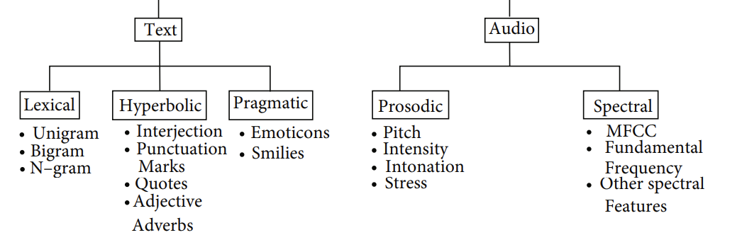
Visionary: Downstream Emotion and Sarcasm Detection
Strength in self-supervised learning with unlabeled data: Limited emotion and sarcasm detection datasets with annotation
Additional information in audio not present in text
Transfer learning: Use the trained weights of contextual representations as starting points for emotion and sarcasm detection models
🔭: Vicky Zeng and Iliana Maifeld-Carucci

