Slide 1
CS.601.471/671 Natural Language Processing: Self-Supervised Models
Mathematics Background Review
27 January 2023
Adam Byerly (Course TA)

Slide 2
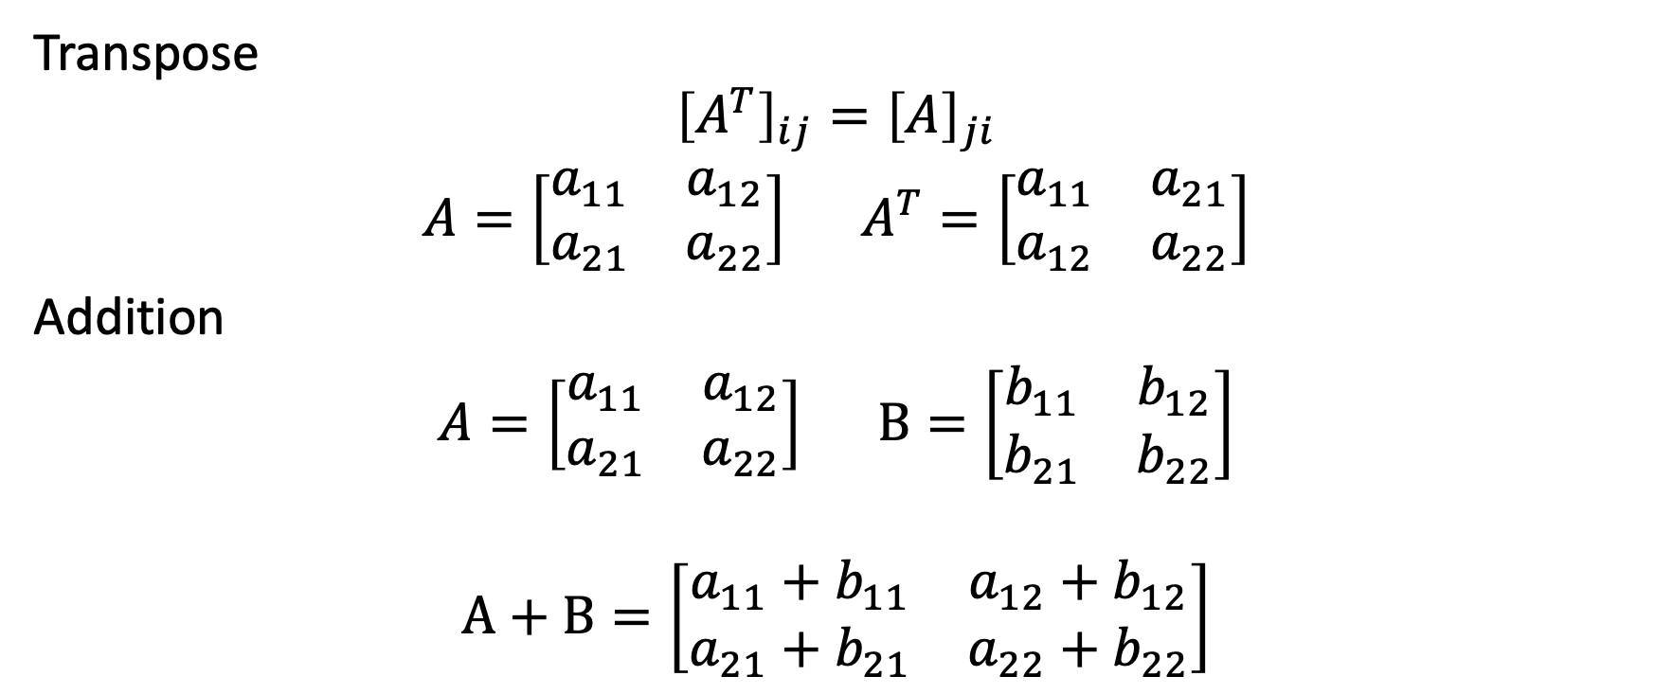
Matrix Operations
Transpose
$${\left[A^{T}\right]}_{ij}={\left[A\right]}_{ji}$$
$A=\left[\begin{matrix}a_{11} & a_{12} \\ a_{21} & a_{22}\end{matrix}\right]$ $A^{T}=\left[\begin{matrix}a_{11} & a_{21} \\ a_{12} & a_{22}\end{matrix}\right]$
Addition
$A=\left[\begin{matrix}a_{11} & a_{12} \\ a_{21} & a_{22}\end{matrix}\right]$ $B=\left[\begin{matrix}b_{11} & b_{12} \\ b_{21} & b_{22}\end{matrix}\right]$
$$A+B=\left[\begin{matrix}{a_{11}+b}_{11} & a_{12}+b_{12} \\ {a_{21}+b}_{21} & a_{22}+b_{22}\end{matrix}\right]$$

Slide 3
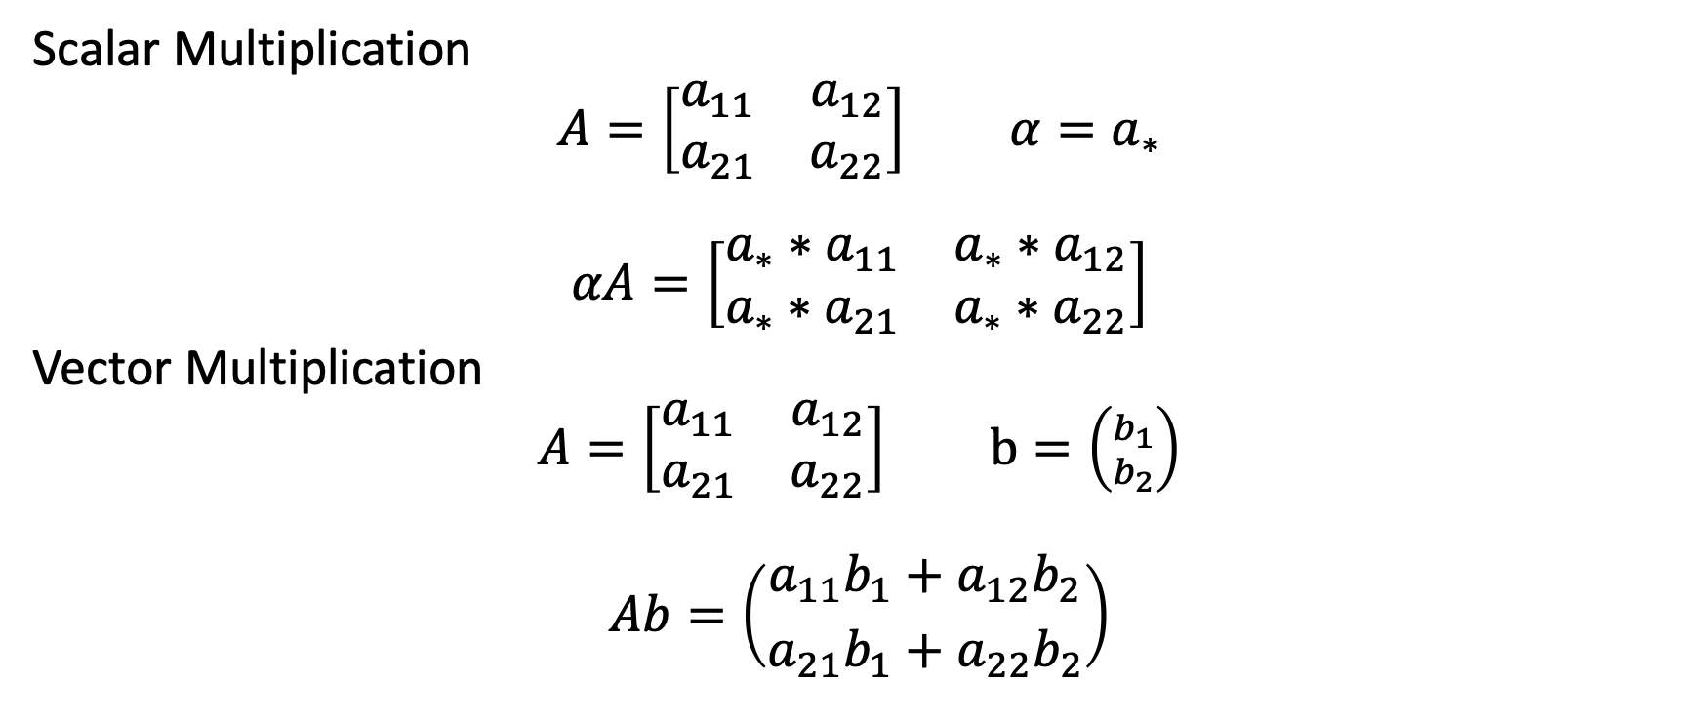
Matrix Operations
Scalar Multiplication
$A=\left[\begin{matrix}a_{11} & a_{12} \\ a_{21} & a_{22}\end{matrix}\right]$ $α=a_{∗}$
$$αA=\left[\begin{matrix}{a_{∗}∗a}_{11} & a_{∗}∗a_{12} \\ a_{∗}∗a_{21} & a_{∗}∗a_{22}\end{matrix}\right]$$
Vector Multiplication
$A=\left[\begin{matrix}a_{11} & a_{12} \\ a_{21} & a_{22}\end{matrix}\right]$ $b=\left({b_{1} \atop b_{2}}\right)$
$$Ab=\left({{a_{11}b}_{1}+a_{12}b_{2} \atop {a_{21}b}_{1}+a_{22}b_{2}}\right)$$

Slide 4
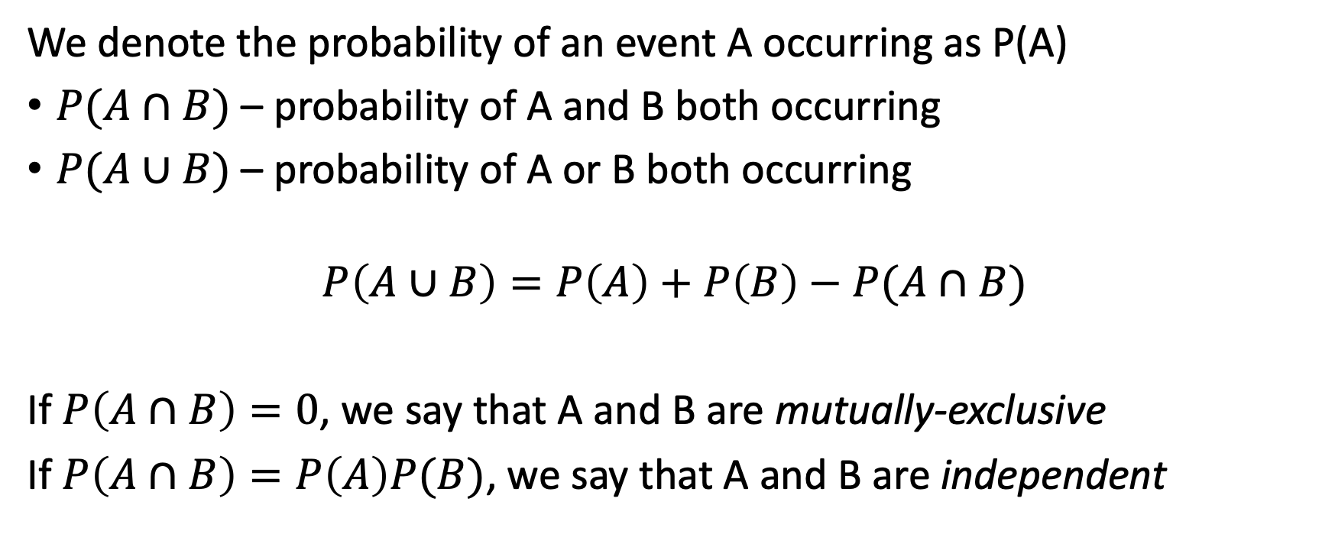
Probability
We denote the probability of an event A occurring as P(A)
$P(A∩B)$ – probability of A and B both occurring
$P(A∪B)$ – probability of A or B both occurring
$$P\left(A∪B\right)=P\left(A\right)+P\left(B\right)−P(A∩B)$$
If $P\left(A∩B\right)=0$, we say that A and B are mutually-exclusive
If $P\left(A∩B\right)=P\left(A\right)P(B)$, we say that A and B are independent

Slide 5

Calculus – Simple Derivatives
Constant Rule
$$\frac{d}{dx}c=0$$
Powers
$$\frac{d}{dx}x^{a}=ax^{a−1}$$
$\frac{d}{dx}x=1$ $\frac{d}{dx}x^{2}=2x$

Slide 6
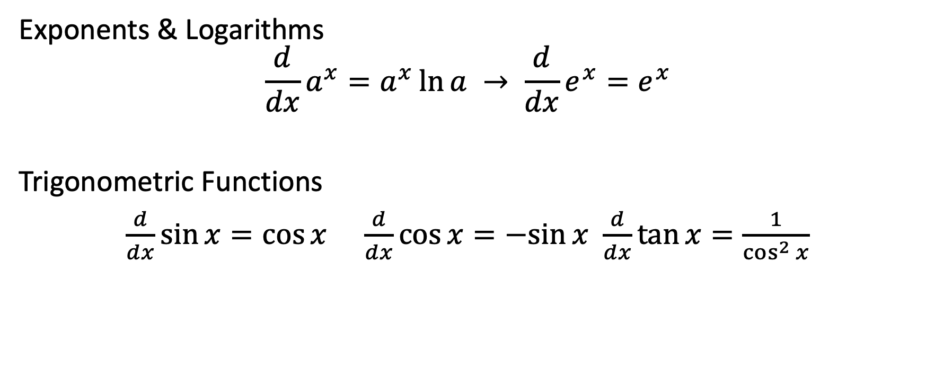
Calculus – Simple Derivatives
Exponents & Logarithms
$$\frac{d}{dx}a^{x}=a^{x}\ln{a → \frac{d}{dx}e^{x}=e^{x}}$$
Trigonometric Functions
$\frac{d}{dx}\sin{x}=\cos{x}$ $\frac{d}{dx}\cos{x}=−sin{x}$ $\frac{d}{dx}\tan{x}=\frac{1}{\cos^{2}{x}}$

Slide 7
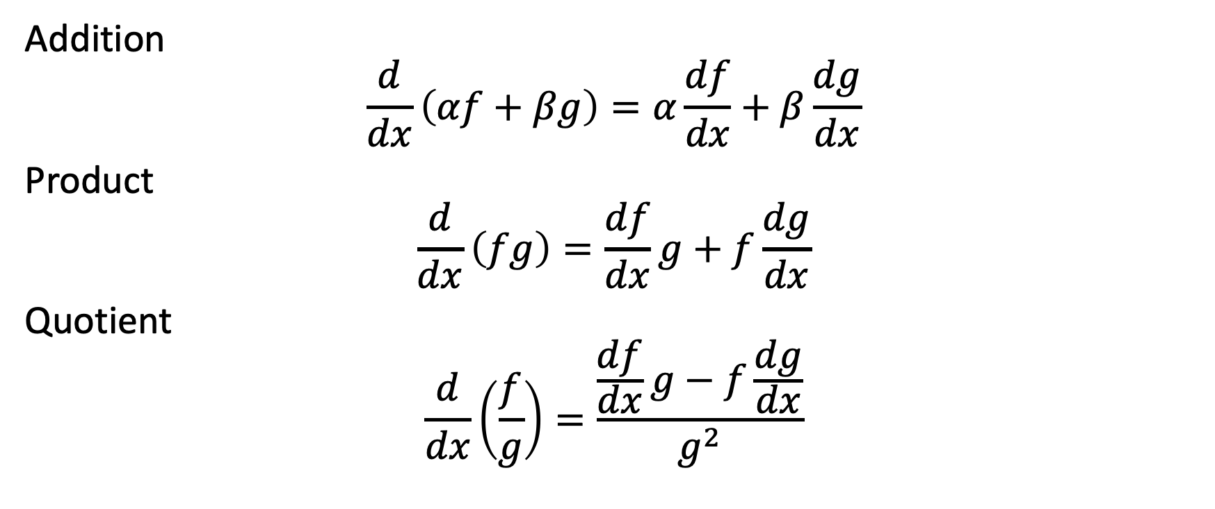
Calculus – Combined Functions
Addition
$$\frac{d}{dx}\left(αf+βg\right)=α\frac{df}{dx}+β\frac{dg}{dx}$$
Product
$$\frac{d}{dx}\left(fg\right)=\frac{df}{dx}g+f\frac{dg}{dx}$$
Quotient
$$\frac{d}{dx}\left(\frac{f}{g}\right)=\frac{\frac{df}{dx}g−f\frac{dg}{dx}}{g^{2}}$$

Slide 8

Calculus – Chain Rule
Chain Rule
$$\frac{d}{dx}\left(f(g(x))\right)=\frac{df}{dx}(g(x))\frac{dg}{dx}(x)$$

Slide 9
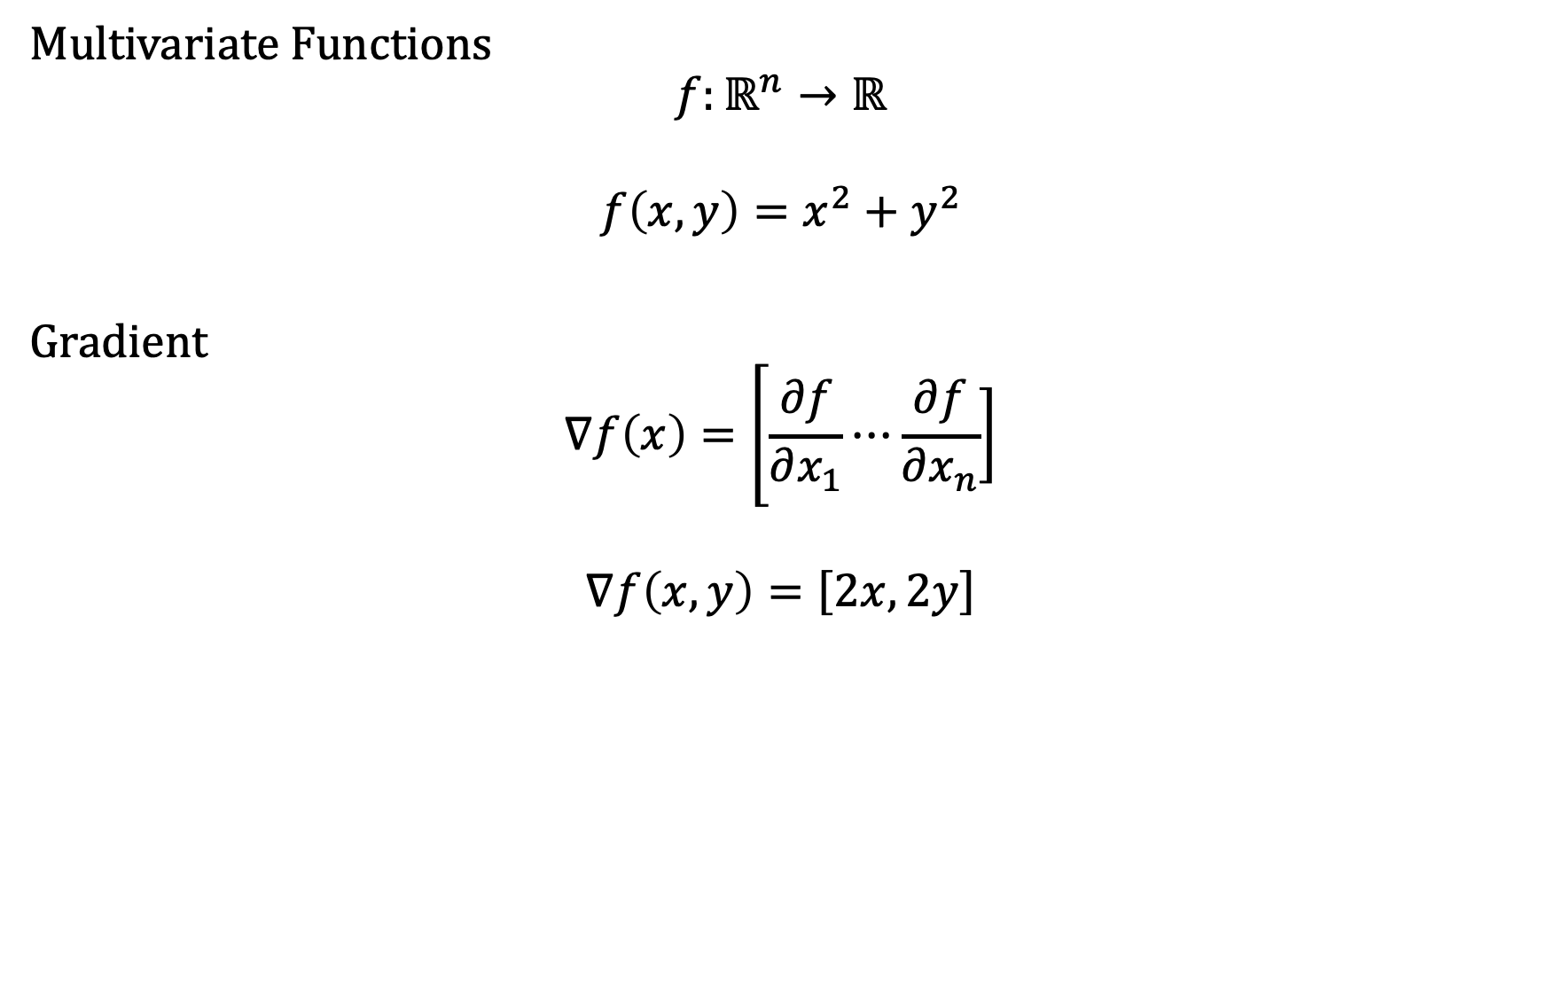
Calculus – Multivariate Derivative
Multivariate Functions
$$f:ℝ^{n}→ℝ$$
$$f\left(x, y\right)=x^{2}+y^{2}$$
Gradient
$$∇f\left(x\right)=\left[\frac{∂f}{∂x_{1}}\right.⋯\left.\frac{∂f}{∂x_{n}}\right]$$
$$∇f\left(x, y\right)=\left[2x\right.,\left.2y\right]$$

Slide 10
Algorithms – Big O
Find the largest number in an unsorted list of n numbers:
No additional information
Need to traverse entire list
Algorithm scales with list size n
O(n)
Find the largest number in an sorted list of n numbers:
Additional information – list is sorted
Only need the last element
O(1)

