Slide 1
Session #8: Limits of In-Context Learning
Thursday, Sept 22
CSCI 601.771: Self-supervised Statistical Models

Slide 2

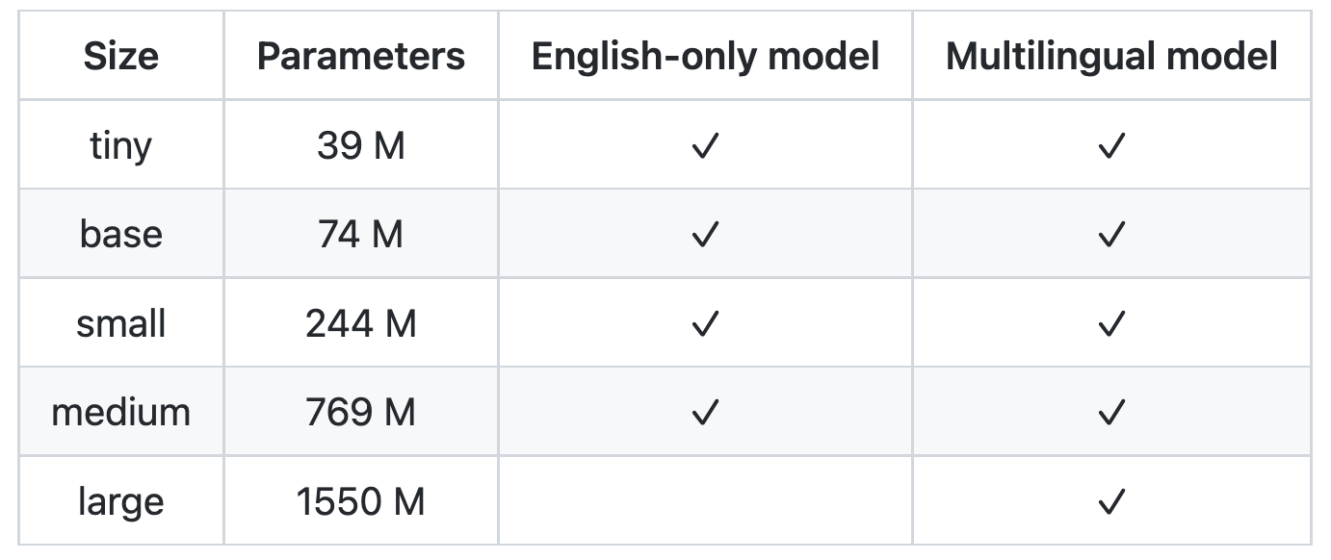
News: Whisper
"The Whisper models are trained for speech recognition and translation tasks, capable of transcribing speech audio into the text in the language it is spoken (ASR) as well as translated into English (speech translation)."
https://openai.com/blog/whisper

Slide 3
This Week's prompt
This paper is good at ___ but fails to address ___

Slide 4
Impact of Pretraining Term Frequencies on Few-Shot Reasoning
The flow of the presentation
-Background / Motivation
-Method
-Experiments
-Conclusions
✍️: Vicky Zeng, Neha Verma, Lingfeng Shen

Slide 5

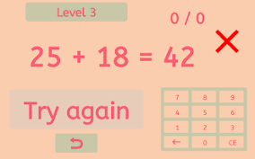
Numerical reasoning
✍️: Vicky Zeng, Neha Verma, Lingfeng Shen

Slide 6
Background
✍️: Vicky Zeng, Neha Verma, Lingfeng Shen

Slide 7
Background
current evaluation schemes for the reasoning of large language models, often neglect or underestimate the impact of data leakage
✍️: Vicky Zeng, Neha Verma, Lingfeng Shen

Slide 8
Background
current evaluation schemes for the reasoning of large language models, often neglect or underestimate the impact of data leakage
A model that has learned to reason in the training phase should be able to generalize outside of the narrow context that it was trained in.
✍️: Vicky Zeng, Neha Verma, Lingfeng Shen

Slide 9


Background
current evaluation schemes for the reasoning of large language models, often neglect or underestimate the impact of data leakage
A model that has learned to reason in the training phase should be able to generalize outside of the narrow context that it was trained in.
Performance
Frequent data
Performance
✍️: Vicky Zeng, Neha Verma, Lingfeng Shen
Less frequent data

Slide 10
Related Work
Sinha et al. (2021) demonstrate that shuffling word order during pretraining has minimal impact on an LMs’ accuracy on downstream tasks
Min et al. (2022) similarly find that shuffling labels in in-context learning demonstrations has a minimal impact on few-shot accuracy.
Data privacy researchers have also shown that LMs may memorize sensitive sequences occurring in training data (e.g., social security and credit card numbers), even if they are rare (Carlini et al., 2019; Song & Shmatikov, 2019).
✍️: Vicky Zeng, Neha Verma, Lingfeng Shen

Slide 11
A little question
Q: What is 63 times 24?
Q: What is 24 times 18?
Q: What is 33 times 12?
Q: What is 41 times 19?
✍️: Vicky Zeng, Neha Verma, Lingfeng Shen

Slide 12
A little question
Q: What is 63 times 24?
Q: What is 24 times 18?
Accuracy: >80%
Q: What is 33 times 12?
Q: What is 41 times 19?
✍️: Vicky Zeng, Neha Verma, Lingfeng Shen

Slide 13
A little question
Q: What is 63 times 24?
Q: What is 24 times 18?
Accuracy: >90%
Q: What is 33 times 12?
Q: What is 41 times 19?
Q: What is 61 times 24?
Q: What is 23 times 18?
Q: What is 31 times 17?
Q: What is 47 times 17?
✍️: Vicky Zeng, Neha Verma, Lingfeng Shen

Slide 14
A little question
Q: What is 63 times 24?
Q: What is 24 times 18?
Accuracy: >90%
Q: What is 33 times 12?
Q: What is 41 times 19?
Q: What is 61 times 24?
Q: What is 23 times 18?
Q: What is 31 times 17?
Accuracy: <40%
Q: What is 47 times 17?
✍️: Vicky Zeng, Neha Verma, Lingfeng Shen

Slide 15
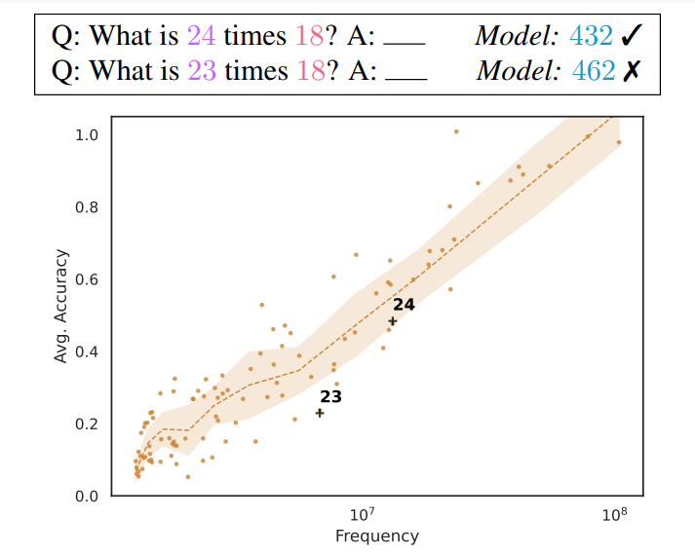
Problems
✍️: Vicky Zeng, Neha Verma, Lingfeng Shen

Slide 16
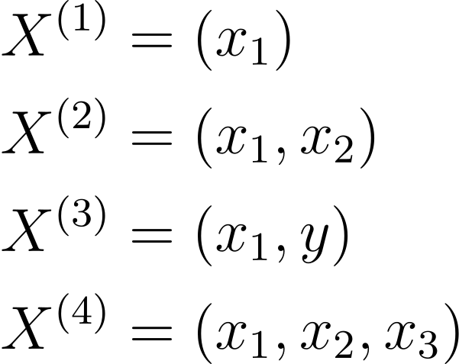
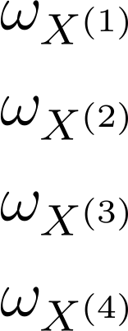
Instances
x = positive integers, units of time
y = positive integers (optional)
ω = frequency, co-occurrences within window=5
✍️: Vicky Zeng, Neha Verma, Lingfeng Shen

Slide 17
Instances
x = positive integers, units of time
y = positive integers (optional)
ω = frequency, co-occurrences within window=5
Input numbers:
3 digits, within top 200 frequent numbers
✍️: Vicky Zeng, Neha Verma, Lingfeng Shen

Slide 18
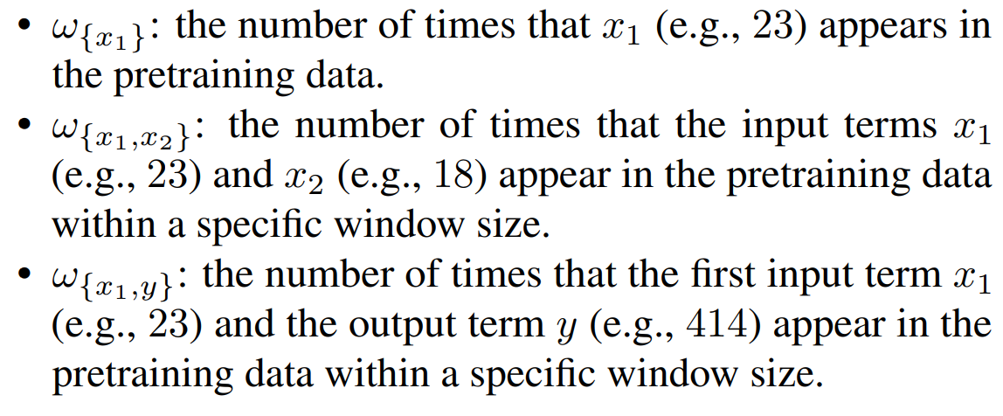
Frequency
✍️: Vicky Zeng, Neha Verma, Lingfeng Shen

Slide 19
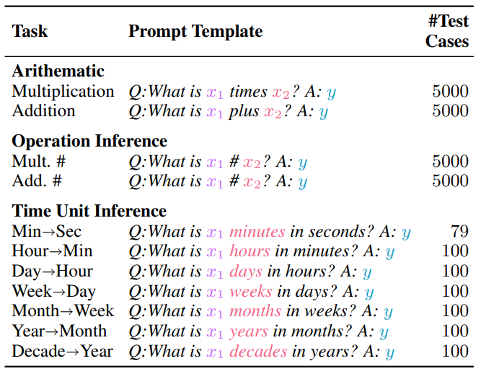
Task prompt templates
✍️: Vicky Zeng, Neha Verma, Lingfeng Shen

Slide 20
Task prompt templates
(3, 11, 33)
(45, 54, 99)
✍️: Vicky Zeng, Neha Verma, Lingfeng Shen

Slide 21
Task prompt templates
(3, 11, 33)
(45, 54, 99)
(3, 11, 33)
(45, 54, 99)
✍️: Vicky Zeng, Neha Verma, Lingfeng Shen

Slide 22
Task prompt templates
(3, 11, 33)
(45, 54, 99)
(3, 11, 33)
(45, 54, 99)
(24, minutes, 60, 1440)
✍️: Vicky Zeng, Neha Verma, Lingfeng Shen

Slide 23
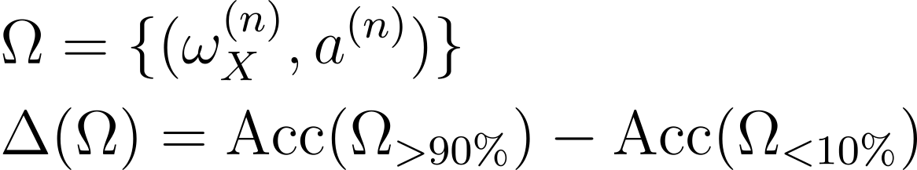
Performance Gap
Difference in accuracy between top 10% of instances and bottom 10% of instances (by frequency)
✍️: Vicky Zeng, Neha Verma, Lingfeng Shen

Slide 24
Experimental setup
Models
GPT-J-6B
GPT-Neo-1.3B
GPT-Neo-2.7B
Corpus
Pile dataset
Prompt counts
k = 0,2,4,8,16
✍️: Vicky Zeng, Neha Verma, Lingfeng Shen

Slide 25
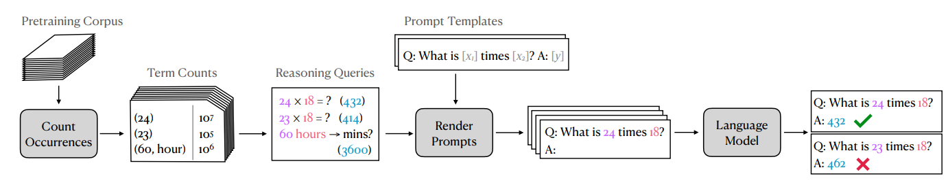
Pipeline for Data Construction
✍️: Vicky Zeng, Neha Verma, Lingfeng Shen

Slide 26
Main Finding: Heavy dependence on pretraining frequency
✍️: Vicky Zeng, Neha Verma, Lingfeng Shen

Slide 27
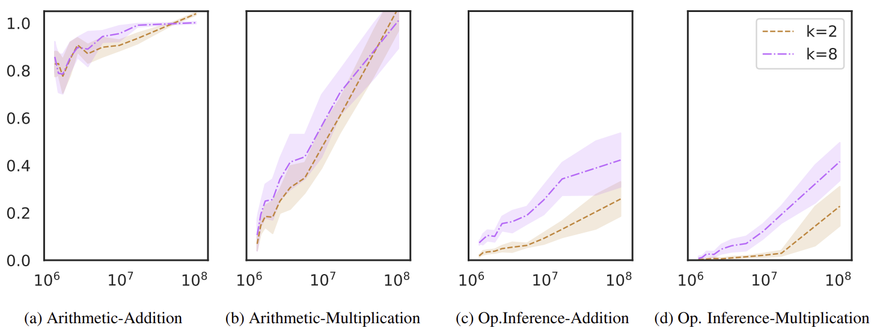
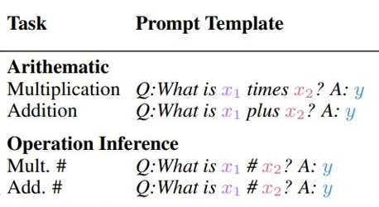
Main Finding: Heavy dependence on pretraining frequency
Strong positive correlation between test performance and pretraining term frequency
✍️: Vicky Zeng, Neha Verma, Lingfeng Shen

Slide 28
Main Finding: Heavy dependence on pretraining frequency
Strong positive correlation between test performance and pretraining term frequency
✍️: Vicky Zeng, Neha Verma, Lingfeng Shen

Slide 29
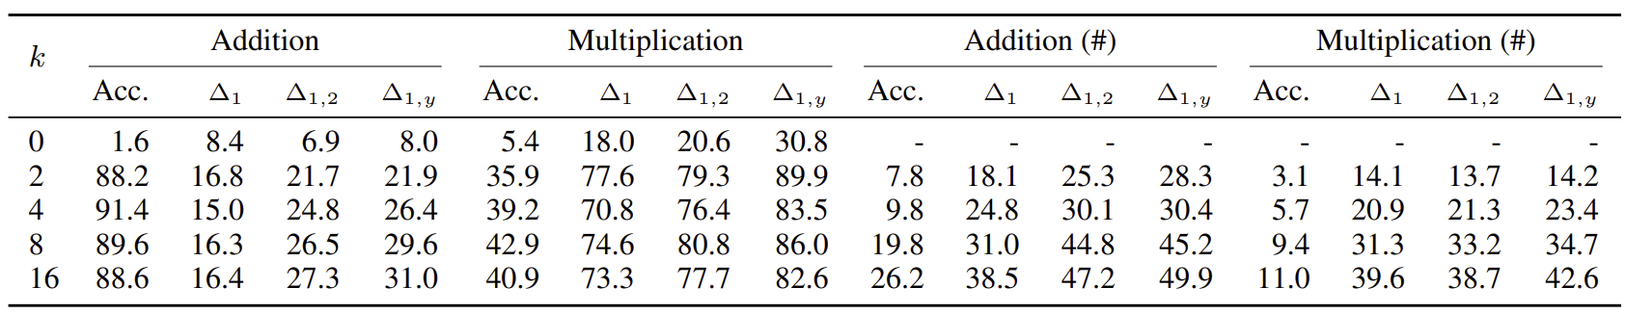
Additional Support: Performance Gap, Inference vs Arithmetic Gap
Performance gap increases as number of k shots increases
Inference task performance is much lower than arithmetic task performance
Generalization (Def.): A form of abstraction whereby common properties of specific instances are formulated as general concepts or claims.
✍️: Vicky Zeng, Neha Verma, Lingfeng Shen

Slide 30
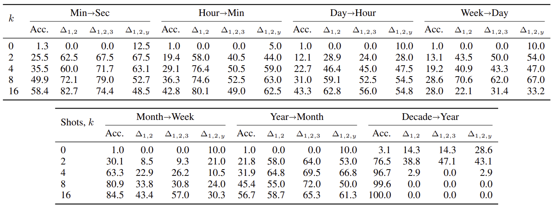
Outlier – Possible (limited) generalization
✍️: Vicky Zeng, Neha Verma, Lingfeng Shen

Slide 31
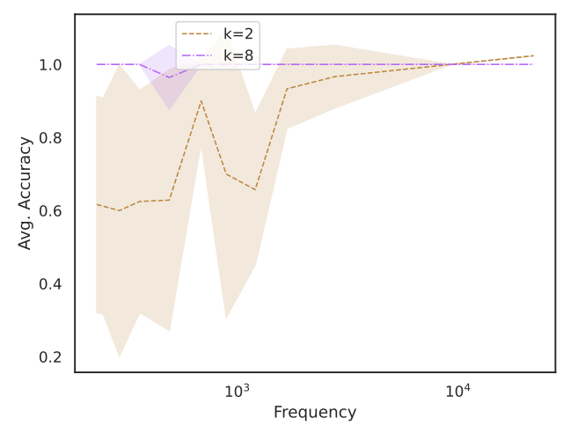
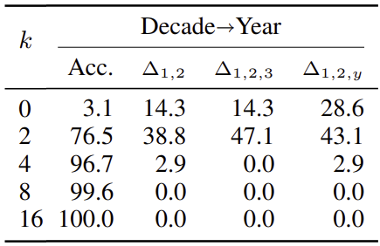
Outlier – Possible (limited) generalization
Task: Time-Unit Conversion for Decade -> Year
Performance gap disappears as k increases
Why?
Task simple enough to generalize?
Bad frequency range, External factors that were neglected..?
✍️: Vicky Zeng, Neha Verma, Lingfeng Shen

Slide 32
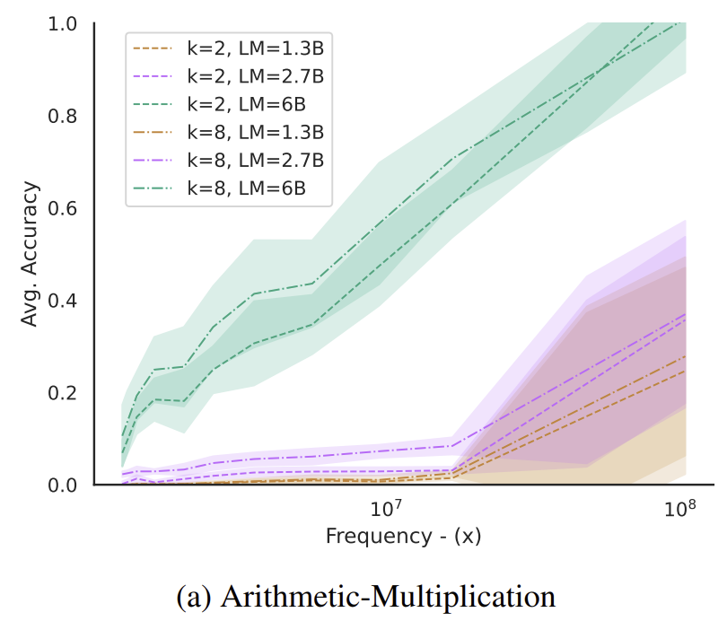
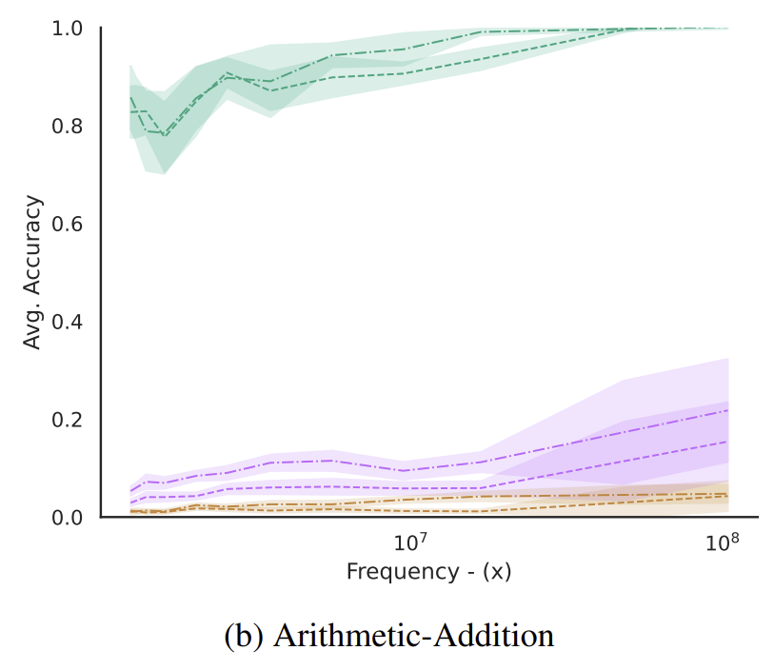
Model Size on Performance
Models perform better on high-frequency terms across all model sizes
✍️: Vicky Zeng, Neha Verma, Lingfeng Shen

Slide 33
Overview of the paper
present analysis on these numerical reasoning tasks for three sizes of the EleutherAI/GPT models pretrained
show a consistently large performance gap between highest-frequency terms and lowest-frequency terms in all of our experiments
Call for a revisit evaluation of language models with respect to their pretraining data on numerical reasoning.
✍️: Vicky Zeng, Neha Verma, Lingfeng Shen

Slide 34
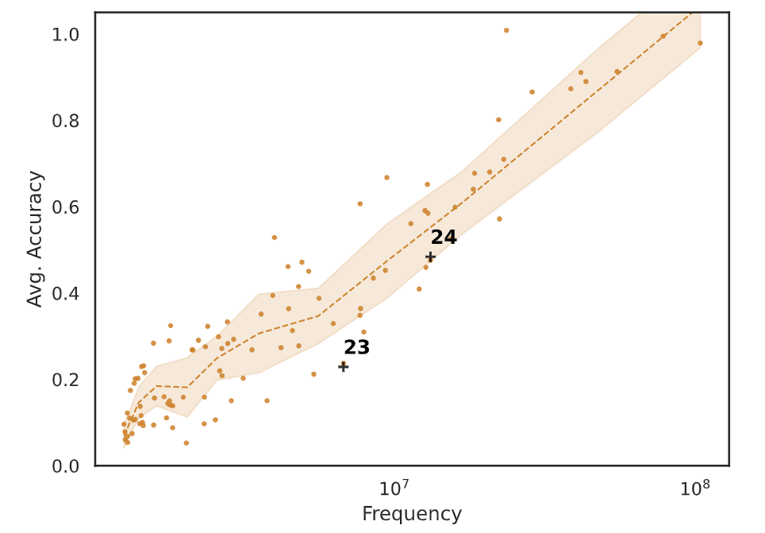
Paper Summary
Relation between term frequency and reasoning (over 11 tasks)
🔎: Steven, Aowei, Illiana

Slide 35
Strengths
Stress the importance of pre-training dataset
🔎: Steven, Aowei, Illiana

Slide 36
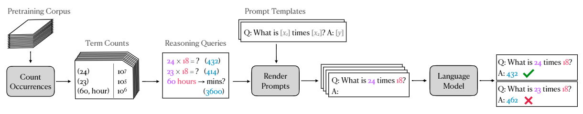
Strengths
Stress the importance of pre-training dataset
Experiment setup is intuitive
🔎: Steven, Aowei, Illiana

Slide 37
Strengths
Stress the importance of pre-training dataset
Experiment setup is intuitive
Consistent results over 11 tasks (arithmetic, operational, time unit conversion)
🔎: Steven, Aowei, Illiana

Slide 38
Strengths
Stress the importance of pre-training dataset
Experiment setup is intuitive
Consistent results over 11 tasks (arithmetic, operational, time unit conversion)
Reproducible methods and code
🔎: Steven, Aowei, Illiana

Slide 39
Strengths
Stress the importance of pre-training dataset
Experiment setup is intuitive
Consistent results over 11 tasks (arithmetic, operational, time unit conversion)
Reproducible methods and code
Does well in tying work to related research
🔎: Steven, Aowei, Illiana

Slide 40
Weakness
Limited to GPT models
🔎: Steven, Aowei, Illiana

Slide 41
Weakness
Limited to GPT models
Limited by numerical reasoning tasks
Analysis on commonsense reasoning would be interesting
🔎: Steven, Aowei, Illiana

Slide 42
Weakness
Limited by numerical reasoning tasks
Hard to explain the performance gap:
Does the gap come from memorization?
Other confounders?
Sentence length
Context (numbers occurs in arithmetic context during training?)
…
🔎: Steven, Aowei, Illiana

Slide 43
Weakness
Limited by numerical reasoning tasks
Hard to explain the performance gap:
Is “frequency vs performance” enough?
Frequency is a simple heuristic measurement
Even if frequency gives no performance gap, can we say model has reasoning ability?
🔎: Steven, Aowei, Illiana

Slide 44

Weakness
Only talked about the result they found but didn’t explained in detail why this happened. Solution needed.
Multiplication task.
Why The other operand was chosen from [1,50].
What if the number was very Unique .
🔎: Steven, Aowei, Illiana

Slide 45
Models used for experiments
GPT-Neo- 1.3B
GPT-2
GPT-3
👩🏽‍🔬:

Slide 46
gpt-neo-1.3B
https://colab.research.google.com/drive/1Nv4Qjmhe3PKenQy2OHeocfrV-y539jOC#scrollTo=hdGXP51_6NDc
https://huggingface.co/spaces/gradio/gpt-neo
https://colab.research.google.com/drive/1rH1EvXmEbSnLjoi7nZgI8noxzlA1CvCI#scrollTo=AHJzdDt6Tagy
gpt2
👩🏽‍🔬:

Slide 47
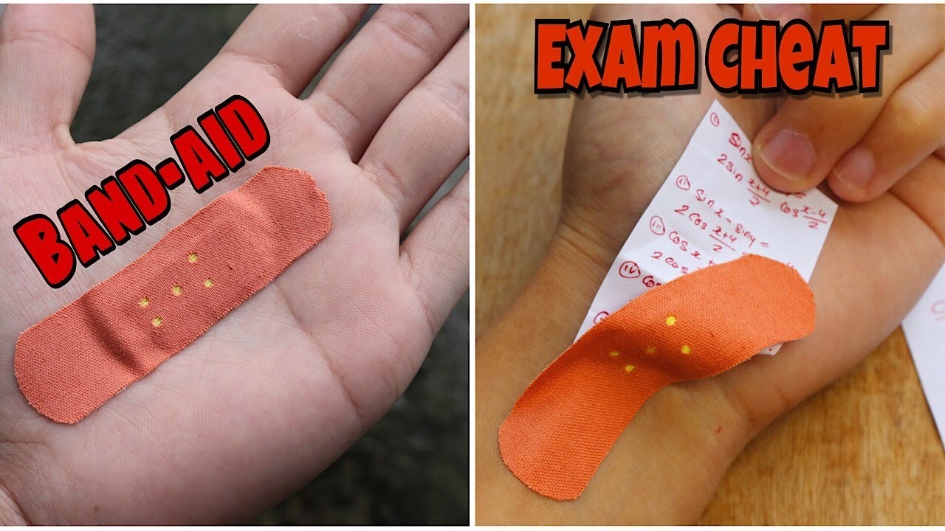
Take Away Messages
1.Low-order co-occurrence statistics impact reasoning tasks significantly
2.Pretraining data, unknown black box?
3.Characterzing the impacting factors on reasoning ability is still an issue
🔭: Boyuan Zheng, Zhiqing Zhong

Slide 48
Short-Term Follow-Ups
Better benchmarks for reasoning ability considering the impact of the training data
1.Mathmatically and Logical as a playground
2.A benchmark without impact of the pretraining data
3.More general form of tasks (natural languages)
🔭: Boyuan Zheng, Zhiqing Zhong

Slide 49
What about 5 years impacts?
More pretraining data aware benchmarks
Quantify the impact through a set of metrics/tools and use that to investigate how much the model is influenced
Remove data points heavily impacted by pretraining data out of the evaluation dataset
Consider the impact of pretraining data when building the evaluation dataset
🔭: Boyuan Zheng, Zhiqing Zhong

Slide 50
Frequency Effects on Syntactic Rule Learning in Transformers
using the case study of BERT’s performance on English subject–verb agreement.
train multiple instances of BERT from scratch, allowing us to perform a series of controlled interventions at pre-training time.
subject–verb pairs that never occurred in training
performance is heavily influenced by word frequency
What if we change the syntactic to logistic, semantic, etc.
🔭: Boyuan Zheng, Zhiqing Zhong

Slide 51
Shortcomes...
BERT appears to represent the correct rule but fails to predict agreement features for low frequency verb forms.
BERT fails to apply the rule when doing so requires overcoming strong item-specific priors.
🔭: Boyuan Zheng, Zhiqing Zhong

