Slide 1

DoRA: Weight-Decomposed Low-Rank Adaptation

Slide 2
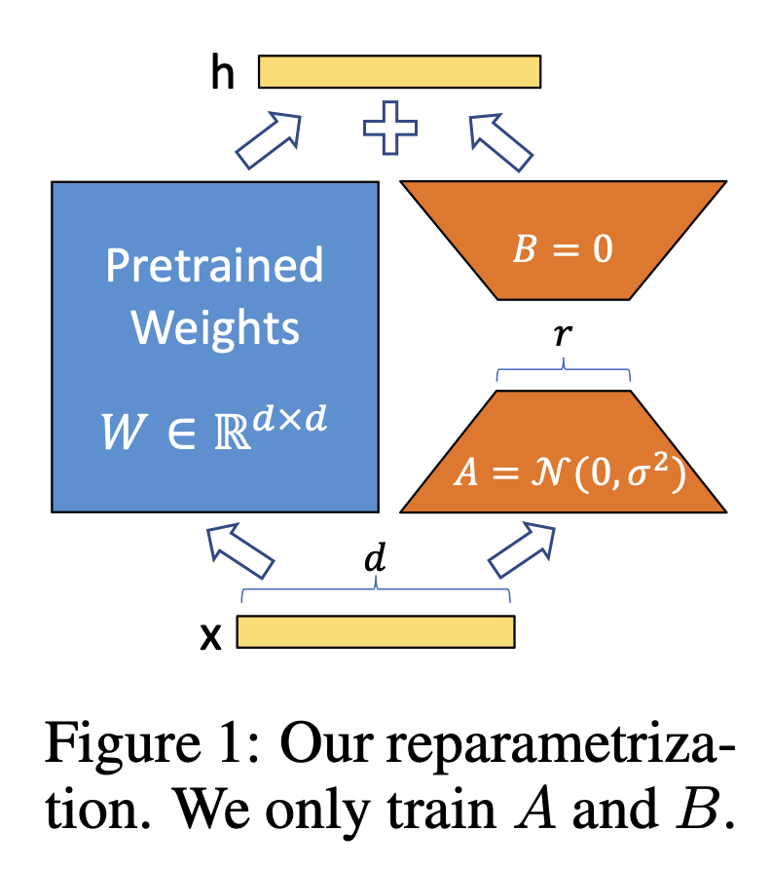
Motivation
Parameter efficient finetuning is great!
It lets us finetune efficiently
And has no overheads during inference
But there’s a gap between FT and LoRA
This is attributed to fewer trainable parameters
But is that all there is to say about this?
Maybe LoRA has certain patterns of updates that are different from FT…

Slide 3
Contributions
Introduce DoRA, which achieves a performance closer to FT
Weight decomposition analysis
Discover learning patterns for FT and LoRA that explains the difference in performance
Empirical results supporting the above

Slide 4
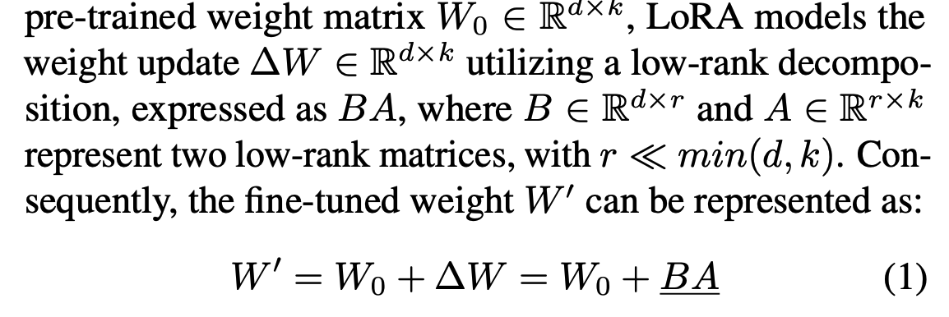
LoRA : Recap
Weight matrix has an intrinsic low rank

Slide 5
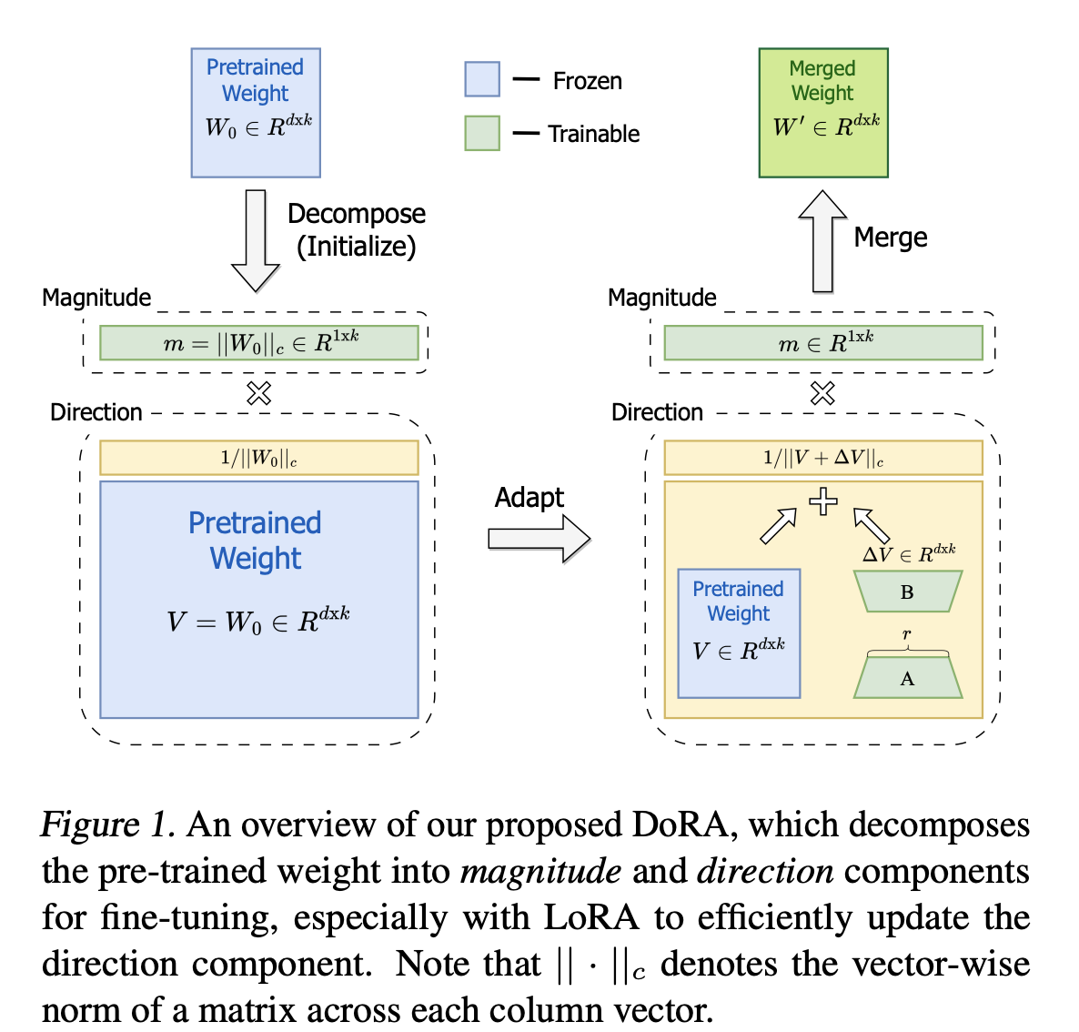
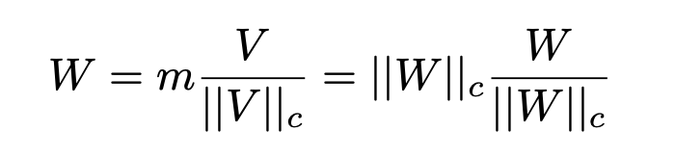
DoRA
Let’s decompose the weight matrix into its magnitude and direction
Decomposition:
Train magnitude separately
Direction is trained using LoRA
More parameters

Slide 6
Inspiration: Weight Normalization
(Salimans & Kingma, 2016)
Reparametrization in this way
Magnitude and direction
Training from scratch

Slide 7
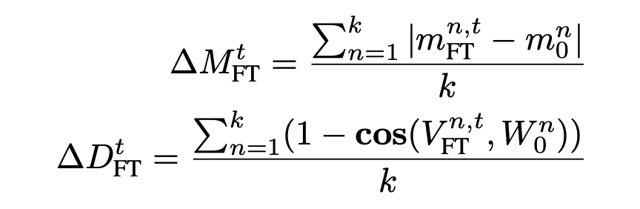
Weight decomposition Analysis
Decomposition:
Magnitude and directional difference:
VL-BART model finetuned on 4 image-text tasks
Only query/value weight matrix in self-attention
Different checkpoints

Slide 8
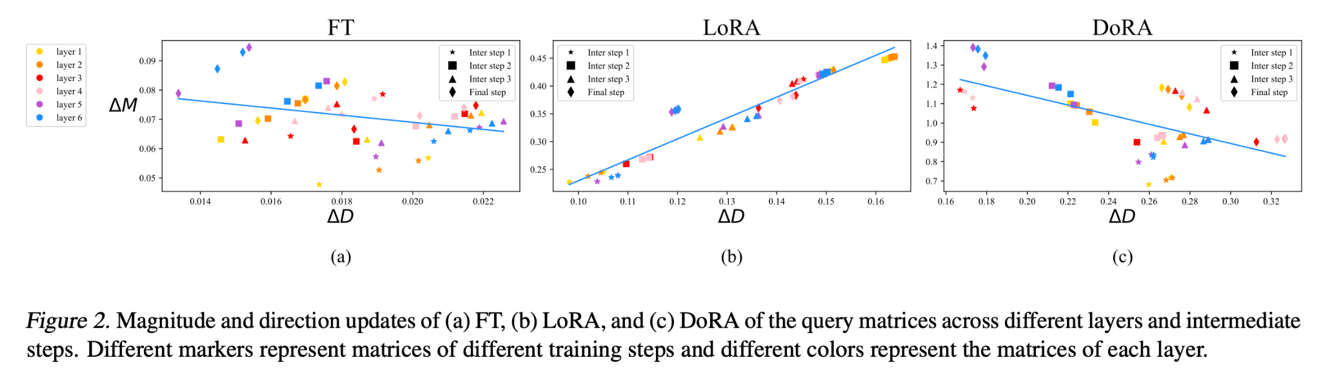

Slide 9
Discussion
FT slightly negative slope
Hypothesis: pretrained weights already know a lot. It’s enough to just change one thing
LoRA has a consistently positive slope
LoRA cannot learn more nuanced adjustments
DoRA also has a negative slope…
…yay?

Slide 10
Further motivation DoRA
Allows directional adaptation with LoRA and magnitude learning separately
Instead of together as in LoRA
Can be merged with pretrained weights before inference - no overhead latency

Slide 11
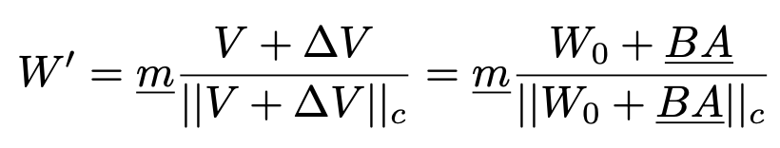
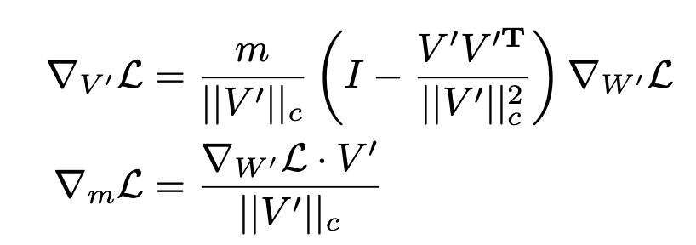
Gradient Analysis
Can be shown that if directional update is lower, then magnitude update is higher (given difference norm is the same)
This is good for stability and optimization
Summary of proof:
If directional update is lower, cosine similarity of gradient and weight matrix is lower
But if gradient norm is the same, then this means that magnitude update is higher

Slide 12
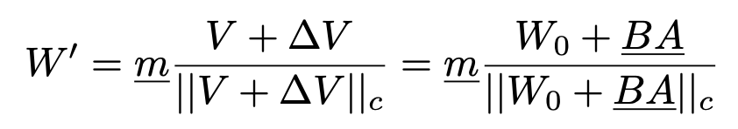
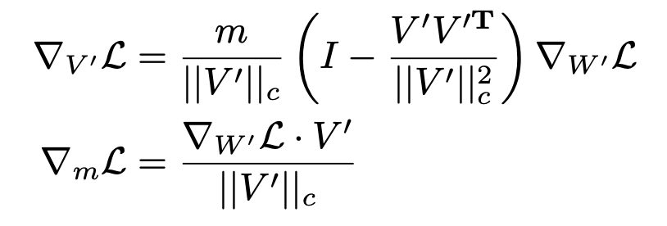
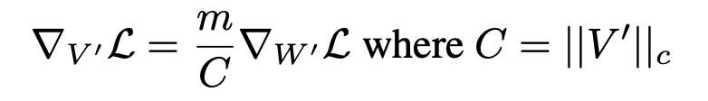
Training overhead
We don’t like to backpropagate to more things
This denominator is extra → let’s ignore it
It will still have actual norm, but won’t receive gradients

Slide 13
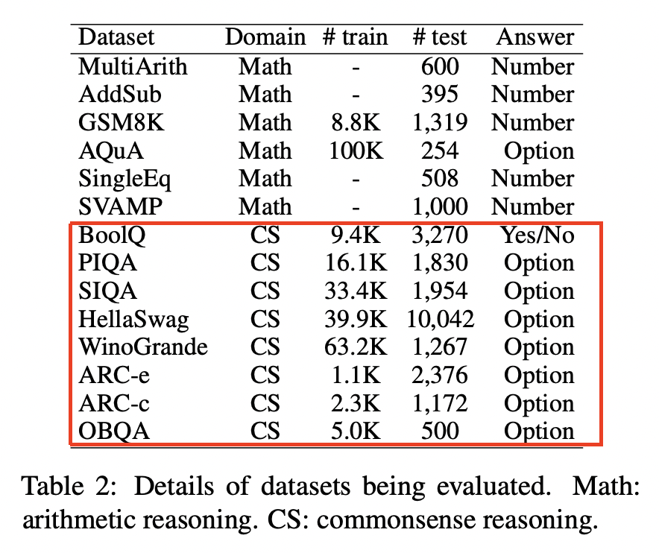
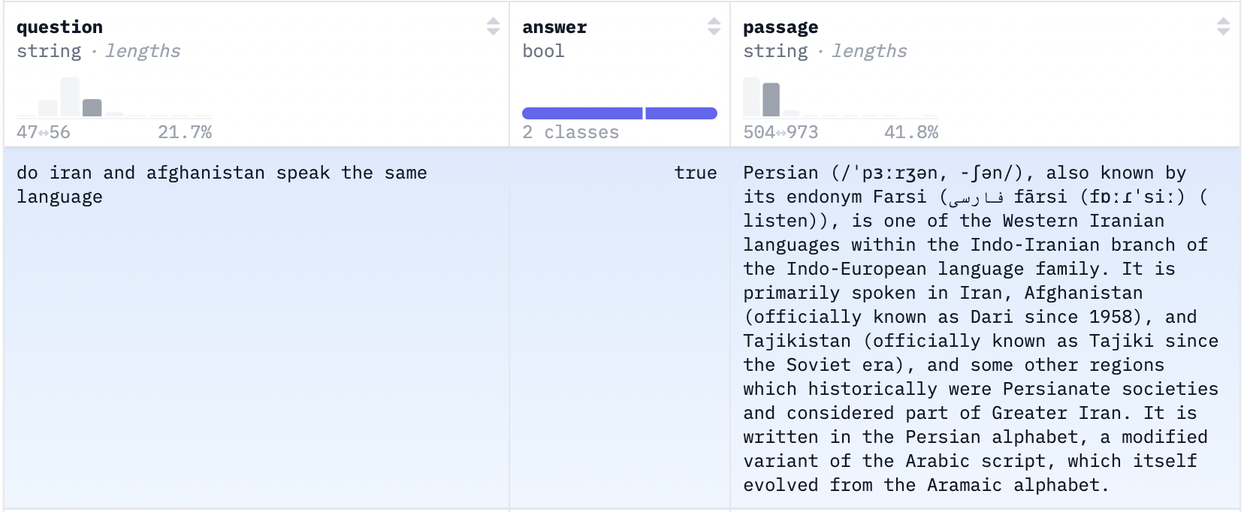
Experiments - Commonsense Reasoning
Datasets
BoolQ

Slide 14
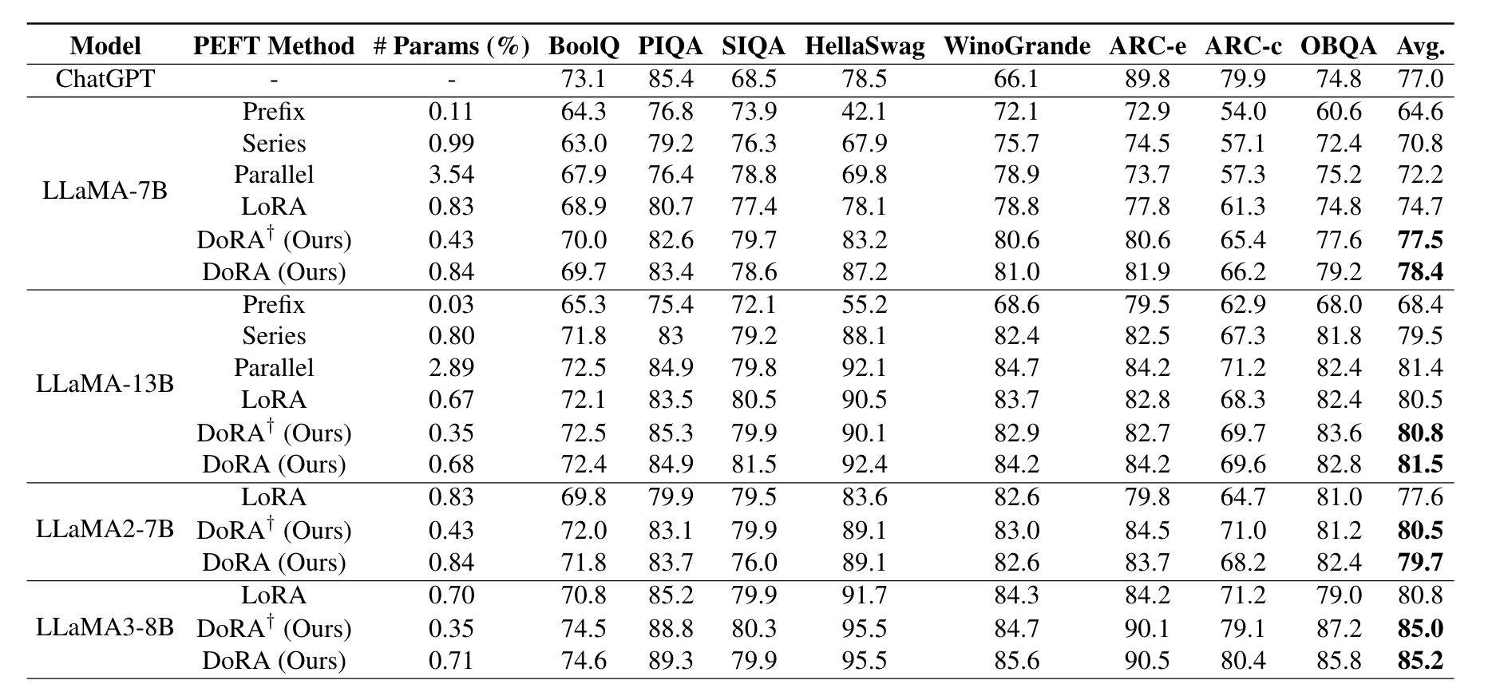
Experiments - Commonsense Reasoning
DoRA outperforms all baselines across LLaMA variants (7B/13B/2-7B/3-8B), with standout gains on LLaMA-7B (+3.7% vs. LoRA, surpassing ChatGPT)
On LLaMA-13B, DoRA matches Parallel adapter's accuracy while using 75% fewer parameters and no extra inference overhead
DoRA† (using half parameters) still beats LoRA by 1-4.2% across all models

Slide 15
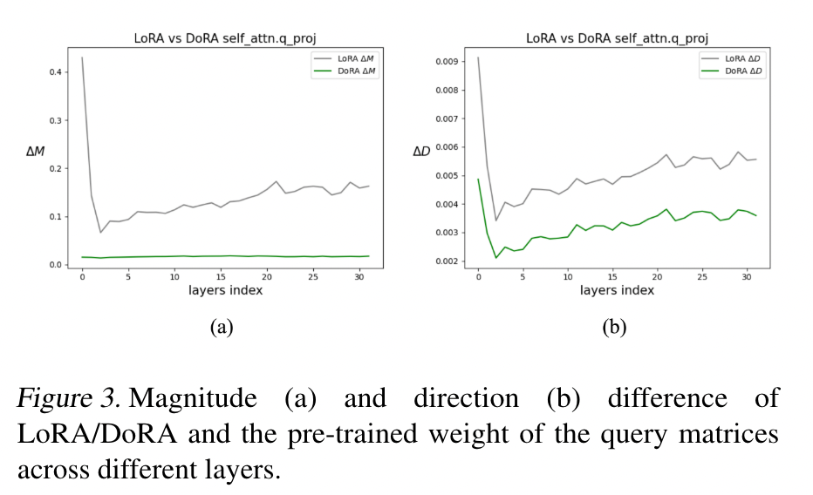
Experiments - Commonsense Reasoning
Pre-trained weights were found to contain sufficient task knowledge - the authors hypothesized that subtle updates are optimal
Their analysis on LLaMA2-7B revealed an interesting pattern: DoRA maintains closer proximity to pre-trained weights vs. LoRA
This explains DoRA's effectiveness: its fine-grained update mechanism enables precise adjustments while preserving model knowledge

Slide 16
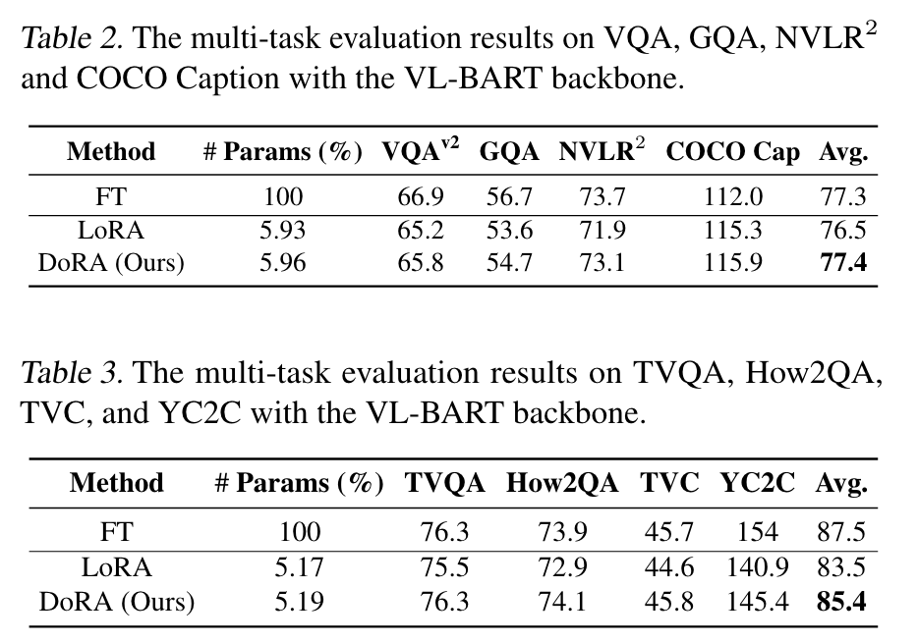
Experiments - Image/Video-Text Understanding
DoRA not only outperformed LoRA (+1% on image tasks, +2% on video tasks), but also matched full fine-tuning accuracy with just a fraction of trainable parameters

Slide 17
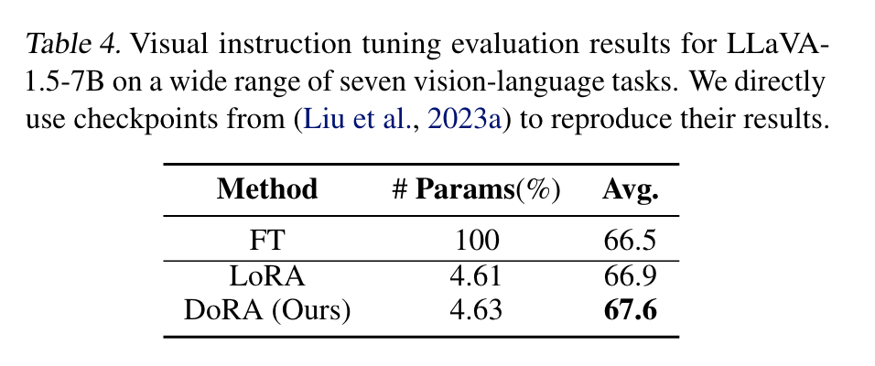
Experiments - Visual Instruction Tuning
Despite LoRA already outperforming full fine-tuning, DoRA still showed consistent gains (+0.7% over LoRA, +1.1% over FT)

Slide 18
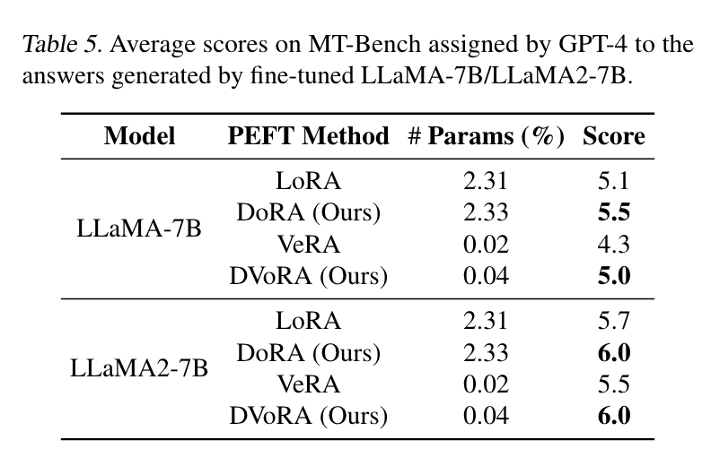
Experiments -
Compatibility of DoRA with other LoRA variants
Test DoRA’s compatibility with VeRA by combining DoRA's directional updates with VeRA's low-parameter, shared-matrix approach for efficiency.
Outperforms LoRA and VeRA on LLaMA-7B and LLaMA2-7B (10K Alpaca dataset).

Slide 19
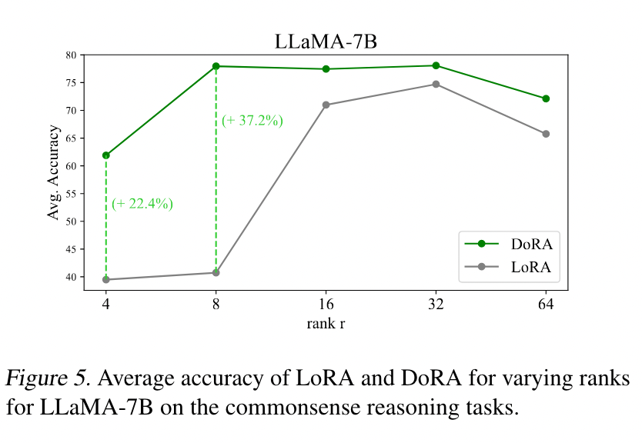
Experiments -
Robustness of DoRA towards different rank settings
DoRA consistently outperforms LoRA at all ranks.
Significant gap at lower ranks:
For r = 4, DoRA achieves 61.89% accuracy vs. LoRA’s 39.49%.
For r = 8, DoRA reaches 77.96% accuracy vs. LoRA’s 40.74%.

Slide 20
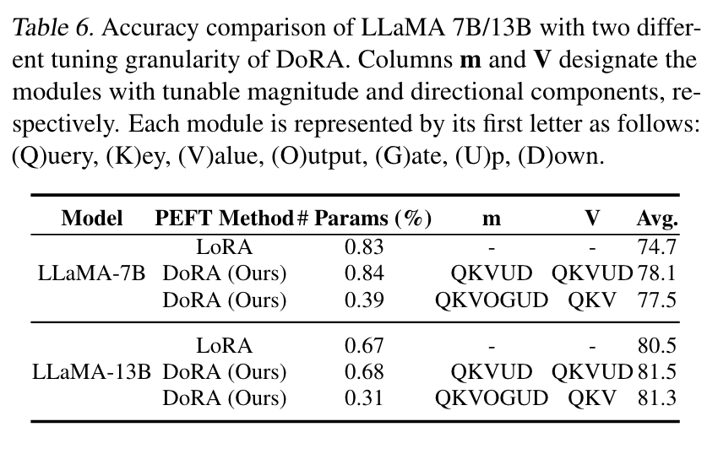
Experiments -
Tuning Granularity Analysis
DoRA can already achieve superior accuracy by updating only the directional and magnitude components of the multi-head layers and the magnitude of the MLP layers.
Method:
Selective updates: QKV (direction & magnitude), MLP (magnitude only)
Key Results (Table 6):
LLaMA-7B: +2.8% accuracy over LoRA
LLaMA-13B: +0.8% accuracy over LoRA
Efficiency: Uses <50% of LoRA’s parameters

Slide 21
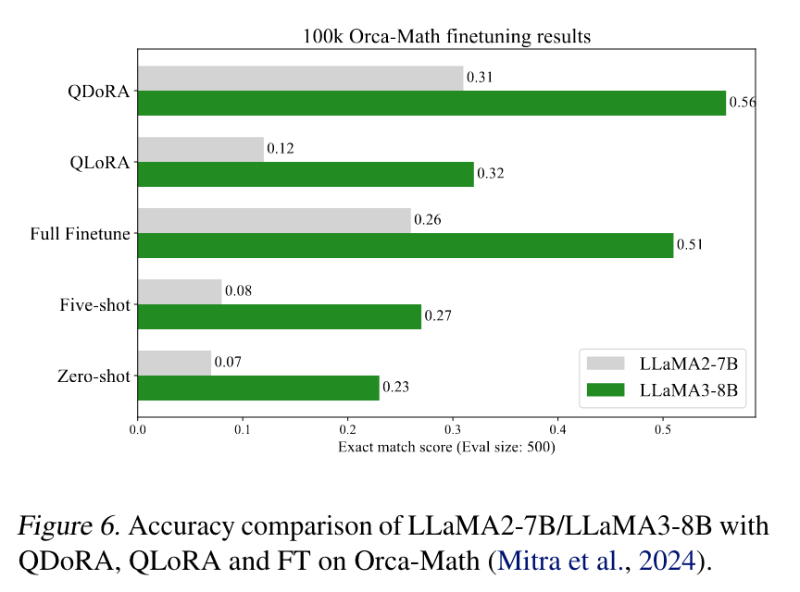
Broader Impacts
QDoRA: Combines DoRA with QLoRA to improve memory efficiency in LLM fine-tuning, surpassing QLoRA by up to 0.23% and outperforming full fine-tuning with less GPU memory.
Text-to-Image: DoRA achieves more accurate and personalized results than LoRA, capturing unique features in generated images (e.g., frames, logos).

Slide 22
Thanks

