Slide 1

Fast Inference from Transformers via Speculative Decoding
Dongwei Jiang, Yiran Zhong, Oct 22

Slide 2
Highlevel TakeAway
This is a method that decodes faster from autoregressive models: 2X-3X in typical scenarios.
Only different decoding algorithm: no architecture changes, no re-training.
Identical output distribution.
Notes:
Notably,
Wisdom of Committees (Schwartz et al., 2020) leverages
off-the-shelf smaller models, but is an adaptive computation
approach, and so it uses a heuristic to determine when to
stop, losing the guarantee of identical outputs to those of
the target models.
Blockwise
Parallel Decoding (Stern et al., 2018) decodes several tokens
in parallel, similarly to our work. However, it only
supports greedy decoding (temperature=0) and not the general
stochastic setting, it requires additional training of a
custom model, and focuses on preserving down-stream task
quality, instead of guaranteeing identical outputs

Slide 3
Observation
Some tokens are easier to predict than others. So it’s possible for efficient smaller models to stand in for their larger counterparts!
prize
physics
100B model
100B model
Geoffrey Hinton was awarded the nobel …
Geoffrey Hinton was awarded the nobel prize in …
This is easy!
Let’s use 1B model!
This is hard!
Have to use 100B model!

Slide 4

How can we make sure small model’s predictions are correct?
We can use small model to propose several candidates and use large model to decide whether to accept them!
Peace
Geoffrey Hinton was awarded the nobel prize in …
Literature
Physics
Physics
Chemistry
Since large models can verify multiple predictions at once, we can let the small model guess several tokens ahead!

Slide 5
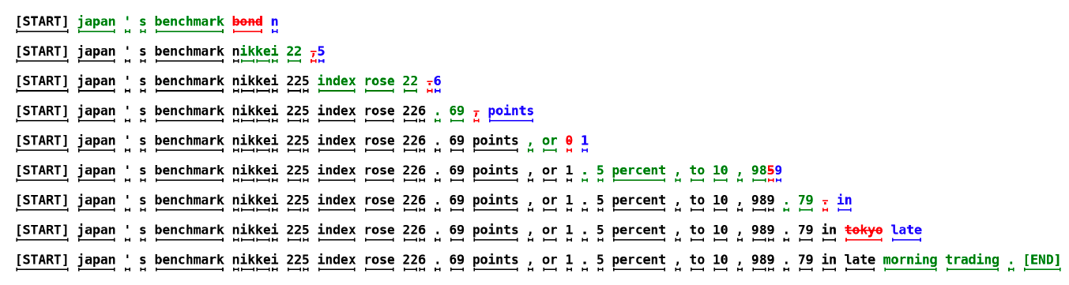
Speculative Decoding
Let the small model make multiple expensive step-by-step predictions, then verify them all at once with the big model!
Green ones are predictions from the small model
Red ones are rejected predictions from the big model
Blue ones are corrections proposed by the big model
For the first prediction, the big model was run only once, and 5 tokens were generated! Thats 80% speed up!

Slide 6
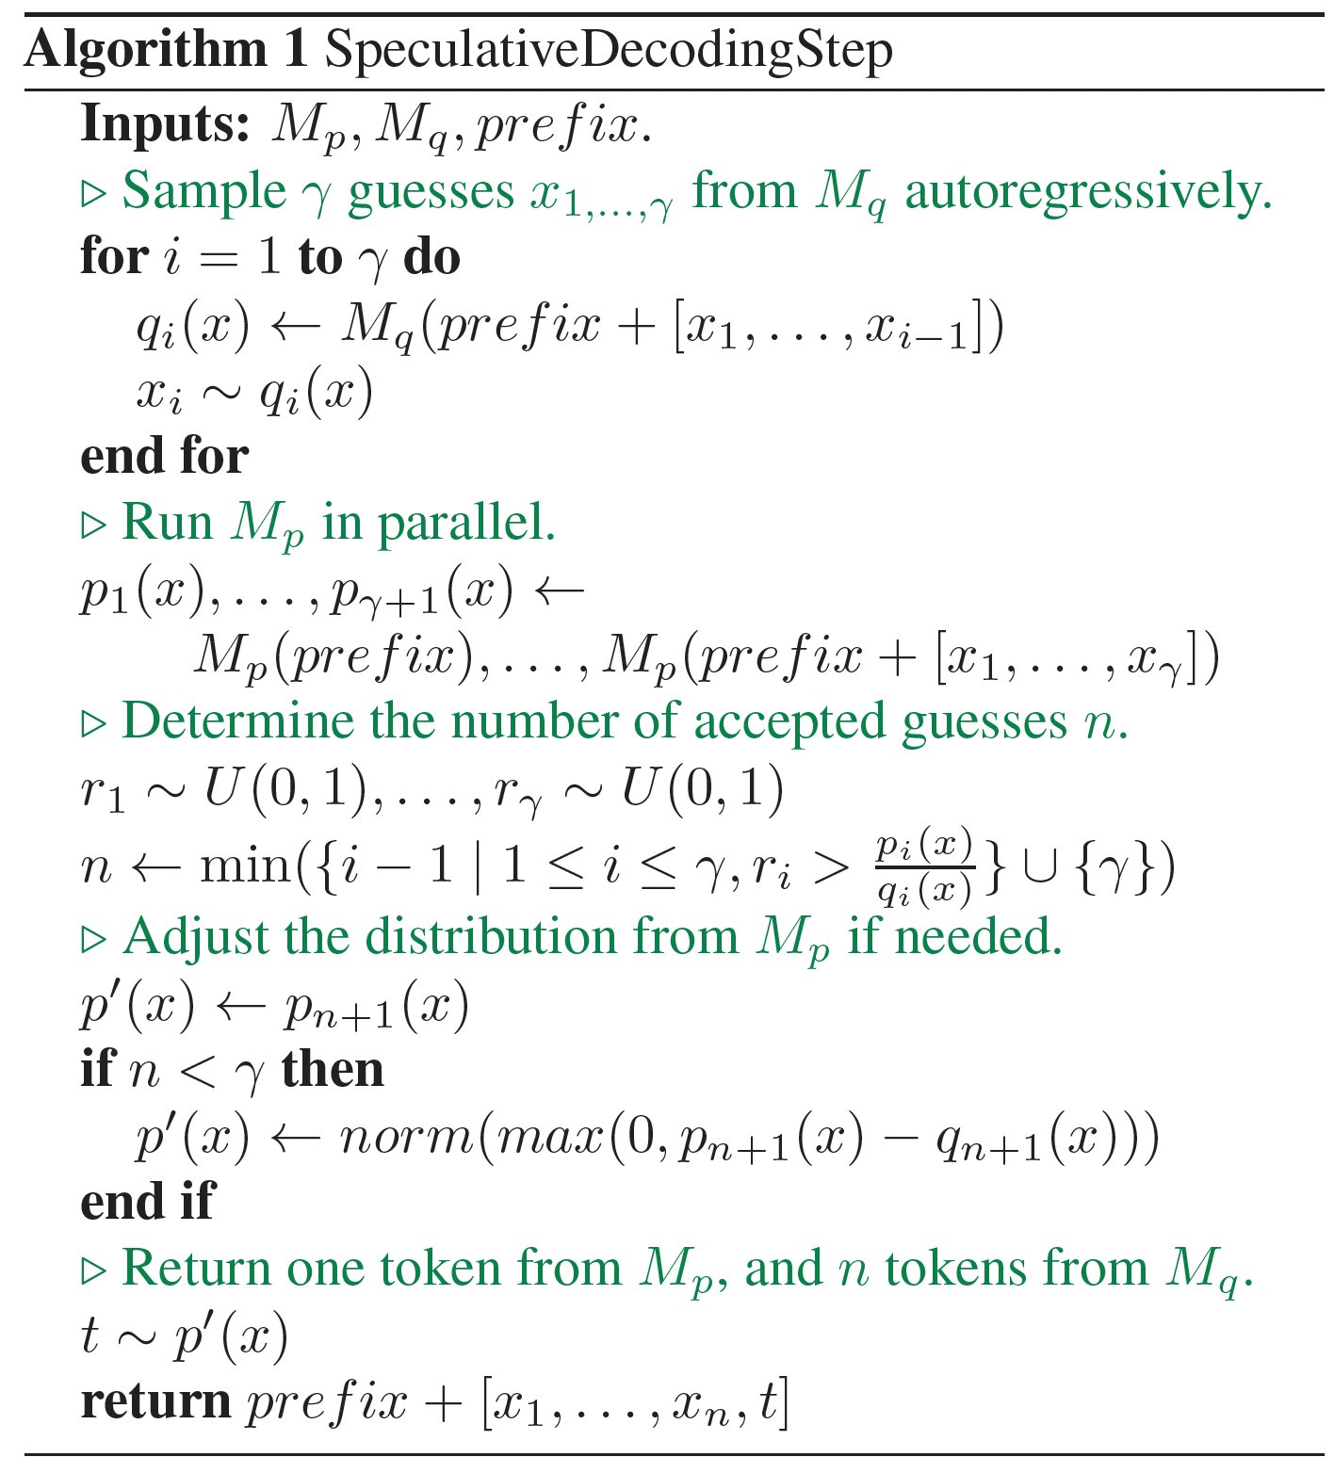
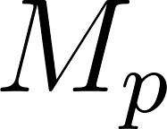
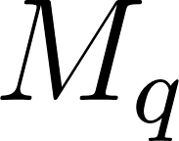
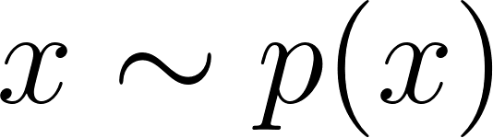
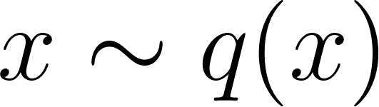
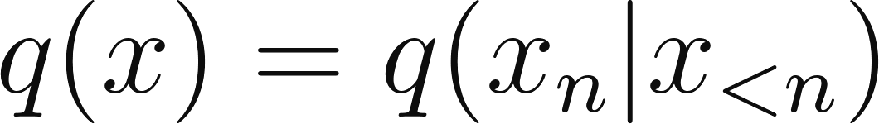
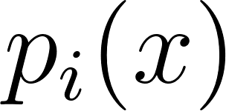
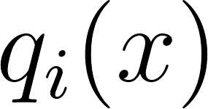

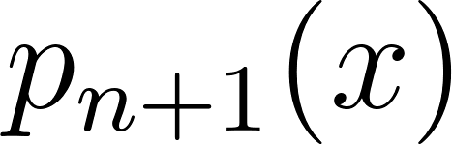
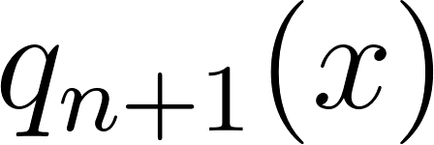
Overall Algorithm
Definition: is the base model and is the efficient approximation model
To sample , we instead sample
We’re substituting multiple AR generation of M_p with multiple AR generation of M_q and one parallel generation of M_p
Random numbers sampled uniformly from [0,1]
Find the min i that satisfies the condition. If > , it’s always accepted. If everything is accepted, it sets n to
Deal with the last token: if everything is accepted, it follows the distribution of
Else, follows the distribution of norm(max(0, - )). This adjusts the probability mass that was affected by the rejected guess by from step n + 1

Slide 7
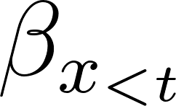
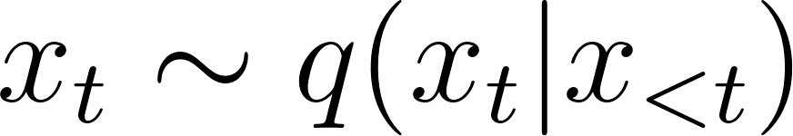
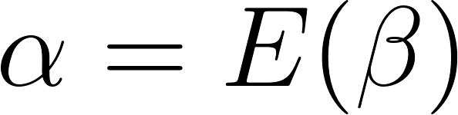
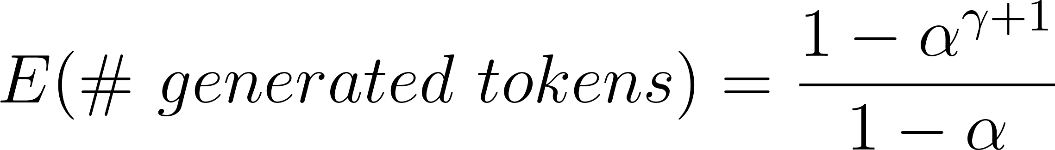
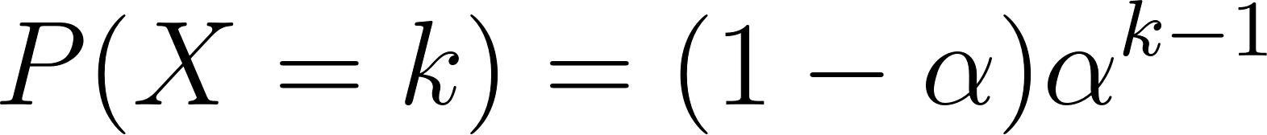
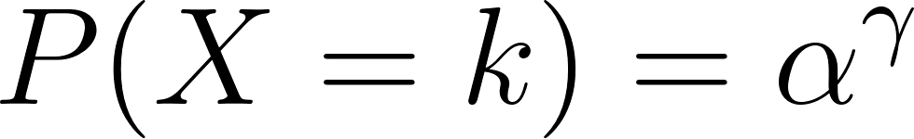
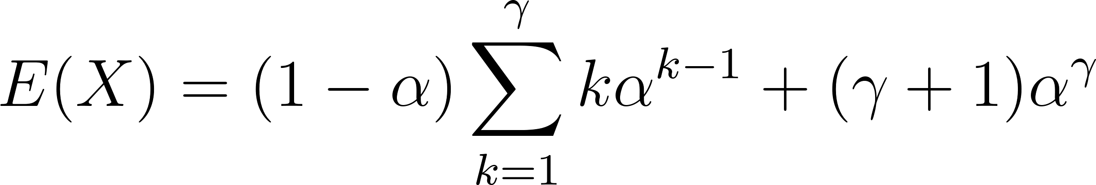
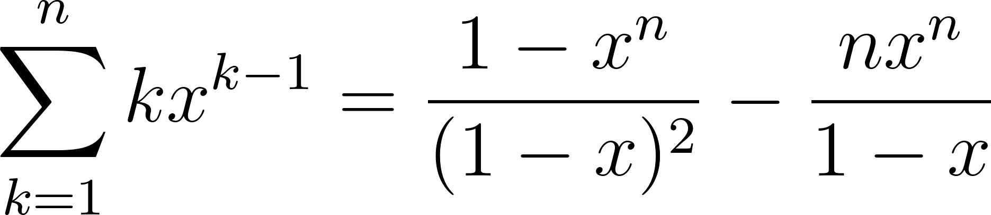
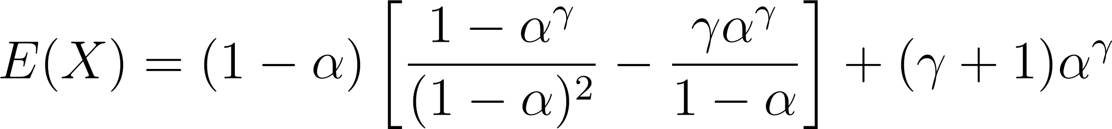

What is the Expected Number of Accepted Tokens?
Definition: is the probability of accepting , under i.i.d assumption,
is its expectation, or the probability of accepting any token, then we have:
First, get the probability mass function of # generated tokens (or X).
For k = 1, 2, ..., :
For k = + 1:
Then, the expected value of X is
Lemma: the sum of a geometric series (proof by induction):
Applying this formula above with x = and n = :
Notes:
Let me break this down for random variables X₁, X₂, ... Xₙ that are i.i.d.:
Expected value E(X) is defined as Σ(x * P(X=x)) - this is a theoretical calculation based on the probability distribution
The average (X₁ + X₂ + ... + Xₙ)/n is a calculation based on observed values
Law of Large Numbers says this average converges to the EXPECTED value, not just any average!
WHY? Because:
Each X_i has the same probability distribution (identically distributed)
Each X_i contributes independently to the sum (independent)
Therefore, when you take enough samples, you're essentially sampling the whole probability distribution according to its true probabilities
So the average must converge to the weighted sum of values (weighted by their probabilities) - which is exactly the definition of expected value!

Slide 8
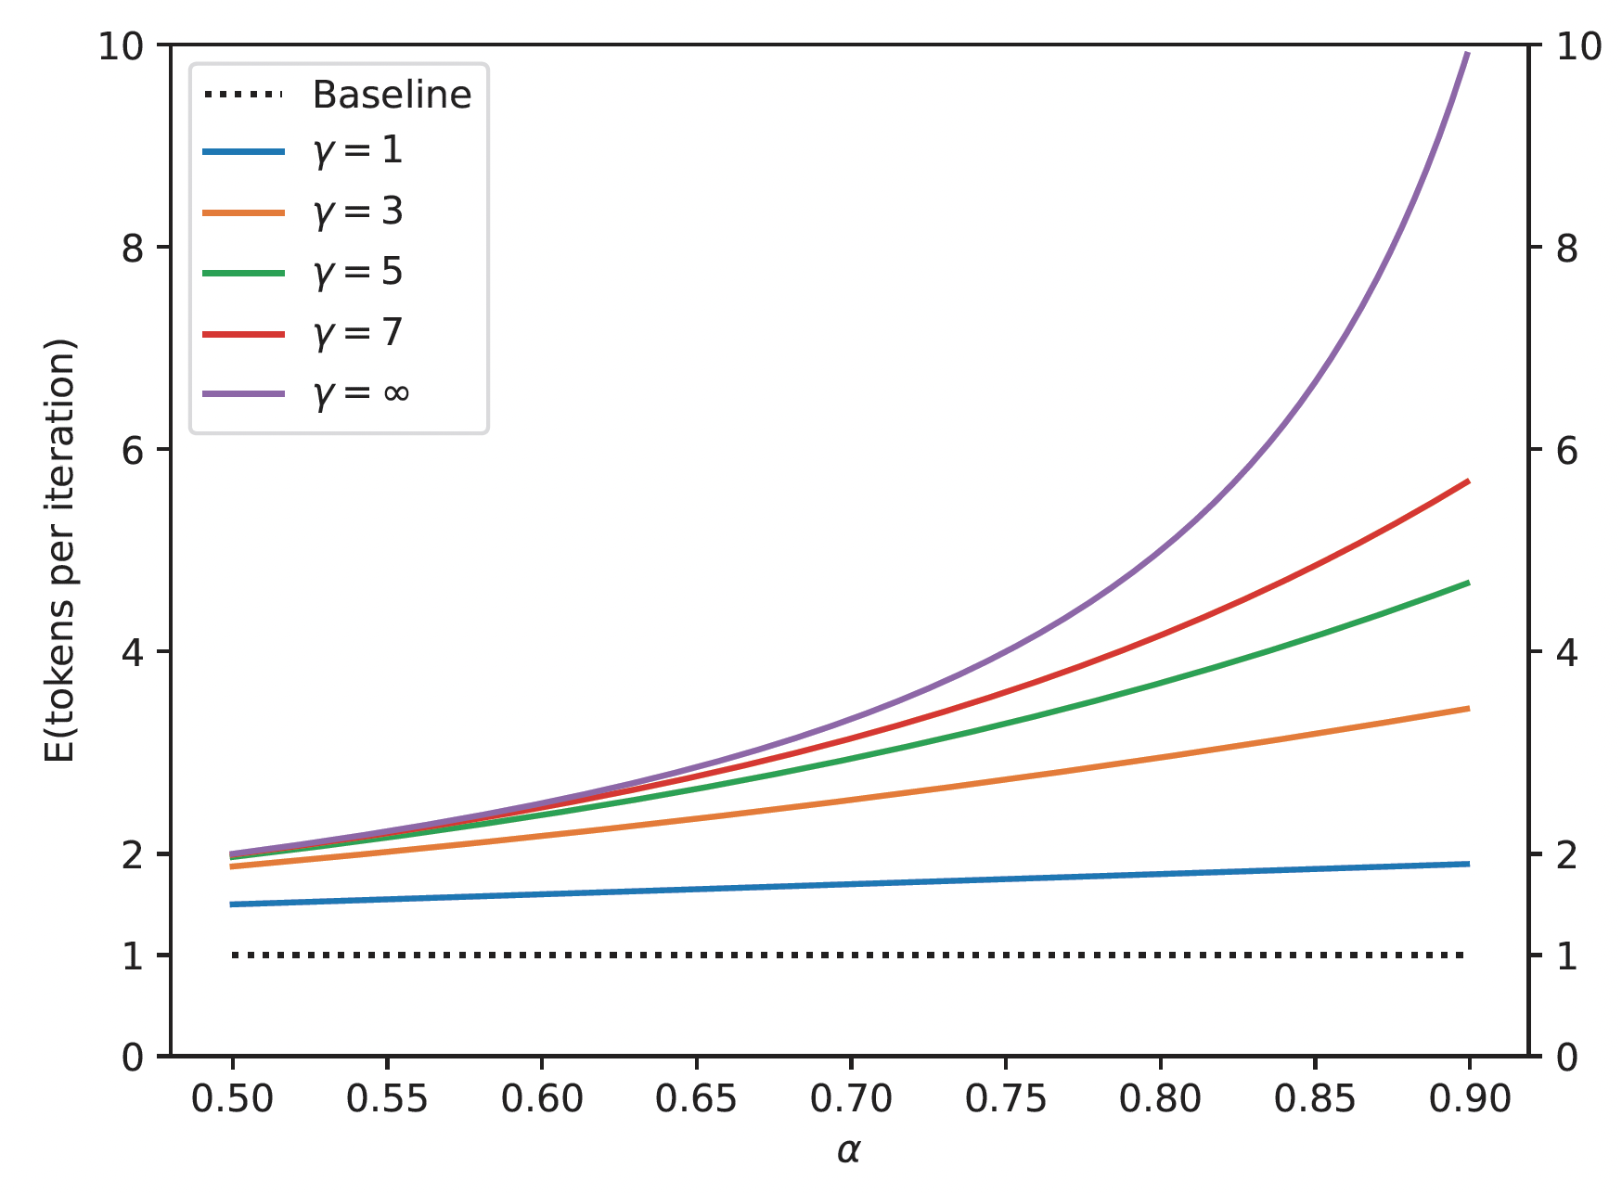
Empirical results for Expected Number of Accepted Tokens
Remember:
If is 0.9, we can almost accept all ! But what are the true alphas?

Slide 9
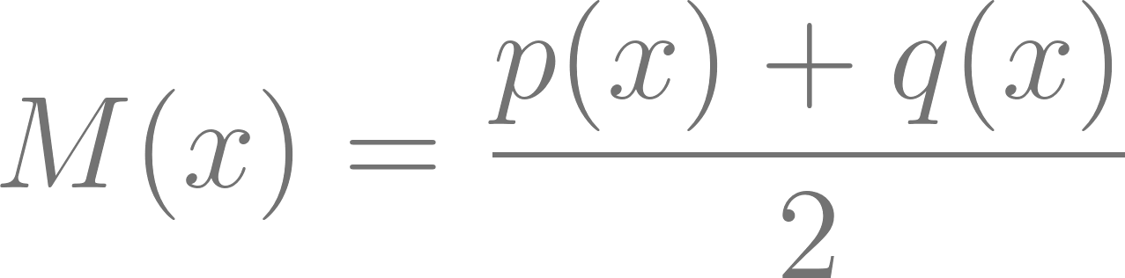
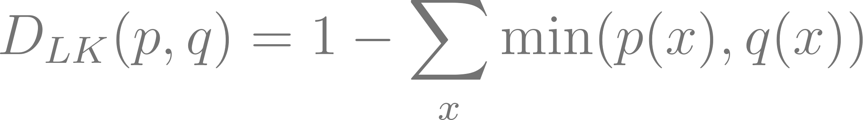
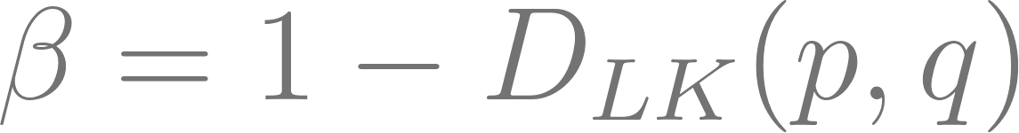
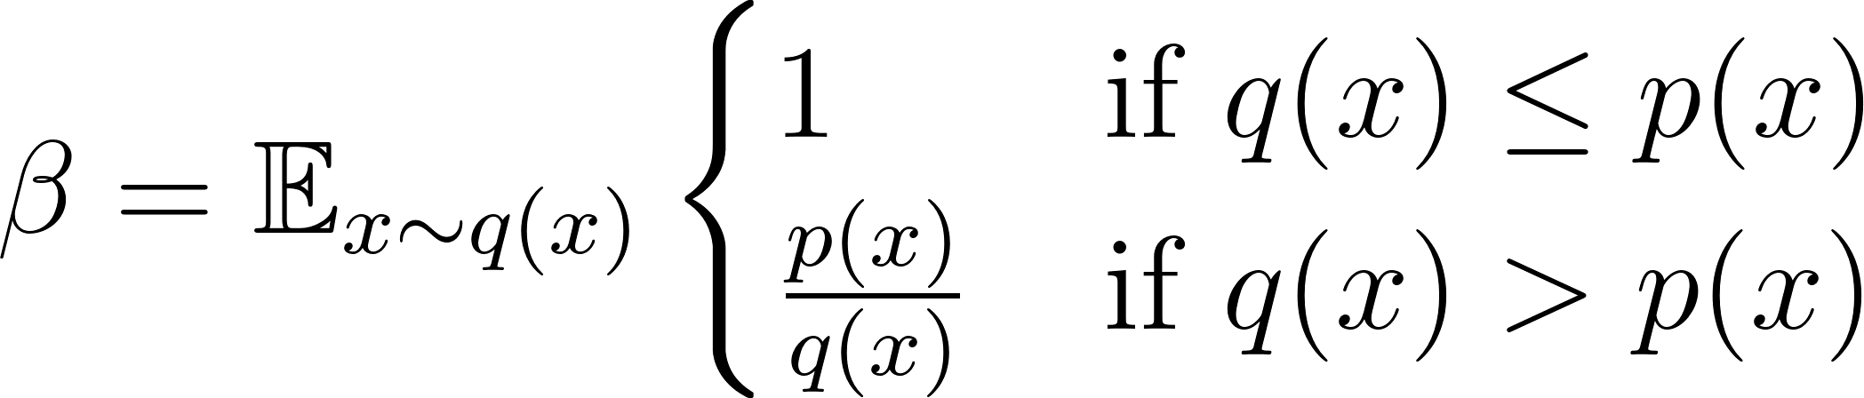
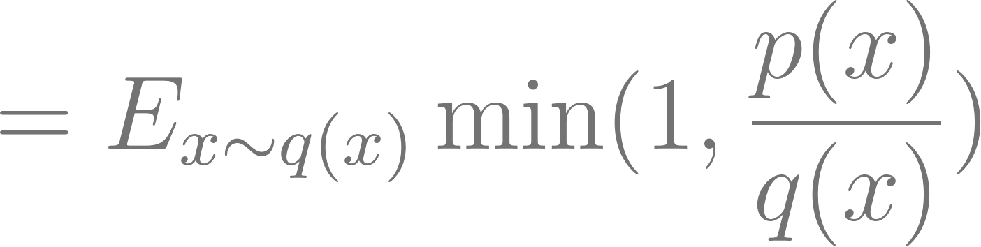
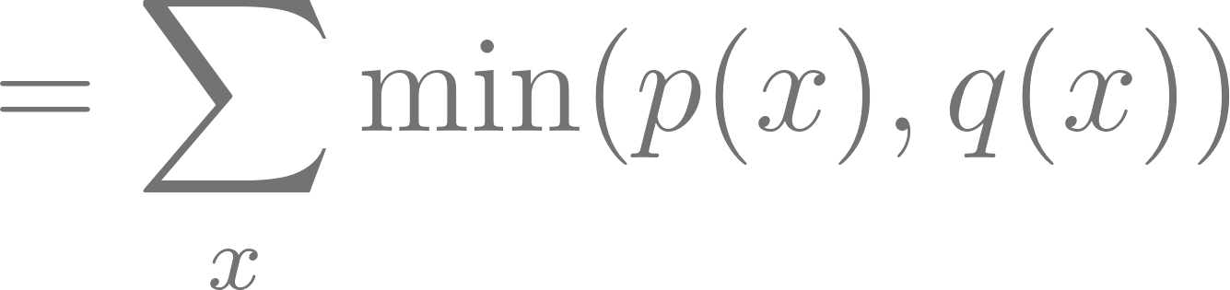
Calculating Alpha
Define: where
Lemma:
Proof:
We also have:
Proof:
So we also have:
So we only need look at how much overlap there is between the distributions p and q!
Notes:
the support of a probability distribution is the set of all possible values that a random variable can take with non-zero probability For a discrete random variable X with probability mass function p(x), the expected value of a function g(X) is:
E[g(X)] = Σ_x g(x) * p(x)
In this case:
X is distributed according to q(x)
g(x) is the function min(1, p(x)/q(x))
So E[g(X)] = Σ_x min(1, p(x)/q(x)) * q(x)
Yes, this is a normal way to expand expectations! The key is that when you see E_x~q(x), it means you multiply by q(x) when you expand the sum. This is why probability theory writes expected values with a subscript showing the distribution.

Slide 10
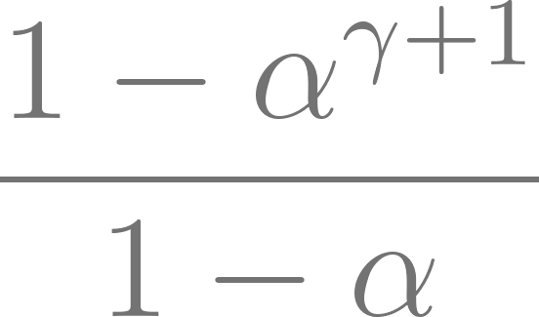


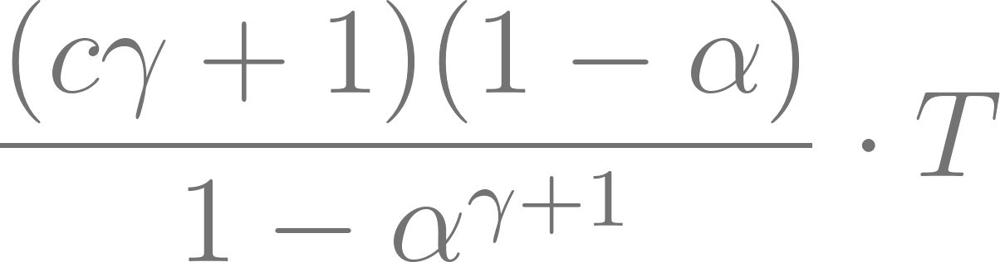
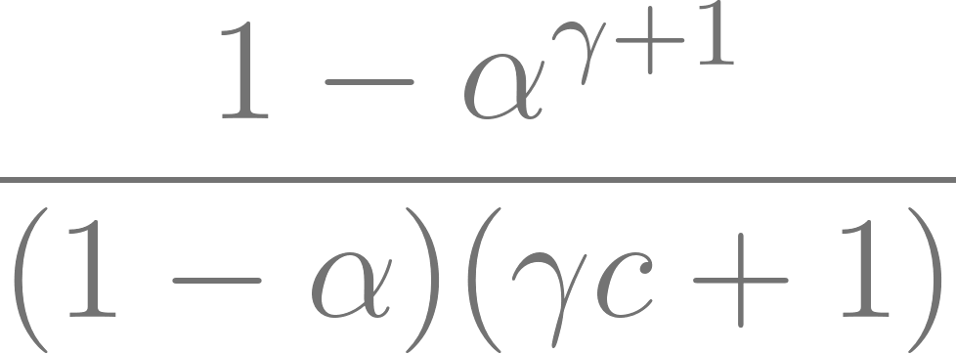

Walltime improvement
To analyze improvement of the actual elapsed time for running algorithm of speculative decoding
Reduction in calls: (reduce the # of call to target model )
Cost efficient: c (ratio of time for single run of approximation model to target model
Expected cost producing a token: where T is cost of single decoding step.
Improvement Factor: the higher value of alpha and lower c for
better improvement

Slide 11



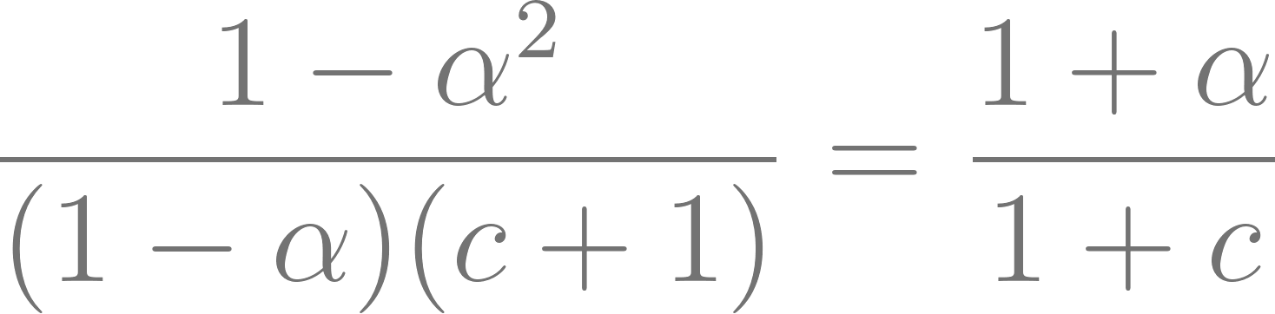
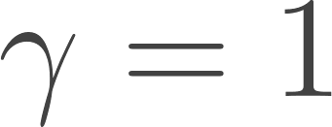
Special case when
When , there’s value of provide improvement
When , The improvement factor is

Slide 12
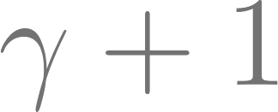
Number of Arithmetic operations
Purpose: Analyze how speculative decoding impacts the total number of arithmetic operations compared to standard decoding.
Speculative decoding involve parallel runs of it increase the number of concurrent arithmetic operations by a factor of .
Increase concurrency will cause the unnecessary additional computation if samples were rejected.

Slide 13


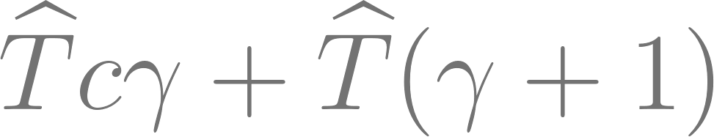
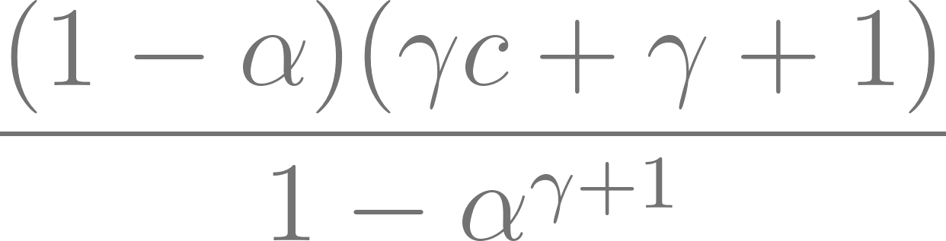
Expected factor of increase
Suppose single run of has operations, and has operations
The run for and the run in parallel for
Total operation:
We normalize (show total operations of speculative decoding compare to the standard decoding) it by and dividing by expected number of tokens.
The expected factor of increase in operations:

Slide 14
Memory Efficiency
Memory shrink by factor (expected token generated)
Because comparing to standard decoding which generating one token at time, we generate this expected number of token in parallel, the target model’s weights and KV cache can be read once per execution.

Slide 15


Choice of γ
represents the number of speculative decoding iterations before a target model evaluation
goal is to maximize walltime improvement by selecting an optimal given cost coefficient and acceptance rate
Could be optimized through numerical search.
The best depends on balance between computation cost and acceptance rate

Slide 16



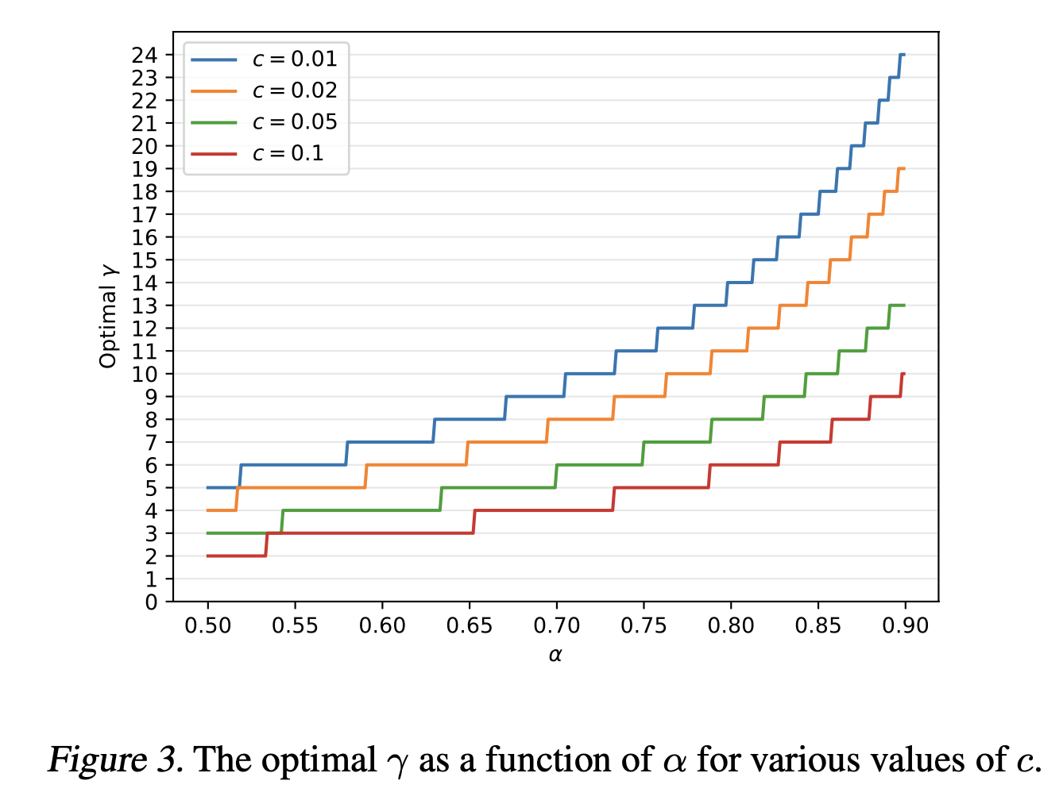
Trade off ( increase with higher and lower )

Slide 17
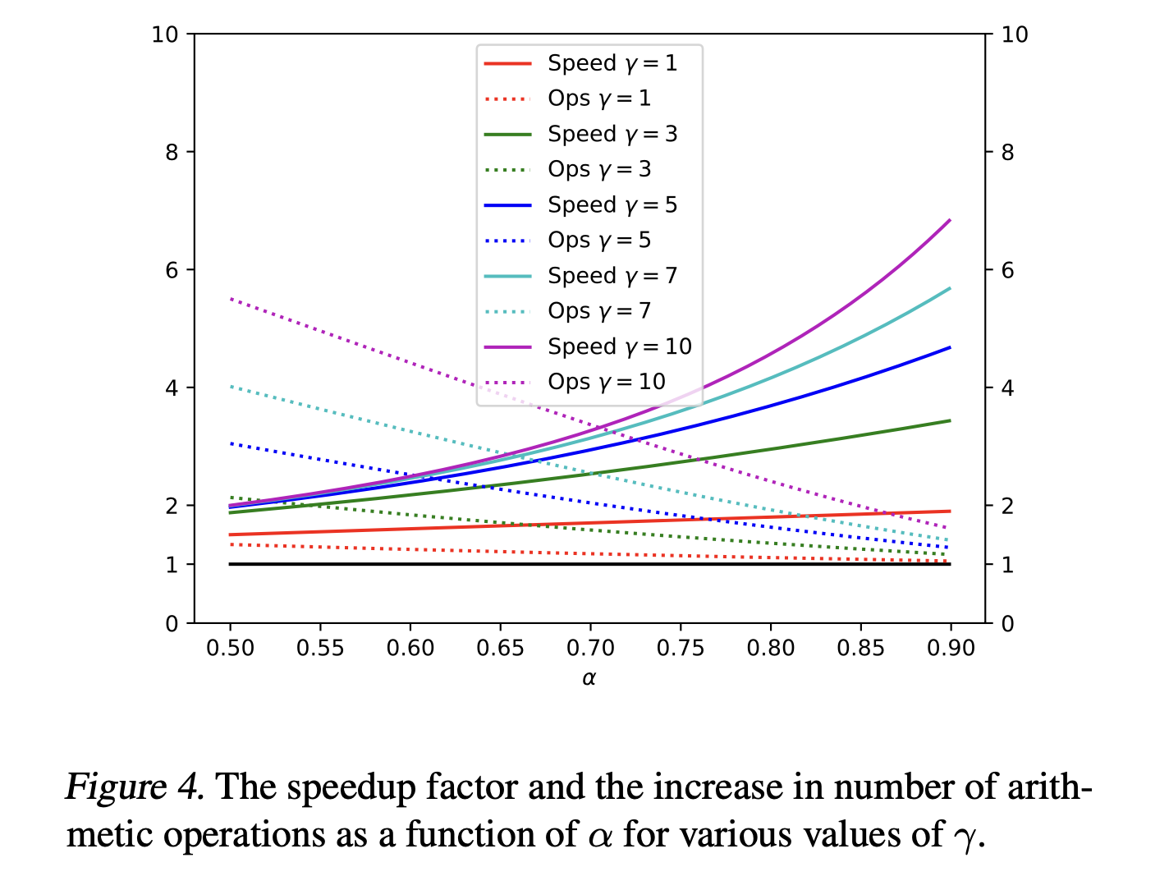
Increase of lead to speed up and lower increase in arithmetic operation

Slide 18
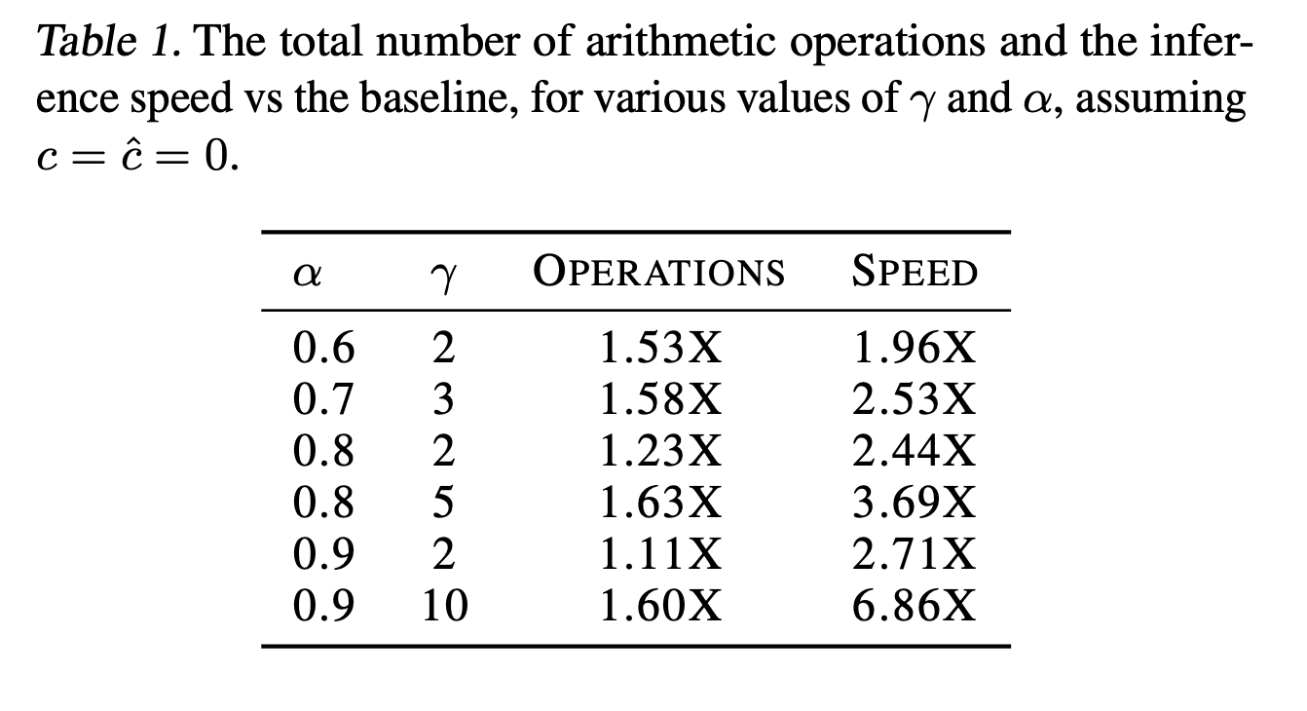
Different affect speed and operations

Slide 19
Observation 4
Adaptive speculative decoding offers a more efficient way to boost speed by intelligently managing the number of speculative steps, leading to significant walltime reductions.
However, if is too high relative to acceptance rate , it may lead to wasted computation due to rejected tokens from , thus reduce efficiency.

Slide 20
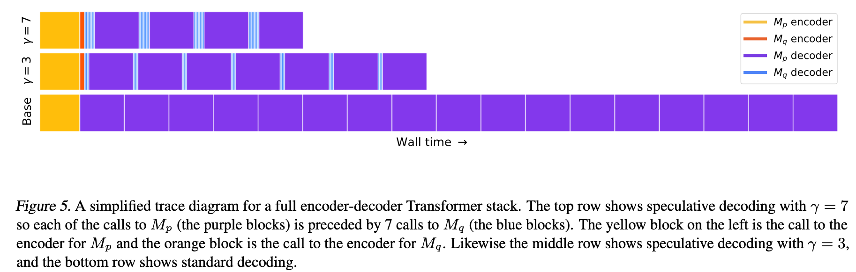
Speculative decoding with different compared to standard decoding

Slide 21
Experiment
Goal: Validate the speculative decoding method on real tasks and compare it with standard decoding.
Task: 1. Machine Translation (English-to-German) 2. Text Summarization
Models:
Target Model: T5-XXL (11B parameters)
Approximation Models: T5-small (77M), T5-base (250M), T5-large (800M)
Decoding type: Argmax Sampling (temperature = 0)
Standard Sampling (temperature = 1)

Slide 22
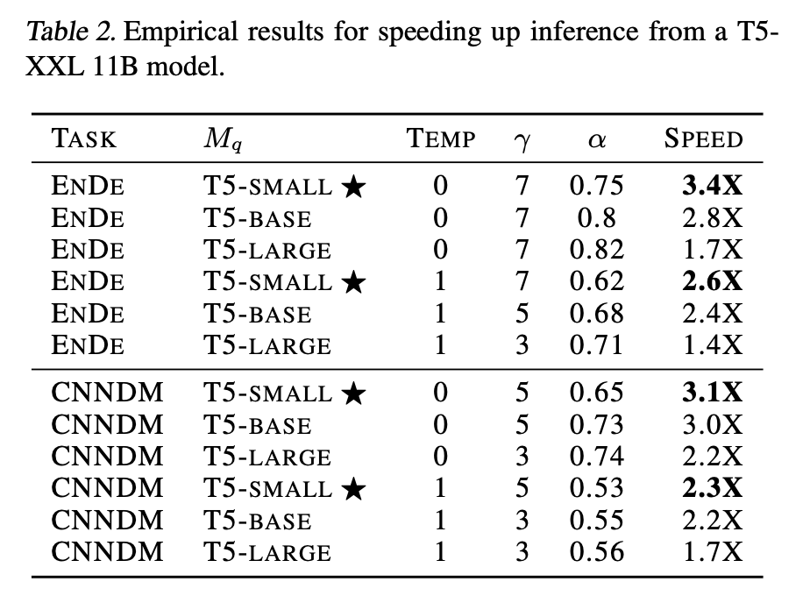
Result
Translation Task: WMT EnDe fine-tuned on T5. Summarization Task: CNN/DM fine-tuned on T5.

Slide 23
Observation 5
Argmax sampling provide higher acceptance rate and thus have better speed up improvement.
Approximation model T5-small achieve best improve in speed

Slide 24
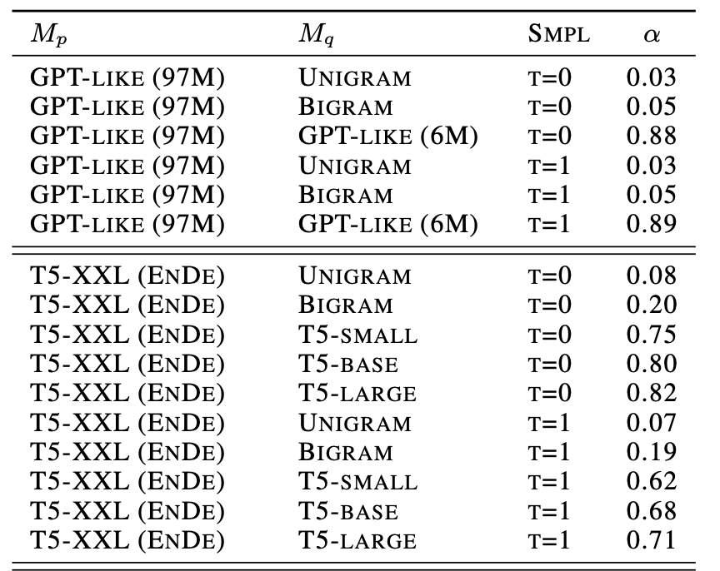
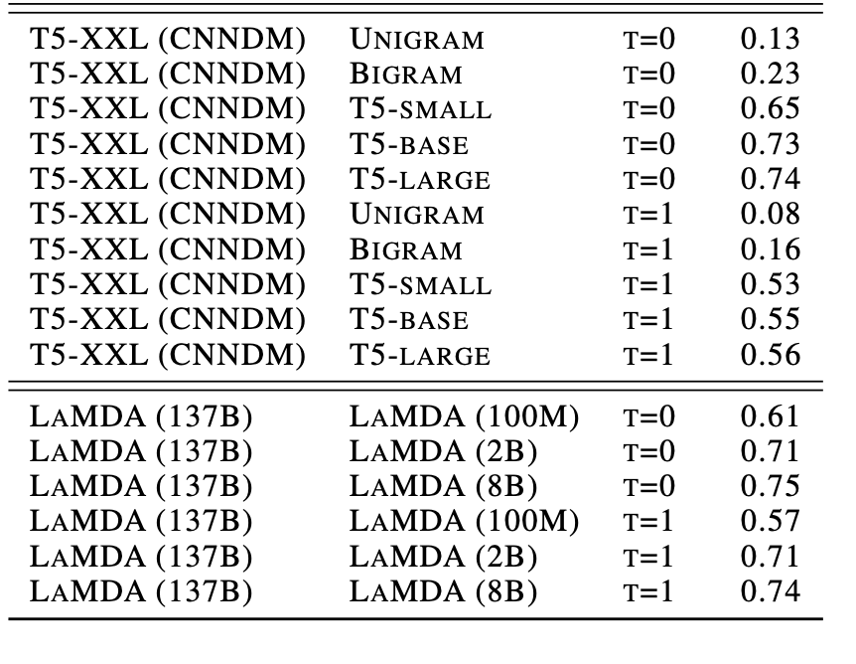
Empirical value for various target model
Smaller (like unigrams/bigrams) lead to lower
Simple models (unigrams, bigrams) still provide non-zero , may yielding reasonable speedups.

Slide 25
Thank you!

