Slide 1
Are Emergent Abilities of Large Language Models a Mirage?
Yiran Zhong, Niyati Bafna

Slide 2
What are “emergent” capabilities?
Defined by the following things:
Sharpness: these abilities simply “appear”
Unpredictability: we don’t know when they will appear
Mysticism: they are part of the LLM dark arts, a miracle of scale
Hype: they indicate that the LLM is *fundamentally* different from the LM.
Emergent Abilities of Large Language Models (Wei et al, 2022)
Notes:
Described by prior work as capabilities that appeared “only” at scale, making large LMs fundamentally different from smaller LMs. Cannot be extrapolated from smaller-scale models. More-is-different idea.

Slide 3
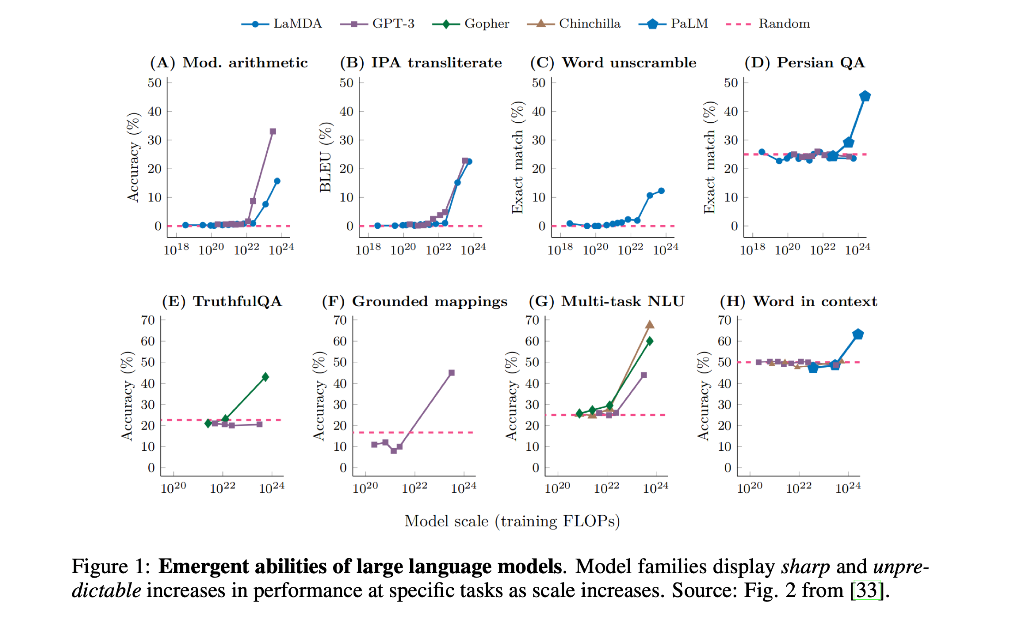

Slide 4
But…
These abilities only show up on tasks measured by metrics with certain properties
→ Claim of paper: emergent properties are a mirage ←
Implying
The LLM is still a familiar creature…
…which we can understand by extrapolating from little LMs. (*phew*)

Slide 5
Issues with Evaluation
“Non-linear or discontinous metric”
Bad statistics
Test dataset resolution
Insufficient sampling

Slide 6
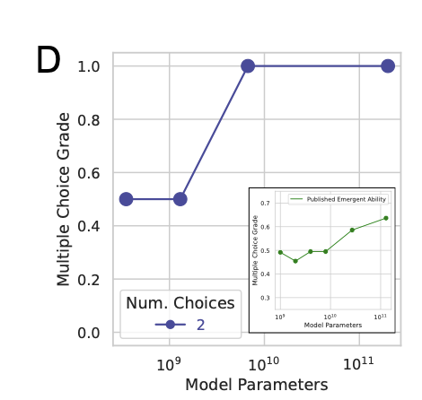
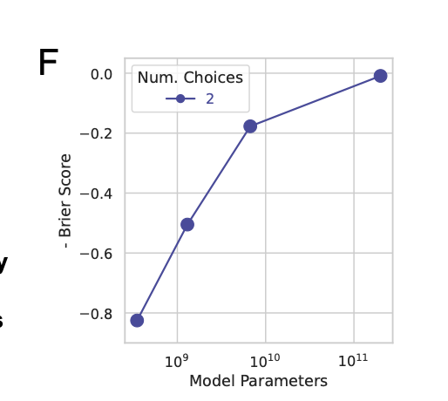
Discontinuity of Metrics
Intuition #1: All-or-nothing evaluation doesn’t let you see in-between progress
Example: Multiple-choice
Instead, using Brier Score (MSE b/w probs)
Our note: you still might argue that a dataset-level metric like a sum of accuracies is continuous…

Slide 7
Statistics: Resolution and Sampling
Intuition #2: a dataset has an inherent granularity that it lets you evaluate any model at. If the resolution is too high, you will miss things.
Resolution: 1/size
Resolution of n coin flips: (½)^n
If resolution is too high, existing model performance will be missed
Intuition #3: If the dataset covers a small range of difficulty, you will see all-or-nothing performance given a model
Sample over a good enough range!
And LLMs will show expected behaviour in performance degradation

Slide 8
Non-linearity
Intuition #4: We know that per-token cross-entropy behaves smoothly. If measured metric is non-linear function of length, then long sequences become very hard…
(1) Non-linear: each token needs to be right (p^L)
(2) Linear: number of tokens we got right (L.f(p)) where f is a linear function
Why is (2) better than (1)?
This can be understood as a resolution/discontinuity problem per sample
(2) lets us measure in-between progress of getting some tokens right

Slide 9
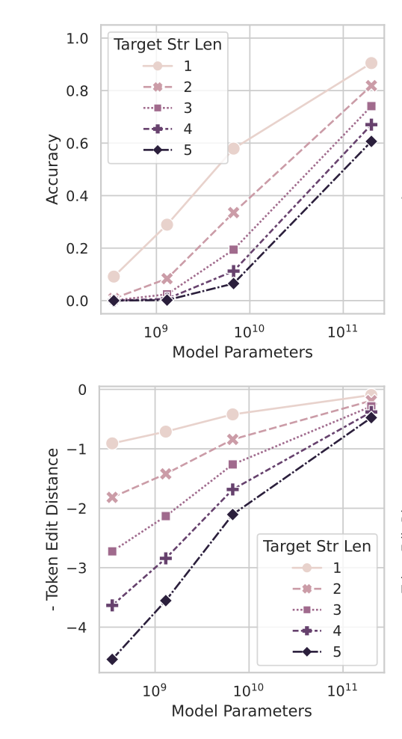
Linearity in target length
Note: We are not measuring performance along target length
But: when L is high, and you don’t have good sampling along the curve, the (actually smooth) curve will appear unsmooth
The authors say that decreasing resolution was a way of fixing this problem, indicating that this is only a problem with bad resolution

Slide 10
A little deeper into the linearity argument (1)
Let’s think about
A = p^L , B = f(p).L where p is the model probability of the right token
A, B: probability of scoring 1 given metric (Accuracy, Token edit distance)
Now, imagine that for small N, p is small, and grows smoothly with N
There will come a sudden time when p is sufficient,
For B: We see a little jump every time some token p becomes sufficient
For A: We’ll see a single, dramatic, jump when all L p’s become sufficient

Slide 11
A little deeper into the linearity argument (2)
Note that
Dependence on p (rather than L) seems more relevant, since p varies with N
Both A and B are smooth in p and therefore in N
But A and B are just prob(metric = 1) , not metric = 1
Both Accuracy and TED are unsmooth in p and therefore in N
This is because we do thresholding/maxing per token
Something like C = L.p^10 is as bad as B
Non-smoothness is coming from discontinuity (which can be thought of as per-sample high resolution), not from non-linearity (either in p or L)
But when metric is non-linear, non-smoothness is more dramatic
Seems like: if we switched to Brier Score for (non-linear) Accuracy, we would end up with a final smooth metric wrt N despite it being non-linear

Slide 12
InstructGPT/GPT3’s emergent abilities
Testing whether the "emergent abilities" of GPT-3 models in arithmetic tasks are real or just an illusion caused by the metrics used.
GPT3: publicly queryable model
Task:
multiplication between two 2-digit integers (e.g., 45 * 67)
addition between two 4-digit integers (e.g., 1234 + 5678)

Slide 13
Prediction 1
Changing from a nonlinear/discontinuous metric to a linear/continuous metric reveal smooth improvements in model performance
– Nonlinear metrics, like Accuracy making improvements look sharp and unpredictable
– linear metrics like Token Edit Distance make improvements look more gradual and continuous

Slide 14
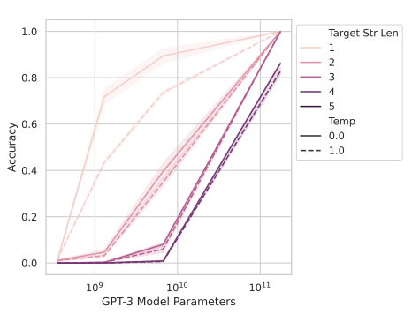
2-digit multiplication

Slide 15
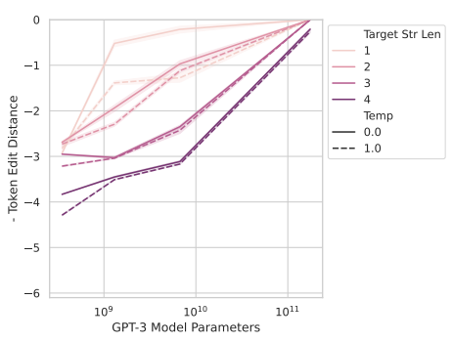

Slide 16
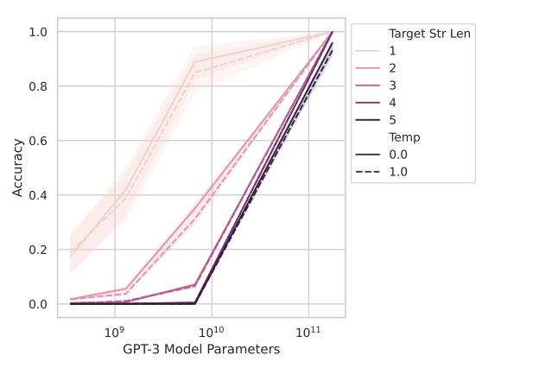
4 digit addition task

Slide 17
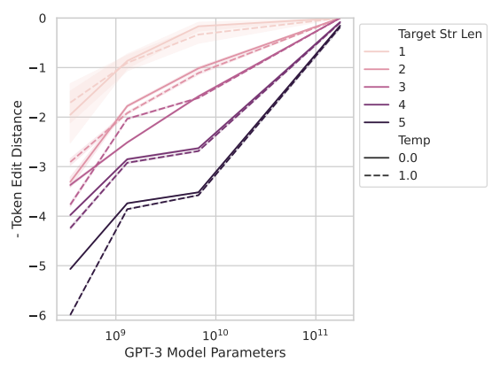

Slide 18
InstructGPT/GPT3’s emergent abilities (2)
Increasing the resolution of measured model performance by using a larger test dataset should also reveal smooth, continuous improvements
– For nonlinear metrics, a smaller dataset can make the model look like it's suddenly getting better
Longer sequences of input data should lead to predictable changes in model performance
– For accuracy, performance should degrade sharply for longer sequences (geometrically).
– For token edit distance, performance should degrade more smoothly (quasilinearly).

Slide 19
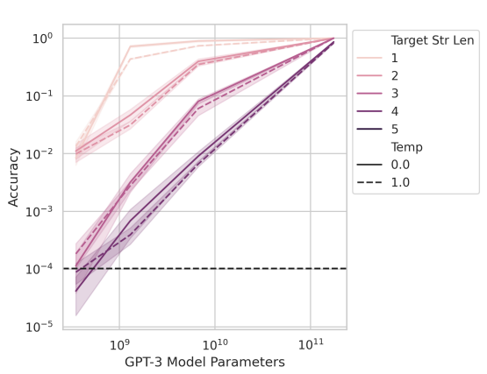
2-digit multiplication with more test data

Slide 20
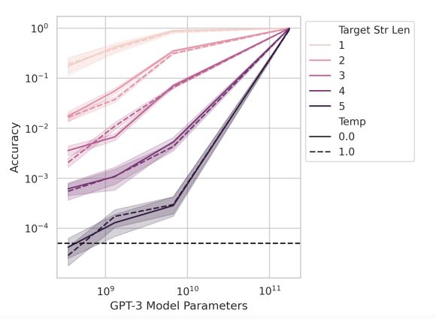
4-digit addition with more test data

Slide 21
Meta-Analysis
Use BIG-Bench, a collection of benchmark tasks used to evaluate language models.
predictions are extended to a broader range of models and tasks. Further studying on whether emergent abilities are dependent on specific metrics, not on task-model family pairs

Slide 22
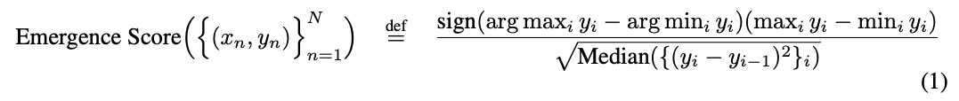
Emerging score
Y is model performance at scale x
Numerator: the difference between the best and worst performance scores.
Denominator: how gradual the performance improvements are over model scale.
higher score indicates sharper, less gradual changes in performance, suggesting the presence of an emergent ability

Slide 23
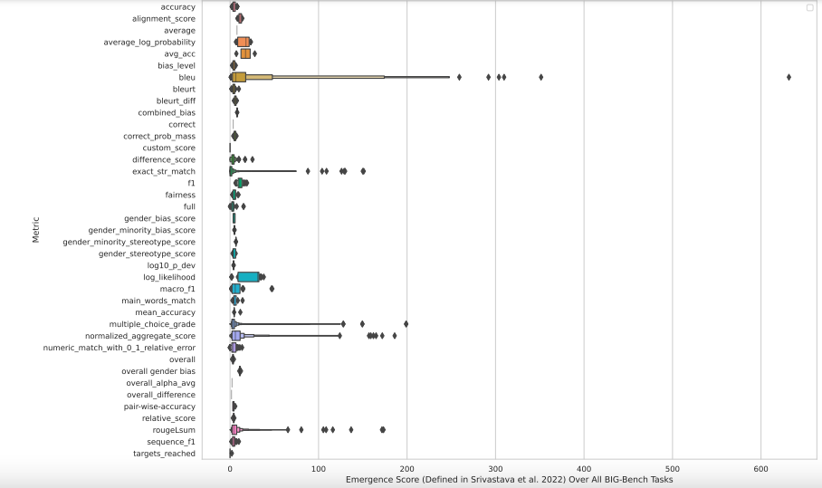

Slide 24
Emergent abilities appear only under specific metrics
Of the 39 preferred metrics in BIG-Bench, only 5 showed any evidence of emergent abilities
5 metrics that did show emergent abilities were primarily nonlinear and/or discontinuous metrics
– Multiple Choice Grade and Exact String Match. Multiple Choice Grade is discontinuous, and Exact String Match is nonlinear

Slide 25
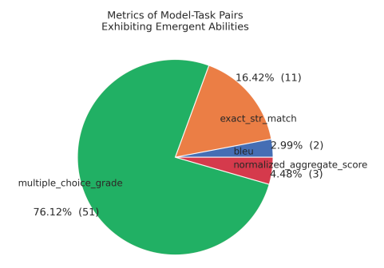
Two metrics account for over 92% of emergent abilities
Multiple Choice Grade (a discontinuous metric)
Exact String Match (a nonlinear metric)

Slide 26
Try different model and metrics
focusing on the LaMDA model family
exhibited emergent abilities under the Multiple Choice Grade
evaluation metric was switched to a continuous one—Brier Score
Finding: emergent abilities are more smooth when switching to a continuous metric

Slide 27
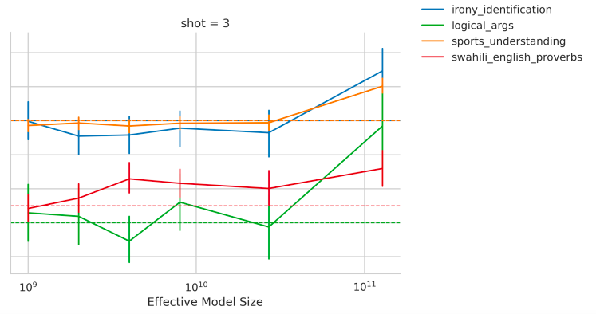
Multiple choice grade

Slide 28
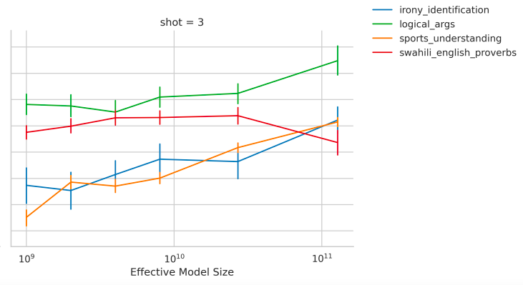
Brier score

Slide 29
For the Brier score the value is negative, I’m not sure why

Slide 30
Emergent ability on vision task
emergent abilities can be artificially induced in neural networks for vision tasks by manipulating the metric
1: define a discontinuous metric that measures a network’s ability to reconstruct CIFAR10 images
2: induce emergent abilities in autoregressive transformers trained to classify handwritten characters from the Omniglot dataset.

Slide 31

Deep network reconstruct image
Reconstruction metric:
X_n is origin image, x^hat is reconstructed image, c is threshold value introduce the emergent ability by setting boundary between acceptable reconstruction and unacceptable one.

Slide 32
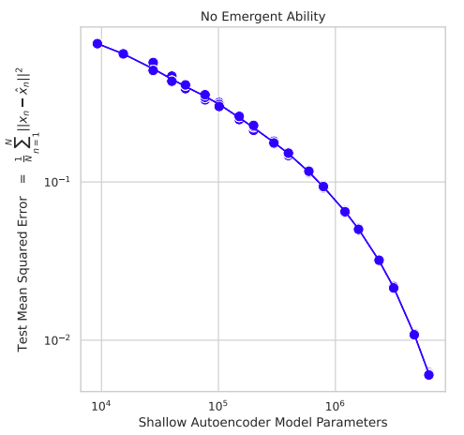

Slide 33
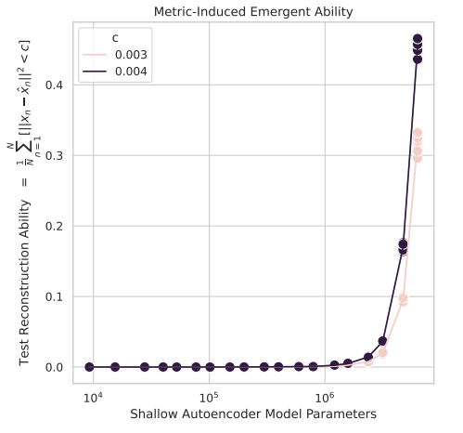

Slide 34
Classify Omniglot handwriting characters
Metrics: Accuracy (gives the model a score of 1 only if it correctly classifies all characters in a sequence, If the model makes even one mistake, it gets 0.)

Slide 35
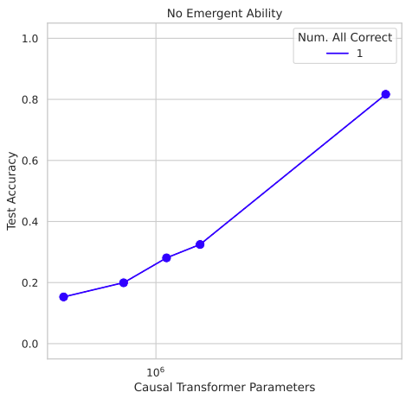

Slide 36
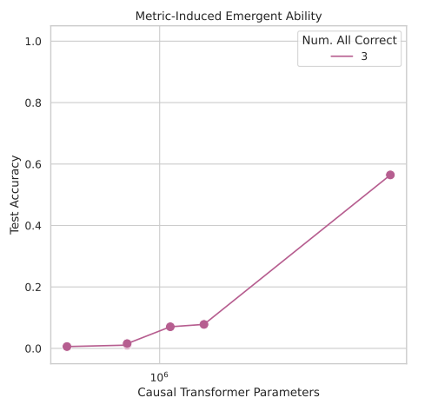

Slide 37
Artifacts or Abduction: How Do LLMs Answer MCQs without the Question?
Yes this is a thing
LLMs are able to do well on MCQ benchmarks without the question
Paper looks at
Memorization: show that the models haven’t simply memorized the benchmark
Priors: Correct answer text is not inherently more probable than others
Choice dynamics and question inference: This is largely what’s happening
Takeaway: LLM evaluation on MCQA benchmarks needs to be further investigated - what is it actually learning?

