Slide 1
The Platonic Representation Hypothesis
Milton Lin, Krithika Ramesh

Slide 2
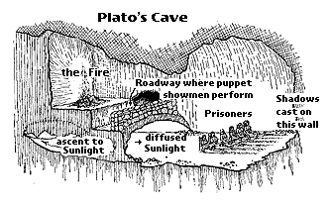
What is the Platonic Representation Hypothesis?

Slide 3
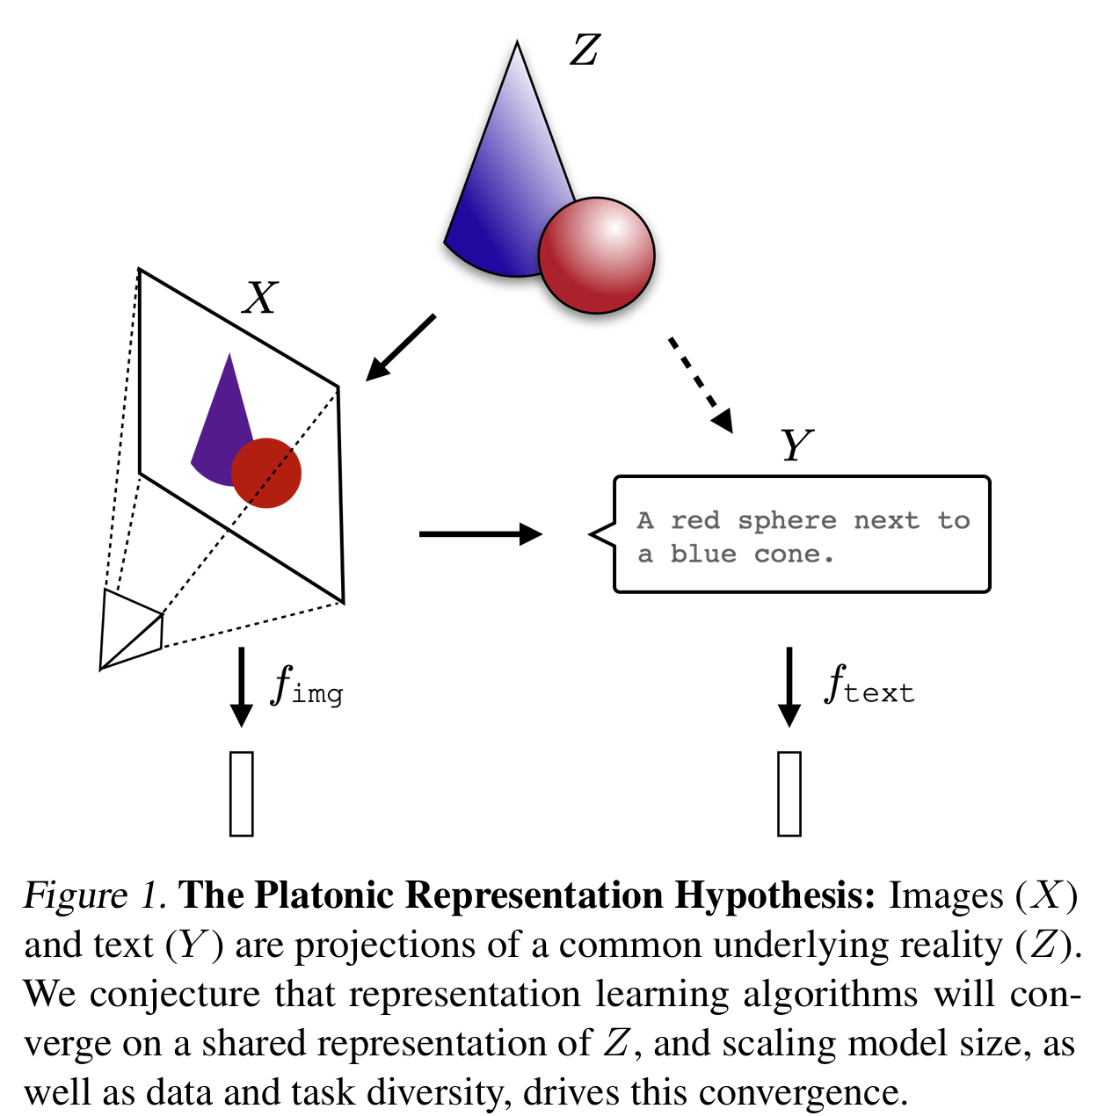
Neural networks, trained with different objectives on different data and modalities, are converging to a shared statistical model of reality in their representation spaces.

Slide 4
What do we mean by alignment of representations?

Slide 5
Terminology
Representation: A function that maps every input to a feature vector f:X->V.
Kernel: (of a representation) A measure of the distance/similarity between multiple input points
Kernel-alignment metric: Measures the similarity between two kernels
Notes:
A Kernel induces s representation similarity matrix.

Slide 6
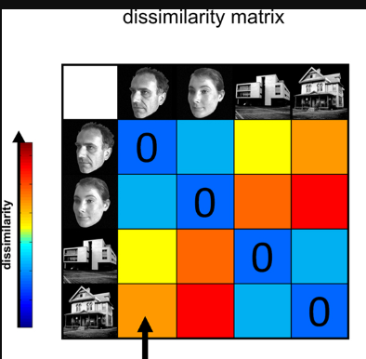
Example of kernels: Representation Dissimilarity Matrix
Kriegeskorte et al. : Representation Dissimilarity Matrix in neuroscience.

Slide 7
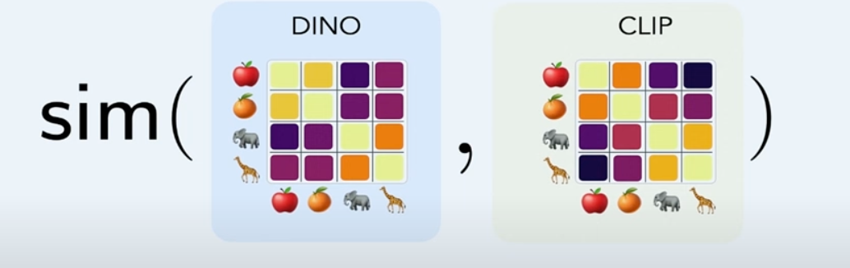
How to measure alignment of representations?
Given two models f,g we compare their Kernels (previous slide) via Mutual k-Nearest Neighbor Alignment Metric [appendix B]
Notes:
For two models with representations f, g the mutual k-nearest neighbor metric measures the average overlap of their respective nearest neighbor sets.
There is canonical choice of embedding layer. For language models, we don’t really know.

Slide 8
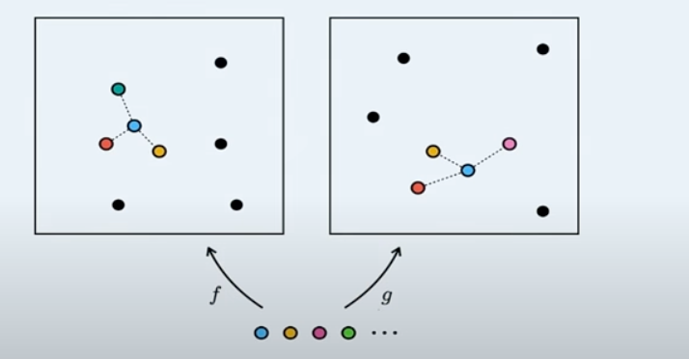
Nearest-neighbor kernel-alignment metric
a) Fix a node (blue). b) Find the k-nearest neighbors for each model f,g. c) Compare common neighbors.
Notes:
Is this a good metric of comparing kernels?

Slide 9
Models are increasingly aligning to brains
Neural networks show alignment with biological brain representations, likely due to facing similar task and data constraints
Studies show agreement between how humans and models perceive visual similarity even when models are trained on tasks that are seemingly unrelated to human perception.

Slide 10
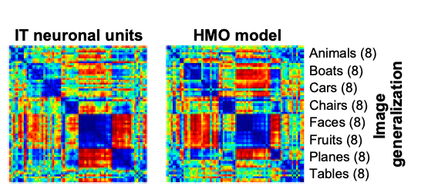
Example: Neuroscience and Deep Neural Nets
Yamins et al. Each entry in the matrix quantifies how dissimilar the neural population’s response is to a pair of visual stimuli.
Notes:
Figure 4A presents a Representation Dissimilarity Matrix (RDM) of the measured IT neural population. 1. Each entry in the matrix quantifies how dissimilar the neural population’s response is to a pair of visual stimuli. 2. When the images are grouped by category, the RDM exhibits clear block-diagonal structure, which highlights the IT cortex’s ability to robustly distinguish between object categories. 3. Moreover, the off-diagonal structure within each block indicates finer distinctions within each category. This result demonstrates IT’s high-level categorization capabilities and suggests that the IT population encodes not only categorical information but also finer, within-category variations.

Slide 11
Background

Slide 12
Models with different architectures & objectives have aligned representations
Lenc & Vedaldi (2015):
Vision model trained on ImageNet aligns with Places-365 model while maintaining performance.
Early layers of convolutional networks are more interchangeable than later layers.
Bansal et al. (2021):
Model stitching shows close alignment between self-supervised and supervised models.
Moschella et al. (2022):
Zero-shot model stitching is feasible without a stitching layer.
Different text models embed data similarly despite training on different modalities.
Notes:
While this trend implies convergence toward a relatively small set of foundation models, it does not imply that different foundation models will arrive at the same representation. Yet that is what has been observed by several recent papers

Slide 13
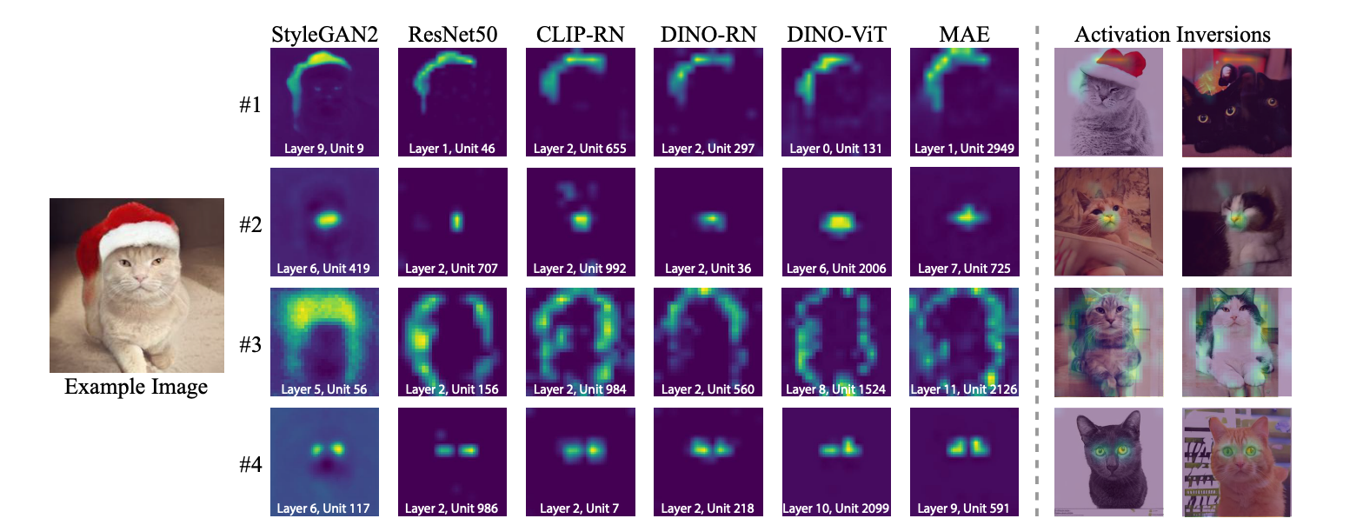
Example: Rosetta Neurons
Dravid et al. (2023) - similar neurons that activate across different vision models:
Notes:
Extends the ideas from Moschella et al. (2022) to enable discovery of Rosetta Neurons that activate similarly across various vision models.

Slide 14
Alignment of representations increases with scale and performance
Model alignment increases with model scale and dataset size.
Models with similar outputs tend to have similar internal activations and models with the same architecture often converge to the same weight basin.
\
This convergence occurs even with different initializations, allowing for permutations in weight space.
Merging separately trained models of the same architecture can combine their capabilities.
Notes:
Modality is fixed
Some models are even trained on synthetic data.
Sort models on how well they do by vision tasks - they are grouped by bin of competency.
The plot embeds various models into a two-dimensional (2D) space using UMAP, a dimensionality reduction technique. The embedding is based on a distance metric defined as the negative logarithm of the alignment between the models' representations. The alignment metric used here indicates the similarity between models' internal representations.
The figure on the right also shows different training regimes.

Slide 15
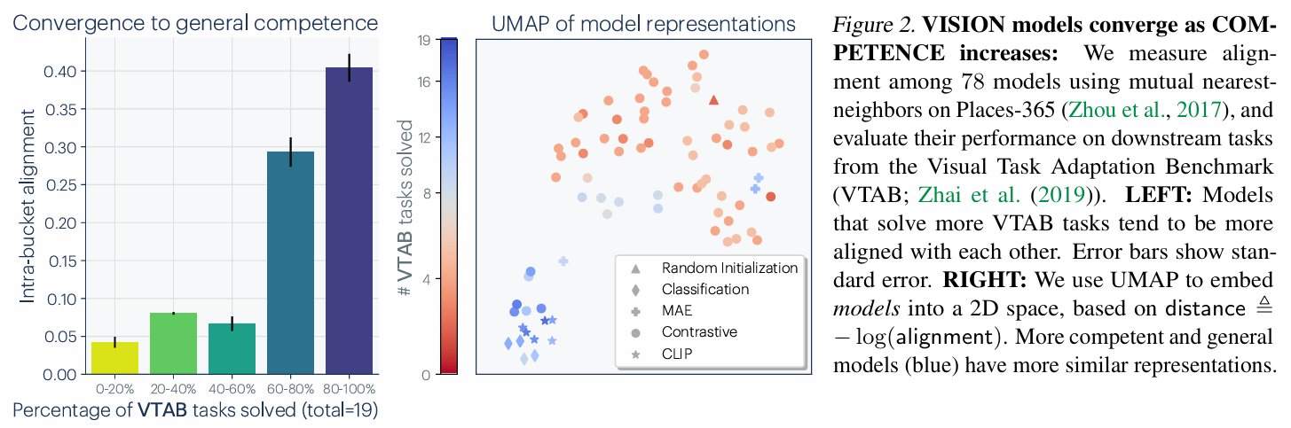
Alignment of representations increases with scale and performance
They evaluate the performance of 78 vision models, trained with varying architecture, training objectives and datasets.
Notes:
Modality is fixed
Some models are even trained on synthetic data.
Sort models on how well they do by vision tasks - they are grouped by bin of competency.
The plot embeds various models into a two-dimensional (2D) space using UMAP, a dimensionality reduction technique. The embedding is based on a distance metric defined as the negative logarithm of the alignment between the models' representations. The alignment metric used here indicates the similarity between models' internal representations.
The figure on the right also shows different training regimes.

Slide 16
Representations are converging across modalities
Do models trained on different data modalities also converge? Yes.
Merullo et al. (2022) showed that a single linear projection can effectively "stitch" a vision model to a language model for visual question answering and image captioning. This approach has also been found to work for aligning text inputs to visual outputs.
LLaVA (Liu et al., 2023) achieve SoTA results by stitching pre-trained language and vision models.
OpenAI discovered that jointly training language and vision models improves language task performance compared to training the language model alone.
Prior work has also found that there is high semantic similarity between vision and language encoders across various training setups.
This work assesses alignment between vision and language models by using paired datasets to bridge the two modalities. They make use of Wikipedia images and the corresponding captions and then measure the alignment between the kernels corresponding to the language and vision models.

Slide 17
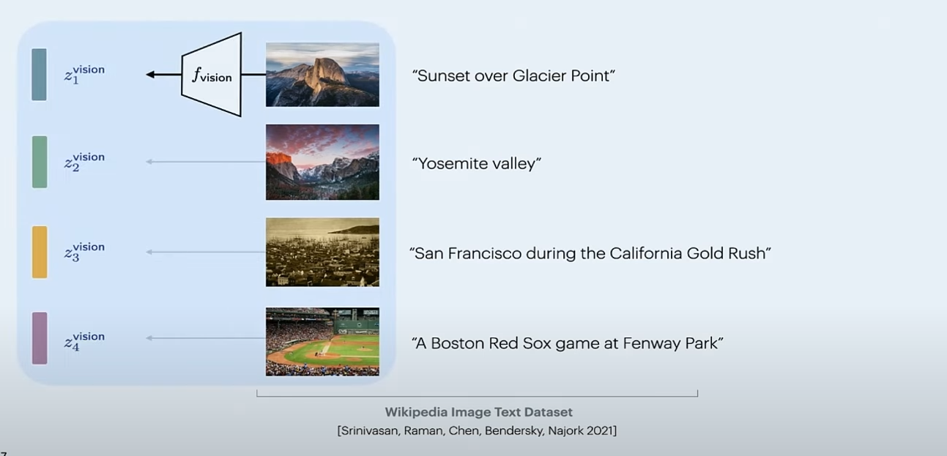
How to compare across model?
Use paired data: The Wikipedia caption dataset (WIT): paired image-text samples.

Slide 18
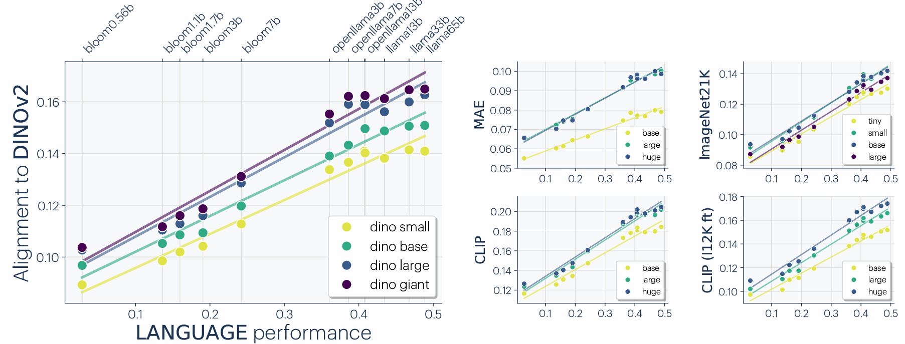
Representations are converging across modalities
The better the LLM is at language modelling, the more it tends to align with vision models.
Notes:
this alignment decreases after fine-tuning on ImageNet (marked as CLIP (I12K ft)), suggesting that task-specific fine-tuning can impact cross-modal representation alignment!

Slide 19
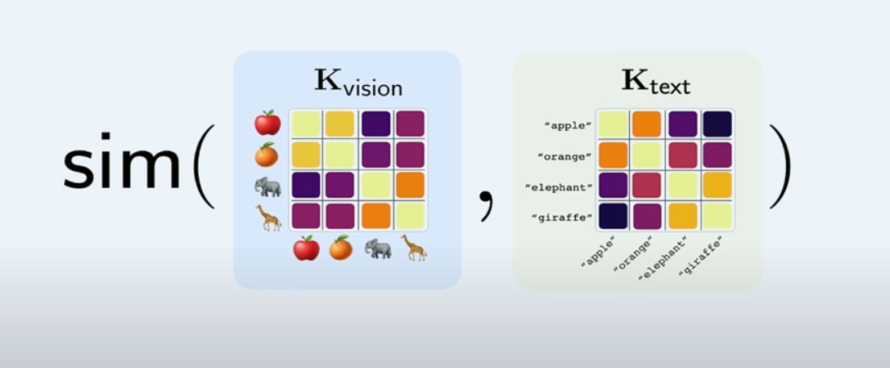
How to compare across model?
Use paired data: The Wikipedia caption dataset (WIT): paired image-text samples.

Slide 20
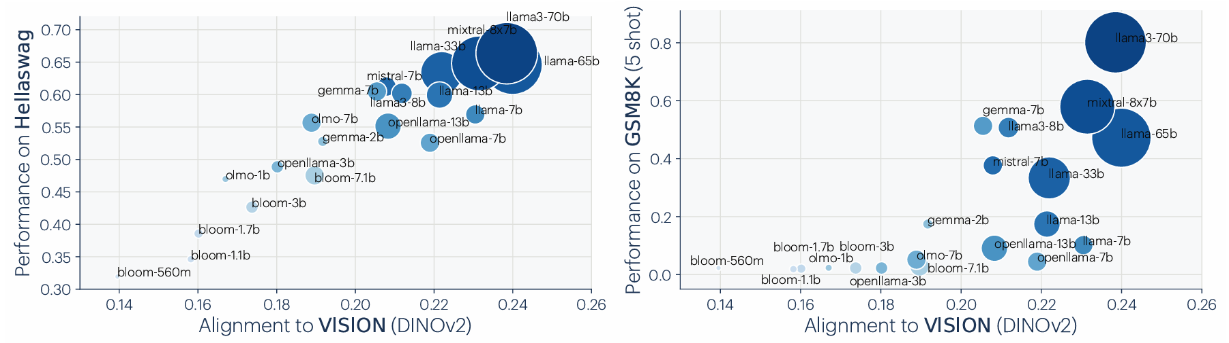
Does alignment predict downstream performance?

Slide 21
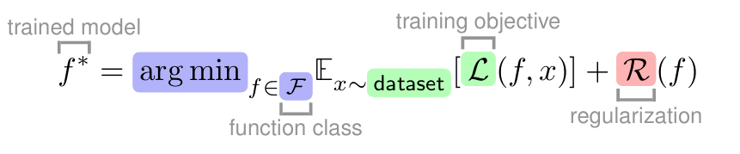
Why are representations converging?

Slide 22
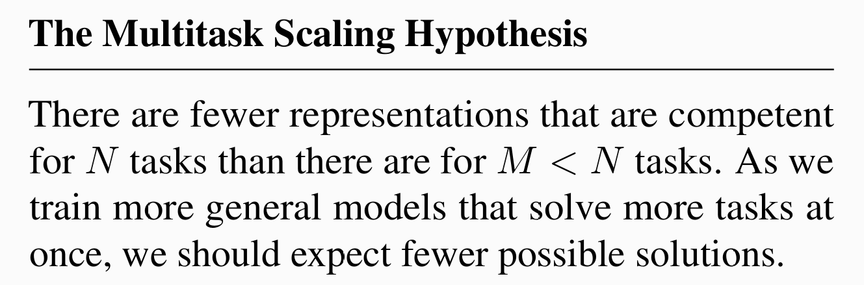
Convergence via Task Generality
Each data point places an additional constraint on the model.
As data scales, models that optimize the empirical risk also improve on the population risk.
Modern representation learning objectives optimize for multi-task solving anyway.
Notes:
training on multiple diverse tasks effectively narrows down the set of viable representations, potentially leading to improved generalization performance and consistency in representations.

Slide 23
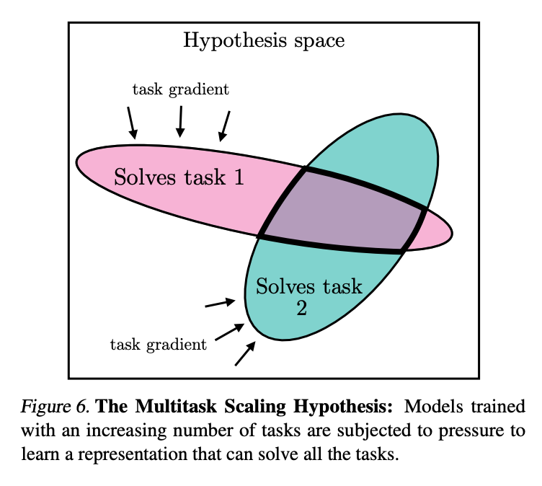

Slide 24
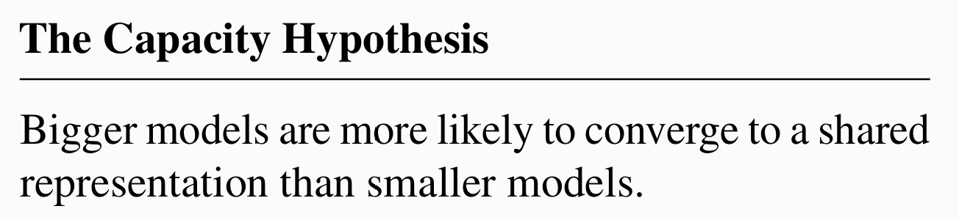
Convergence via Model Capacity
Scaling a model should be more effective at findings better approximations to the optimum.
With the same training objective, larger models, even with diff architectures will converge to the optimum.
When different training objectives share similar minimizers, larger models are better at findings these minimizers.

Slide 25
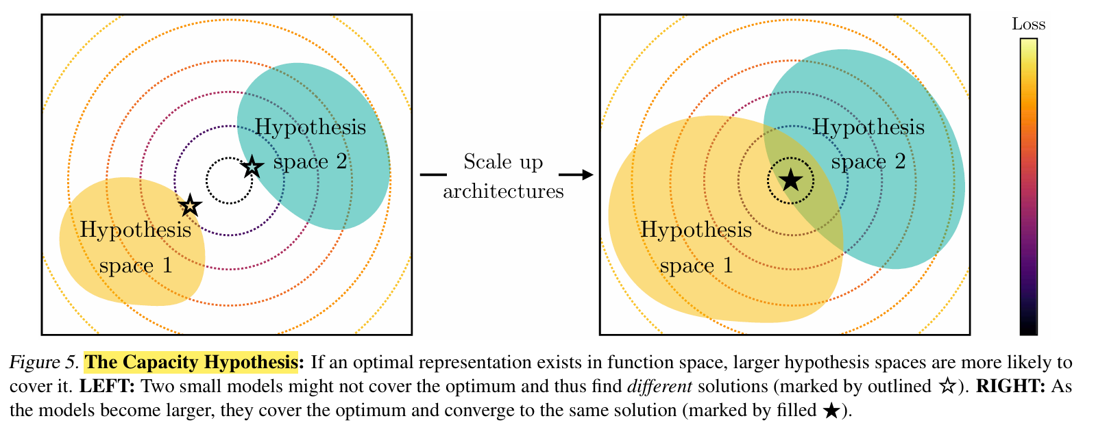
The Capacity Hypothesis

Slide 26
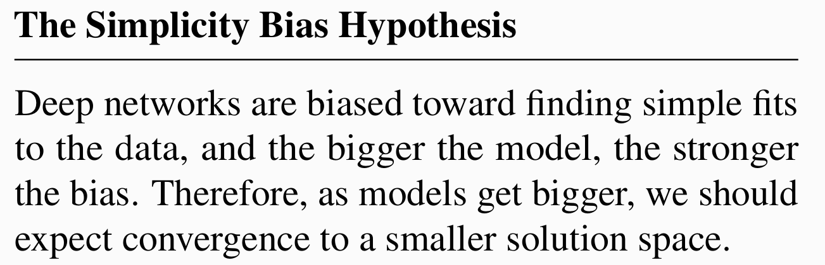
Convergence via Simplicity Bias
What prevents models from developing distinct internal representations?
Such simplicity bias could come from explicit regularization (e.g weight decay and dropout)
Even in the absence of regularization, deep networks implicitly favor simple solutions.

Slide 27
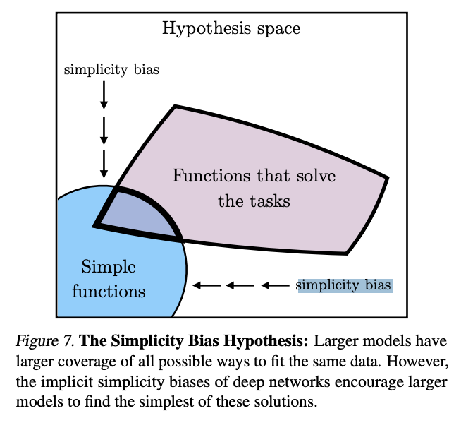
Convergence via Simplicity Bias

Slide 28
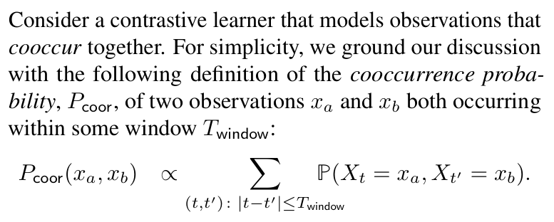
A family of contrastive learners
Notes:
Explain contrastive learning objective
Representation of the world is viewed in a contrastive sense; co-occurence of events that occur nearby together vs ones that don’t (negative pairs - latter)
Observing representational convergence for any modality (to the same kernel) from this family of contrastive learners

Slide 29
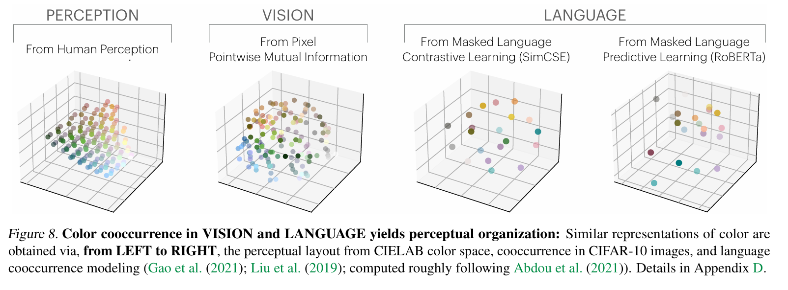
A study of color

Slide 30
Implications of convergence
Scaling is sufficient but not necessarily efficient
Training data can be shared across modalities
Ease of translation and adaptation across modalities
Scaling may reduce hallucinations and bias
Notes:
1: they argue that you can zone done to a model of world. But sufficient’ in what sense? 3: sharing across modalities is also used in stitching 3: hallucination - or the bias

Slide 31
Limitations I
Different modalities may contain different information
Does this apply to scenarios where these modalities are orthogonal to each other?
The work presently focuses on vision and language modalities, and there is no telling that this hypothesis will translate across modalities
For example, the state space in robotics is presently not well-defined in that there is no standardized approach
Notes:
1.How can we quantify the capacity limits of models to align representations from fundamentally different modalities?
2. Can abstract concepts be represented in a unified form across modalities, and what might such representations look like?

Slide 32
Limitations II
Collective preferences of researchers/developers within the community may filter down the pipeline and shape the trajectory of model development
Hardware lottery hypothesis challenges us to ask: Are there better alternatives to developing systems that mimic human reasoning?
Other questions regarding measuring alignment, the convergence of special-purpose intelligence, etc.

